Slide 1
Team management in summer school project
Presented by Artemiy Firsov, velvetech llc
04/05/2017

Slide 2
Project
Corporate portal
  News
  Events
  Ads
  Help
  Forget
.NET Core/.NET Framework
Entity Framework – ORM
Angular JS
ASP NET MVC
TeamCity
GitLab
SignalR

Slide 3
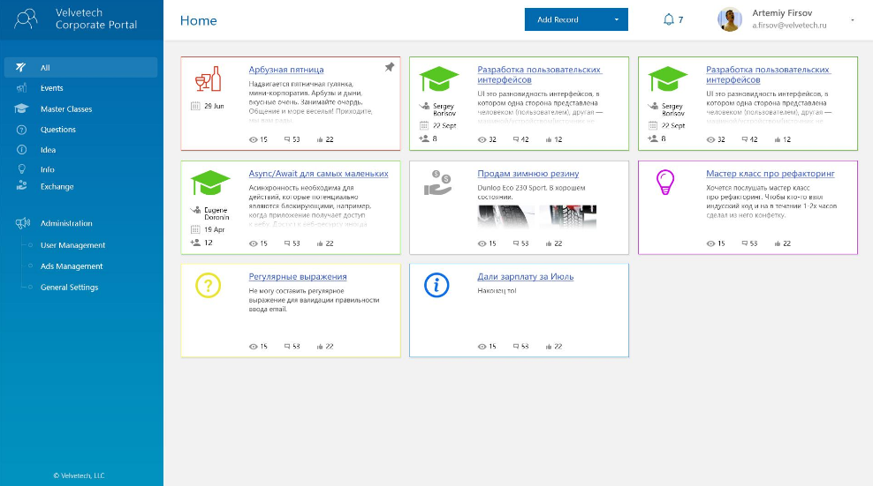
Mock-Up

Slide 4
Team
4 students
Basic knowledge in
  C#
  SQL
  JS (the very basic knowledge)
Were not familiar
Me as
  PM
  Team lead
  Client – some issues were delegated to company’s BAs’
No knowledge of .NET Core, JS Frameworks, ORMs (even plain SQL)

Slide 5
1st approach
Gave free rein to team
  Not very precise issues estimation
  Big issues (16 – 40 hours)
  COMMUNICATION!
  Kind of a SCRUM
  Developing from the ground up
  Trying to give them work in every part of the system
No issue tracking
  Big issues travelled from sprint to sprint
  Guys were not able to decompose big issue on small parts
Guys felt a bit depressed
  Didn’t finish issue for a long period
  Jumped from 1 type of work to another to due from the ground development
  However, they liked communication strategy
No stable version in first 3 weeks

Slide 6
2nd approach
Help them get started
Divided issues on smaller ones
Divide their responsibilities basing on their interest – UI, server, design, deployment
Strict control of their code through merge requests
Longer discussions of problems
Every problem, improvement, new feature – documented and estimated
Project issues became manageable
Guys became energized
More closed issues per sprint
After 1 week of 2nd approach – stable version of site
Understandable scope of project

Slide 7
Production
http://portal.velvetech.com/MainPage
hope it works

