Slide 1
Temporal Data and Real-Time Algorithms
Artemiy Firsov

Slide 2
Frontiers in Massive Data Analysis
National Academy of Sciences, 2013
Data Acquisition
Data Processing, representation, and inference
System and hardware for temporal data sets
Challenges (as of 2013)

Slide 3
Data Acquisition.Example
Consider an issue predicting option price on some option exchange (e.g. CBOE)
  Stock market data
  Economic indicators
    Gross national product
    Unemployment rates
    …
  Interest rate
  …
Overall – a big number of data sources

Slide 4
Data Acquisition.Problems
Data is not correct
  Temporal data is not gathered yet
  Data was generated without exercising proper care
Data is not timely
  Data was generated through a system or process that is not fast enough to meet the needs of the business or the big data objective.
Data is not indexed
  Data was generated without considering the needs or business objectives
Data is not present
  Not yet present
  Server failure
  Unannounced change in schema
Data is not consistent
  New data sources appear, old one disappear (IPad - telegraph)

Slide 5
Data Acquisition.Solutions
Eventual consistency (EC) – event sourcing (event chain, history), CQRS
  How to provide confidence that data is distributed to all servers?
Temporal consistency (TC) + materialized views – Golab and Johnson (2013)
  May data collection provide sufficiently trustworthy data up to time t to build materialized view?
Real-time scheduling (RTS) – hard/firm/soft, bounded-tardiness scheduling
  How to decide which task to perform first/discard/delay?
Consistency in a Stream Warehouse, Lukasz Golab and Theodore Johnson, AT&T Labs – Research , 2013

Slide 6

Questions?

Slide 7
Data Acquisition.TC
DS1 | 1 |  | 2 | 3 |  |  |  | 5 | 6
DS2 |  | 1 | 2 | 3 | 4 |  |  | 5 | 6
DS3 | 1 |  |  |  |  |  | 2 |  | 3
DS4 |  |  |  | 1 | 2 | 3 |  | 7 | 5
Result |  |  |  | 1 |  |  | 2 |  | 3
 | 1 | 2 | 3 | 4 | 5 | 6 | 7 | 8 | 9
Time

Slide 8
Data Acquisition.TC
DS1
DS2
DS3
DS4
IR1
IR1
IR1
DS1
DS2
DS3
DS4
IR2
IR2
RES
RES
RES
Consistency in a Stream Warehouse, Lukasz Golab and Theodore Johnson, AT&T Labs – Research , 2013
Example: gross domestic product

Slide 9
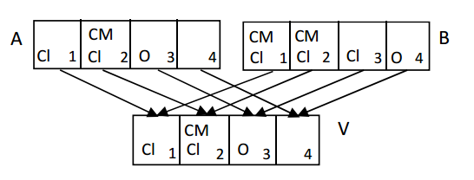
Data Acquisition.TC.Query consistency
DS1
DS2
DS3
DS4
IR1
IR1
IR1
Open(B(d)) if data exist or might exist in B(d).
Closed(B(d)) if we do not expect any more updates to B(d) according to a supplied definition of expectation; e.g., that data can be at most 15 minutes late.
Complete(B(d)) if Closed(B(d)) and all expected data have arrived (i.e., no data are permanently lost).
IR2
IR2
RES
RES
Consistency in a Stream Warehouse, Lukasz Golab and Theodore Johnson, AT&T Labs – Research , 2013
Example: gross domestic product

Slide 10
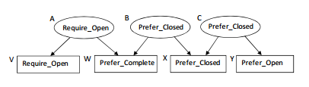
Data Acquisition.TC.Update consistency
DS1
DS2
DS3
DS4
IR1
IR1
IR1
Prefer_Open: a table that does not have to reflect the most recent data, but one whose partitions can be easily updated (in an incremental manner) if necessary; e.g., monotonic views such as selections and transformations of one other table.
Require_Open: a real-time table in which any possible data must be provided as soon as possible.
Prefer_Closed: Tables whose partitions are expensive to recompute, such as joins and complex aggregation (depending on the incremental maintenance strategy).
Prefer_Complete: a table whose output is only meaningful if the input is complete.
IR2
IR2
RES
RES
Consistency in a Stream Warehouse, Lukasz Golab and Theodore Johnson, AT&T Labs – Research , 2013

Slide 11
Data Acquisition.TC.Update consistency
DS1
DS2
DS3
DS4
IR1
IR1
IR1
Update Consistency Resolution:
If Require_Open is in M, mark T as Require_Open
Else, if some label in M is Prefer_Closed, mark T as Prefer_Closed
Else, if all labels in M are Prefer_Complete, mark T as Prefer_Complete
Else, mark T as Prefer_Open.
Prefer_Closed
Prefer_Closed
Require_Open
IR2
IR2
Require_Open
Require_Open
RES
RES
Prefer_Closed
Require_Open
Consistency in a Stream Warehouse, Lukasz Golab and Theodore Johnson, AT&T Labs – Research , 2013

Slide 12
Questions?

Slide 13
Data Acquisition.RTS
Hard real-time - tasks that miss deadlines break the system
Firm real-time - tasks that miss deadlines are discarded
Soft real-time - tasks that miss deadlines are ignored
Bounded-tardiness scheduling – tasks can miss their deadline without breaking the system or being discarded, but their tardiness in completion after their deadline is bounded (Earliest Deadline First, Earliest Pseudo-Deadline First)

Slide 14
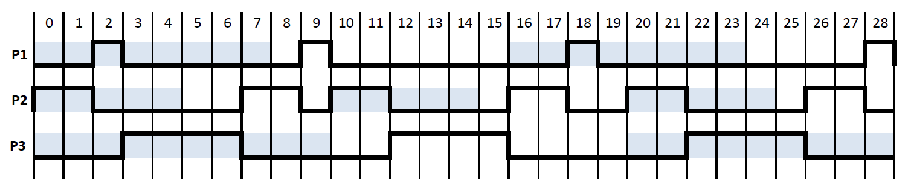
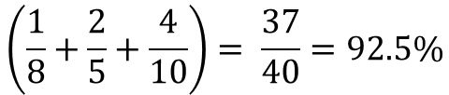
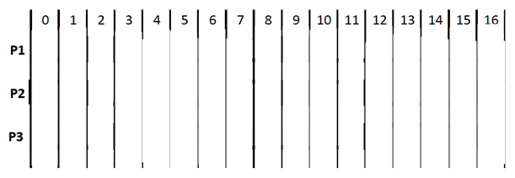
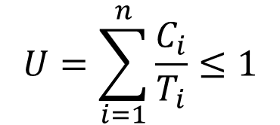
Data Acquisition.RTS.Bounded-tardiness scheduling
Earliest Deadline First
Process | Execution time | Period
1 | 1 | 8
2 | 2 | 5
3 | 4 | 10
$$U=\sum_{i=1}^{n}{\frac{C_{i}}{T_{i}}≤1}$$
$$\left(\frac{1}{8}+\frac{2}{5}+\frac{4}{10}\right)= \frac{37}{40}=92.5\%$$
Comment about resource locking, additional deadline
2nd process deadline
1st process deadline
2nd, 3rd process deadline
2nd process deadline
1st process deadline

Slide 15
Data Acquisition.Data integrity
Paxos algorithm
  Family of protocols for solving consensus in a network of unreliable processors
Roles
  Client
  Acceptor (Voter)
    All accept -> request accepted, Acceptors form Quorums
  Proposer
    Coordinator, advocates request, chosen from processes
  Learner
    Performs request, system may have multiple learners

Slide 16
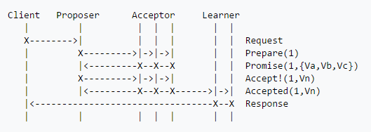
Data Acquisition.Data integrity
Chandra, T., R. Griesemer, and J. Redstone. 2007. Paxos made live—An engineering perspective.
PODC ‘07: 26th ACM Symposium on Principles of Distributed Computing. Available
at http://labs.google.com/papers/paxos_made_live.html

Slide 17
Data Acquisition.Challenges
  The challenge in building largescale temporal systems is that they must be robust to hardware failures as well as software bugs. For example, because a modern central processing unit (CPU) has a failure rate of about one fatal failure in 3 years, a cluster of 10,000 CPUs would be expected to experience a failure every 15 minutes on average.
Distributed real-time acquisition, storage, and transmission of temporal data
Consistency of data
  Can Paxos, etc. solutions scale when the input stream is one or two orders of magnitude more massive, as in the case of audio and video data?
Lack of effective tools for the design, analysis, implementation, and maintenance of real-time, temporal, time-aware systems for nonprofit, educational, and research institutions, including lack of realistic data sources for benchmarking algorithms and hardware performance.

Slide 18
Questions?

Slide 19
Data processing, representation and inference (Data PRI)
Coding – encoding temporal data
  Lossy
    Autoencoder (not mentioned in the article)
  Lossless
    Markov models – context tree weighting method
Sketching – tool for summarizing temporal data
  Native format
    Sliding window
    Sub-sampling time series
  Derived format
    Random projections
    Histograms of underlying distribution
  Combination of above types

Slide 20
Data PRI.Coding.Context tree weighting method
cup or cop
from the
wash the
drink
run

Slide 21
Data PRI.Sketching.Querying and Mining Data Streams: You Only Get One Look
D
9 | 1 | 8 | 3 | 8 | 0 | 3 | 5 | 7 | 9
S
9 | 8 | 0 | 5 | 9
Select AGG from D where D.e is odd
  If AGG – average, return average of odds in S : (9 + 0 + 9) / 3 = 6 (real : 7)
We do not have strict guaranties, we have probabilistic guaranties
M. Garofalakis, J. Gehrke, and R. Rastogi, “Querying and Mining Data Streams: You Only Get One Look. A Tutorial,” presented at the 28th International Conference on Very Large Data Bases (VLDB 2002), August 20-23, 2002, available at http://www.cse.ust.hk/vldb2002/program-info/tutorial-slides/T5garofalalis.pdf, accessed June 16, 2012.

Slide 22
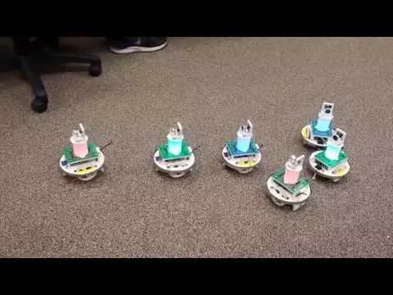
Data PRI. FTRL
Problem – most algorithms impose linear/sub-linear
memory assumptions, but to cope with non-stationery effects (distribution changing) we need more computationally and space consuming approaches
FTRL – follow the regularized leader.
  Experts – suggest an action
  On each round, a new expert is chosen
Cesa-Bianchi and Lugosi proposed an approach of mixed online and batch learning by FTRL algorithms
On prediction of individual sequences, Nicolo Cesa-Bianchi and Gabor Lugosi, 1999
Prediction, Learning, and Games, Nicolo Cesa-Bianchi and Gabor Lugosi, 2006

Slide 23
Data PRI. Stanford Data Stream Management System
Problem - input data rate exceeds the computing capabilities of online learning and prediction algorithms.
Solution – approximate representation (data-stream approach)
  Stanford Data Stream Management System
  Muthukrishnan, 2005
Efficient statistical inference for general models remains a major research challenge..

Slide 24
System and hardware (SHW) for temporal datasets
Problem - massive temporal data also pose high demands on the hardware and systems infrastructure
Solution – no general solution
  Google’s file system (GFS)
  Tens of data-acquisition machines to funnel the data
  Thousands of processors using very fast interconnects
  Qualified engineers
Difficult to replicate and expensive to maintain, requiring a good complement of reliability engineers

Slide 25
SHW for temporal datasets.Noise
Problems – errors in data brake integrity and may lead to burst of errors
Solution - theory of error correction for communication over channels prone to burst errors
  McAuley, 1990
Applications of the theory to massive storage of temporal data are mostly confined to only proprietary systems – no general solution

Slide 26
References
Frontiers in Massive Data Analysis
  Committee on the Analysis of Massive Data; Committee on Applied and Theoretical Statistics; Board on Mathematical Sciences and Their Applications; Division on Engineering and Physical Sciences; National Research Council
Maintaining Temporal Consistency: Issues and Algorithms
  Ming Xiong, John A. Stankovic, Krithi Ramamritham, Don Towsley, Rajendran Sivasankaran
Consistency in a Stream Warehouse
  Lukasz Golab and Theodore Johnson
Paxos made live—An engineering perspective
  Chandra, T., R. Griesemer, and J. Redstone. 2007.. PODC ‘07: 26th ACM Symposium on Principles of Distributed Computing. Available at http://labs.google.com/papers/paxos_made_live.html
https://en.wikipedia.org/wiki/Paxos_(computer_science)
http://retis.sssup.it/~lipari/courses/rtos/lucidi/edf.pdf

Slide 27
References
Context tree weighting method
  http://www.cs.cmu.edu/~aarti/Class/10704_Fall16/CTW.pdf
  https://cs.anu.edu.au/courses/comp4620/2015/slides-ctw.pdf
Querying and Mining Data Streams: You Only Get One Look. A Tutorial
  M. Garofalakis, J. Gehrke, and R. Rastogi, presented at the 28th International Conference on Very
  Large Data Bases (VLDB 2002), August 20-23, 2002, available at http://www.cse.ust.hk/
  vldb2002/program-info/tutorial-slides/T5garofalalis.pdf, accessed June 16, 2012.
  http://www.cse.ust.hk/vldb2002/program-info/tutorial-slides/T5garofalalis.pdf
On prediction of individual sequences
  Nicolo Cesa-Bianchi and Gabor Lugosi, 1999
Prediction, Learning, and Games
  Nicolo Cesa-Bianchi and Gabor Lugosi, 2006

