Slide 1
Artificial Music
How Machine Learning could help Musicians
Dmitry Beloglazov
dmitry.beloglazov@gmail.com

Slide 2
My background
Novosibirsk State University: maths & computer science
Project manager at a freelance team
Basic machine learning knowledge

Slide 3
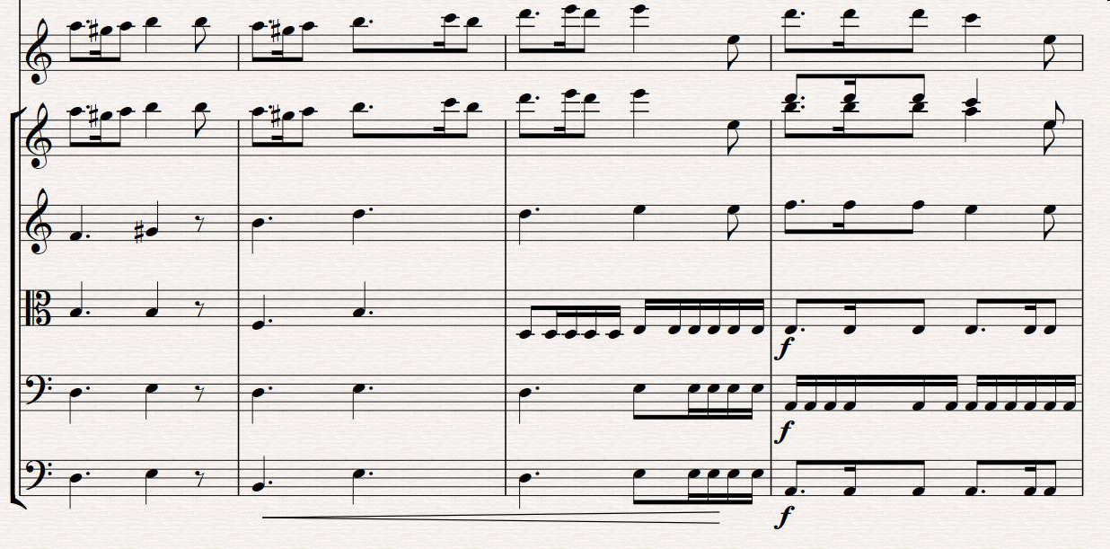
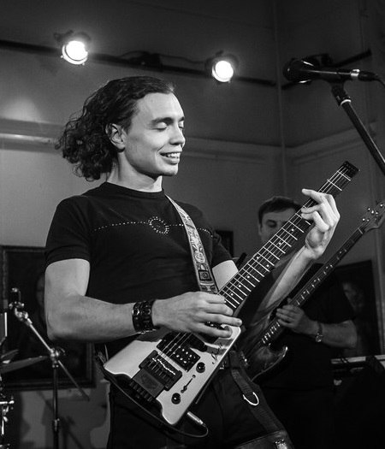
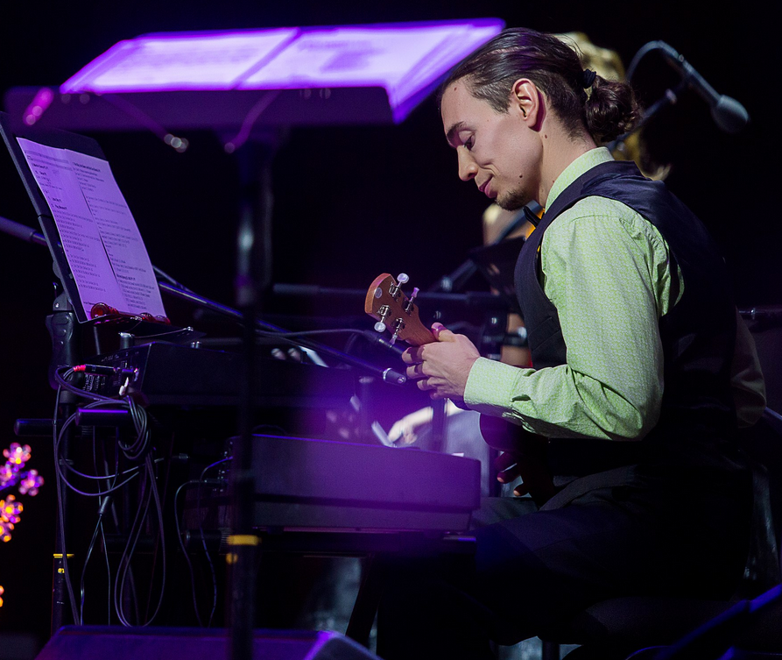
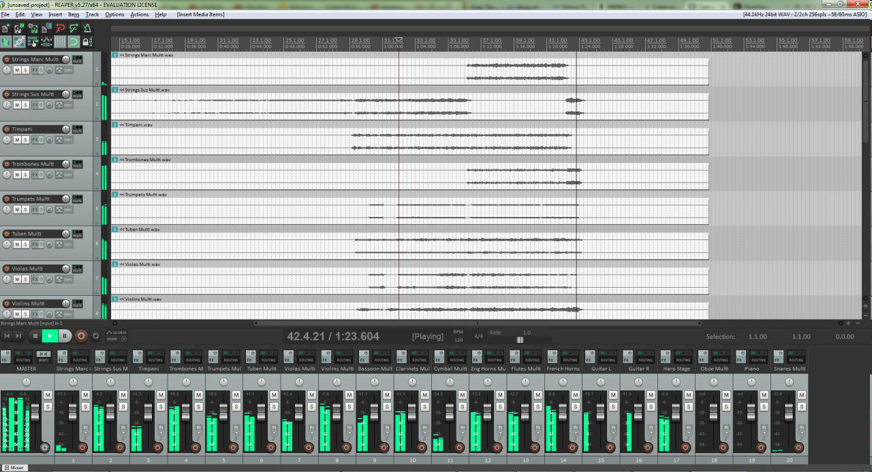
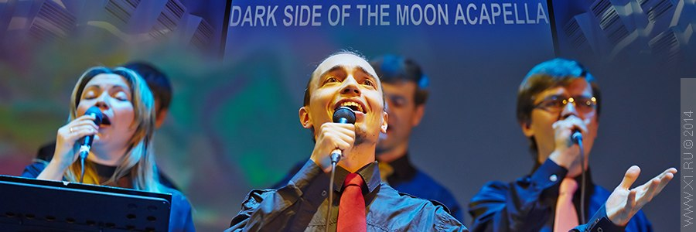
My background

Slide 4
Digital music: Audio & MIDI
Audio (mp3, ogg, WAV)
Converted & compressed analog signal
MIDI (Musical Instrument Digital Interface)
Digital musical score for computer:
Instruments information, note start & duration,
Note pitch, note velocity, etc.

Slide 5
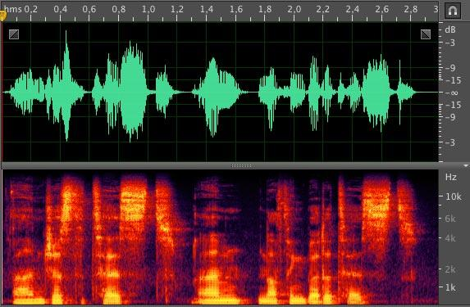
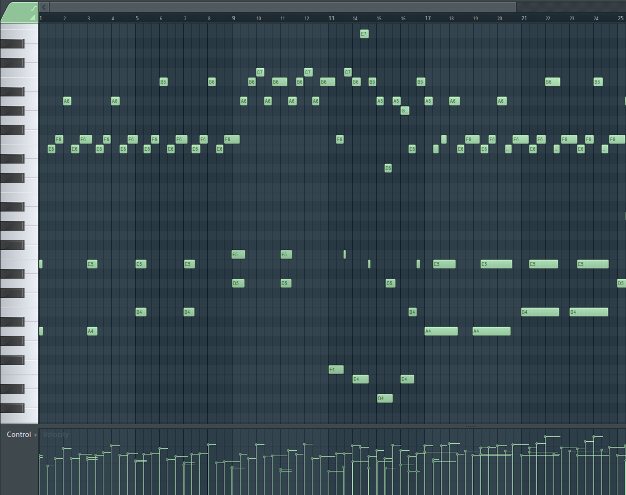
Digital music: Audio & MIDI
Notes:
Continuous

Slide 6
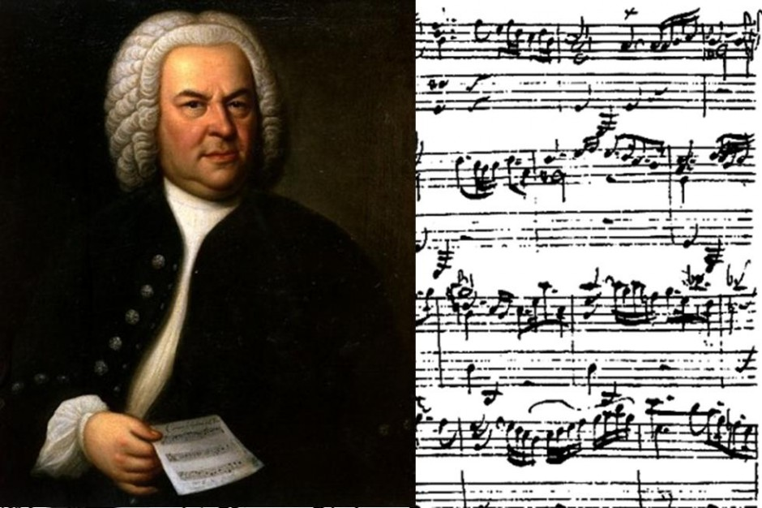
Why should we choose MIDI?
Significantly less data
More natural: composers think in terms of music score, not waveforms

Slide 7
A piece of music (example: Little Fir-tree)
Monophony: one voice, a “melody”
“Song”: melody + harmony (accompaniment)
Polyphony: multiple “independent” voices

Slide 8
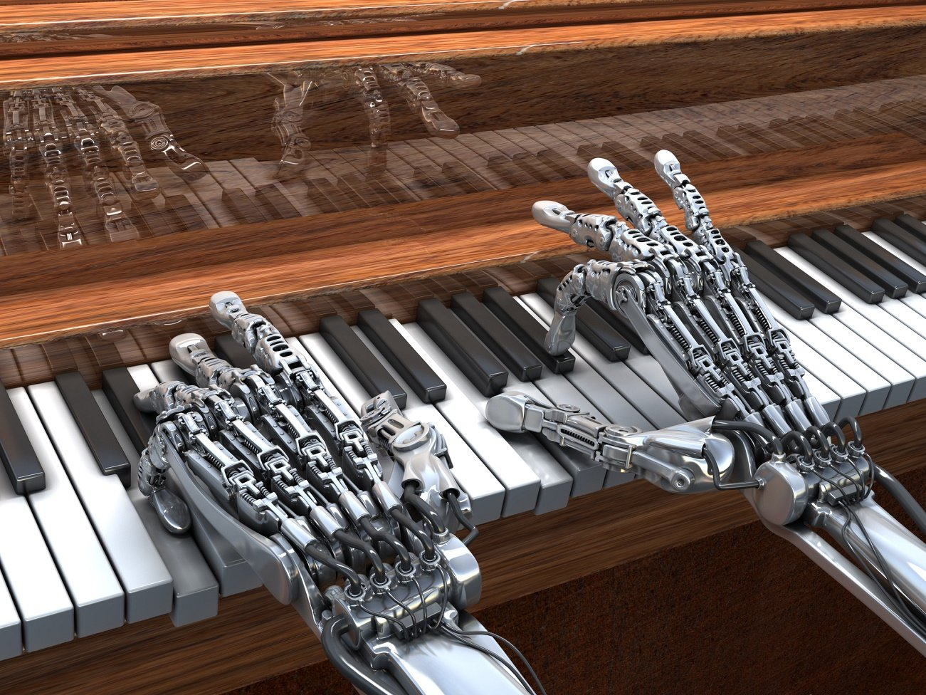
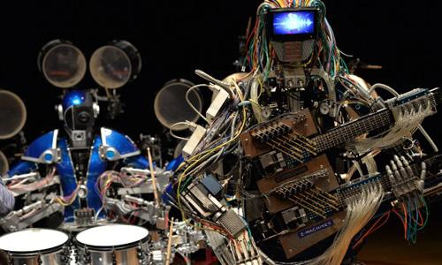
So how can machines help us making music?

Slide 9
#1.1 Generate new melody in a given style
Task: compose a melody
Learn based on a given data set
Generate new melody
Simple, but not very useful

Slide 10
#1.2 Generate a polyphonic piece
Task: compose a polyphonic piece in a certain style (like Mozart, Bach, etc.) and or format (piano, string quartet, symphonic orchestra)
DeepBach

Slide 11
#2 Generate a melody for a given harmony
Task: compose a solo based on a given harmony.
AI needs to “understand”:
Scales
Harmonies
Consonant and dissonant tones
Voice leading rules

Slide 12
#3 Harmonize a given melody
Task: create an accompaniment for a given melody
Reverse task for #2.

Slide 13
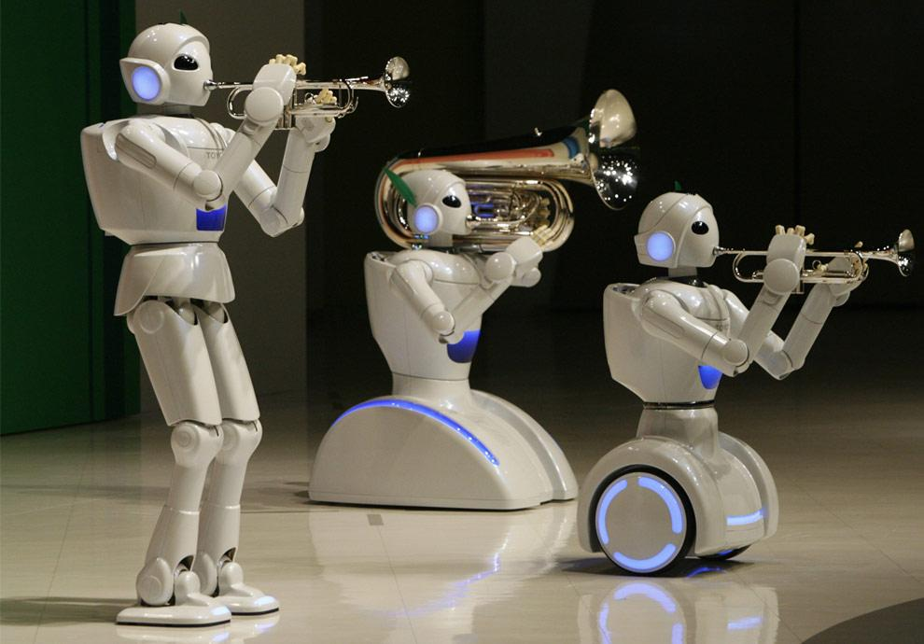
#4 Automatic orchestration
Task: create an orchestration based on a given piano piece (melody + harmony).
Start from smaller orchestras (e.g. string quartet)
We’ll need to understand:
Orchestration principles

Slide 14
#5 Lyrics creation
Task: create lyrics in style of certain poets/poems.
Neural Defense: programmers from Yandex recorded an album with lyrics generated by their NN after learning on “Civil Defense” lyrics

Slide 15
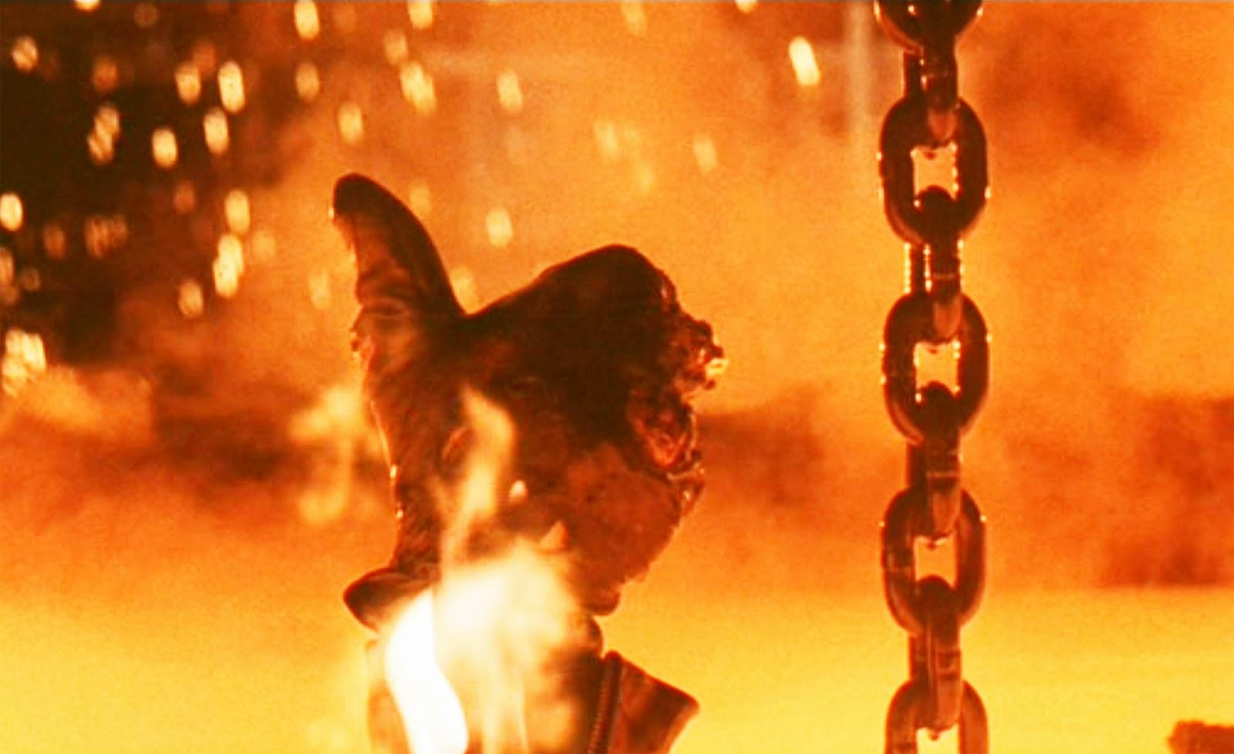
#6 AI Audience
Task: create a mechanism for rating a melody (or a composition).
- Learn based on popular melodies and songs: “good” and “bad” examples
- Receive a melody as an input and tell how “good” or “bad” it is

Slide 16
Summary
Tasks for applying Neural Networks:
Generate melodies
Generate melodies on a given harmony
Harmonize a given melody
Orchestrate
Create lyrics
Rate a song
Combination of applications

Slide 17
Thank you!
Dmitry Beloglazov
dmitry.beloglazov@gmail.com

