Slide 1
Sampling techniques for massive data sets.

Slide 2
What is Sampling ?
To take a small amount of data from huge set of data to do analysis

Slide 3
What is a good sample ?
One that represents the entire set of data in most optimal way.
Gives each element to have equal chance to get sampled

Slide 4
Why we need Sampling ?
Simple answer, to save money . We don’t have enough resources

Slide 5
Types of Sampling Techniques
Random Sampling – Sampling in which each event of Sample space have equal chance of being sampled.
Non-Random Sampling – Basically just opposite to random sampling, here some events are selected to be sampled prior the starting of sampling, and by this not each event has equal chance to be sampled.

Slide 6
Examples of Random Sampling
Simple Random Sampling
Strata based Random Sampling
Systematic Random Sampling
Hierarchical or cluster Sampling

Slide 7
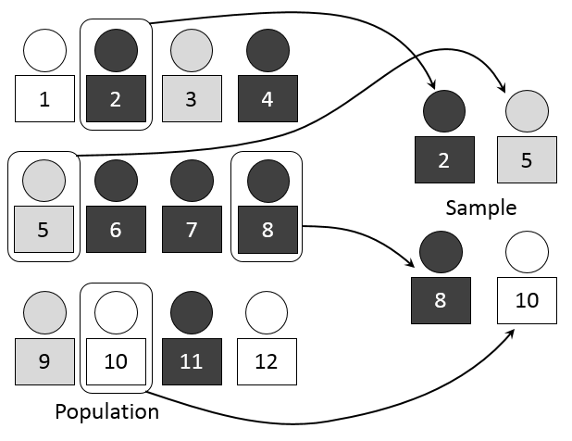
Simple Random Sampling

Slide 8
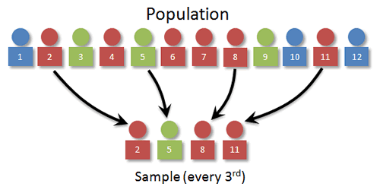
Systematic Random Sampling

Slide 9
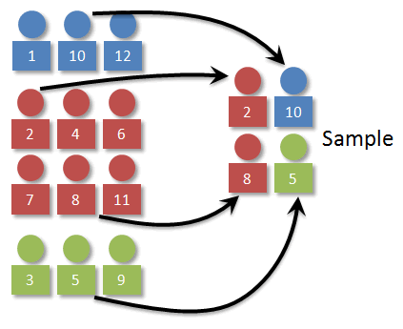
Stratified Random Sampling

Slide 10
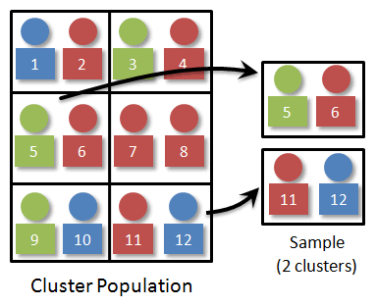
Cluster or Hearchical Random Sampling

Slide 11
Step by step
Identify sampling frame
Decide on sample size
Choose sampling technique

Slide 12
Identifying Sampling Frame
Complete set of all cases from which your sample is going to be drawn.

Slide 13
Identify sample size
First decide “Confidence level”, this is the level of certainty that data collected in sample represent the total characteristics of complete dataset or sampling frame.
Let us say we choose 95 %, then it mean if we choose 100 events then at least 95 of them represent the complete sampling frame.
Margin of error = 3%-5%, means if 47 says yes for an answer and our margin of error is 4%. Then we will say from 43 to51 members says yes.
Then we can simply use any sampling calculator to decide our sample size there are tons of them which can be found by simple search on Google.

Slide 14
Examples of Non – Random Sampling
Snowball Sampling (Chain Sampling)
RDS(Respondent Driven Sampling)

Slide 15
Snowball Sampling
Method
Draft a participation program (likely to be subject to change, but indicative).
Approach stakeholders and ask for contacts.
Gain contacts and ask them to participate.
Community issues groups may emerge that can be included in the participation program.
Continue the snowballing with contacts to gain more stakeholders if necessary.
Ensure a diversity of contacts by widening the profile of persons involved in the snowballing exercise.

Slide 16
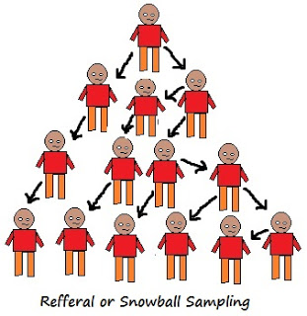

Slide 17
RDS
To overcome shortcomings of Snowball sampling.
Use Coupon system to monitor the sample size and how the connection flows in sample.

Slide 18
Challenges of Sampling Massive data
Sample recruitment is on-going.
Which incoming samples should be chosen or omitted
Participants can leave and enter anytime
Data needed to be taken from all available sources.
Sampling doesn’t matter how precise can never preserve all the information, for example sampling all graph structures can never be done.
The decision of how to sample depends on what to sample .

Slide 19
Further Topics which I am learning now and would present in future seminars.
Sparse Signal recovery
Use of Sampling not just for estimation purpose but also for testing.

Slide 20
Thank you for your attention !

