Slide 1
Speech to Text Recognition (Mixed Channels) NLP as human does
Akilesh Sivaswamy
Guided by:
Dr. Evgeniy Pavlovsky

Slide 2
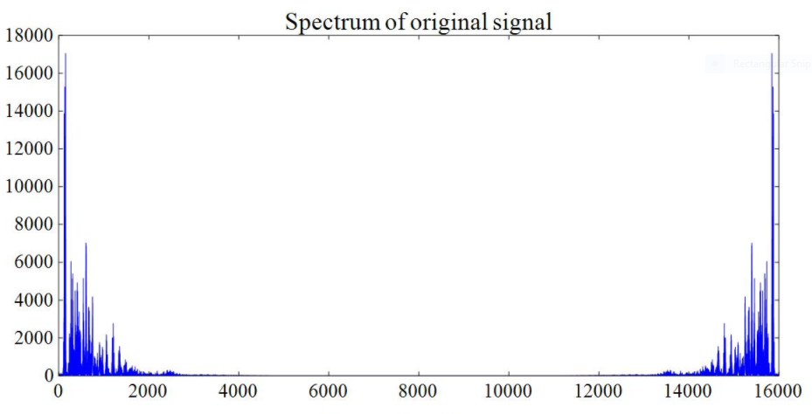
General Representation of the process:
Data cleaning (removes noise)
Fourier transformation is used here for conversion into frequency spectrum
Input Signal (Audio dataset)
Stored in a data set
(F- Data set)

Slide 3
Neural Network 1:
We first train the NN with the handwritten digits to produce the numerical output when the written digit is fed.
Neural
Network 2:
Here, we train the frequency data set with the digits dataset…..
This is done after training the handwritten data set to obtain the fulfilment of recognition of the digits.
MNIST data set for handwritten digits
Data Conversion
F – Data set

Slide 4
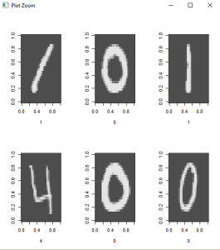
Data conversion
Lets start with the MNIST DATASET:
This dataset is a dataset of handwritten numbers from 0 to 9. It consists of 55,000 training images, 10,000 test images and 5,000 validation images. In this, a single digit can be represented as an array:

Slide 5
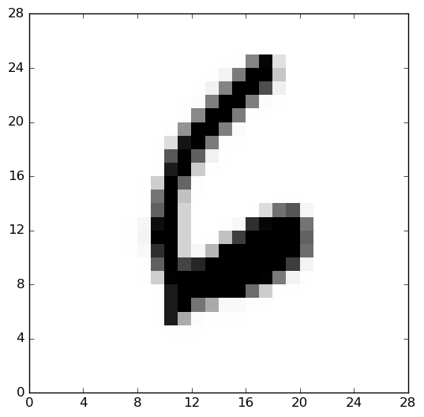
Since the array representation has to be uniform, we can represent it in the form of 28 x 28 pixels. (784 pixels)

Slide 6
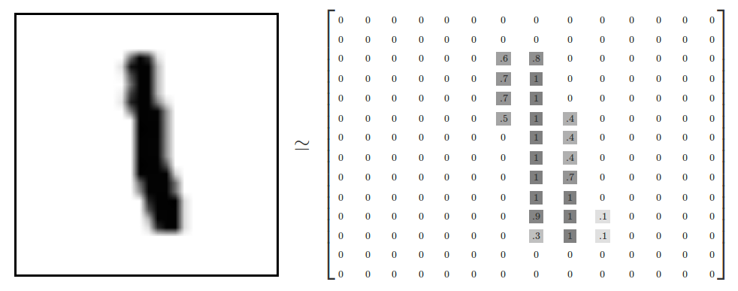
After this conversion, when we read the array, it comes out something like this:

Slide 7
Now, we proceed to data flattening once the array conversion is done.
We can flatten the array shown previously into a 1-D vector of numbers, with dimension 784.
Flattening basically ends up removing some of the 2D information, such as the relationship of a pixel to its neighbouring pixel.

Slide 8
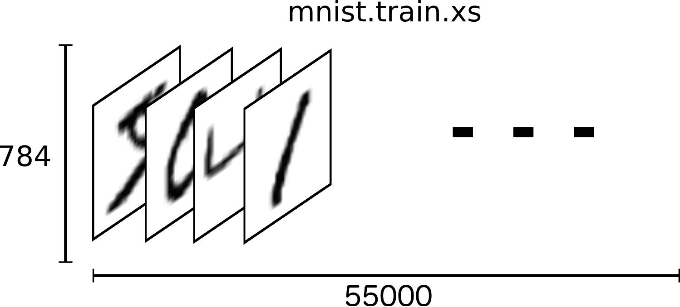
Now, we create a tensor using tensorflow. A tensor, which is basically a n-dimensional array, is used here to hold the training data set images as shown below:

Slide 9
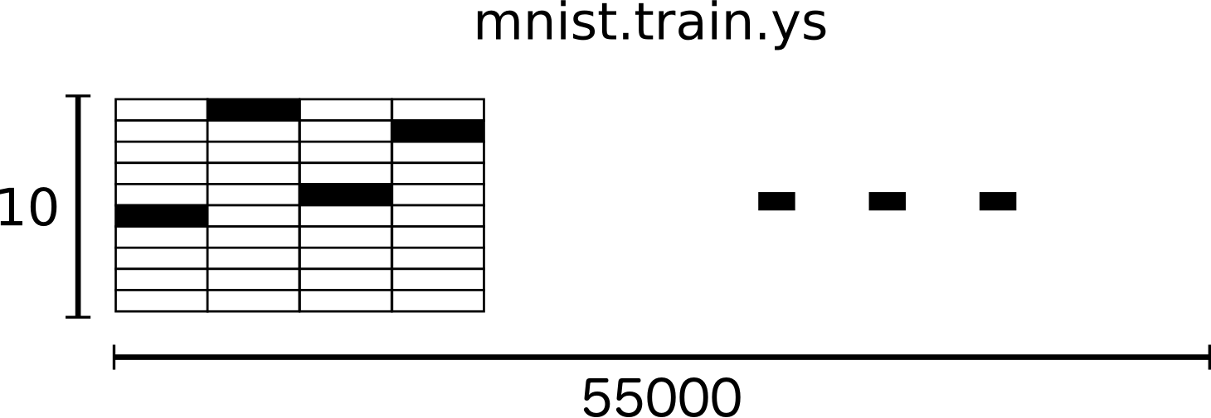
The basic idea of doing so is to create an array shown previously which is one-hot encoded. This means that instead of having labels as “one”, “two”, we will have the name as a single array for each image. For instance:
4 is expressed as: [0, 0, 0, 0, 1, 0, 0, 0,…..0]
This is based on index position.
So, finally, the labels alone end up being a large 2-D array (10, 55000).

Slide 10
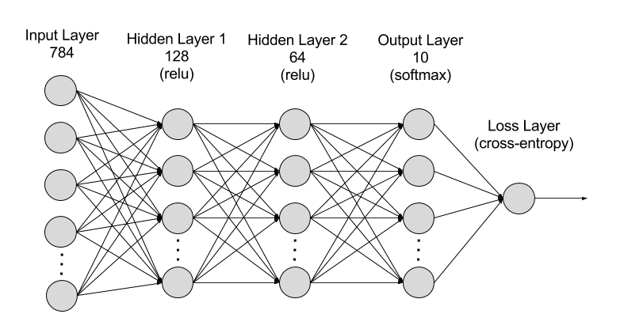
The next step would be to proceed with the softmax regression, which returns a list of values between 0 and 1 that add up to 1.
It is a list of probabilities.

Slide 12
Output of this Neural network 1:

Slide 13
Neural Network 1:
We first train the NN with the handwritten digits to produce the numerical output when the written digit is fed.
Neural
Network 2:
Here, we train the frequency data set with the digits dataset…..
This is done after training the handwritten data set to obtain the fulfilment of recognition of the digits.
MNIST data set for handwritten digits
Data Conversion
F – Data set

Slide 14
Now, coming to the audio dataset, we use Fourier transformation for conversion into frequency spectrum. samples a signal over a period of time (or space) and divides it into its frequency components. Most importantly, a Fourier transform of a signal tells you what frequencies are present in your signal and in what proportions. The magnitude square of the Fourier transform, |X(f)|^2, instantly tells us how much power the signal x(t) has at a particular frequency f.
From Parseval's theorem, we have:
∫R|x(t)|^2 dt = ∫R|X(f)|^2 df∫R|x(t)|^2 dt = ∫R|X(f)|^2 df
which means that the total energy in a signal across all time is equal to the total energy in the transform across all frequencies. Thus, the transform is energy preserving. By being able to split signals into their constituent frequencies, one can easily block out certain frequencies selectively by nullifying their contributions. Another advantage is that it is fast.

Slide 15
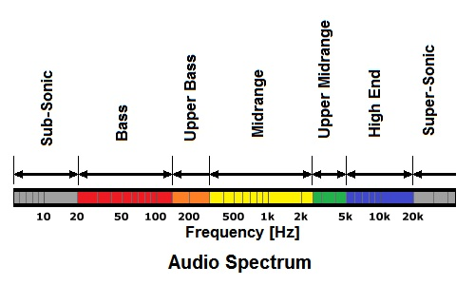

Slide 16
Neural Network 1:
We first train the NN with the handwritten digits to produce the numerical output when the written digit is fed.
Neural
Network 2:
Here, we train the frequency data set with the digits dataset…..
This is done after training the handwritten data set to obtain the fulfilment of recognition of the digits.
MNIST data set for handwritten digits
Train this data set to identify it with the digits which were recognized in Neural Network 1
Converted F – Data set

Slide 17
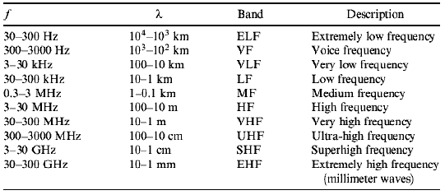
Ideas to approach the design of Neural Network 2:
Convert the audio spectrum into an array of suitable dimensions and compare it with the digits array.
Build a probabilistic model which finds the probabilities of the audio spectrum. (Take the corresponding digit which has the largest probability)
With the given classification, we can easily separate the audio signals from noise and the true signal using Fourier Transformations.

Slide 18
Applications and scope:
Conversion of video input (audio input + digits input) to text.
Can be useful for teaching and correcting small children in nurseries and playgroups.

