Slide 1
AI self-reflection for increasing deep learning efficiency.
Author: Andrey Zubkov
zubkov.av@g.nsu.ru
Scientific adv: Alexander Savostyanov
PhD in Philosophy

Slide 2
Main lacks of modern deep learning:
Performance | Structured data volume
Moore’s law: number of transistors twices ~every 2 years | ImageNet DS size: 2010 - ~10M, 2017 - ~14M.
Cambrian data sources explosion: quantity of information twices ~every year. | Datasets still being collected manually. Non-degenerate class usually takes from 500 samples to train properly.
Combination: percentage of received information could be processed being twice less ~every 2 years. | Better results require larger datasets.

Slide 5
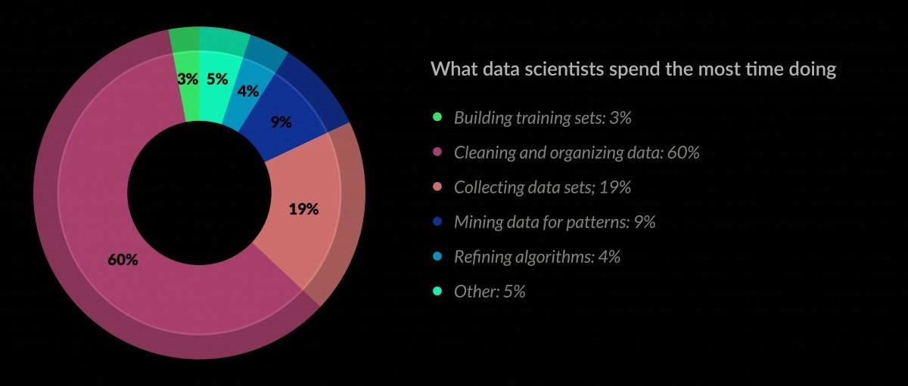
Why data usage efficiency is important?

Slide 6
Existing results - Google AutoML(NasNet-A)
Automatically generated CV-network.
At least 1.2% better than any human-invented architecture.
Scalable with preservation of superiority(low-scale is even 3.1% better than human-invented equivalently-sized architecture).
Transferable among CV-classification.
48000 GPU-hours to run(11 years of learning in my case).
Hyper-parameters optimized specifically for model.

Slide 7
How AutoML designs NLs:

Slide 8
Inspiring scientific rationality.
Philosophy distinguish 3 primary types of scientific rationality, that mainly differ by the level of self-reflection:
Classical rationality - considers only an object of research. I.e. images in classification task.
Non-classical - considers also the arsenal of methods and operations of research. For instance - CNN and it’s parameters in classification task.
Post non-classical - takes into account also the goals and reasoning of research.

Slide 9
What AI should know about reaching goals?
What is the goal? In progress.
How could it act to reach goal? In progress.
How much does it cost to act in specific way?.. Undone.

Slide 10
Plan of experiment:
Choose an open environment(for instance Starcraft 2).
Implement reinforcement learning algorithm to explore the environment.
Include the self-monitoring parameters(time-consumption, validation score improvement, power-consumption) into cost-function. Probably - create separate cost-function for meta-model, that would guide the original model.
Check what would be the difference in learning process and if improvement would surpass overheads.

Slide 11
References:
Learning Transferable Architectures for Scalable Image Recognition, Google Brain, July 2017
Reinforcement learning Policy Gradient, Marcello Restelli, Politecnico di Milano, March-April 2015
Rationality: From AI to Zombies, Eliezer Yudkowsky, MIRI, March 2015
Model-Agnostic Meta-Learning for Fast Adaptation of Deep Networks, Chelsea Finn, Pieter Abbeel, Sergey Levine, March 2017

