Slide 1


Acceleration of the solution of parametric inverse problem by constructing a hierarchical structure of a pre-computed modeled signals database
Novosibirsk ICK&C C&B lab.
Artem Muliukov
Sci. Adv. Maxim Yurkin

Slide 2
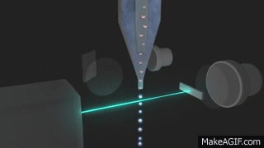
Scanning flow cytometer

Slide 3
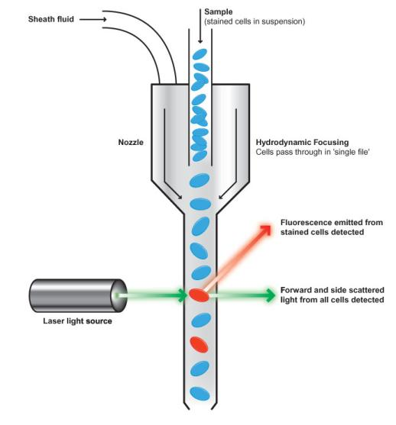
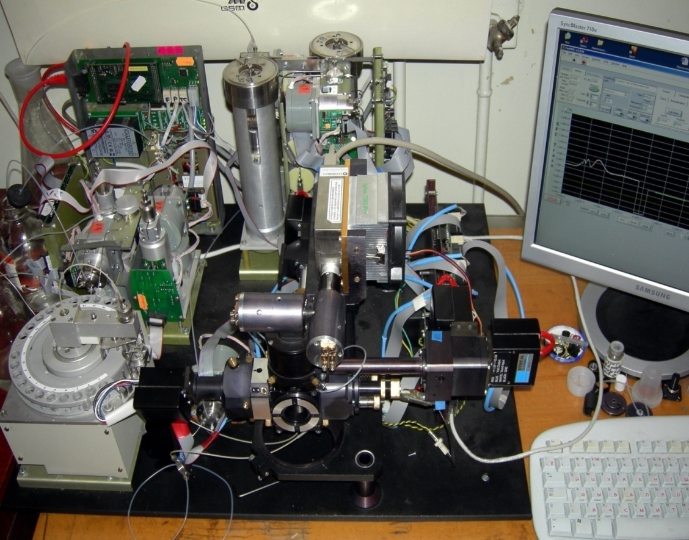
Scanning flow cytometer

Slide 4

FSC
Standard flow cytometry
Scanning flow cytometry

Slide 5
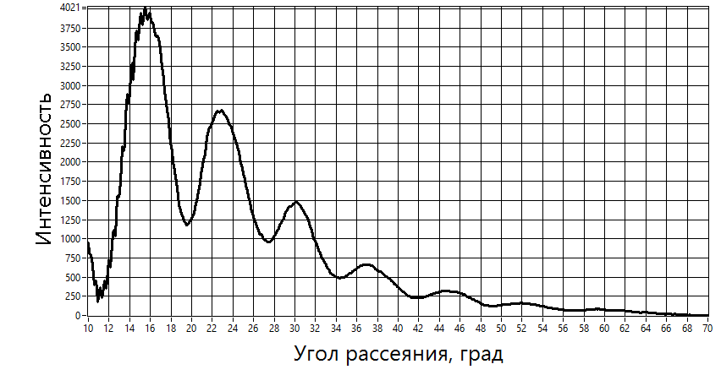
Result of Cytometer work
Intensity
Scattering angle, grad

Slide 6
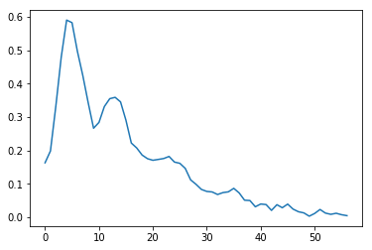
Problem
V = ? a/b = ?
n = ? β = ?

Slide 7
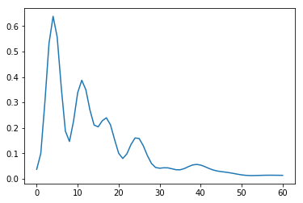
Problem
V = ? a/b = ?
n = ? β = ?
Solved problem (DDA):
V = 1.2 a/b = 5.4
n = 1.47 β = 24.73

Slide 8
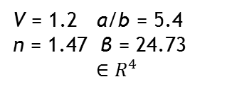

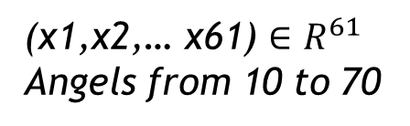
DDA
V = 1.2 a/b = 5.4
n = 1.47 β = 24.73
$${∈R}^{4}$$
(x1,x2,… x61) ${∈R}^{61}$
Angels from 10 to 70
a/b
=
1.0
1.1
1.2
1.3
DDA
V = 1.0 1.1 1.2 1.3
$$R^{61}$$

Slide 9

a/b
=
1.0
1.1
1.2
1.3
DDA
V = 1.0 1.1 1.2 1.3
Measuring
$$R^{61}$$
a/b
=
?
V = ?

Slide 10





$$R^{61}$$
r1
r2
r3
r4
We are choosing the closest point
Next we can say that the nearest point is the desired point to within noise. And get more detailed results about the evaluation of cell parameters by counting the statistics (ME, STD) .

Slide 11

Change brute force alg. to the hierarchical data structure ( firstly the ball tree)
Realization on Cython or on C++. Boosting algorithm from O(n) to ~O( log(n) )
Implementation my library to the current laboratory soft(LabVIEW)
Distribute my code as open source for solving of inverse tasks.
Next here the example of hierarchy structure of points in precomputed database

Slide 12

$$R^{61}$$

Slide 13
$$R^{61}$$

Slide 14
$$R^{61}$$

Slide 15
$$R^{61}$$

Slide 16
$$R^{61}$$
D1_max
D1_min

Slide 17
bypass width
$$R^{61}$$
D4_min
D2_max
D2_max < D4_min

Slide 18
bypass width
$$R^{61}$$
D4_min
D2_max
D2_max < D4_min

Slide 19
bypass depth
$$R^{61}$$
D4_min
R_min
R_min < D4_min

Slide 20
bypass depth
$$R^{61}$$
D4_min
R_min
R_min < D4_min

Slide 21
Results
Testing of existing realization of BallTree from sklearn.
Processed the measures for speed of work and for the number of compotation's
Selected Dimention:
Max(Di)
D1
D2
Divide by half
D2

Slide 22
$$R^{61}$$
D1
D2

Slide 23
$$R^{61}$$

Slide 24
$$R^{61}$$

Slide 25
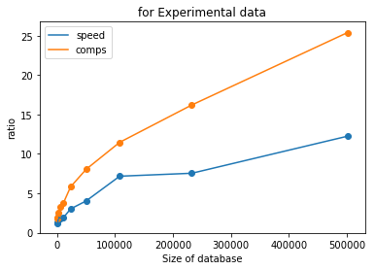
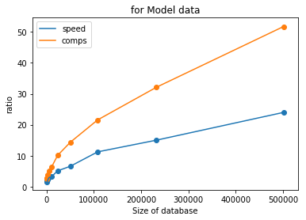
Ratio between the brute force and ball tree (result peed up of process)

Slide 26
Thanks for attention
«Acceleration of the solution of parametric inverse problem by constructing a hierarchical structure of a pre-computed modeled signals database»
Novosibirsk ICKC C&B lab. Artem Muliukov
Sci. Adv. Maxim Yurkin

