Slide 1
Revealing research institutes and their interactions: a case study of miRNA research.
Novosibirsk State University
Mechanic-Mathematical Department
SDAML, BDA
Artemiy Firsov
Scientific advisor: Igor Titov, Cand. Sci. (Phys.-Math.), Institute of Cytology and Genetics, Molecular Genetics Department
20.12.2017

Slide 2
Presentation structure
Motivation of institution reference (affiliation) disambiguation problem
Aim and issues
Affiliation identification problem
Affiliation identification problem results
Future work
2￼

Slide 3
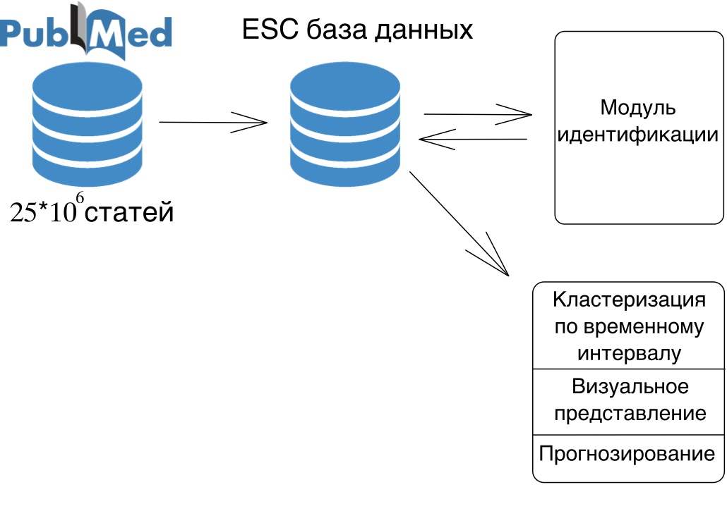
ESC system
database
Identification
module
papers
Clustering
over time
intervals
Problem
Affiliation, papers topic, email, etc are not used in author disambiguation
Visualization
Prediction
3￼

Slide 4
Author identification problem example
Name | John
Surname | Smith
Affiliation | ICG
Topic | Molecule-Genetic Department
DOB | 1975
Room | 2114
Name | John
Surname | Smith
Affiliation | ICG
Topic | Molecule-Genetic Department
DOB | 1966
Room | 2115
4￼

Slide 5
Author disambiguation problem example
Name | J
Surname | Smith
Affiliation | ICG
Topic | Molecule-Genetic Department
DOB | ???
Room | ???
Name | J
Surname | Smith
Affiliation | ICG
Topic | ???
DOB | ???
Room | ???
5￼

Slide 6
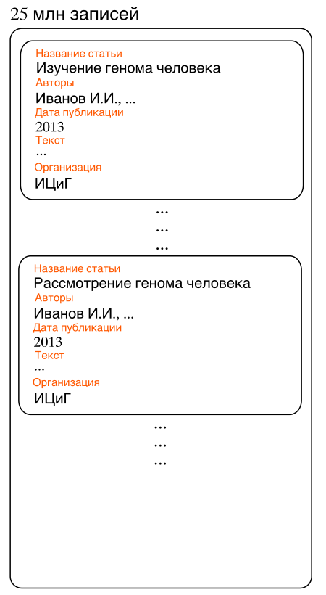
Сложность идентификации авторов
Имя | Игорь
Фамилия | Иванов
Отчество | Иванович
Место работы | ИЦиГ
Тематика | Гены человека
Год рождения | 1975
Наличие аккаунта в соц.сетях | Нет
Имя | Иван
Фамилия | Иванов
Отчество | Иванович
Место работы | ИЦиГ
Тематика | Гены человека
Год рождения | 1932
Наличие аккаунта в соц.сетях | Нет
6￼

Slide 7
Author disambiguation challenges
Typos of author/editor
Different ways to type authors name
Different ways to type affiliation
Author name change
Institution name change
...
7￼

Slide 8
Current solutions
A Brief Survey of Automatic Methods for Author Name Disambiguation Anderson A. Ferreira, Marcos André Gonçalves, Alberto H. F. Laender
1) Cost-effective on-demand associative author name disambiguation Adriano Veloso, Anderson A. Ferreira, Marcos André Gonçalves, Alberto H.F. Laender, Wagner Meira Jr.
2) Efficient name disambiguation for large-scale database J.Huang, S.Ertekin, C.L.Giles
 | 1 | 2
Algorithm complexity n – number of papers in dataset k – number of features | О(n^{k}) | O(n²)
Used features | Co-authors, papers topic, affiliation
Test set volume | 576 | 700000
F1 metric | 92 % | 90,6 %
Open-source availability | No
8￼

Slide 9
Aim
Develop the utility that disambiguates affiliations and provide examples of it’s usage for English institution names
Author disambiguation
Affiliation disambiguation
Paper topic
9￼
Notes:
Тут почётче рассказать

Slide 10
Affiliation disambiguation challenges
Novosibirsk Institute of Bioorganic Chemistry, Siberian Division, Russian Academyof Sciences, Russia. mor@niboch.nsc.ru
Institute of Bioorganic Chemistry, Siberian Division of Russian Academy of Sciences, pr. Academika Lavrentyeva 8, Novosibirsk. knorre@modul.bioch.nsk.su
Novosibirsk Institute of Bioorganic Chemistry, Russian Academy ofSciences,Novosibirsk.
Institute of Bioorganic Chemistry, Siberian Division of the USSR Academy ofSciences, Novosibirsk.
Institute of Cytology and Genetics, Russian Academy of Sciences, Siberian Department, Novosibirsk, Russia, MRC Clinical Sciences Centre, Imperial College of Medicine, Hammersmith Hospital, London, United Kingdom
Blank | Institute of Bioorganic Chemistry | Russian Academy of | Space | Sciences | Blank | Novosibirsk | knorre@modul.bioch.nsk.su
Novosibirsk | Institute of Bioorganic Chemistry | Russian Academy of | Blank | Sciences | pr. Academika Lavrentyeva 8, | Novosibirsk | Blank
10￼

Slide 11
Issues
Perform data preprocessing
Find promising similarity and clustering algorithms
Get clustering parameters on Novosibirsk affiliation dataset
Provide homogeneity, completeness, v-measure scores
Cluster – subset of affiliations set that are alike (thus, probably referring to the same institution)
11￼

Slide 12
Data preprocessing
Remove email, zip and other non-institutional artifacts
Lowercase and leave only “a-z”, “A-z”, “ ”, “,” characters
Split affiliation if contains several institution names
Extract only name and country from affiliation
Institute of Cytology and Genetics, Russian Academy of Sciences, Siberian Department, Novosibirsk, Russia, MRC Clinical Sciences Centre, Imperial College of Medicine, Hammersmith Hospital, London, United Kingdom
institute of cytology and genetics, russia
mrc clinical sciences centre, united kingdom

Slide 13
Clustering and similarity algorithms
Set of affiliations of 62 unique Novosibirsk institution names. From PubMed DB. Volume – 1000 objects.
K-Means, DBSCAN over Levenshtein, Jaccard, Smith-Waterman, K-Mer distances/features
DBSCAN, eps: 0.009, min_samples: 5, metric: Sokal-Michener over 6-Mer features (Boolean vector of K-Mers presence)
Homogeneity, each cluster contains only members of a single class: 0.979 Completeness, all members of a given class are assigned to the same cluster : 0.995 v-measure, their harmonic mean: 0.986

Slide 14
Similarity functions comparing
 | F1; N > 200 | F1; 10 < N < 50 |  | t, мс | Big cluster separation
Levenshtein | Big clusters mixed and divided into small clusters, no structure in small clusters
Jaccard | 0.79 | < 0.72 (2/9) |  | ~7200 | 16
Smith-Waterman | 0.9 | < 0.81 (3/7) |  | ~73000 | 7
KMer | 0.98 | < 0.85 (7/8) |  | ~10500 | 2
14￼
Notes:
Диаграмму классов

Slide 15
Solution drawbacks
Growth of features number with the growth of dataset volume
DBSCAN cannot cluster data sets well with large differences in densities
Union of clusters if alike names: institute of organic/bioorganic/inorganic chemistry
Further work
Introduce city consideration in data preprocessing stage
Try another approach based on sorting and pairwise consequent similarity measuring
Provide statistics for “miRNA” search query dataset from PubMed – institution dynamics, their interactions
Use authors name disambiguation problem solution in affiliation disambiguation problem and vice versa
15￼

Slide 16
Thank you!
Artemiy Firsov
+7-983-122-34-67
E-mail:artyomfirsov@mail.ru
Skype:fabio0112358
16￼

Slide 17
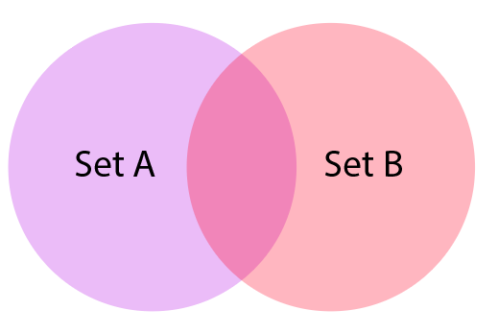
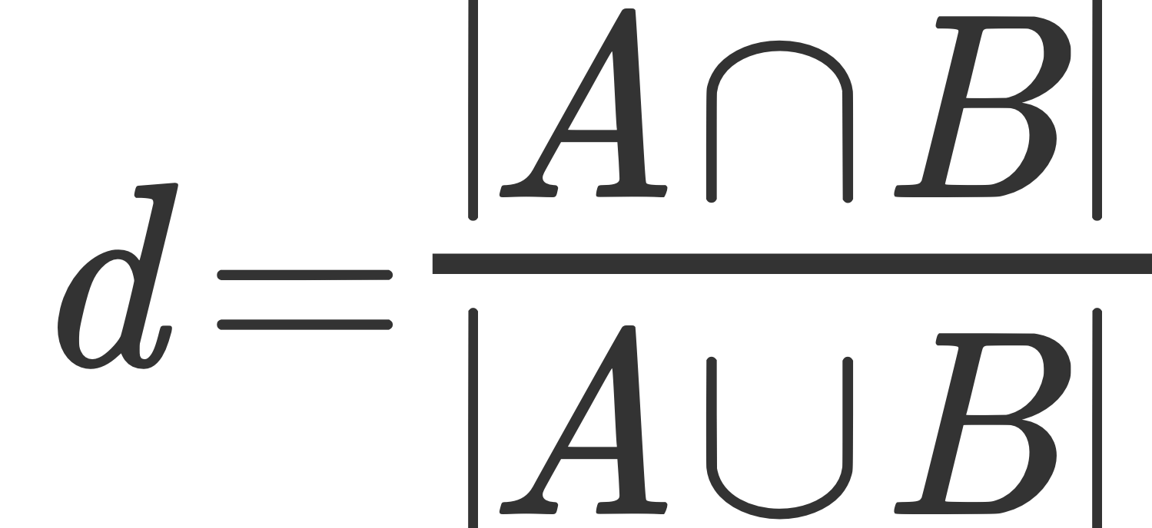
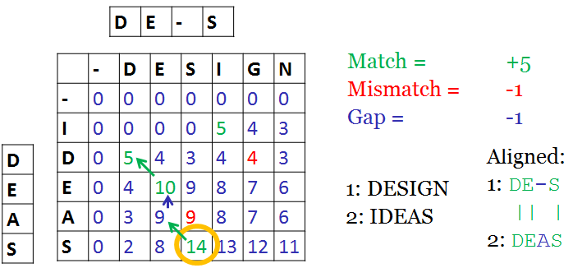
Algorithms
Levenshtein
https://www.researchgate.net/profile/Cihan_Varol/publication/220500491_Author_Disambiguation_using_an_Hybrid_Approach_of_Queries_and_String_Matching_Techniques/links/541b9bc20cf203f155b3284a.pdf
Jaccard coefficient
http://link.springer.com/chapter/10.1007/978-3-319-06028-6_26
KMer
http://www.ncbi.nlm.nih.gov/pmc/articles/PMC3692045/
Smith-Waterman
http://www.sciencedirect.com/science/article/pii/0022283681900875
17￼

Slide 18
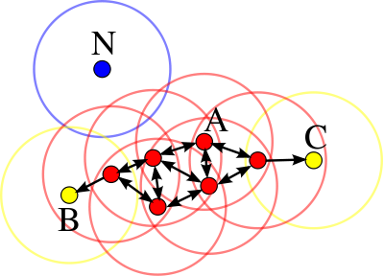
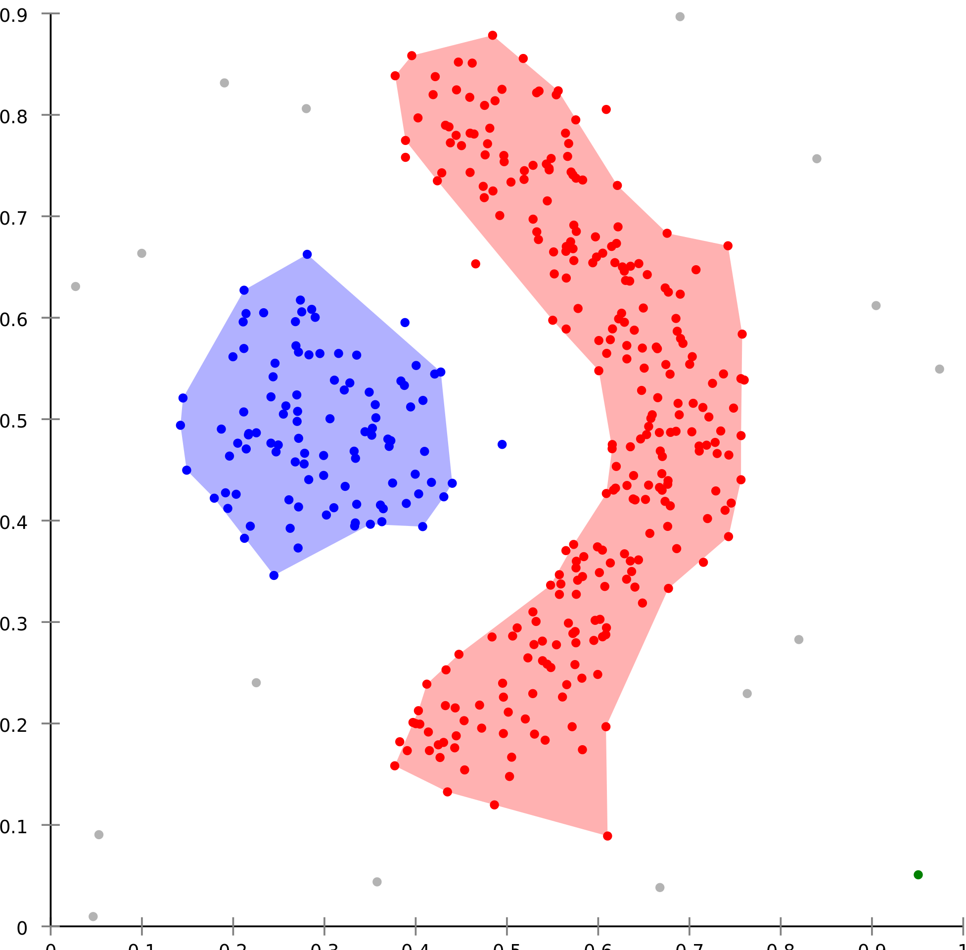
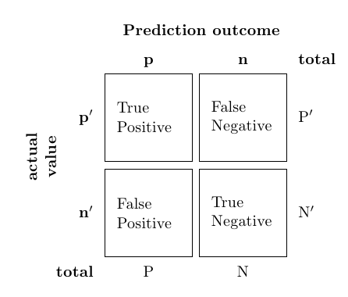
Novosibirsk affiliations dataset, clustering
Set of affiliations of 62 unique Novosibirsk institution names. From PubMed DB. Volume – 1000 objects.
DBSCAN clustering. Provides transitivity. Can handle noise. Does not require clusters number. Can handle complex cluster structures.
V-measure
18￼
Notes:
Транзитивность указать на слайде
Пресижон, рекол-тоже формула

