Slide 1
Brain activity analysis (using methods of Machine Learning)

Slide 2
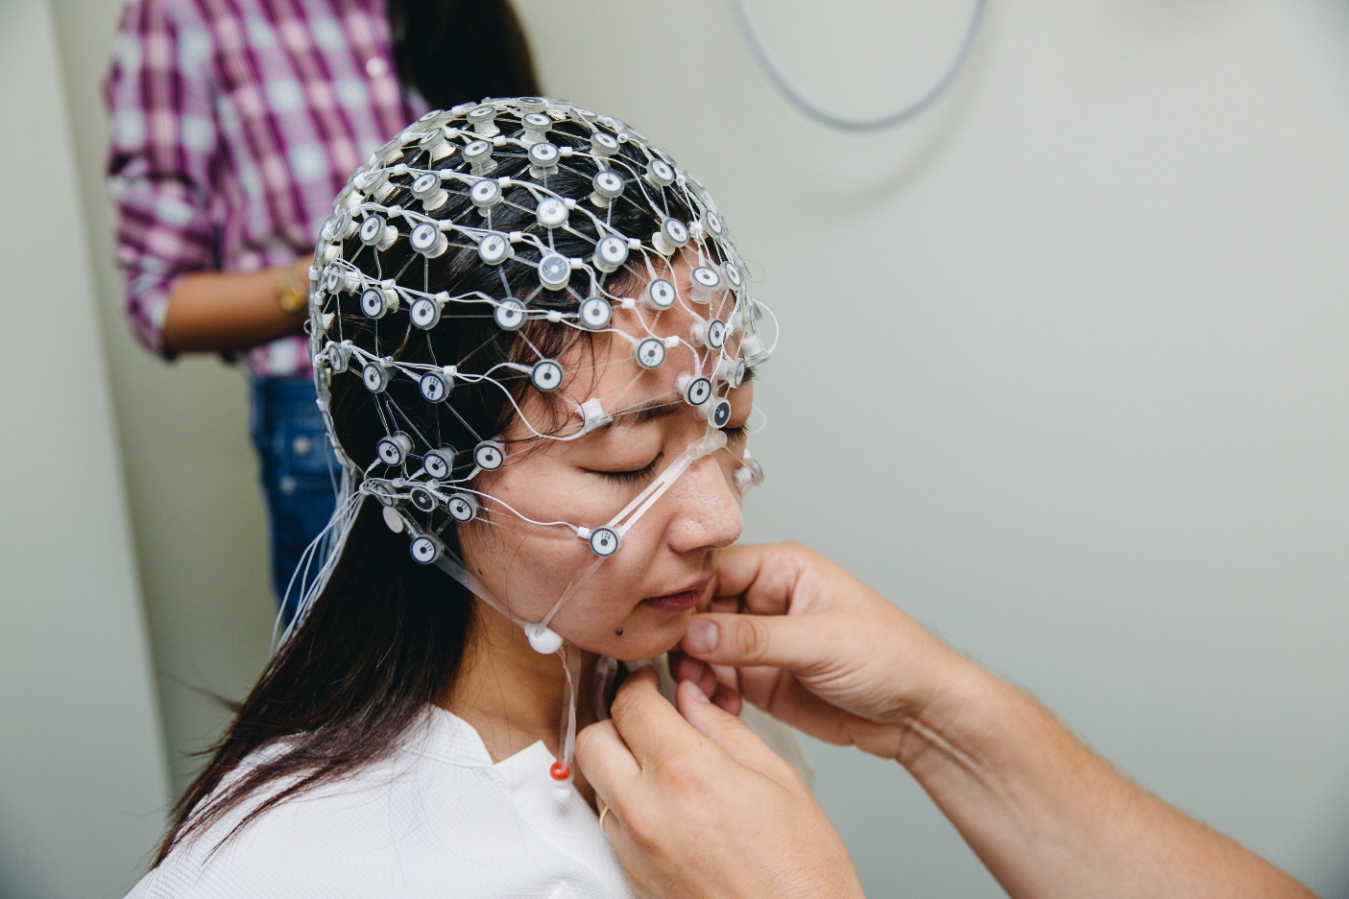
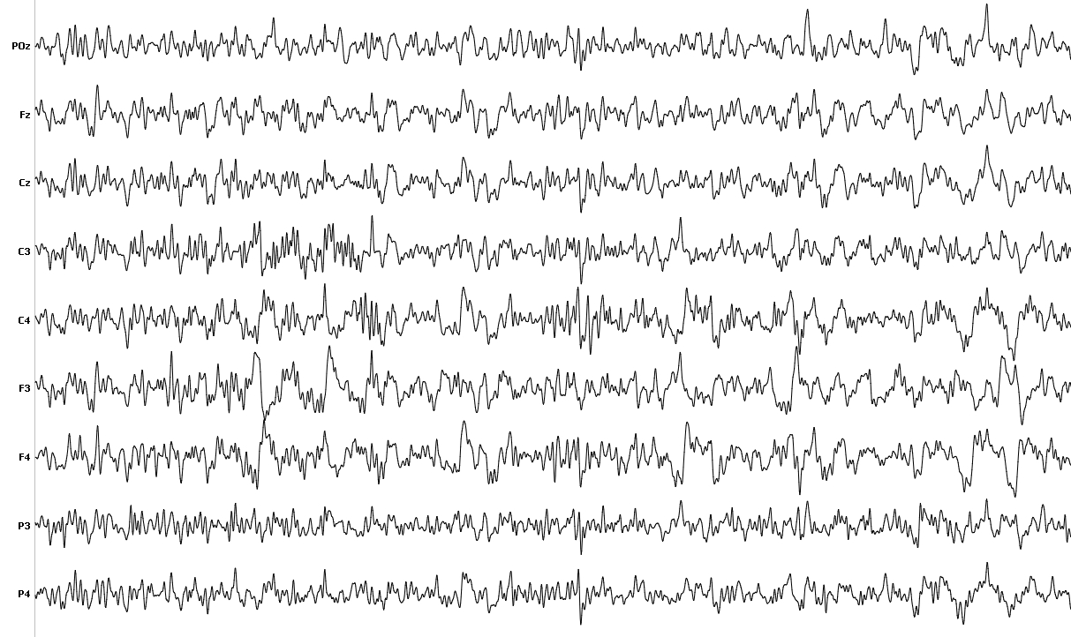
What’s EEG? (electroencephalography)

Slide 3
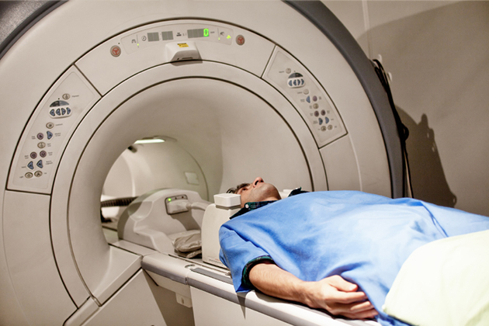
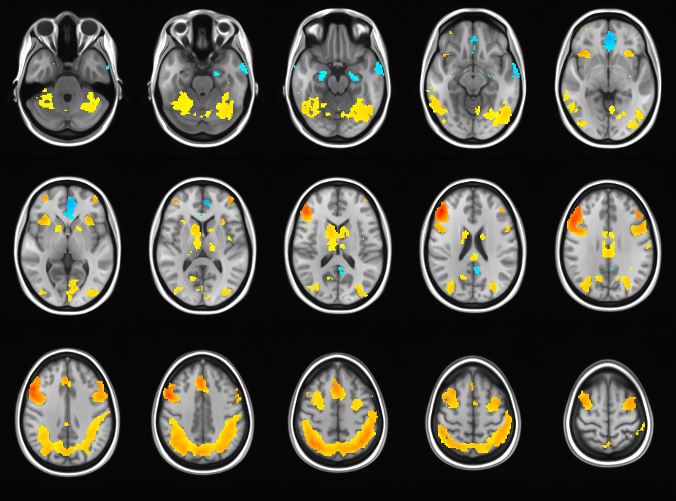
What’s fMRI? (Functional magnetic resonance imaging)

Slide 4
How do we analyse fMRI data?
Brain is a wonky matter
People are different
We need statistics!

Slide 5
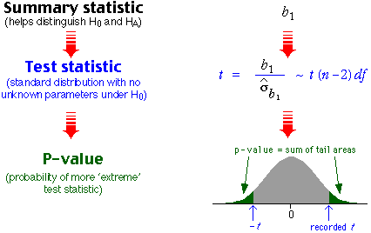
P-values

Slide 6
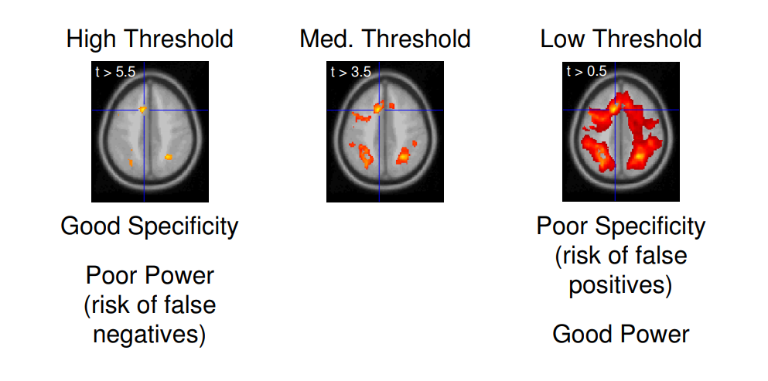
P-values thresholds

Slide 7
Problems of this approach
We lose a lot of information by averaging
We need a lot of statistics to get good p-values
Possible solution: reproducibility analysis

Slide 8
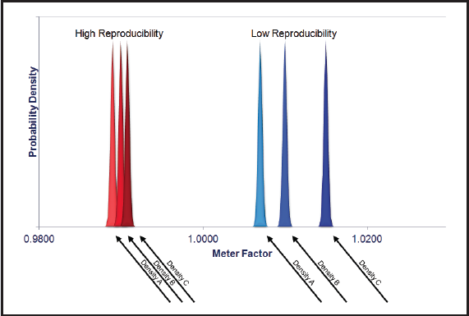
Reproducibility analysis
Robust to a smaller sample sizes
Allows us to see more subtle signals, if they are highly reproducible

Slide 9
My goals
Implementation of this method in software
Further analysis of results
Probably, adopting method for EEG data
Possible applications
Depression detection on preclinical stages
Other disorders detection
General neuroscience researches

