Slide 1
Development of storage and analysis methods of multidimensional and heterogeneous data in parallel systems focused on the use of analytical streaming tools
Student: M. Tussupova
Scientific advisor: F.A. Murzin

Slide 2
Aim
Development of new methods for organizing memory with parallel access to a wide class segments contained within multidimensional arrays.

Slide 3
Memory modules – parallel connection
Data Bus
Read/Write Bus
Address Bus

Slide 4
Parallel Access to Tree-like Data-Structures
In general parallel memories designed for obtaining conflict-free access to arrangements of cells that belong to a specified set of data templates.
Trees are another important data structure. Parallel access to a subtree means the conflict-free access to all the nodes of the subtree.

Slide 5
Known results
Theorem 1. A parallel conflict-free access to all the nodes of an arbitrary complete q-ary subtree of height t of a q-ary tree (q>1, t>1), with a special recursively linear module assignment function S is possible, if the number of memory modules N is equal to:

Slide 6
Known results
Theorem 2. The minimal number of N of needed memory modules for the parallel conflict-free access to general extended q-ary subtrees of height t is equal to:
N = qt The minimal number N of needed memory modules for the parallel conflict-free access to complete left- or right extended q-ary subtrees is equal to
N = (q-1)t+1

Slide 7
Known results
Theorem 3. A parallel conflict-free access to all t layers of a complete q-ary subtree of height t (t>0) of a complete q-ary (q>0) tree is possible with
memory modules using a special recursively linear module assignment function S. The number N is minimal.

Slide 8
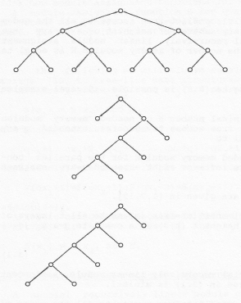
Types of subtrees:
Complete
q-ary subtree
Complete general extended q-ary subtree
Complete left extended q-ary subtree

Slide 9
Development of storage and analysis methods of multidimensional and heterogeneous data in parallel systems focused on the use of analytical streaming tools
Student: M. Tussupova
Scientific advisor: F.A. Murzin

