Slide 1
Semantic contracts development.
Sci. adv.: Dmitry ivanovich sviridenko

Slide 2
What are smart contracts?
Smart contract is a computer algorithm, that defines the rules and penalties around an agreement in the same way that a traditional contract does and automatically enforce those obligations.

Slide 3
How you can use smart contracts.
Government – voting system.
Management – ledger.
Automobile – insurance.
Real Estate , Healthcare and so on.

Slide 4
Ethereum platform.
Was developed by Vitalik Buterin
Smart contracts development platform
Internal currency – Token.

Slide 5
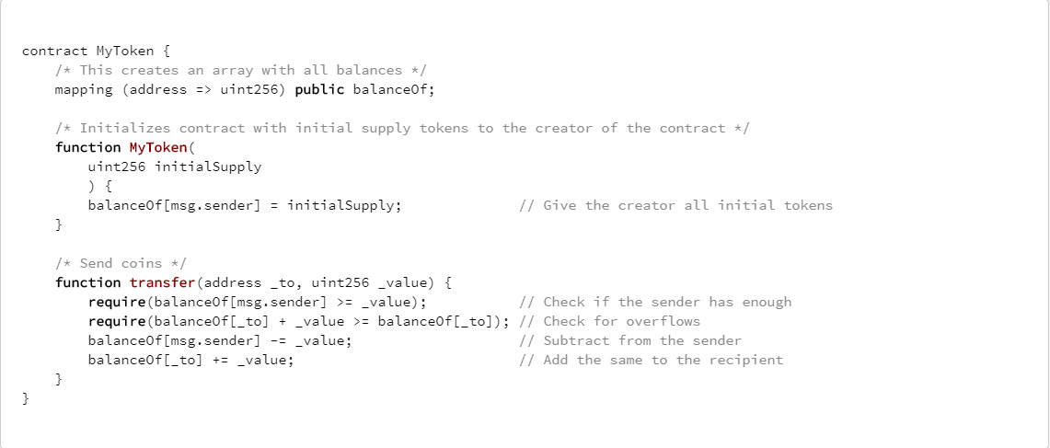
Smart contract example.

Slide 6
Disadvantages of such approach.
Dissolution of semantics in a smart contract
Inaccessibility to key participants
External resources
Binding to a specific type of block-chain

Slide 7
What is semantic modeling?
original direction of artificial intelligence and mathematical logic, which describes knowledge about the subject area, presenting it in a declarative logical form.

Slide 8
Why semantic modeling.
The rejection of programming greatly increases the speed of development
Specifies the explicit modeling of the semantics, that is required for AI and robots
Availability for a wide range of employees

Slide 9
What will be my first step.
To create an interpreter of logic language to one of the programming languages.

