Slide 1
Sentiment Analysis in Social Media Texts
Research Investigation Topic:
Juan Fernando Pinzon
Scientific Supervisor:
Dr. Anton Kolonin
Институт вычислительной математики и математической геофизики СО РАН

Slide 2
What is Sentiment Analysis?
Sentiment analysis (or opinion mining) refers to the use of natural language processing, text analysis, computational linguistics, and biometrics to systematically identify, extract, quantify, and study affective states and subjective information.
Generally speaking, SA aims to determine the attitude of a speaker, writer, or other subject with respect to some topic or the overall contextual polarity or emotional reaction to a document, interaction, or event.

Slide 3
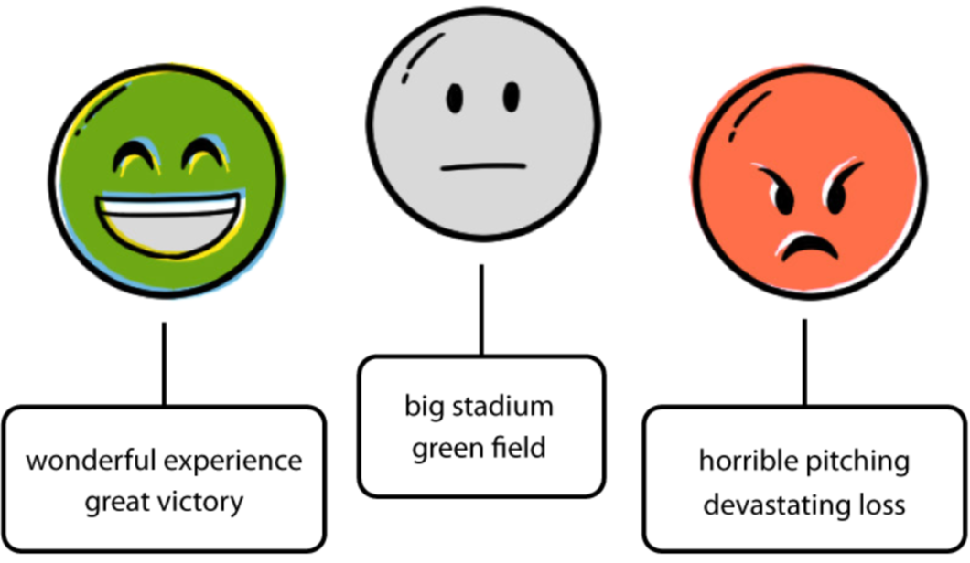
Example:
Humans seemingly have no trouble reading a sentence and mentally scoring the sentiment. We humans use a process of reading and understanding the descriptors placed on the subject of a sentence.
Consider these sentences:
A horrible pitching performance resulted in another devastating loss.
Sub-par pitching and superb hitting combined to cost us another close game.
They both have the same basic subject, the loss of a baseball game, but obviously (to you) the first sentence is contextually much more negative.

Slide 4
Why should we care about SA?
The scoring of sentiment from a document is a problem that was originally raised in the context of marketing and business intelligence, where being able to measure the public’s reaction to a new marketing campaign can have a measurable financial impact on a business.
With a consistent machine-based sentiment scoring, there are a number of applications that become feasible:
Financial services: automated trading, better information to traders.
Reputation management: the problem every marketing person faces.
Voice of customer: listen to how they’re saying what they say, don’t constrain to closed-ended questions.
Among others…

Slide 5
Why SA in Social Media Texts?
Social Media is known for being places where people can “blow some steam” and comment without reservations.
Seems like a good source of training towards SA.
Most of the final applications of SA will will be implemented under Social Media scenarios (reputation management, attitude/opinion towards a product or service, consumer behavior…).

Slide 6
Steemit as a platform for our first tests, Why?
Is a blogging and social networking website on top of the Steem blockchain database.
Steem blockchain produces STEEM and Steem Dollars which are tradeable tokens users obtain for posting, discovering, and commenting on interesting content.
Seems like a good source of relevant posts and commentaries to analyze (compared to Twitter, FB…).

Slide 7
First tasks:
Analyze Steemit Database (.txt file 14gb)
Use grep functions to extract post/comments with emotions. (which contain any kind of emoji to obtain a reduced file to work with).
Separate this new file by languages (English and Spanish) using grep functions. These 2 new files will be the baseline for testing and analyzing emotions.
Provide summary of these files (# of posts, # of posts by language, # of positive comments, # of negative comments).
Categorize these smaller files post/comments by emotions.
Start Machine Learning experiments with these previously categorized data and compare results.

Slide 8
Reference Works/Achievments:

Slide 10
