Slide 1
A music generation system
Scientific advisors: Pavlovskiy E.N., Beloglazov D.M.
Author: Prokopchik Konstantin

Slide 2
Known music generation systems
The problem of music generation has become very popular with the development of Recurrent Neural Networks (RNNs) in the last years. There are many systems that work with different kinds of music:
Magenta - a project by Google Brain team
DeepJazz - the result of a thirty-six-hour hackathon by Ji-Sung Kim
BachBot – a research project by Feynman Liang at Cambridge University
FlowMachines – a research project from a team in Paris
WaveNet – a project by Google’s DeepMind
GRUV – a Stanford research project
MIDInet – an Academia Sinica research project (claim to be better than the rest)

Slide 3
Known music generation systems
 | Magenta | DeepJazz | BachBot | FlowMachines | WaveNet | GRUV | MIDInet
Input type | midi | midi | - | - | raw audio | raw audio | midi
Core model | basic RNN + 2 LSTM’s | 2-layer LSTM | LSTM | Markov Constraints | CNN | GRU and LSTM | GAN
Open-source | Yes | Yes | Yes | No | No* | Yes | Yes
* - Others have implemented it based on google documentation

Slide 4
RNN (Recurrent Neural Network)

Slide 5
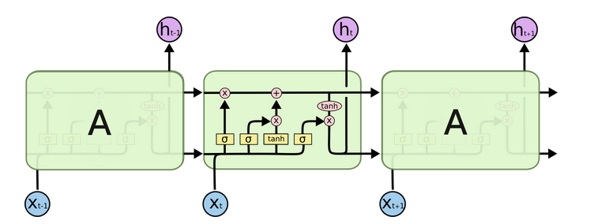
LSTM (Long-Short Term Memory)
$$C_{t−1}$$
$$C_{t}$$
$$f_{t}$$
$$i_{t}$$
$$o_{t}$$
$${\tilde{C}}_{t}$$
$$h_{t−1}$$
$$h_{t}$$
$f_{t}=σ(W_{f}∙[h_{t−1}, x_{t}]+b_{f}$)
$i_{t}=σ\left(W_{i}∙\left[h_{t−1}, x_{t}\right]+b_{i}\right), {\tilde{C}}_{t}=tanh(W_{C}∙\left[h_{t−1}, x_{t}\right]+b_{C})$
$C_{t}=f_{t}∗C_{t−1}+i_{t}∗{\tilde{C}}_{t}$
$o_{t}=σ\left(W_{o}∙\left[h_{t−1}, x_{t}\right]+b_{o}\right), h_{t}=o_{t}∗tanh⁡(C_{t})$
$$σ\left(x\right)=\frac{1}{1+e^{−x}}$$

Slide 6
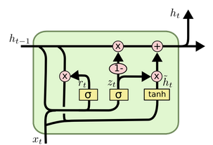
GRU (Gated Recurrent Units)
$z_{t}=σ(W_{z}∙[h_{t−1}, x_{t}]$)
$r_{t}=σ\left(W_{r}∙\left[h_{t−1}, x_{t}\right]\right), {\tilde{h}}_{t}=tanh(W∙\left[r_{t}∗h_{t−1}, x_{t}\right])$
$C_{t}={(1−z}_{t})∗h_{t−1}+z_{t}∗{\tilde{h}}_{t}$

Slide 7
Goals
Create a new dataset with corrected data
Make a GAN (Generative Adversarial Network), that will be generating an accompaniment to the piece of music.

Slide 8
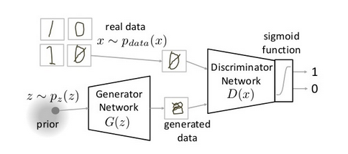
GAN
$$\min_{G}{\max_{D}{V\left(D,G\right)}}$$
$$\left.V\left(D,G\right)=𝔼_{x\sim p_{data}\left(x\right)}\left[logD\left(x\right)\right]+𝔼_{z\sim p_{z}\left(z\right)}[log(1 − D(G(z))\right]$$

Slide 9
What I have done
A script for collecting MIDIs from https://thesession.org/ - a web-crawler that downloads files by genre.
A script that transposes melodies to one tonality.
Trained a Magenta MelodyRNN model with the initial downloaded set and the transposed set. (20000 train steps, 64x64 size of the RNN)
Trained a the network on 10 samples to see the difference between the generated outputs.

Slide 10
Results
The initial set:
The transposed set:
10 samples set:
The primer melody:

