Slide 1
2018 DATA SCIENCE BOWL KAGGLE COMPETITION
Anastasia malysheva
Andrey marinov
Petr gusev
Juan pinzon

Slide 2
Spot Nuclei, Speed Cures
The 2018 Data Science Bowl offers a ambitious mission: create an algorithm to automate nucleus detection.
By automating nucleus detection, we could help unlock cures faster from rare disorders to the common cold.
By participating, teams will work to automate the process of identifying nuclei, which will allow for more efficient drug testing, shortening the 10 years it takes for each new drug to come to market.

Slide 4
Evaluation format and metrics
This competition is evaluated on the mean average precision at different intersection over union (IoU) thresholds. The IoU of a proposed set of object pixels and a set of true object pixels is calculated as:
The metric sweeps over a range of IoU thresholds, at each point calculating an average precision value. The threshold values range from 0.5 to 0.95 with a step size of 0.05.
At each threshold value tt, a precision value is calculated based on the number of true positives (TP), false negatives (FN), and false positives (FP) resulting from comparing the predicted object to all ground truth objects:
The average precision of a single image is then calculated as the mean of the above precision values at each IoU threshold.
Lastly, the score returned by the competition metric is the mean taken over the individual average precisions of each image in the test dataset.

Slide 5
Rules & prizes:
Competition Timeline
Start Date: January 16, 2018
Entry deadline: April 9th, 2018
Stage one deadline and stage two data release: April 11, 2018 - PLEASE NOTE: If you do not make a submission during the second stage of the competition, you will not appear on the final competition leaderboard.
End date: April 16, 2018 - 11:59PM UTC
Prizes:
1st place - $50,000 and 1 DGX system to the top placing team. The DGX system is provided by NVIDIA, a Data Science Bowl sponsor.
2nd place - $25,000
3rd place - $12,000
4th place - $8,000
5th place - $5,000

Slide 6
Exploratory data analysis
There are 670 training images and 65 test images making the test set less than 10% of the training set.
16 different image dimensions:
There are 7 dimensions that are in Test data set only and not in the Train data set.

Slide 7
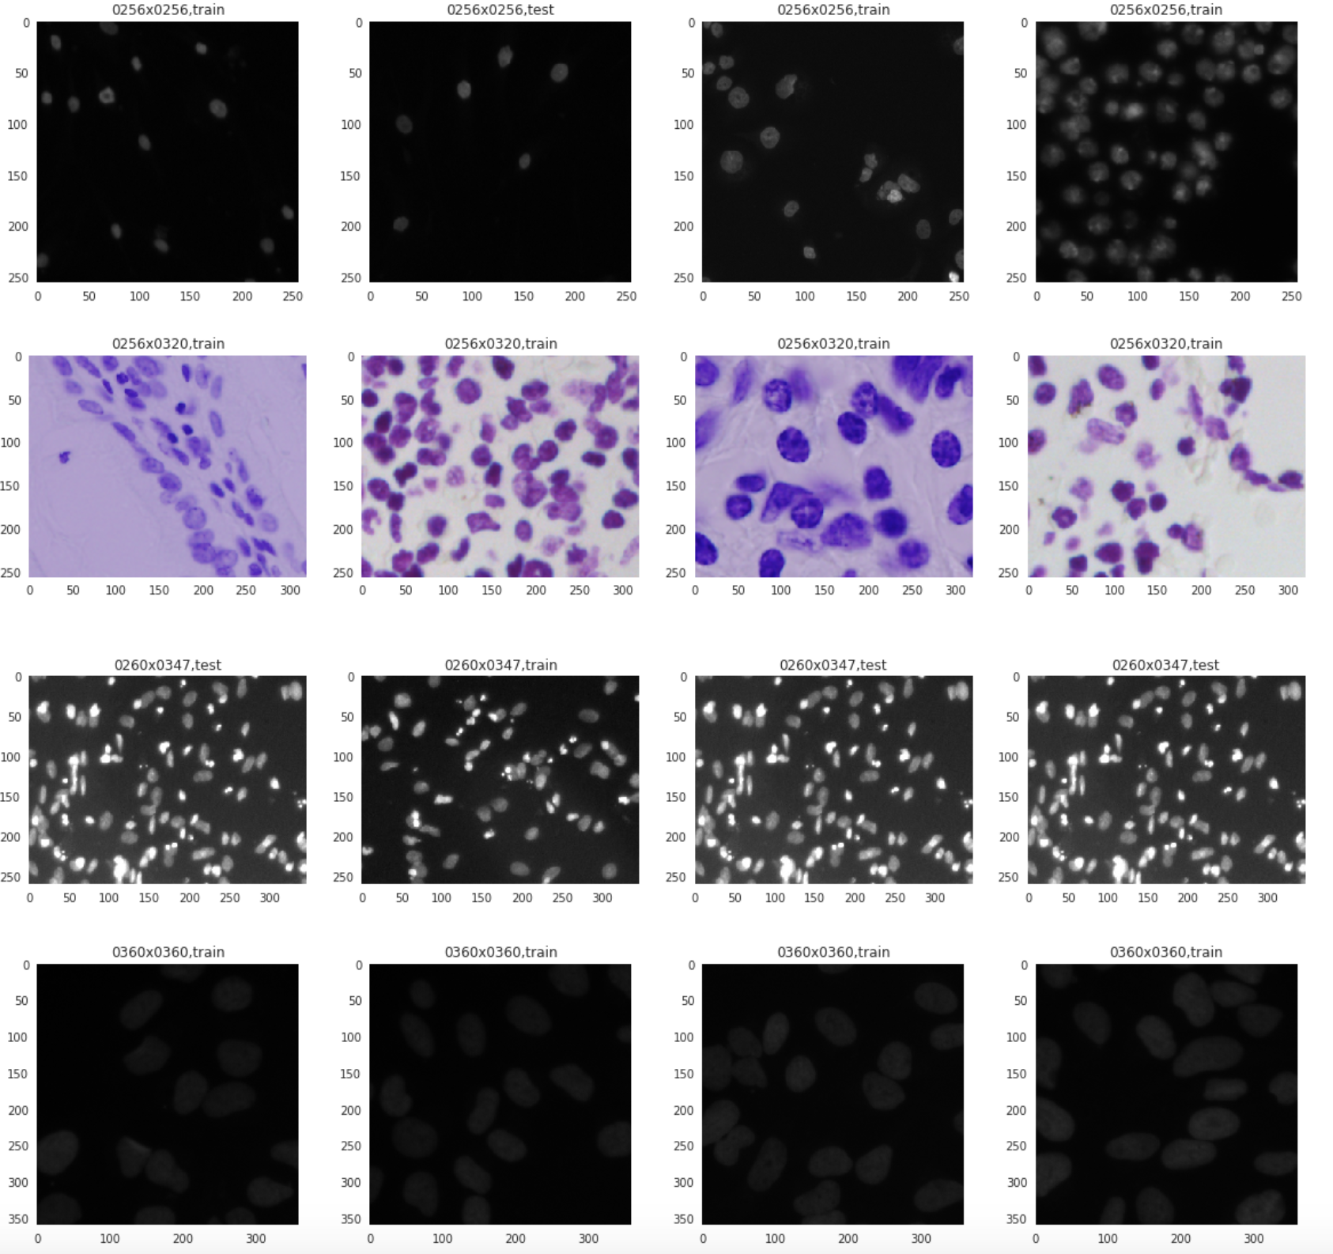

Slide 8
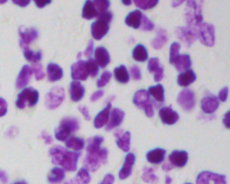
Nuclei identification process
Given a mask and an image perform the following actions
Identify the contours in the mask
Apply mask on the image to leave only the identified objects
Identify contours in the mask
For each contour extract metadata about the mask
Extract the nuclei and rotate it to get a clipped horizontal rectangle

Slide 9
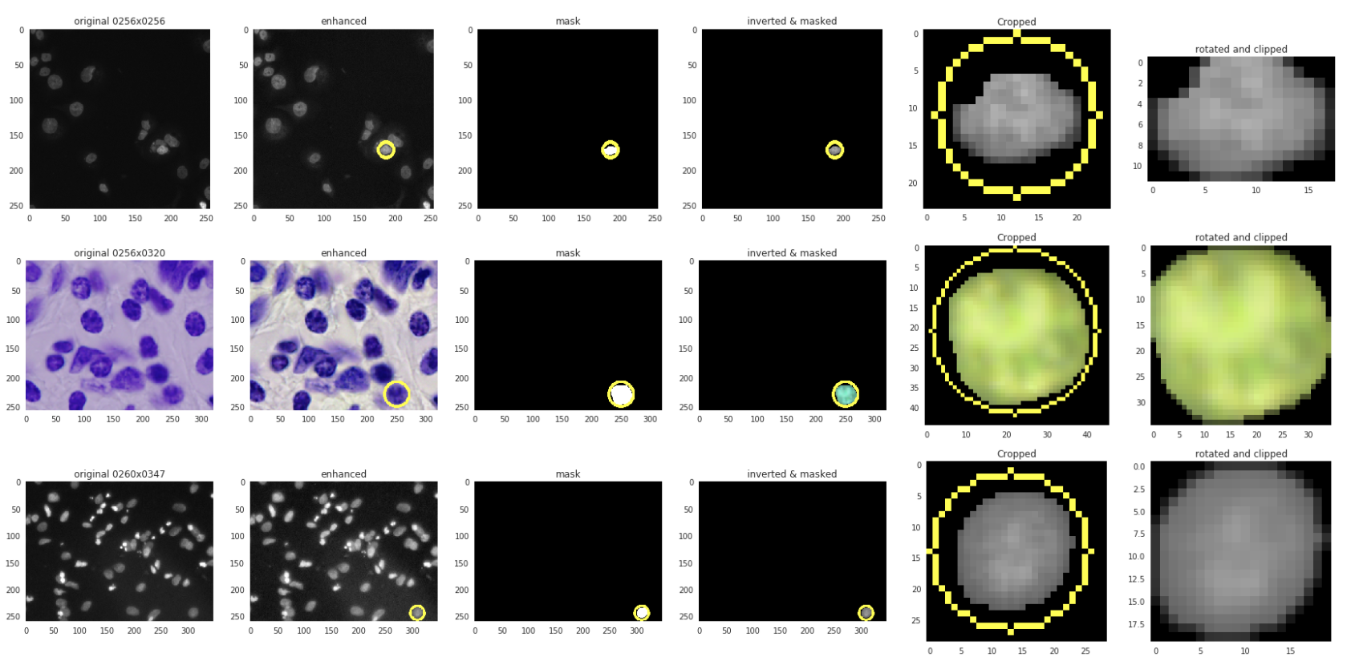
The images below show the processing steps followed to extract the final nuclei:

