Slide 1
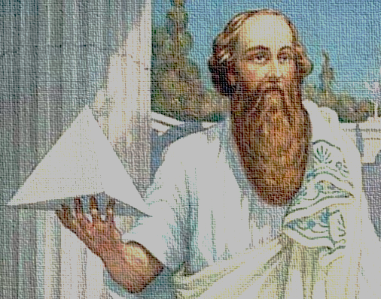
 | Evgeniy N. Pavlovskiy, Ph.D., head of the NSU Stream Data Analytics and Machine Learning lab.
Quan | 1 | 0 | 1 | 1
Tum | 0 | 1 | 0 | 0
Se | 1 | 0 | 0 | -1
Man | All | Things | Are | Number
Tics | 1 | 0 | Pythagoras

Slide 2
Bra-ket notation (Dirac, 1939)
$V$ – vector (Hilbert) space, $𝔽$- field
$\left.\left|ψ\right.\right\rangle$ - pure state (vector, or operator $𝔽→V$) – ket
$\left\langle \left.ψ\right|\right.$ - effect of state $\left.\left|ψ\right.\right\rangle$ (dual vector, dual operator $V→$ $𝔽$ Hermitian conjugate) – bra
Inner product of $\left.\left|ψ\right.\right\rangle$ and $\left.\left|φ\right.\right\rangle$ is $\left\langle ψ | φ\right\rangle$

Slide 3
Outer product
Outer product $\left|\left.w\right\rangle \right.\left\langle \left.v\right|\right.$ for $w∈W, v∈V$ is a $V→W$ operator:
$$\left(\left|\left.w\right\rangle \right.\left\langle \left.v\right|\right.\right)\left(\left|\left.v^{′}\right\rangle \right.\right)≡\left|\left.w\right\rangle \right.\left\langle v | v^{′}\right\rangle =\left\langle v | v^{′}\right\rangle \left|\left.w\right\rangle \right.$$
Arbitrary $A:V→W$ can be written in a basis ${\left\{\left|\left.v_{i}\right\rangle \right.\right\}}_{i}$ for $V$ and ${\left\{\left|\left.w_{j}\right\rangle \right.\right\}}_{j}$for $W$:
$A=\sum_{ij}{m_{ij}\left|\left.w_{j}\right\rangle \right.\left\langle \left.v_{i}\right|\right.}$,
where $m_{ij}=\left\langle w_{j} | A | v_{i}\right\rangle$

Slide 4
Eigenvectors and eigenvalues
$A=\sum_{i}{λ_{i}\left|\left.i\right\rangle \right.\left\langle \left.i\right|\right.}$, if $\left|\left.i\right\rangle \right.$ is an orthogonal basis in which $A$ is diagonal.
$\left|\left.i\right\rangle \right.$ - are eigen vectors
$λ_{i}$ - are eigen values
Easy to check:
$$\text{A}\left|\left.i\right\rangle \right.=λ_{i}\left|\left.i\right\rangle \right.$$

Slide 5
Density operator (matrix)
If $\left|\left.φ_{i}\right\rangle \right.$ - are pure states,
$\left\{p_{i}\right\}$ - are probabilities over them, then
$ρ≡\sum_{i}{p_{i}\left|\left.φ_{i}\right\rangle \right.\left\langle \left.φ_{i}\right|\right.}$ is a dense operator
Positive operator:
$\left\langle v | A | v\right\rangle ≥0$ for all $v$
Theorem: $ρ$ is a density operator iff it’s a positive Hermitian operator with trace =1.

Slide 6
Trace inner product
$A$and $B$are density matrices same dimension
$tr(A^{T}B)$
$A=\sum_{i}{p_{i}\left|\left.i\right\rangle \right.\left\langle \left.i\right|\right.}$and $B=\sum_{j}{q_{j}\left|\left.j\right\rangle \right.\left\langle \left.j\right|\right.}$
$tr\left(A^{T}B\right)=tr\left(\sum_{i}{p_{i}\left|\left.i\right\rangle \right.\left\langle \left.i\right|\right.}\sum_{j}{q_{j}\left|\left.j\right\rangle \right.\left\langle \left.j\right|\right.}\right)=$
$$=\sum_{ij}{p_{i}q_{j}\left\langle \left.i\right|\right.\left.j\right\rangle }tr(\left|\left.i\right\rangle \right.\left\langle \left.j\right|\right.)$$
$$=\sum_{ij}{p_{i}q_{j}\left\langle \left.i\right|\right.\left.j\right\rangle }\left\langle \left.i\right|\right.\left.j\right\rangle$$
$$=\sum_{ij}{p_{i}q_{j}{\left\langle \left.i\right|\right.\left.j\right\rangle }^{2}}$$

Slide 7
Distributional Semantics
“You shall know the word by the company it keeps” (Firth)
Obtain meaning high dimensional vector representations from large corpora automatically
Compositionality
DS can not be applied for entire sentence (lack of frequency)
Entailment
$w$ entails $v$ if the meaning of a word $w$ is included in the meaning of a word $v$ ($w$is-a $v$) - subsumption relation
non symmetric

Slide 8
Distributional Inclusion Hypothesis
If $u$ is semantically narrower than $v$, then a significant number of salient distributional features of $u$ are also included in the feature vector of $v$:
Hypothesis 1: If $v$ => $w$ then all the characteristic features of $v$ is expected to appear in $w$.
Hypothesis 2: If all the characteristic features of $v$ appear in $w$, then $v$ => $w$.

Slide 9
Category Theory
A monoidal category C is a category consisting of the following:
a functor $⊗:𝓒×𝓒→𝓒$ called the tensor product
an object $I∈𝓒$ called the unit object
a natural isomorphism whose components $\left(A⊗B\right)⊗C\underset{→}{α_{A,B,C}}A⊗(B⊗C)$ are called the associators
a natural isomorphism whose components$I⊗A\underset{→}{λ_{A}}A$ are called the left unitors
a natural isomorphism whose components $A⊗I\underset{→}{ρ_{A}}A$are called the right unitors

Slide 10
Category Theory
The objects of the category are thought to be types of systems
A morphism $f:A→B$ is a process that takes a system of type $A$ to a system of type $B$.
for $f:A→B$ and $g:B→C$ , $g∘f$ is the composite morphism that takes a system of type $A$ into a system of type $C$ by applying the process $g$ after $f$.
Morphisms of type $ψ:I→A$ are called elements of $A$.

Slide 11
Compact closed categories
A monoidal category is compact closed if for each object $A$, there are also left and right dual objects $A^{r}$and $A^{l}$, and morphisms
$η^{l}:I→A⊗A^{l}$ $η^{r}:I→A⊗A^{r}$
$ε^{l}:A^{l}⊗A→I$ $ε^{r}:A⊗A^{r}→I$
that satisfies
$$\left(1_{A}⊗ε^{l}\right)∘\left(η^{l}⊗1_{A}\right)=1_{A}$$
$$\left(ε^{r}⊗1_{A}\right)∘\left(1_{A}⊗η^{r}\right)=1_{A}$$
$$\left(ε^{l}⊗1_{A^{l}}\right)∘\left({1_{A^{l}}⊗η}^{l}\right)=1_{A^{l}}$$
$$\left(1_{A^{r}}⊗ε^{r}\right)∘\left(η^{r}⊗1_{A^{r}}\right)=1_{A^{r}}$$
The maps of compact categories are used to represent correlations, and in categorical quantum mechanics they model maximally entangled states.

Slide 12
Graphical calculus
$f:A→B$
$ψ:I→A$
$$π:A→I$$

Slide 13
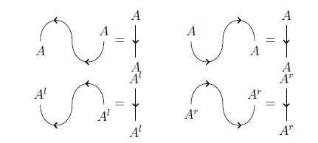
Graphical calculus
Snake identities
$$\left(1_{A}⊗ε^{l}\right)∘\left(η^{l}⊗1_{A}\right)=1_{A}$$
$$\left(ε^{r}⊗1_{A}\right)∘\left(1_{A}⊗η^{r}\right)=1_{A}$$
$$\left(ε^{l}⊗1_{A^{l}}\right)∘\left({1_{A^{l}}⊗η}^{l}\right)=1_{A^{l}}$$
$$\left(1_{A^{r}}⊗ε^{r}\right)∘\left(η^{r}⊗1_{A^{r}}\right)=1_{A^{r}}$$
Swing rule

Slide 14
Compositional Distributional Model
Pregroup grammars (Lambek)
A partially ordered monoid $(P,≤, ⋅,1)$consists of:
a set $P$
a monoid multiplication operator $⋅:P×P→P$ satisfying the condition
$\left(a⋅b\right)⋅c=a⋅(b⋅c)$ for all $a,b,c∈P$
and thу monoidal unit $1∈P$ where for all $a∈P$
$$a⋅1=a=1⋅a$$
a partial order $≤$ on $P$

Slide 15
Pregroup (Lambek, 2001)
A pregroup $(P,≤,⋅,1,{\left(−\right)}^{l},{\left(−\right)}^{r})$ is a partially ordered monoid in which each element $a$ has both a left adjoint $a^{l}$ and a right adjoint $a^{r}$ such that
$a^{l}a≤1≤aa^{l}$ and $aa^{r}≤1≤a^{r}a$
Adjoints have properties:
Uniqueness: Adjoints are unique
Order reversal: If $a≤b$ then $b^{r}≤a^{r}$ and $b^{l}≤a^{l}$
The unit is self adjoint: $1^{l}=1=1^{r}$
Multiplication operation is self adjoint: ${\left(a⋅b\right)}^{l}=b^{l}⋅a^{l}$ and ${\left(a⋅b\right)}^{r}=b^{r}⋅a^{r}$
Opposite adjoints annihilate: ${\left(a^{r}\right)}^{l}=a={\left(a^{l}\right)}^{r}$
Same adjoints iterate: $a^{ll}a^{l}≤1≤a^{rr}a^{r}, a^{lll}a^{ll}≤1≤a^{rrr}a^{rr}, …$

Slide 16
Pregroup grammar
$a→b$ means $a≤b$ ($a$ reduces to $b$)
“John likes Mary”
“John” and “Mary” assigned to type $n$ (noun)
“likes” is assigned to compound type $(n^{r}sn^{l})$
“likes” takes a noun from the left and from the right, and returns a sentence
$$n\left(n^{r}sn^{l}\right)n→1sn^{l}n→1s1→s$$

Slide 17
Basic types
$n$ : noun $s$ : declarative statement
$j$ : infinitive of the verb $g$: glueing type

Slide 18
Pregroups as compact closed categories
$P$ is a concrete instance of a compact closed category
$η^{l}=[1≤p⋅p^{l}]$ $ε^{l}=\left[p^{l}⋅p≤1\right]$
$η^{r}=[1≤p^{r}⋅p]$ $ε^{r}=[p⋅p^{r}≤1]$
Test snake identities:
$$\left(1^{p}⊗ε_{p}^{l}\right)∘\left(η_{p}^{l}⊗1_{p}\right):$$
$$p=1p≤pp^{l}p≤p1=p$$
…

Slide 19
Examples
“John likes Mary”
“John does not like Mary”

Slide 20
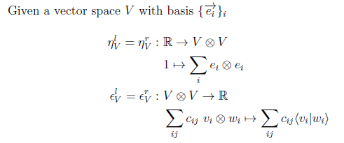
$FVect$- finite dimensional vector space
$FVect$- finite dimensional vector spaces over the base field R together with linear maps, form a monoidal category
FVect as a compact closed category.

Slide 21
$FVect×P$ – categorical representation of meaning space

Slide 22
“From-the-meanings-of-words-to-the-meanings-of-the-sentence” map
Let $v_{1}v_{2}…v_{n}$ be a string of words, each $v_{i}$ with a meaning space representation $\vec{v_{i}}∈(V_{i},p_{i})$. Let $x∈P$ be a pregroup type such that $[p_{1}p_{2}…p_{n}≤x]$. Then the meaning vector for the string is:
$\vec{v_{1}v_{2}…v_{n}}∈(W,x)≡f(v_{1}⊗v_{2}⊗…⊗v_{n})$,
where $f$ is defined to be the application of the compact closure maps obtained from the reduction $[p_{1}p_{2}…p_{n}≤x]$ to the composite vector space $V_{1}⊗V_{2}⊗…⊗V_{n}$.

Slide 23
Example: “John likes Mary”
It has the pregroup type $nn^{r}sn^{l}n$
vector representations $\vec{John},\vec{Mary}∈V$and $\vec{likes}∈V⊗S⊗V$
The morphism in $FVect×P$ corresponding to the map is of type:
$$\left(V⊗\left(V⊗S⊗V\right)⊗V,nn^{r}sn^{l}n\right)→(s,S)$$
From the pregroup reduction$\left[nn^{r}sn^{l}n→s\right]$ we obtain the compact closure maps $ε^{r}1ε^{l}$. In $FVect$this translates into:
$$ε_{V}⊗1_{S}⊗ε_{V}:V⊗\left(V⊗S⊗V\right)⊗V→S$$

Slide 24
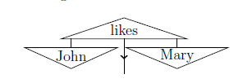
Example: “John likes Mary”
$\vec{John}⊗\vec{likes}⊗\vec{Mary}$

Slide 25
Example

Slide 26
Example

Slide 27
Example

Slide 28
Example

Slide 29
Example

Slide 30
Readings
Esma Balkir. Using Density Matrices in a Compositional Distributional Model of Meaning. // Master thesis. University of Oxford. 2014
Joachim Lambek. Type grammars as pregroups. Grammars, 4(1):21{39, 2001.

