Slide 1
Google landmark recognition
Daniil Fishman
Klim Markelov
Artem Sergeev
Seth Gysmerah
https://www.kaggle.com/c/landmark-recognition-challenge

Slide 2
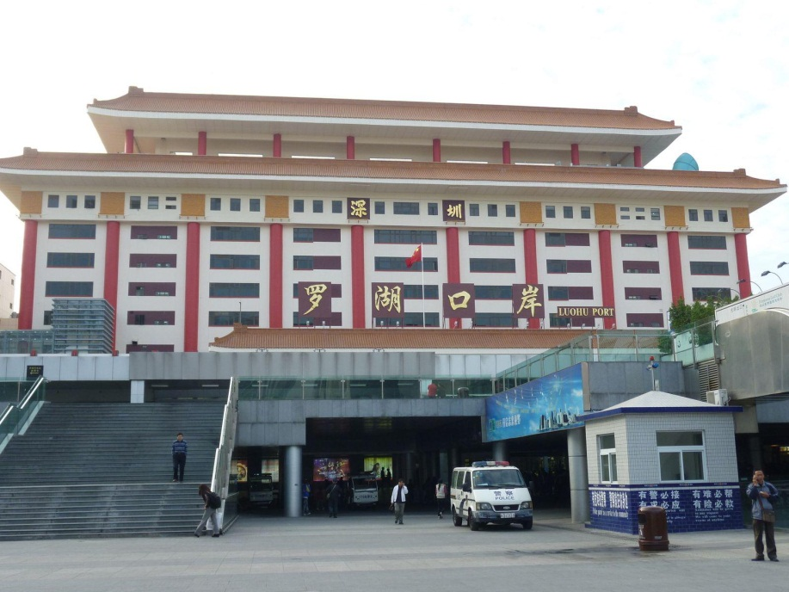
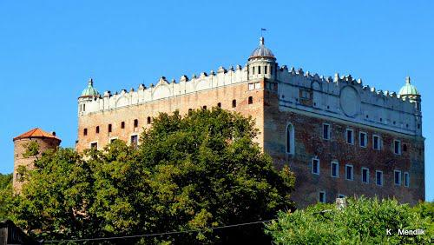
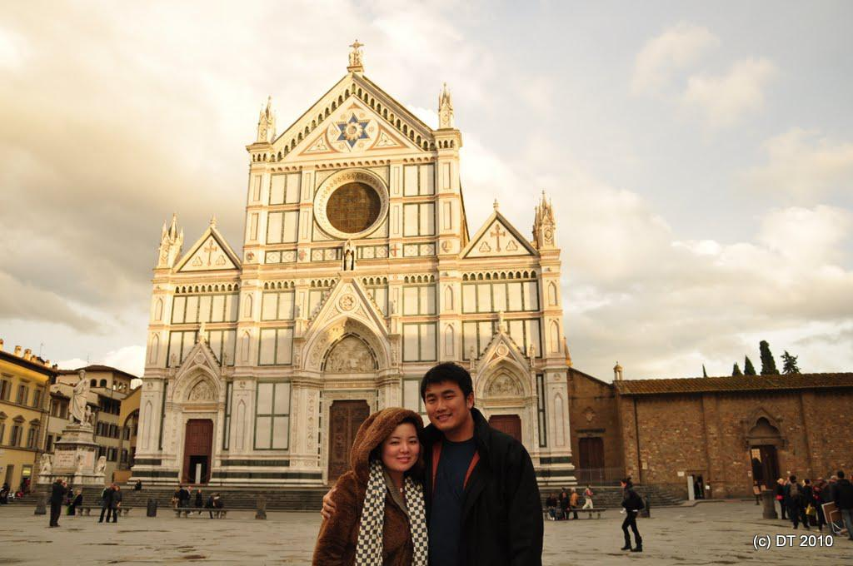
Overview
The main goal of the competition is to predict which landmark is on the foto.

Slide 3
Data description
Data set contains over 300gb of images.
Over 14 000 different landmarks
More then 6000 of them was represented less then 5 examples in dataset
About 1 200 000 different pictures
Test dataset – 25000 pictures

Slide 4
483 teams
2500$ prize money
About 80 days to go
Base line – 0.001

Slide 5
Problems we faced with
Images can have different size
Images can have different quality
Images can have some noise (humans, which hide part of landmark and something like this)
Enormous size of train data set
Lack of experience on working with images

Slide 6
Our approaches
Google convolutional NN (pre-trained NN + trained on our data full-connected layer)
AlexNet
Our convolutional NN (7 convolutional layers, 4 pooling layers + full-connected layer)

Slide 7
16 Gb RAM
4 nucleus
72 hours
500gb physical memory

Slide 8
Raw data
Size of each image – 1000*1000
No filters
Delete every image, that has less than 3 examples in train
Delete every image with size less than 200*200
AlexNet 0.0052
GoogleNet 0.0071
Our NN – 0.0064
Best - GoogleNet – 200 out 483

Slide 10
Data preparation
Apply filters: pre-trained human recognition (keras); Bounders identification (Oxford university); quality improvement (Yandex tutorial)
Sampling rare pictures with Google image search and extracting parts of the pictures
Still about 50 000 of “bad” pictures

Slide 11
Final results
GoogleNet – 0.101
AlexNet – 0.092
Our NN – 0.103 (49 hours)
Best – Our NN: 91—94 out of 483 ( a day to go) (top 20%)

Slide 12
Best result - 0.304
In-money result - 0.289
50-th result – 0.129

