Slide 1
Speech Recognition with Deep Recurrent Neural Networks
Department of Computer Science, University of Toronto
Alex Graves, Abdel-rahman Mohamed, Geoffrey Hinton

Slide 2
Overview
ASR
Background
RNN vs LSTM
CTC
Experimental results

Slide 3
Automatic speech recognition (ASR)
Audio signal -> sequence of words

Slide 4
Background (year 2013)
COMPONENT APPROACH
Feature extraction (MFCC)
MFCC to phonemes (HMM + Gaussian mixtures)
Phonemes to phrases (LM)
Before the study, RNNs were NOT successfully applied to speech data.

Slide 5
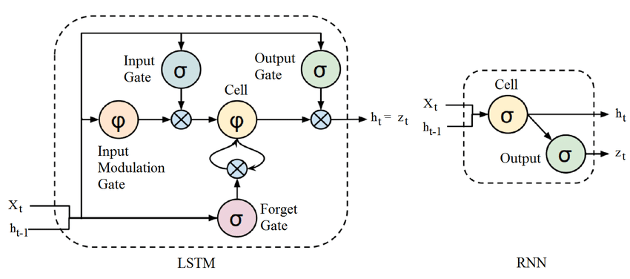
Basic RNN unit
LSTM unit

Slide 6
Connectionist Temporal Classification (CTC)
Objective function, that can be minimised through stochastic gradient descent
CTC calculates joint probability of mapping of some sequence to another sequence

Slide 7
Experimental results

Slide 8
References
Speech Recognition with Deep Recurrent Neural Networks (https://www.cs.toronto.edu/~graves/icassp_2013.pdf)
Recurrent Neural Networks and LSTM (https://towardsdatascience.com/recurrent-neural-networks-and-lstm-4b601dd822a5)
DURP -- Speech recognition with Deep recurrent neural networks by Alex graves (https://www.youtube.com/watch?v=DKCY6KUkuUc)

