Slide 1
Mobile-net
Akilesh sivaswamy

Slide 2
What is mobile-net?
It is an efficient CNN model. But, what is a CNN?
A Convolutional Neural Network is a multi-layered perceptron model.
In contrast to a normal Artificial Neural Network, a CNN accepts a volume as an input instead of a vector.
There exists a kernel “window” or filter which will slide through the entire matrix repeating the same operation.
Mobile-Net is an architecture which is more suitable for mobile and embedded based vision applications where there is lack of compute power. This architecture was proposed by Google.

Slide 3
Calculate output size of layers in the neural network
Input: [10 x 10] image → (4d tensor = [1, 10, 10, 1] batch size, width, height , no of channels)
Filter: [3x3] → (4d tensor = [3, 3, 1, 1] width, height , no of channels, no of filters )
Output:
Zero Padding: same shape as input = [10x10]
Without Zero padding: (VALID mode) = input size – kernel dimension +1 = 10 – 3 +1 = 8 → Size = [8x8]
Strides are the number of pixels kernels should be moved by. E.g. [1, 1, 1,1]

Slide 4
CNN model map

Slide 5
Separable convolutions
Normal
Spatial
Depth-wise (Mobile-Net)

Slide 6
Normal convolution
If we have a 3x3 kernel, then we have one convolution with nine calculations or multiplications.
A typical image, however, is not 2-D; it also has depth as well as width and height. Let us assume that we have an input image of 12x12x3 pixels, an RGB image of size 12x12.
Let’s consider a 5x5 convolution on the image with no padding and a stride of 1. If we only consider the width and height of the image, the convolution process is kind of like this: 12x12 — (5x5) — >8x8. The 5x5 kernel undergoes scalar multiplication with every 25 pixels, giving out1 number every time. We end up with a 8x8 pixel image, since there is no padding (12–5+1 = 8).
However, because the image has 3 channels, our convolutional kernel needs to have 3 channels as well. This means, instead of doing 5x5=25 multiplications, we actually do 5x5x3=75 multiplications every time the kernel moves.

Slide 9
Spatial separable convolutions
A spatial separable convolution simply divides a kernel into two, smaller kernels. The most common case would be to divide a 3x3 kernel into a 3x1 and 1x3 kernel

Slide 10
What is the use?
Now, instead of doing one convolution with 9 multiplications, we do two convolutions with 3 multiplications each (6 in total) to achieve the same effect. With less multiplications, computational complexity goes down, and the network is able to run faster.

Slide 12
Sobel kernel (popular example)

Slide 13
Depth wise separable convolutions (mobile-Net)
A depth wise separable convolution separates the normal convolution process into 2 parts: a depth wise convolution and a pointwise convolution.
In the first part, depth wise convolution, we give the input image a convolution without changing the depth. We do so by using 3 kernels of shape 5x5x1.
Each 5x5x1 kernel iterates 1 channel of the image
This is the type of separable convolution seen in keras.layers.SeparableConv2D or tf.layers.separable_conv2d.

Slide 15
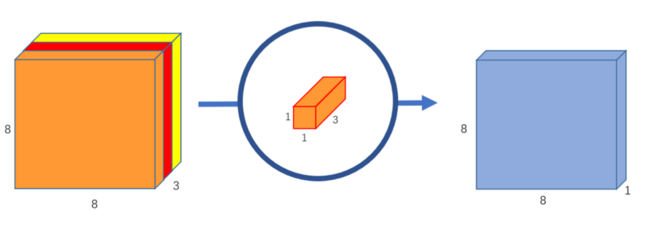
The pointwise convolution is so named because it uses a 1x1 kernel, or a kernel that iterates through every single point. This kernel has a depth of however many channels the input image has; in our case, 3. Therefore, we iterate a 1x1x3 kernel through our 8x8x3 image, to get a 8x8x1 image.
We can create 256 1x1x3 kernels that output a 8x8x1 image each to get a final image of shape 8x8x256.

Slide 16
What is the use?
Original convolution: There are 256 5x5x3 kernels that move 8x8 times. That’s 256x3x5x5x8x8=1,228,800 multiplications.
In the depth wise convolution, we have 3 5x5x1 kernels that move 8x8 times. That’s 3x5x5x8x8 = 4,800 multiplications.
In the pointwise convolution, we have 256 1x1x3 kernels that move 8x8 times. That’s 256x1x1x3x8x8=49,152 multiplications.
Adding them up together, that’s 53,952 multiplications.

Slide 17
Mobile-net map
It is noted that Batch Normalization (BN) and ReLU are applied after each convolution.

Slide 18
Some types
MobileNet (Separable Conv)
Mobile-Net [1] is a stack of the separable convolution modules which are composed of depth wise conv and conv1x1 (pointwise conv).
MobileNet-v2
MobileNet-v2 [2] utilizes a module architecture similar to the residual unit with bottleneck architecture of ResNet; the modified version of the residual unit where conv3x3 is replaced by depth wise convolution.

Slide 19
Results
This architecture uses depth wise separable convolutions which significantly reduces the number of parameters when compared to the network with normal convolutions with the same depth in the networks. This results in light weight deep neural networks.
By using depth wise separable convolutions, there is some sacrifice of accuracy for low complexity deep neural network.

Slide 20
Results
When 1.0 MobileNet-224 is used, it outperforms GoogLeNet (Winner of ILSVRC 2014) and VGG Net (1st Runner Up of ILSVRC 2014)

Slide 21
applications

Slide 22
References
[1] A. G. Howard, M. Zhu, B. Chen, D. Kalenichenko, W. Wang, T. Weyand, M. Andreetto, and H. Adam, “Mobilenets: Efficient Convolutional Neural Networks for Mobile Vision Applications,” in arXiv:1704.04861, 2017.
[2] M. Sandler, A. Howard, M. Zhu, A. Zhmoginov, and L. Chen, “MobileNetV2: Inverted Residuals and Linear Bottlenecks,” in arXiv:1801.04381v3, 2018.

