Slide 1
Determination of grammatical categories using machine learning algorithms
Student: Tussupova M.
Scientific advisor: Murzin F.

Slide 2
Tasks
Testing machine learning algorithms for solving problems of determining parts of speech;
Development of an algorithm based on machine learning for syntax detection for filling up Link Grammar Parser dictionaries

Slide 3
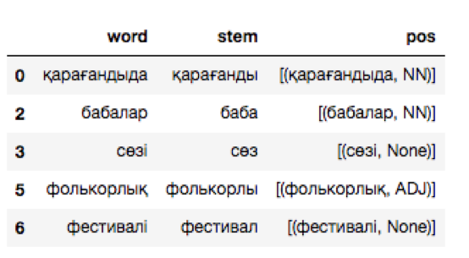
POS-determination for kazakh language

Slide 4
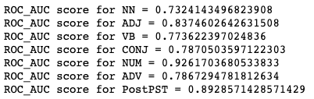
Logistic regression

Slide 5
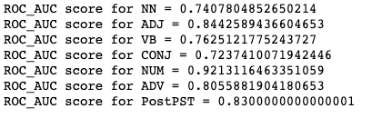
SVM

Slide 6
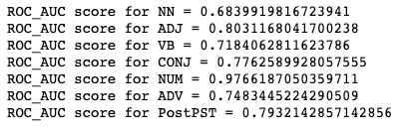
Random Forest

Slide 7
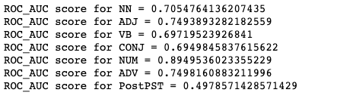
Decision Tree

Slide 8
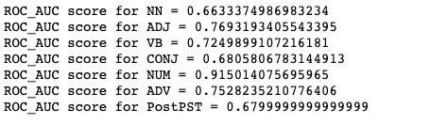
k-nearest neighbors

Slide 9
Results for Kazakh language
Best algorithm for:
NN is SVM
ADJ is SVM
VB is SVM
CONJ is Logistic Regression
NUM is Random Forest
ADV is SVM
PostPST is Logistic Regression

Slide 10
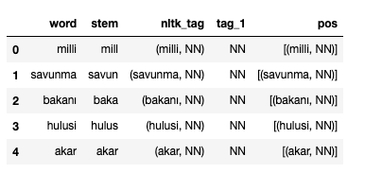
POS-determination for turkish language

Slide 11

Logistic Regression

Slide 12

SVM

Slide 13

Random Forest

Slide 14

Decision Tree

Slide 15
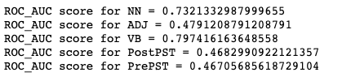
k-nearest neighbors

Slide 16
Results for Turkish language
Best algorithm for:
NN is Logistic Regression
ADJ is Decision Tree
VB is Logistic Regression
PostPST is Random Forest
PrePST is Logistic Regression

Slide 17
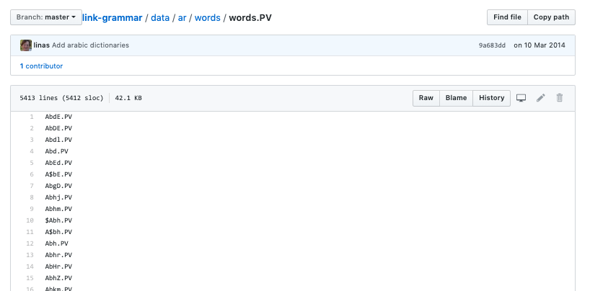
Filling up Link Grammar Parser dictionaries

Slide 18
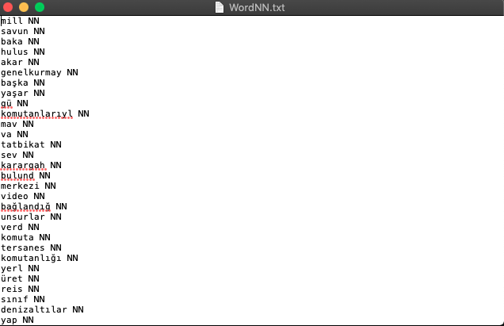
Filling up Link Grammar Parser dictionaries

Slide 19
Results:
Grammatical categories of kazakh and turkish languages were predicted using machine learning algorithms
Research was tested on CiTech2018

Slide 20
Продолжение данной работы
Extend dictionaries
Make predictions better

