Slide 1
Machine Learning in Photonics
Alexey Kokhanovskiy
alexey.kokhanovskiy@gmail.com
Laboratory of Non-linear Photonics
Notes:
Hello everyone! My name is Evgeny. And today I am going to tell you about Machine learning based characterisation of dissipative solitons.

Slide 2
OUTLINE
Applications
Lasers
Optical Computers
Telecommunications
Notes:
According to the radio spectrum data from the DFT pulsed laser mode, it is possible to implement a mode classifier with an accuracy of 97.14% and predict the duration, power and width of a pulse with an accuracy of 97.80%, 99.22% and 98.25%, respectively.
The use of peaks of the radio frequency spectrum from the DFT pulsed laser radiation as features for machine learning problems led to a high accuracy of the classical algorithms. The best result is shown by the ultra-random tree algorithm.
A feedback system for a mode-locked laser can be implemented using only a radio frequency spectrometer and a long fiber with a high dispersion.

Slide 3
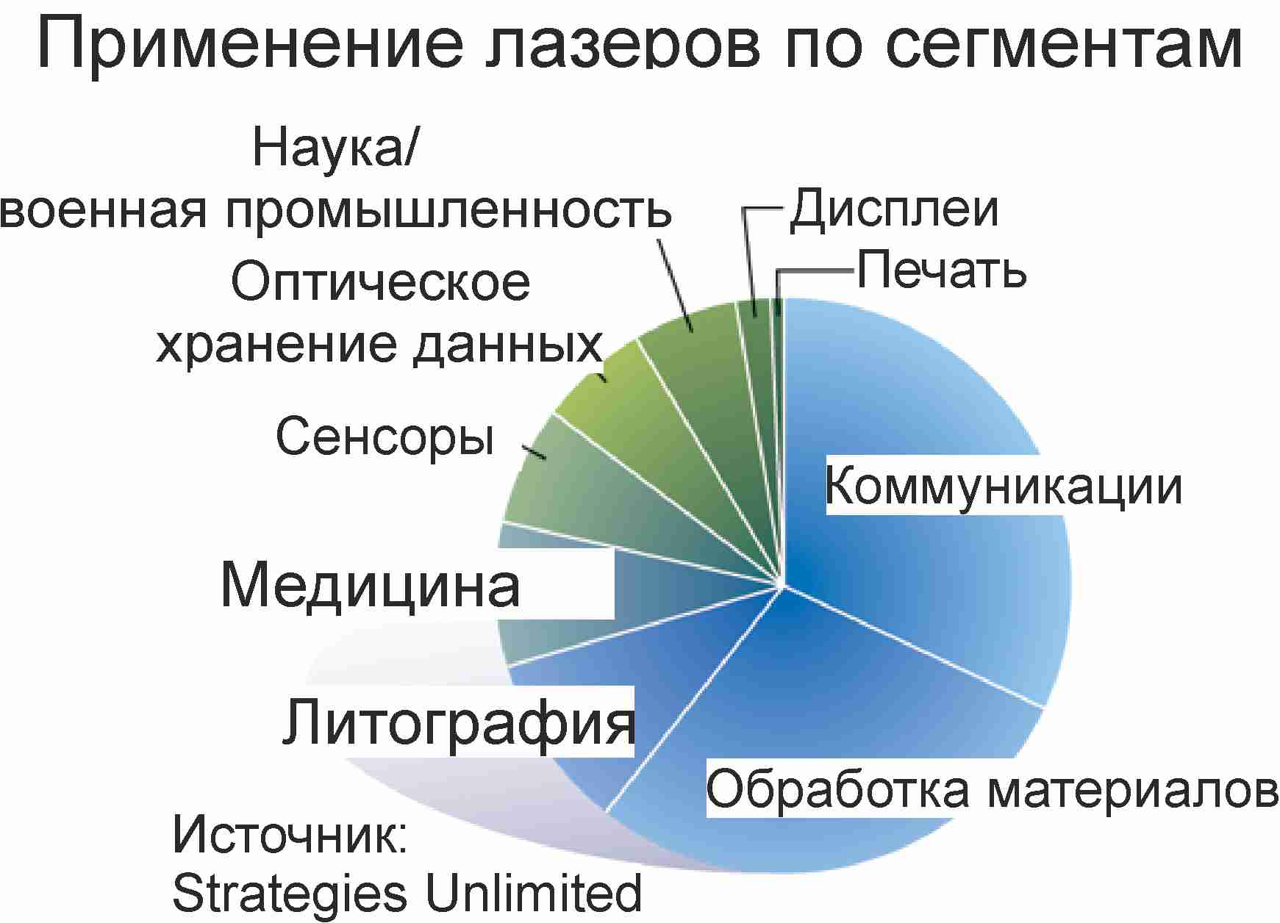
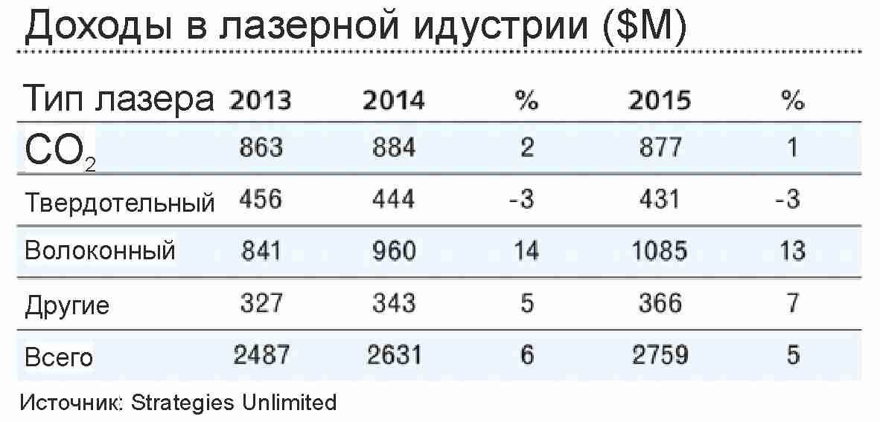
Fiber lasers
Notes:
In the experiment, we used fiber figure of eight (F-8) laser with two amplifiers in a resonator. Changing the pump currents of the diodes from 1 to 8 amperes, we received different modes. In the first stage, we used an autocorrelator, oscilloscopes, a spectrometer and a radiofrequency spectrometer to collect a large database of modes.
Next, we trained models to predict the characteristics of a laser pulse mode. And after training, these models can be used to characterize the mode using only a radio frequency spectrum analyzer. (As shown in the bottom picture)

Slide 4
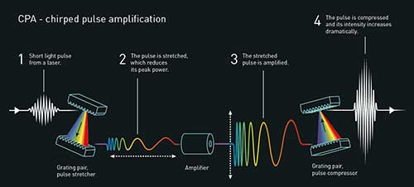
Recent Novel Price in Physics
Notes:
In the experiment, we used fiber figure of eight (F-8) laser with two amplifiers in a resonator. Changing the pump currents of the diodes from 1 to 8 amperes, we received different modes. In the first stage, we used an autocorrelator, oscilloscopes, a spectrometer and a radiofrequency spectrometer to collect a large database of modes.
Next, we trained models to predict the characteristics of a laser pulse mode. And after training, these models can be used to characterize the mode using only a radio frequency spectrum analyzer. (As shown in the bottom picture)

Slide 5
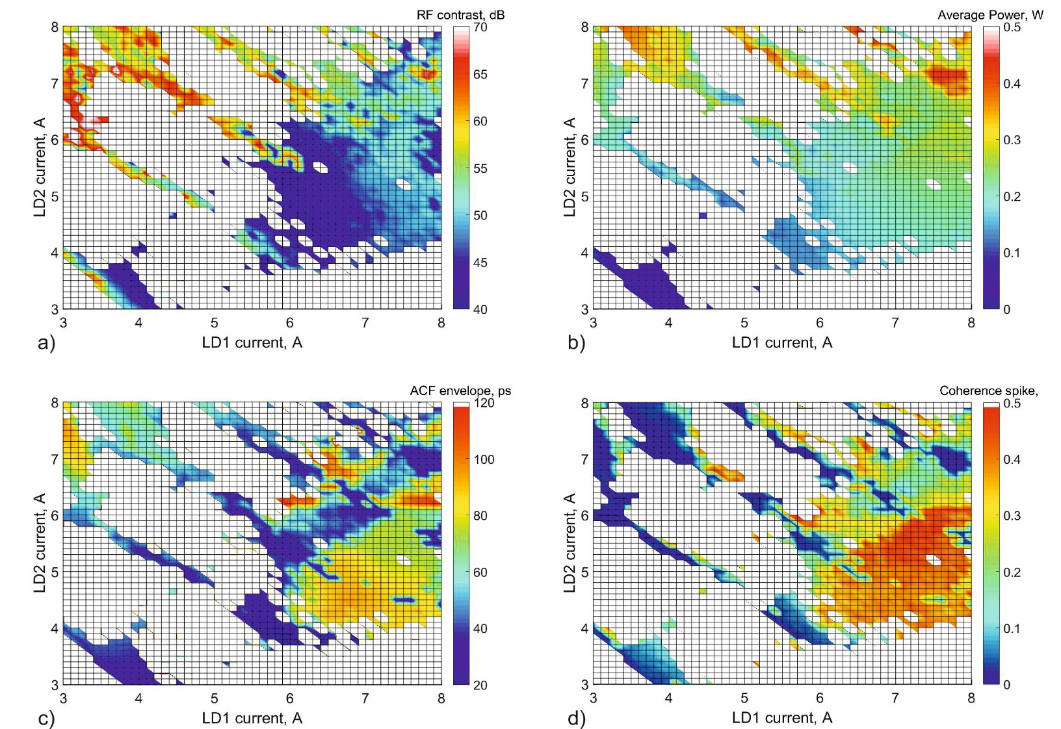
Map of possible pulsed regimes
Radio-frequency
contrast
Average power
Duration of ACF
envelope
High of coherence
spike
Notes:
In the experiment, we used fiber figure of eight (F-8) laser with two amplifiers in a resonator. Changing the pump currents of the diodes from 1 to 8 amperes, we received different modes. In the first stage, we used an autocorrelator, oscilloscopes, a spectrometer and a radiofrequency spectrometer to collect a large database of modes.
Next, we trained models to predict the characteristics of a laser pulse mode. And after training, these models can be used to characterize the mode using only a radio frequency spectrum analyzer. (As shown in the bottom picture)

Slide 6
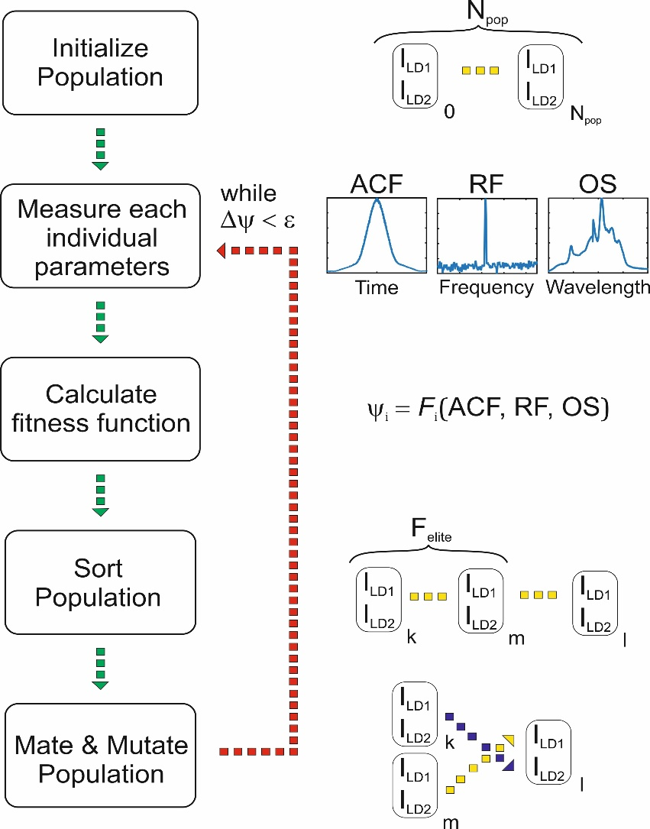
Scheme of evolutionary algorithm
Notes:
In the experiment, we used fiber figure of eight (F-8) laser with two amplifiers in a resonator. Changing the pump currents of the diodes from 1 to 8 amperes, we received different modes. In the first stage, we used an autocorrelator, oscilloscopes, a spectrometer and a radiofrequency spectrometer to collect a large database of modes.
Next, we trained models to predict the characteristics of a laser pulse mode. And after training, these models can be used to characterize the mode using only a radio frequency spectrum analyzer. (As shown in the bottom picture)

Slide 7
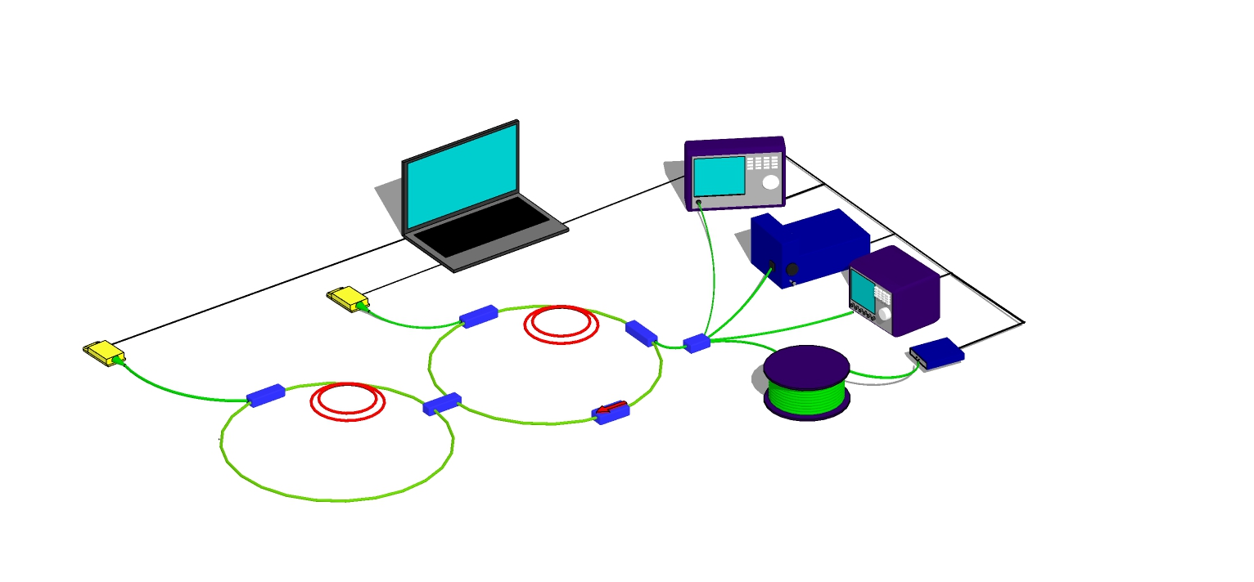
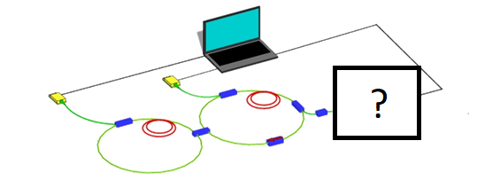
Feed back Issue
Experiment
Optical spectrum
analyser
Controlling
PC
Measurement tools:
Optical spectrum analyser
Autocorrelator
Oscilloscope
Radio-frequency spectrum analyser
Autocorrelator
Pump diode
Output
coupler
Oscilloscope
Pump diode
Combiner
Combiner
Active fiber
Radio-frequency
spectrum analyzer
Active fiber
Fiber spool
ML for pulse characterization
Is it possible to replace all measuring devices by only one?
Notes:
In the experiment, we used fiber figure of eight (F-8) laser with two amplifiers in a resonator. Changing the pump currents of the diodes from 1 to 8 amperes, we received different modes. In the first stage, we used an autocorrelator, oscilloscopes, a spectrometer and a radiofrequency spectrometer to collect a large database of modes.
Next, we trained models to predict the characteristics of a laser pulse mode. And after training, these models can be used to characterize the mode using only a radio frequency spectrum analyzer. (As shown in the bottom picture)

Slide 8
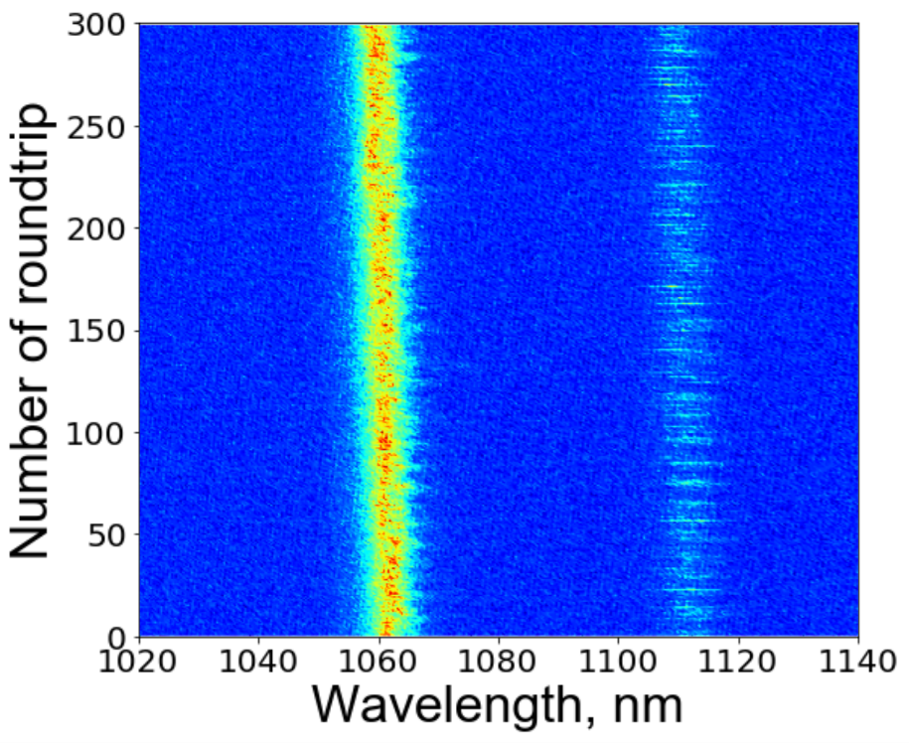
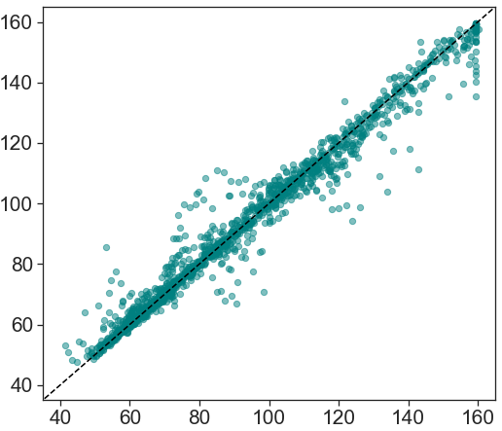
Regression tasks
Scheme of algorithm
Dispersive Fourier transformed pulse trace
DFT
Classifier
Not single pulses or unstable regime
Regressors
∆T E ∆λ
∆T
Predicted time duration, ps
Measured time duration, ps
Notes:
In this slide, you can see the results of the work of the trained models for the problem of classification and regression. Since the sample was not balanced, so for the classification problem we also considered measures such as precision, recall and f1-score. We also tried to classify not only into 2 classes, but also into many. Where classes determine the number of pulses in the mode. The results you can see on the slide. On the right side of the slides you can see the results of the algorithms for solving regression problems.

Slide 9
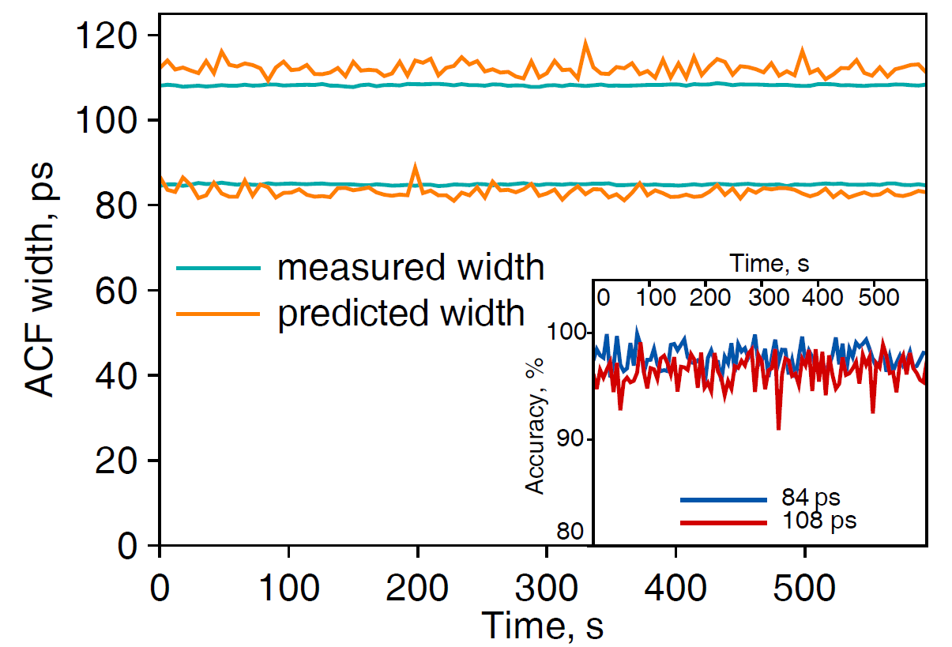
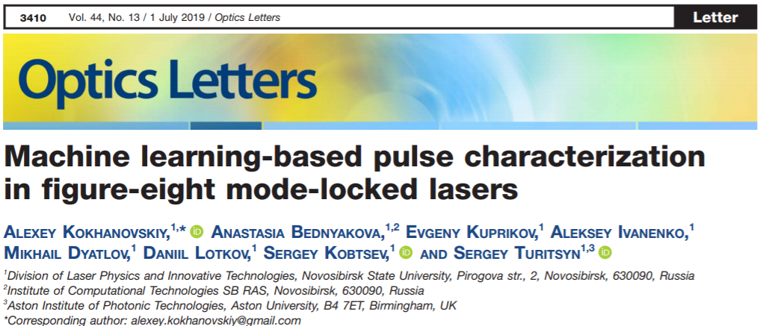
Prediction of a pulse duration in time
Notes:
To test the performance of the models we used, we built learning curves. On the y-axis, accuracy is answered, and on the x-axis, the size of the training set. You can see that only 1000 examples are required for good performance. We also determined the required number of peaks for the algorithms to work well. Results you can see on the screen.
We also tested other machine learning models for these tasks. For testing, we use 5-folds cross validation. As features we use the first 40 peaks.

Slide 10
Tasks for ML in lasers
Experimental
Self-controlling “smart laser”
Developing feed back system based on ML algorithm
Numerical
1) Optimization of laser cavity design
Notes:
In the experiment, we used fiber figure of eight (F-8) laser with two amplifiers in a resonator. Changing the pump currents of the diodes from 1 to 8 amperes, we received different modes. In the first stage, we used an autocorrelator, oscilloscopes, a spectrometer and a radiofrequency spectrometer to collect a large database of modes.
Next, we trained models to predict the characteristics of a laser pulse mode. And after training, these models can be used to characterize the mode using only a radio frequency spectrum analyzer. (As shown in the bottom picture)

Slide 11
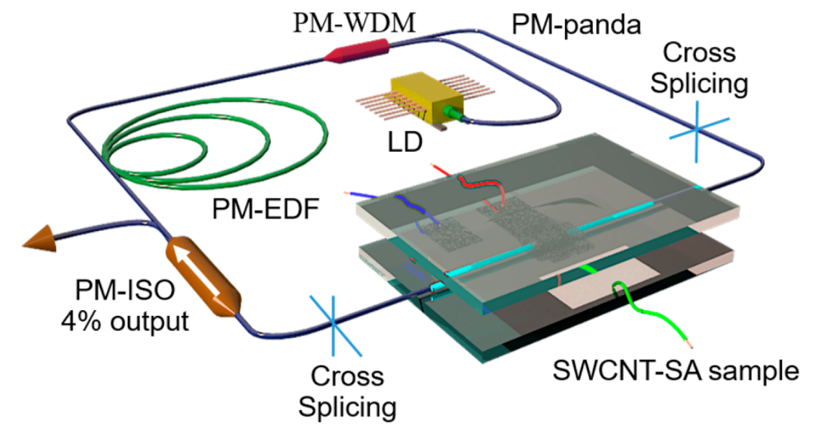
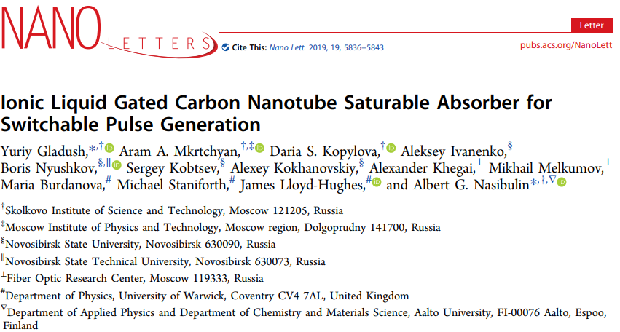
Recent achievement: Fiber laser based on nanotubes
Impact factor > 12
Notes:
In the experiment, we used fiber figure of eight (F-8) laser with two amplifiers in a resonator. Changing the pump currents of the diodes from 1 to 8 amperes, we received different modes. In the first stage, we used an autocorrelator, oscilloscopes, a spectrometer and a radiofrequency spectrometer to collect a large database of modes.
Next, we trained models to predict the characteristics of a laser pulse mode. And after training, these models can be used to characterize the mode using only a radio frequency spectrum analyzer. (As shown in the bottom picture)

Slide 12
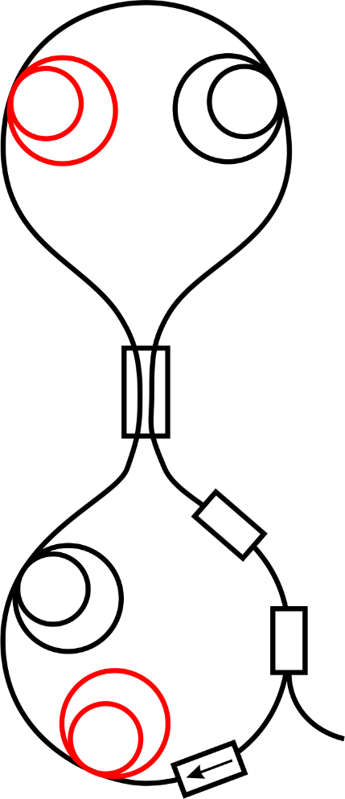
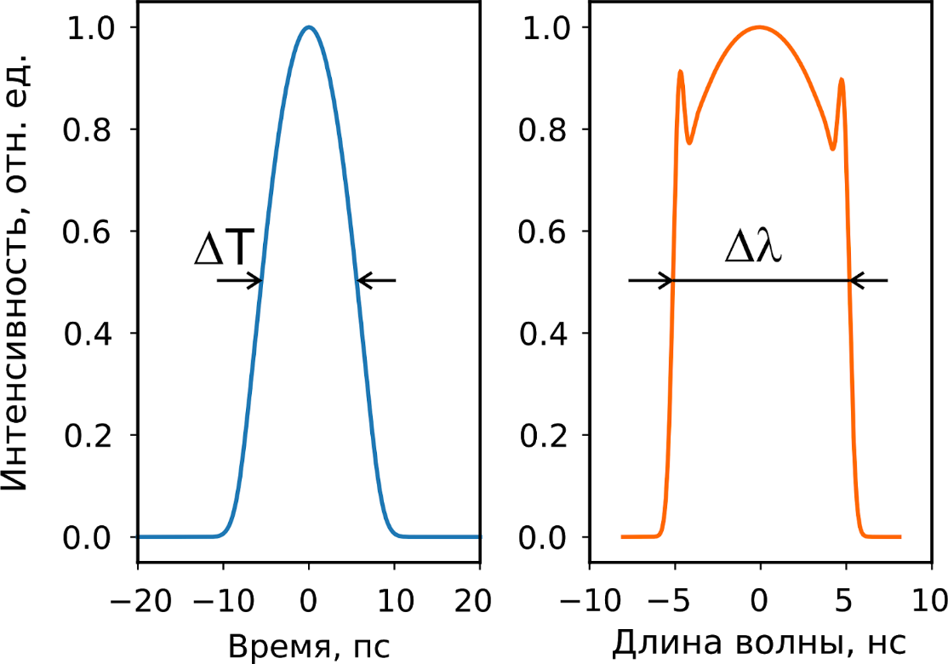
Fiber laser modeling
L active
Gain coefficient
L passive
Coupler ratio
Filter bandwidth
L passive
Coupler ratio
L active
Gain coefficient
Intensity, a.u.
Time, ps
Wavelength, nm
Notes:
In the experiment, we used fiber figure of eight (F-8) laser with two amplifiers in a resonator. Changing the pump currents of the diodes from 1 to 8 amperes, we received different modes. In the first stage, we used an autocorrelator, oscilloscopes, a spectrometer and a radiofrequency spectrometer to collect a large database of modes.
Next, we trained models to predict the characteristics of a laser pulse mode. And after training, these models can be used to characterize the mode using only a radio frequency spectrum analyzer. (As shown in the bottom picture)

Slide 13
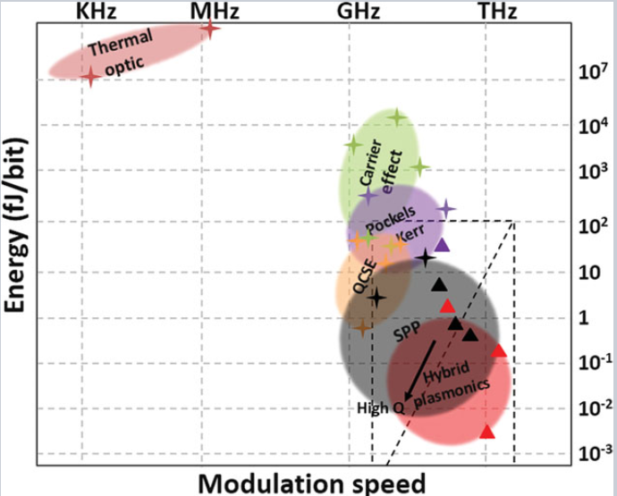
Optical computing
Modern artificial neural networks are simulated by devices based on Von Neumann architecture.
Semiconductor technology approaching to the limits.
Photonics may provide another approach in calculations due to intrinsic parallelism and nonlinearity
Notes:
In the experiment, we used fiber figure of eight (F-8) laser with two amplifiers in a resonator. Changing the pump currents of the diodes from 1 to 8 amperes, we received different modes. In the first stage, we used an autocorrelator, oscilloscopes, a spectrometer and a radiofrequency spectrometer to collect a large database of modes.
Next, we trained models to predict the characteristics of a laser pulse mode. And after training, these models can be used to characterize the mode using only a radio frequency spectrum analyzer. (As shown in the bottom picture)

Slide 14
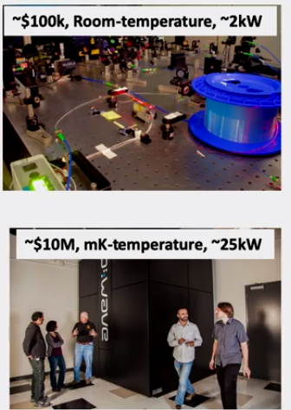
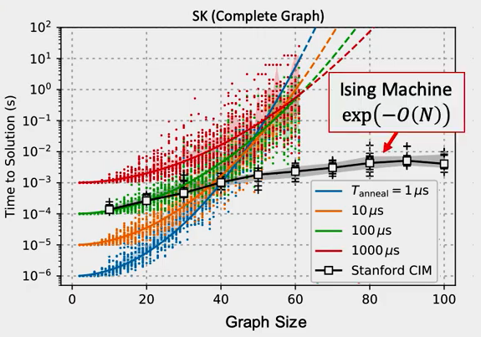
Optical computing advantages
Ising Machines: Non-Von Neumann Computing with Nonlinear Optics - Alireza Marandi - 6/7/2019
Notes:
In the experiment, we used fiber figure of eight (F-8) laser with two amplifiers in a resonator. Changing the pump currents of the diodes from 1 to 8 amperes, we received different modes. In the first stage, we used an autocorrelator, oscilloscopes, a spectrometer and a radiofrequency spectrometer to collect a large database of modes.
Next, we trained models to predict the characteristics of a laser pulse mode. And after training, these models can be used to characterize the mode using only a radio frequency spectrum analyzer. (As shown in the bottom picture)

Slide 15
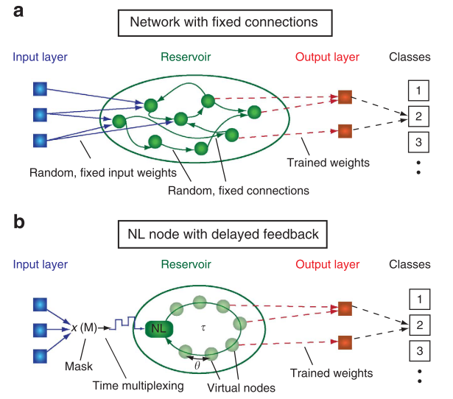
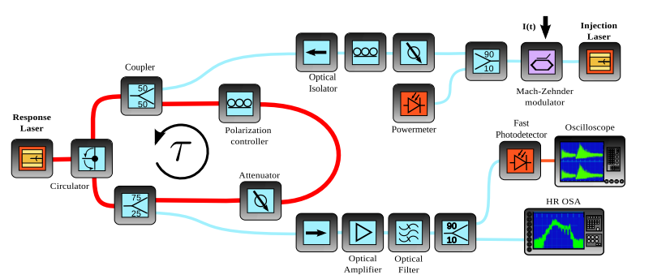
Reservoir computing
Notes:
In the experiment, we used fiber figure of eight (F-8) laser with two amplifiers in a resonator. Changing the pump currents of the diodes from 1 to 8 amperes, we received different modes. In the first stage, we used an autocorrelator, oscilloscopes, a spectrometer and a radiofrequency spectrometer to collect a large database of modes.
Next, we trained models to predict the characteristics of a laser pulse mode. And after training, these models can be used to characterize the mode using only a radio frequency spectrum analyzer. (As shown in the bottom picture)

Slide 16
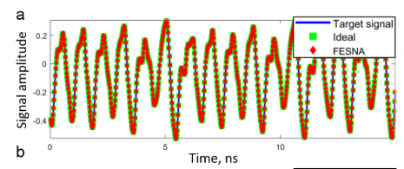
Reservoir computing: Prediction of time sequence
Mackey-Glass equation
Notes:
In the experiment, we used fiber figure of eight (F-8) laser with two amplifiers in a resonator. Changing the pump currents of the diodes from 1 to 8 amperes, we received different modes. In the first stage, we used an autocorrelator, oscilloscopes, a spectrometer and a radiofrequency spectrometer to collect a large database of modes.
Next, we trained models to predict the characteristics of a laser pulse mode. And after training, these models can be used to characterize the mode using only a radio frequency spectrum analyzer. (As shown in the bottom picture)

Slide 17
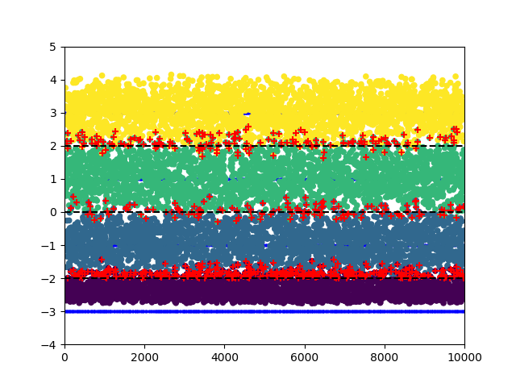
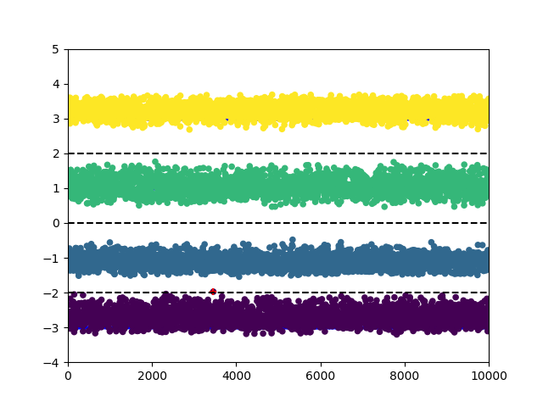
Reservoir computing: Channel equalization
4 – Pulse amplitude modulation
Notes:
In the experiment, we used fiber figure of eight (F-8) laser with two amplifiers in a resonator. Changing the pump currents of the diodes from 1 to 8 amperes, we received different modes. In the first stage, we used an autocorrelator, oscilloscopes, a spectrometer and a radiofrequency spectrometer to collect a large database of modes.
Next, we trained models to predict the characteristics of a laser pulse mode. And after training, these models can be used to characterize the mode using only a radio frequency spectrum analyzer. (As shown in the bottom picture)

Slide 18
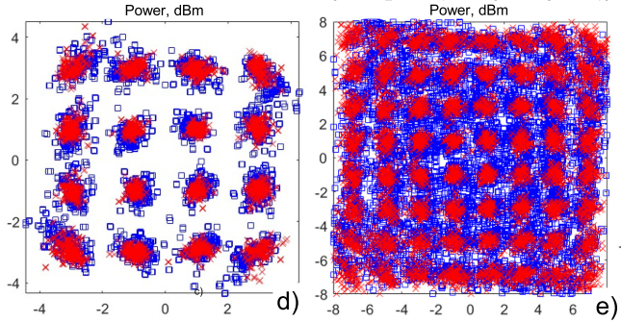
Telecommunication Task
Optical signal propagating through telecommunication line is distorted by linear and nonlinear effects.
This leads to increasing Bit Error Rate
Quadrature amplitude modulation
Notes:
In the experiment, we used fiber figure of eight (F-8) laser with two amplifiers in a resonator. Changing the pump currents of the diodes from 1 to 8 amperes, we received different modes. In the first stage, we used an autocorrelator, oscilloscopes, a spectrometer and a radiofrequency spectrometer to collect a large database of modes.
Next, we trained models to predict the characteristics of a laser pulse mode. And after training, these models can be used to characterize the mode using only a radio frequency spectrum analyzer. (As shown in the bottom picture)

Slide 19
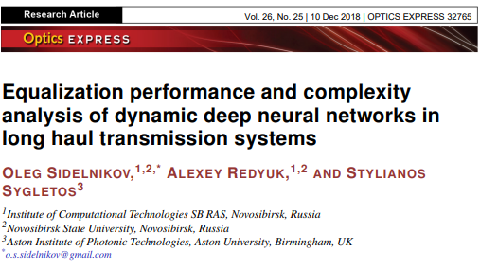
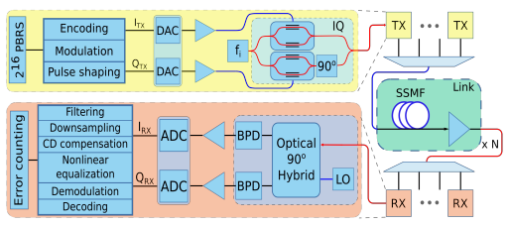
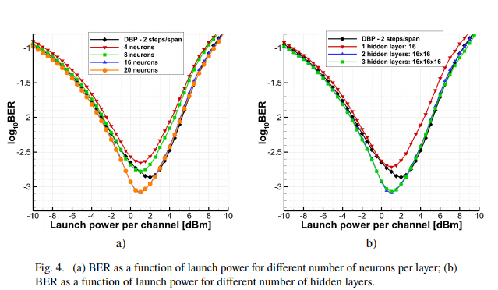
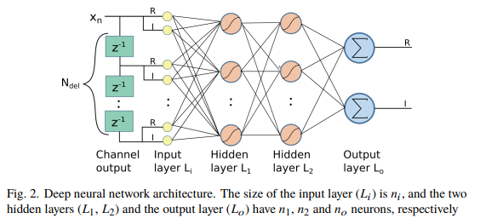
Decreasing Bit Error Rate in
Notes:
In the experiment, we used fiber figure of eight (F-8) laser with two amplifiers in a resonator. Changing the pump currents of the diodes from 1 to 8 amperes, we received different modes. In the first stage, we used an autocorrelator, oscilloscopes, a spectrometer and a radiofrequency spectrometer to collect a large database of modes.
Next, we trained models to predict the characteristics of a laser pulse mode. And after training, these models can be used to characterize the mode using only a radio frequency spectrum analyzer. (As shown in the bottom picture)

Slide 20
Thank you for your attention!
Notes:
According to the radio spectrum data from the DFT pulsed laser mode, it is possible to implement a mode classifier with an accuracy of 97.14% and predict the duration, power and width of a pulse with an accuracy of 97.80%, 99.22% and 98.25%, respectively.
The use of peaks of the radio frequency spectrum from the DFT pulsed laser radiation as features for machine learning problems led to a high accuracy of the classical algorithms. The best result is shown by the ultra-random tree algorithm.
A feedback system for a mode-locked laser can be implemented using only a radio frequency spectrometer and a long fiber with a high dispersion.

