Slide 1
Understanding Consumer Behavior with Recurrent Neural Networks
Tobias Lang, Matthias Rettenmeier
Zalando adtech lab GmbH, Hamburg, Germany

Slide 2
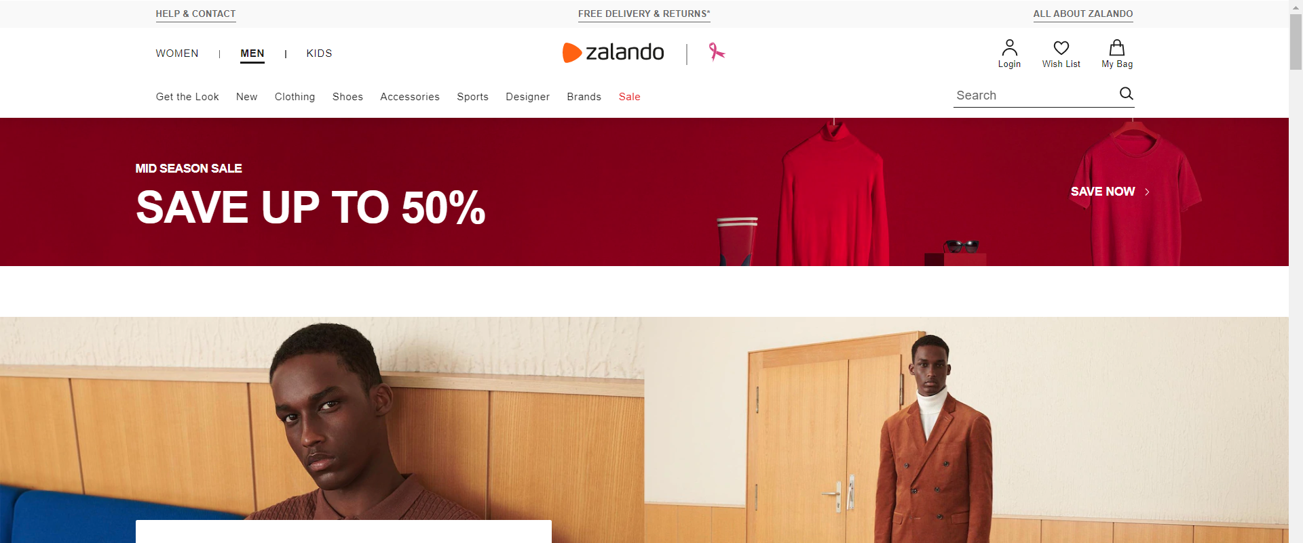
Researcher’s objectives
Demonstrate how well RNNs with LSTM predict probabilities of consumer order without applying complex feature engineering
Show empirical results of how RNNs are more superior than vector-based methods such as Logistic regression
The experiment bases on data of Zalando (www.zalando.com), European online fashion platform

Slide 3
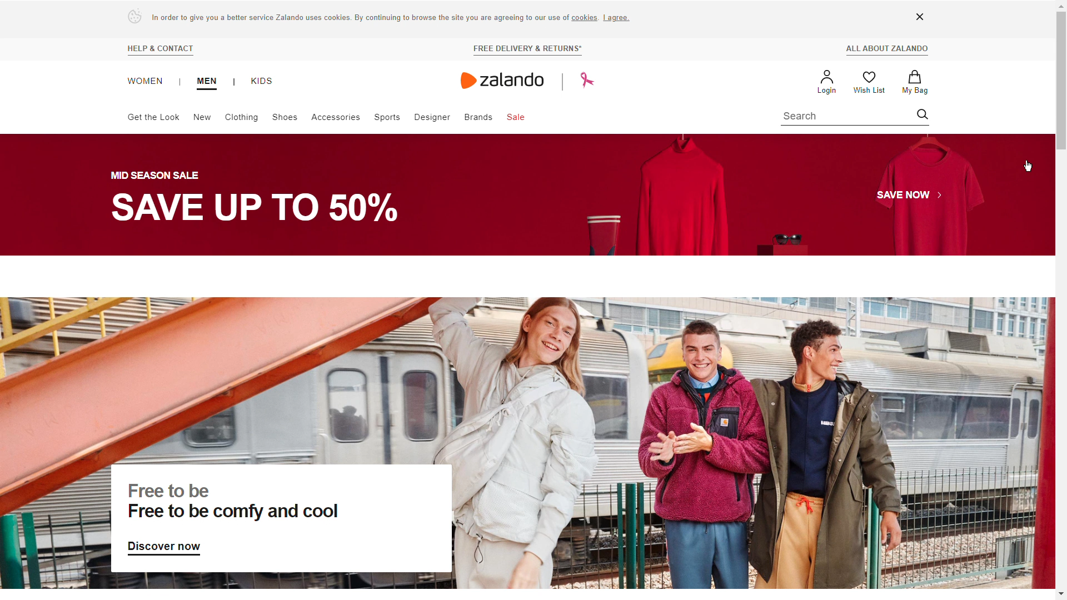
Definitions of consumer behavior regarding to this research
Sequences of consumer’s interactions with web-shop. For example,
Product view – products that consumers observe
Cart addition – amount of product in shopping basket

Slide 4
Predicting future consumer behavior
Each consumer interaction contains essential historical information
Consumer characteristics – age, genders
Product details – luxury brands, generic brands
Timestamp – viewing products, surfing a web-shop, session journey
Historical information is acquired and processed by machine learning methods
Vector-based models – logistic regression, neural networks, or random forests
Recurrent neural networks (RNNs) with long short-term memory cells (LSTMs)
Applications
Recommender system
Appropriate product recommendations
Web-shop contents

Slide 5
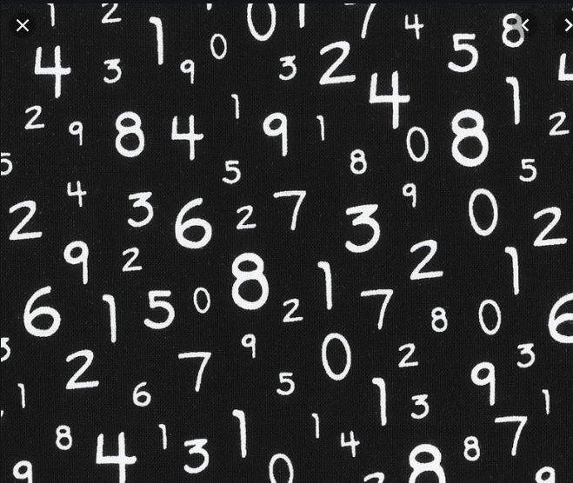
Logistic regression - Why did the researchers say it was inefficient?
Meaningful features require domain knowledge and feature engineering to enhance model performance
Artificially increase dimension of the input vectors
Establish strong correlations among binary variables
Consequences are the followings
Difficulty in explaining which consumer’s historical action patterns had significant impacts on the predicted outcomes
Time-consuming and tiresome task for human
Product view | = 0
 | = 1
 | ∈ [2,…,5]
 | ∈ [6,…,10]
 | ∈ [11,…,50]
Last session | < 1 hour ago
 | 1-24 hours ago
 | 2-7 days ago
 | 8-30 days ago
 | > 8-30 days ago

Slide 6
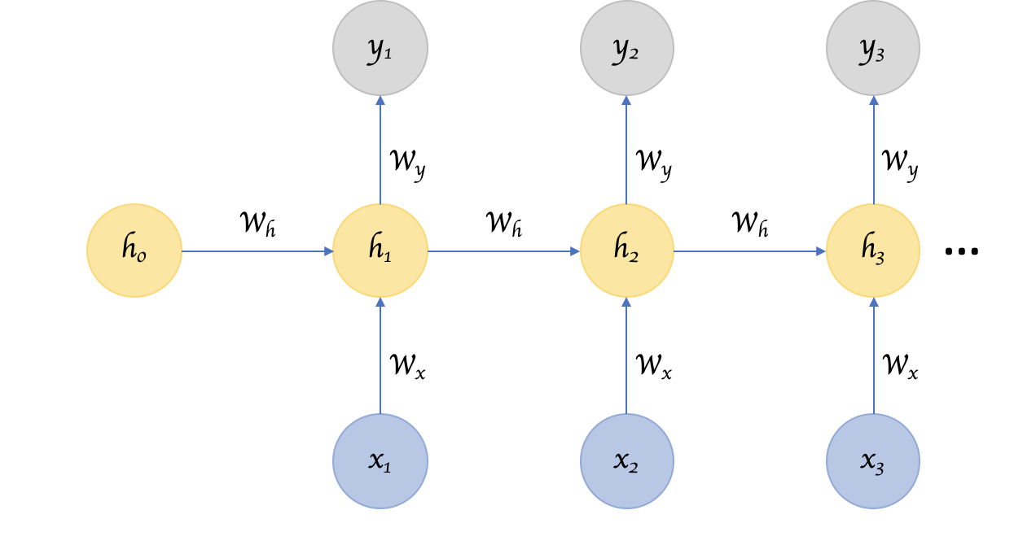
Recurrent Neural Networks (RNNs)
h_{t} is called a hidden state which works similarly to human memory
W_{h} W_{x} W_{y} determine how much importance according to both the present input and the past hidden state
Source: https://towardsdatascience.com/recurrent-neural-networks-d4642c9bc7ce
h_{t} | = | tanh(W_{h}h_{t-1} + W_{x}x_{t})
y_{t} | = | W_{y}h_{t}
Vanilla Recurrent Neural Network

Slide 7
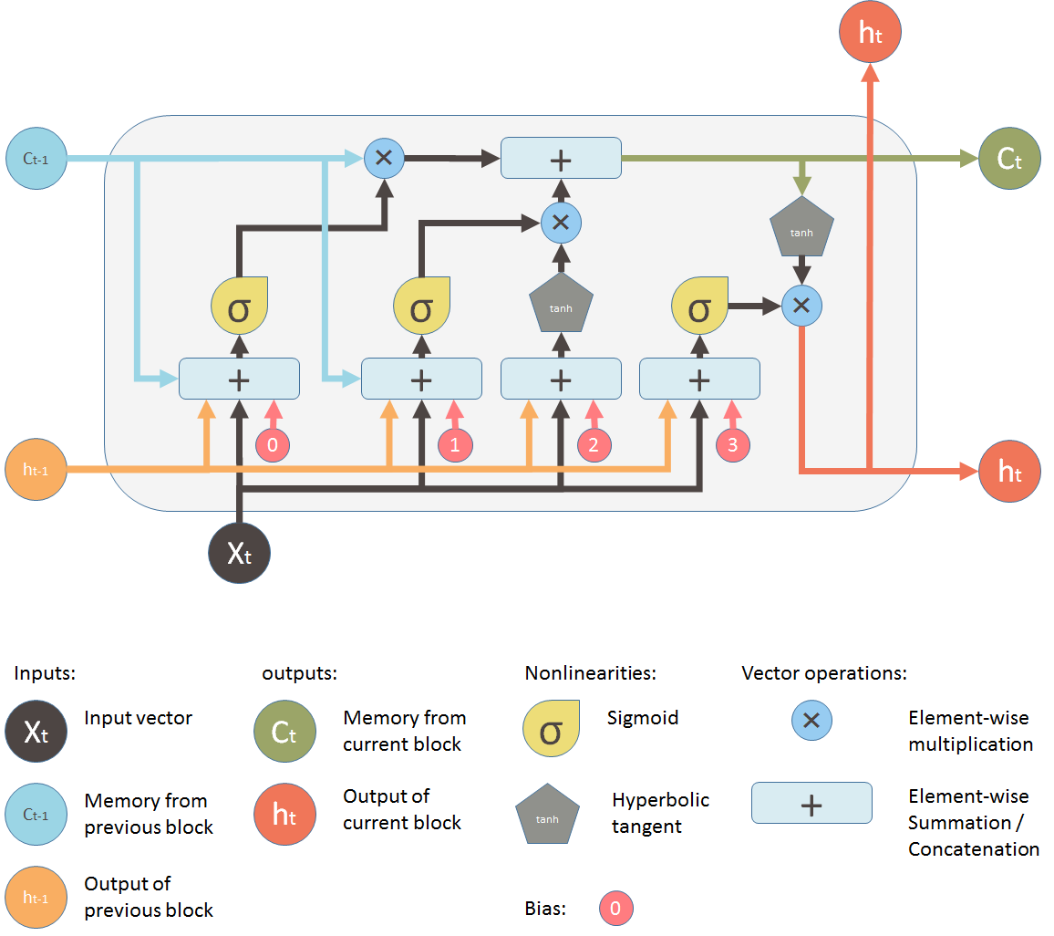
Recurrent Neural Networks (RNNs) - with LSTMs
Source: https://medium.com/mlreview/understanding-lstm-and-its-diagrams-37e2f46f1714

Slide 8
Visualize functions in RNNs with LSTMs
h_{t-1}
forget gate
f_{t} = | σ(W_{f}[h_{t-1},x_{t}] + b_{f})
h_{t-1}
input gate
i_{t} = | σ(W_{i}[h_{t-1},x_{t}] + b_{i})
C_{t-1}
Input x_{t}
C_{t} = | f_{t}C_{t-1} + i_{t}Ĉ_{t}
h_{t} = | o_{t}tanh(C_{t})
Output y_{t}
Ĉ_{t} = | tanh(W_{c}[h_{t-1},x_{t}] + b_{c})
output gate
h_{t-1}
o_{t} = | σ(W_{o}[h_{t-1},x_{t}] + b_{o})
h_{t-1}

Slide 9
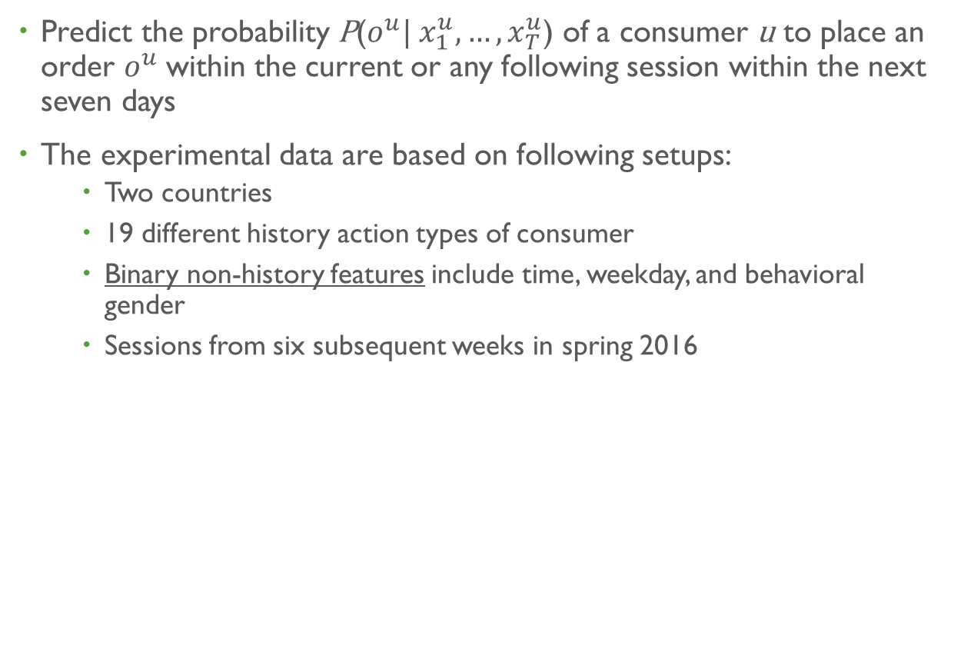
Applying RNNs for predicting future consumer behavior - Setups
Predict the probability P($o^{u}| x_{1}^{u},…, x_{T}^{u}$) of a consumer u to place an order $o^{u}$within the current or any following session within the next seven days
The experimental data are based on following setups:
Two countries
19 different history action types of consumer
Binary non-history features include time, weekday, and behavioral gender
Sessions from six subsequent weeks in spring 2016
1st week | 2nd week | 3rd week | 4th week | 5th week | 6th week
Training [25% are used as a validation set] |  |  |  | Testing

Slide 10
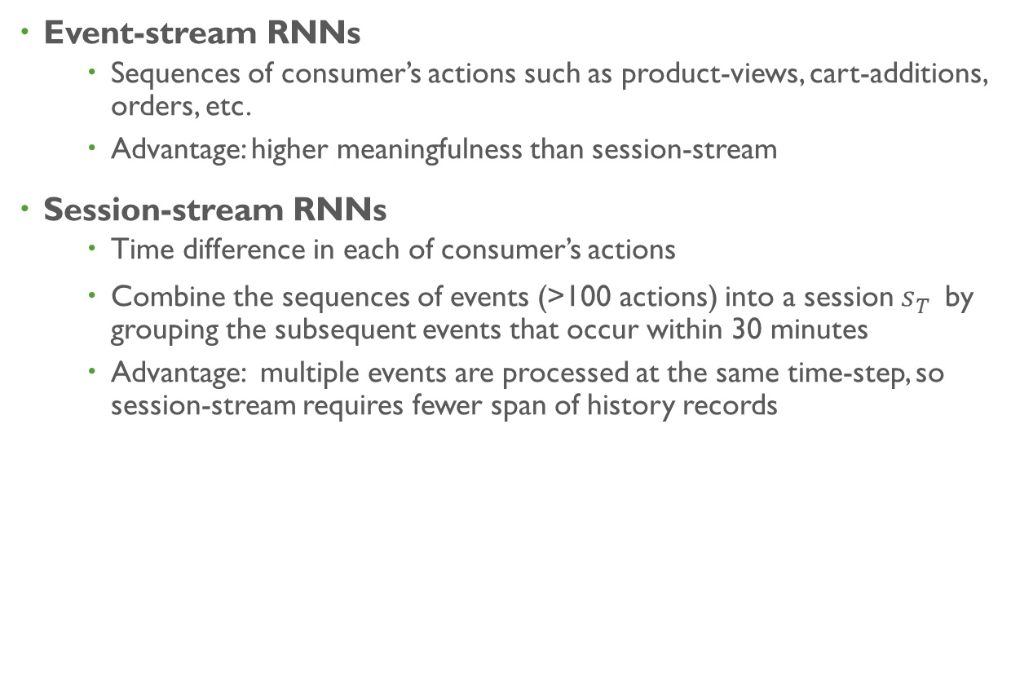
Applying RNNs for predicting future consumer behavior - Models
Event-stream RNNs
Sequences of consumer’s actions such as product-views, cart-additions, orders, etc.
Advantage: higher meaningfulness than session-stream
Session-stream RNNs
Time difference in each of consumer’s actions
Combine the sequences of events (>100 actions) into a session $s_{T}^{}$by grouping the subsequent events that occur within 30 minutes
Advantage: multiple events are processed at the same time-step, so session-stream requires fewer span of history records
Notes:
For instance, it may learn that a sequence of product views in the morning and a subsequent cart-addition in the evening increases the order probability more than the reversed sequence, in which a product is first placed into the cart before the consumer continues to view other products later.

Slide 11
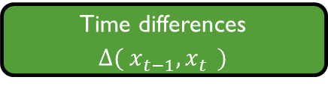
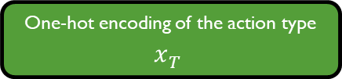
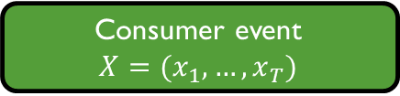


Event-stream RNNs
History inputs
$$x_{t}^{}∈ℝ_{}^{20}$$
RNN
Single LSTM layer
Ten-dimensional cell states
Hidden state $h_{t}^{}$at last time-step
Consumer event
$$X=(x_{1},…,x_{T})$$
combine
One-hot encoding of the action type
$$x_{T}^{}$$
Binary non-history features
Linear RNN output
Time differences
$∆{( x}_{t−1}^{},x_{t}^{}$)
Consumer history
Final prediction in logistic layer
200th event
recent event
Notes:
- Combine the sequences of events (>100 actions) into a session 𝑠_𝑇^ by grouping the subsequent events that occur within 30 minutes
- Binary vector to specify which action types occurred

Slide 12
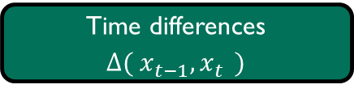



Session-stream RNNs
History inputs
$$s_{t}^{}∈ℝ_{}^{23}$$
RNN
Single LSTM layer
Ten-dimensional cell states
Hidden state $h_{t}^{}$at last time-step
Session stream
$$S=(s_{1},…,s_{T})$$
combine
Full session
$$s_{T}^{}$$
Binary non-history features
Linear RNN output
Time differences
$∆{( x}_{t−1}^{},x_{t}^{}$)
Consumer history
Final prediction in logistic layer
30th session
recent session
Notes:
- Combine the sequences of events (>100 actions) into a session 𝑠_𝑇^ by grouping the subsequent events that occur within 30 minutes
- Binary vector to specify which action types occurred

Slide 13
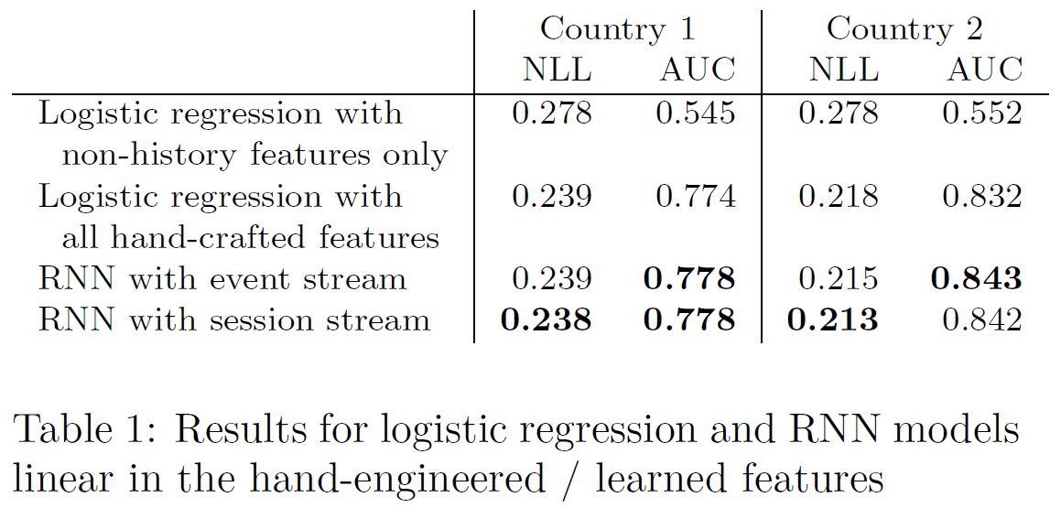
Results & Discussions
Table 1. Tobias Lang, Matthias Rettenmeier. Understanding Consumer Behavior with Recurrent Neural Networks. 2017
RNN models perform on par or better than logistic regression
Session-stream RNNs yields slightly greater accuracy than even-stream RNNs. This might due to insufficient parameter optimization for the event-stream RNNs
Most of the relevant information for order prediction is in the consumer histories
In the future, the researchers will focus on product-level and individual preferences
Negative log-likelihood (NLL) Area under the ROC curve (AUC)

Slide 14
Output of event-stream RNN
Figure 2. Tobias Lang, Matthias Rettenmeier. Understanding Consumer Behavior with Recurrent Neural Networks. 2017

Slide 15
Output of session-stream RNN
Figure 3. Tobias Lang, Matthias Rettenmeier. Understanding Consumer Behavior with Recurrent Neural Networks. 2017

