Slide 1
Deep contextualized word representations
Matthew E. Peters, Mark Neumann, Mohit Iyyer, Matt Gardner
Christopher Clark, Kenton Lee, Luke Zettlemoyer
Allen Institute for Artificial Intelligence
presented by Sergei Garmaev

Slide 2
Challenges of learning high quality representations
Complex characteristics of word use, e.g. syntax and semantics
How these uses vary across linguistic contexts – to model polysemy

Slide 3
Bidirectional Language Models
Forward language model
$$p(t_{1},t_{2}, …,t_{N})= \prod_{k=1}^{N}{\left(t_{k}\right|t_{1},t_{2}, …,t_{k−1})}$$
Backward language model
$$p(t_{1},t_{2}, …,t_{N})= \prod_{k=1}^{N}{\left(t_{k}\right|t_{k+1},t_{k+2}, …,t_{N})}$$
maximize the log likelihood of the forward and backward directions
$$\sum_{k=1}^{N}{(logp\left(t_{k}|t_{1}, …,t_{k−1}; θ_{x}, {\vec{θ}}_{LSTM}θ_{s}\right)+logp(t_{k}|t_{k+1}, …,t_{N};θ_{x},{\overset{⃖}{θ}}_{LSTM}, θ_{s}))}$$

Slide 4
ELMo
task specific combination of the intermediate layer representations in the biLM
for each token $t_{k}$, a L-layer biLM computes a set of 2L+1 representations
$$R_{k}= \left\{x_{k}^{LM}, {\vec{h}}_{k,j}^{LM}, {\overset{⃖}{h}}_{k,j}^{LM}| j=1, …, L\right\}= \left\{h_{k,j}^{LM}| j=0,…,L\right\}$$
where $h_{k,0}^{LM}$ - token layer, $h_{k,j}^{LM}$ = $\left[{\vec{h}}_{k,j}^{LM};{\overset{⃖}{h}}_{k,j}^{LM}\right]$, for each biLSTM layer

Slide 5
ELMo
collapse into a single vector ${ELMO}_{k}=E(R_{k};θ_{e})$
in simplest case top layer $E\left(R_{k}\right)=h_{k,L}^{LM}$
more generally, compute a task specific weighting of all biLM layers
$${ELMO}_{k}^{task}=E\left(R_{k}; θ^{task}\right)=γ^{task}\sum_{j=0}^{L}{s_{j}^{task}h_{k,j}^{LM}}$$
$s^{task}$ - softmax-normalized weights,
$γ^{task}$ - scalar parameter allows the task model to scale the entire ELMO vector

Slide 6
biLMs for supervised NLP tasks
run the biLM and record all of the layer representations for each word
let the end task model learn a linear combination of these representations

Slide 7
Evaluation
question answering – The Stanford Question Answering Dataset (SQuAD)
textual entailment – The Stanford Natural Language Inference (SNLI) corpus
semantic role labeling (SRL)
coreference resolution
named entity extraction – NER task
sentiment analysis – the fine-grained sentiment classification task in the Stanford Sentiment Treebank

Slide 8
Evaluation

Slide 9
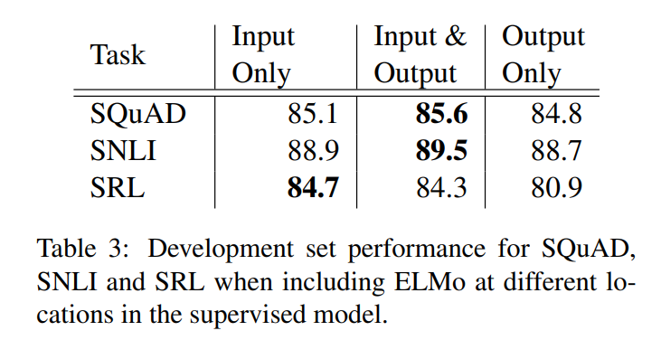
Where to include ELMo?
including ELMo at both the input and output layers for SNLI and SQuAD improves over just the input layer
for SRL (and coreference resolution, not shown) performance is highest when it is included at just the input layer

