Slide 1
SeqSleepNet: End-to-End Hierarchical Recurrent Neural Network for Sequence-to-Sequence Automatic Sleep Staging
Huy Phan, Fernando Andreotti, Navin Cooray, Oliver Y. Chen, Maarten De Vos

Slide 2
Polysomnography(PSG): a test conducted to study sleep and to diagnose a variety of sleep disorders.
30-second epochs: the basic time periods on which data analysis and interpretation is performed.
Electroencephalography (EEG): an electrophysiological monitoring method to record electrical activity of the brain.
Electrooculography (EOG): a technique for measuring the corneo-retinal standing potential that exists between the front and the back of the human eye.
Electromyography (EMG): an electrodiagnostic medicine technique for evaluating and recording the electrical activity produced by skeletal muscles.
The electrocardiogram (ECG): a diagnostic tool that is routinely used to assess the electrical and muscular functions of the heart.
A survey conducted in the US between 1999 and 2004 reveals that 50-70 million adults suffer from over 70 different sleep disorders and 60 percent of adults report having sleep problems a few nights a week or more.

Slide 3
The public dataset Montreal Archive of Sleep Studies (MASS) was used for evaluation. MASS is a considerably large open-source dataset which were pooled from different hospital-based sleep laboratories.
20-second epochs were converted into 30-seconds ones by including 5-second segments before and after each epoch.
It consists of whole-night recordings from 200 subjects
18-76 years
97 males
103 females
Divided into 5 subsets(SS1-SS5)
Converted into 5 sleep stages{W,N1,N2,N3,REM}
Using channels: EEG,EOG,EMG

Slide 4
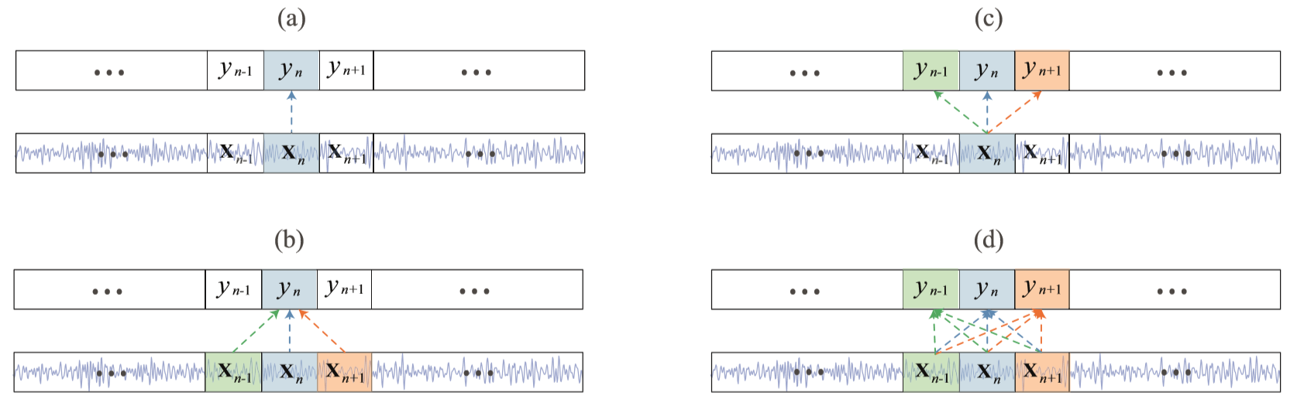
Illustration of the classification schemes used for automatic sleep staging. (a) one-to-one, (b) many-to-one, (c) one-to-many, and (d) the proposed many-to-many.
The goal is to map an input sequence of multiple epochs to the sequence of all target labels at once. Therefore, the automatic sleep staging task is framed as a sequence-to-sequence classification problem. With this generalized scheme, the disadvantages of other schemes were circumvented (i.e. short context, modelling ambiguity, and computational overhead) while maintaining the one-to-many’s advantage regarding the availability of decision ensemble.

Slide 5
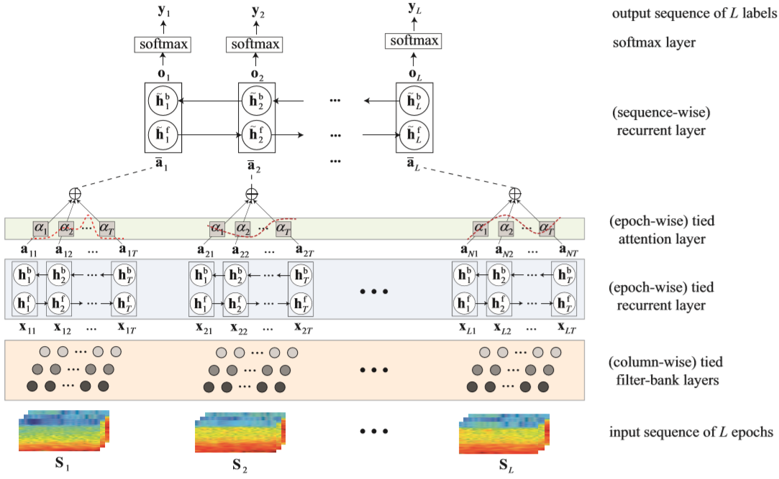
SeqSleepNet is composed of three main components:
parallel filterbank layers for preprocessing,
an epoch-level bidirectional RNN coupled with the attention mechanism for short-term (i.e. intra-epoch) sequential modelling,
a sequence-level bidirectional RNN for long-term (i.e. inter-epoch) sequential modelling. The network is trained in an end-to-end manner.
End-to-end network training is desirable in deep learning as an end-to-end network learns the global solution directly in contrast to multiple-stage training that estimates local solutions in separate stages.
Illustration of SeqSleepNet, the proposed end-to-end hierarchical RNN for sequence-to-sequence sleep staging.

Slide 6
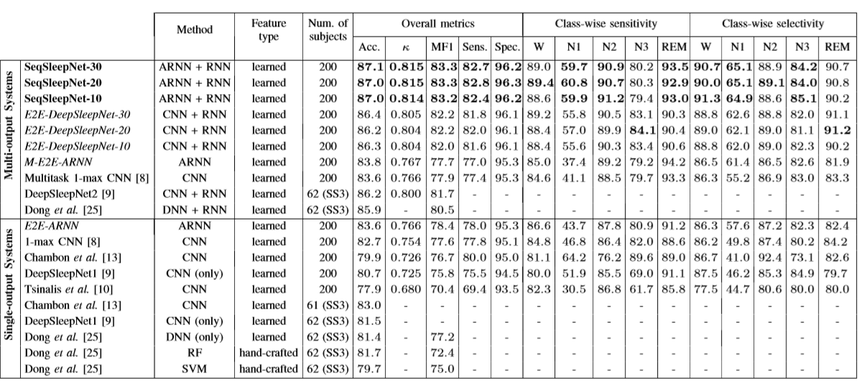
The 20-fold cross validation on the MASS dataset was conducted. At each iteration, 200 subjects were split into training, validation, and test set with 180, 10, and 10 subjects, respec-tively. During training, the network was evaluated after every 100 training steps and the one yielded the best overall accuracy on the validation set was retained for evaluation. The outputs of 20 cross-validation folds were pooled and considered as a whole for computing the sleep staging performance.
Performance obtained by the proposed SeqSleepNet, the developed baselines, and existing works on the MASS dataset. The proposed SeqSleepNet is marked in bold, the developed baselines in italic, and existing works in normal font. SeqSleepNet-L indicates a SeqSleepNet with sequence length of L, a similar notation is used for E2E-DeepSleepNet baseline.
Output hypnogram (a) produced by the proposed SeqSleepNet (L = 20) for subject 22 of the MASS dataset compared to the ground-truth (b). The errors are marked by the × symbol.
Epochs index

Slide 7
Q&A

