Slide 1
Vision and feature norms: improving automatic feature norm learning through cross-modal maps
Published in HLT-NAACL
Authors - Luana Bulat, Douwe Kiela and Stephen Clark
Presenting by - Dinesh Reddy
Notes:
NOTE:
To change the image on this slide, select the picture and delete it. Then click the Pictures icon in the placeholder to insert your own image.

Slide 2
Introduction
Many cognitive theories of conceptual organization assume that concepts are distributed representations over semantic primitives, often referred to as features or properties. That is, we can understand the meaning of a concept through its properties. Property norms are a valuable source of semantic information, and can potentially be applied to a variety of NLP tasks, but are expensive to obtain because they involve intensive human annotation.
The alternative to collecting more data through human annotation is to increase the coverage of property norms datasets by automatically inferring properties of concepts from easily accessible resources, such as textual data.

Slide 3
Objective
Property norms have the potential to aid a wide range of semantic tasks, provided that they can be obtained for large numbers of concepts. Recent work has focused on text as the main source of information for automatic property extraction. In this paper we examine property norm prediction from visual, rather than textual data, using cross-modal maps learnt between property norm and visual spaces. Also investigate the importance of having a complete feature norm dataset, for both training and testing to evaluate how these datasets and cross-modal maps can be used in an image retrieval task.

Slide 4
Methodology
Images without annotations are ubiquitous on the Internet, and recommending tags for them has become a challenging open task in image understanding. A common bottleneck of related work is the semantic gap between the image and text representations. In this paper, we bridge the gap by introducing a semantic layer, the space of word embeddings that represents the image tags as the word vectors. Our model first learns the optimal mapping from the visual space to the semantic space using training sources. Then we annotate test images by decoding the semantic representations of the visual features.
One of the most widely used property norm datasets is the one collected by McRae et al. (2005), henceforth MCRAE. It contains feature norms for a set of 541 concrete nouns. Each concept was seen by 30 participants and only features that were listed by at least 5 participants were recorded. The published dataset contains a total of 2526 features, with a mean of 13.7 features per concept.

Slide 5
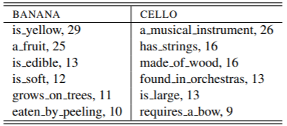
Methodology (Continuation)
We obtain distributed representations of concepts in the property-norm semantic space (henceforth PROPNORM) by simply treating MCRAE as a bag of 2526 properties, with the production frequencies representing the “co-occurrence counts”
An input word is used to retrieve 10 images from Google, these are passed through an ImageNet classifier to get feature vectors, and then averaged to get a vector representation for that word. A supervised model (partial least-squares regression) is then trained to predict vectors of feature norms based on the input vectors (image-based, distributional, or a combination). Including the image information helps quite a bit, especially for detecting properties like colour and shape.
Fig 1.
Fig 2.

Slide 6
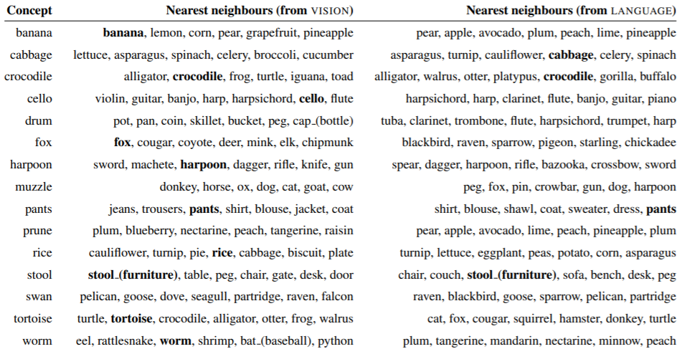
Results
Fig 3. Comparison of the top nearest neighbours when mapping from vision or from language

Slide 7
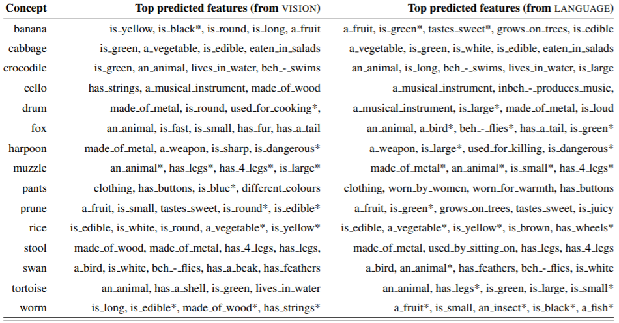
Results (Continuation)
Fig 4. Comparison of the top predicted features when mapping from vision or from language. Properties marked with * don’t appear as attributes of the associated concept in MCRAE

Slide 8
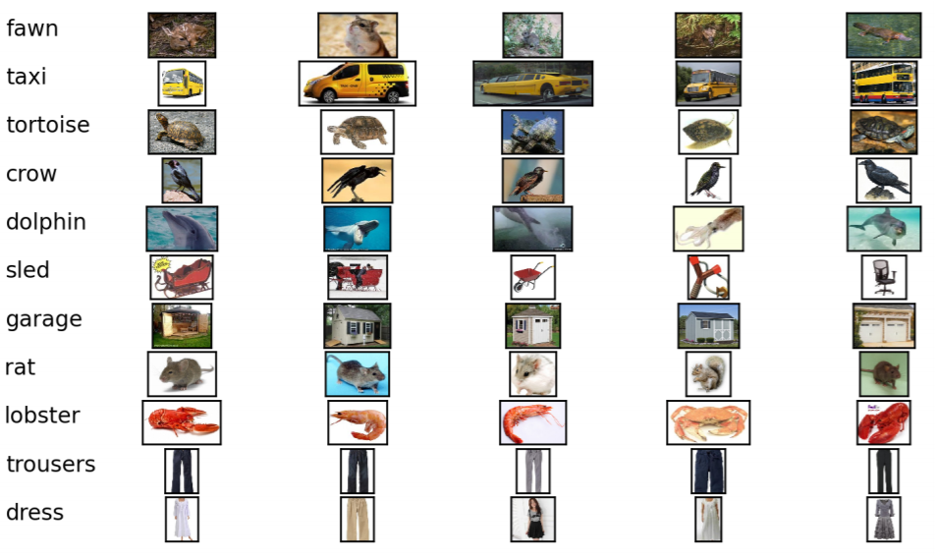
Results (Continuation)
Fig 5. Nearest neighbours of the predicted visual vectors

Slide 9
Conclusion
We have studied the automatic prediction of property norms for unseen concepts, through learning the cross-modal mapping from image data. Following previous work, we evaluated on a zero-shot learning task and show that raw visual information (images) is a better predictor for conceptual properties than linguistic input (text). We also presented a short case study demonstrating the importance of having complete annotations in the property norm datasets, for both testing and training. Lastly, we demonstrated a possible use case for property norm datasets in an image retrieval task.

Slide 10
References
Mark Andrews, Gabriella Vigliocco, and David Vinson. 2009. Integrating experiential and distributional data to learn semantic representations. Psychological review, 116(3):463.
Eduard Barbu. 2008. Combining methods to learn feature-norm-like concept descriptions. In Proceedings of the ESSLLI Workshop on Distributional Lexical Semantics, pages 9–16.
Marco Baroni, Brian Murphy, Eduard Barbu, and Massimo Poesio. 2010. Strudel: A corpus-based semantic model based on properties and types. Cognitive Science, 34(2):222–254.

