Slide 1

Automated Stock Market Trading Using Machine Learning
Made By:
Kaivalya Anand Pandey

Slide 2
Introduction
Producing accurate methods for predicting stock prices has been a goal of both the financial and technological communities for many years.
This research includes utilising Artificial Intelligence and Machine Learning methods to predict both sudden and long term changes in a given share’s price, minimising loss and maximising profit.
Existing Software attempting to deliver such results rely mostly on simple assertions on raw statistical data and trend indicators such as “ Sell shares when 50 day moving average is going below 200 day moving average. This approach is known as Algotrading.
Another common method is ARIMA which means Auto- Regressive Integrated Moving Average to allow forecasting, being particularly useful where data is non stationary, as it is with financial data.

Slide 3
Introduction(Cont.)
Many research papers have been published concerning the use of Artificial Neural Networks, Support Vector Machines and Linear Regression.
A core challenge facing stock market prediction, is the unpredictability of extreme case events, such as when price drops dramatically with in a very short period.
Most Stock Prediction model utilise per day historical data over the last n-years for long term prediction but often neglect the use of alternate information for predicting more frequent changes.
Use of predicted information for making trading decisions requires considerations by human which therefore introduces restriction and uncertainty in terms of stock choice and purchase/sale quantity which can affect the performance of investments, potentially reducing expected returns.

Slide 4
Scope
Allowing control of the trading process by an autonomous agent would bypass emotional-based restrictions and could yield greater result in reduced time-frame.
Given a high-frequency stock market data feed, such freedom would allow exploitation of the fast paced fluctuations in real time day trading as well as long term portfolio improvement.
It can also be beneficial to optimise the portfolio prior to automated trading, by selecting a good balance of risky and safe stocks, whilst diversifying amongst various industries/sectors and allocating a portion of overall investments to each stock accordingly.

Slide 5
Aims and Contributions
The aim of this project is to analyse and compare the latest Machine Learning Stock Market Prediction methods and to develop a new variant of Artificially, Intelligent Automated Trading System, improving upon existing applications, that utilises a prediction model, Portfolio Optimisation and Natural Language Processing to provide an “All-in-One” software to suite to automate trading without the need for human intervention.
Using an appropriate brokerage API, this software could be used to trade stocks in future work.
The final deliverables include a practical and customisable consumer-level software package with uses outside the configuration described in this project, allowing non-expert users a greater opportunity for investing in stocks.

Slide 6
Stock Prediction
1. Linear/Polynomial/Logistic Regression : Multiple Regression is usually required in stock market prediction using Regression due to many variable inputs that can effect a price’s value. It is used for technical analysis, being useful in identifying price trends in the long term but often rarely outperforms the prediction accuracy of other models in the short-term.

Slide 7
2. Artificial Neural Networks:
ANN are non-linear models that simulate the processes between neurons and synapses within the brain in order to model complex problems. They have been popular for use in predicting stock market due to their black-box nature, allowing users to try an arbitrary amount features to generate usable results.
There are many variations of ANN that can be applied to time-series forecasting, such as Multilayer Perceptrons (MLP) – the simplest variant or Convolutional Neural Networks(CNN) which encode price information into image formats for convolutions to be performed.
Memory based networks such as Recurrent Neural Networks(RNN) and Long Short term Memory(LSTM) networks allow for predictions to be remembered and forgotten.

Slide 8
3. Support Vector Machines
SVM are popular alternative to other models due to their ability to find global maxima and their over-fitting control using regularisation and minimisation of generalisation error.
Separating points by finding a maximum-margin between Support Vectors and a hyper plane allows them to have greater reliability over methods such as linear regression, which find suitable but not optimal solution.

Slide 9
4. Random Forests
They are ensemble models that utilise a set of weak learners and apply them to a separate subspace of the input matrix, taking the majority or mean output of all the trees to create a single strong learner. Based on previous research, this method is very popular, reaching accuracies of up to 94.533% for predicting the price direction of a stock at 3 months.

Slide 10
4. Natural Language Processing
Sentiment Analysis is the process of determining the positive or negative connotation of a mass of text. This can be done through various methods, including the use of sentiment-labelled dictionaries, matching document metadata to the text and labelling text in a semi-supervised manner by mining additional metrics in which to rate the text.
This project will investigate the suitability of the third example, utilising price increase and decrease data on any given day, to label news articles published on the same trading date.
Sentiment Analysis to stock prediction can use multiple sources, including Social Media Information such as Twitter posts, etc.

Slide 11
5. Crowd Sourcing
The combined knowledge and opinions of Internet communities can be useful in predicting stock direction and velocity, by allowing users access to online voting systems to express their own predictions. This information can be combined into a feature vector alongside prices and technical indicators with appropriate weighting of objective versus subjective data or used individually.

Slide 12
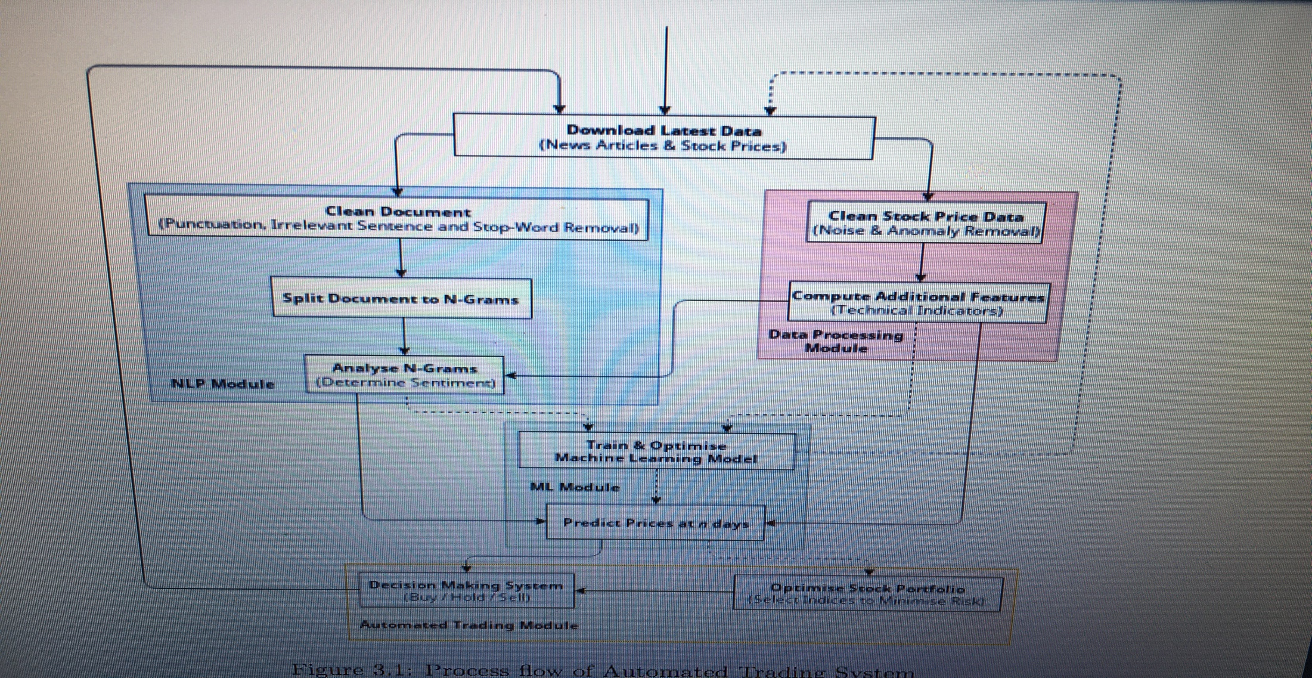
Design

Slide 13
Data Sourcing
Historic data dating back to the Initial Public Oﬀering (IPO) of each stock is sourced from Yahoo! Finance, which provides per-day of Open, High, Low and Close prices and trade volume (OHLCV) data. This data has been criticised within the ﬁnancial industry for not being as accurate as paid-for data sources such as Quandl, however it will be used in this research due to its free availability.
Real-Time data including 1-minute interval intraday OHLCV data and the latest per-day data not covered in the historic data set, is downloaded regularly via the Alpha Vantage Application Programming Interface (API).
News article corpus containing headlines, summaries and URLs of news publications from various sources is downloaded via the Intrinio API, covering both historic and recent information. URLs available within this information are then crawled for the main content of each article.

Slide 14
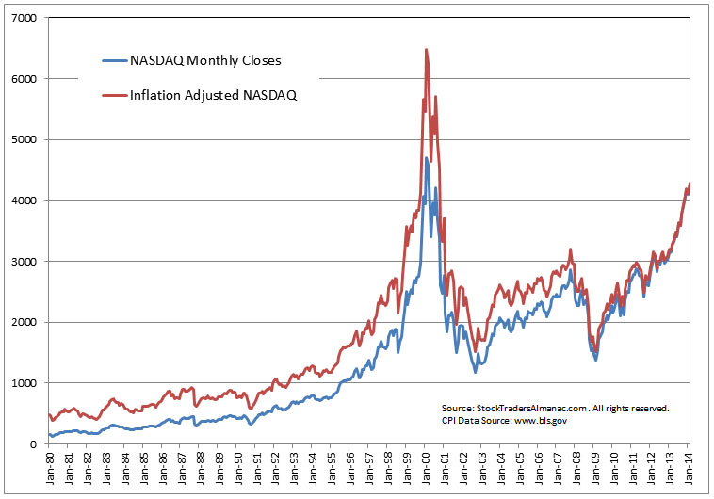

Slide 15
Stock Tickers
This project will consider the stocks listed under theNASDAQ-100 collection, covering the top 100 actively traded companies on the NASDAQ Exchange, including those from the healthcare, services, technology, ﬁnancial and consumer goods sectors.

Slide 16
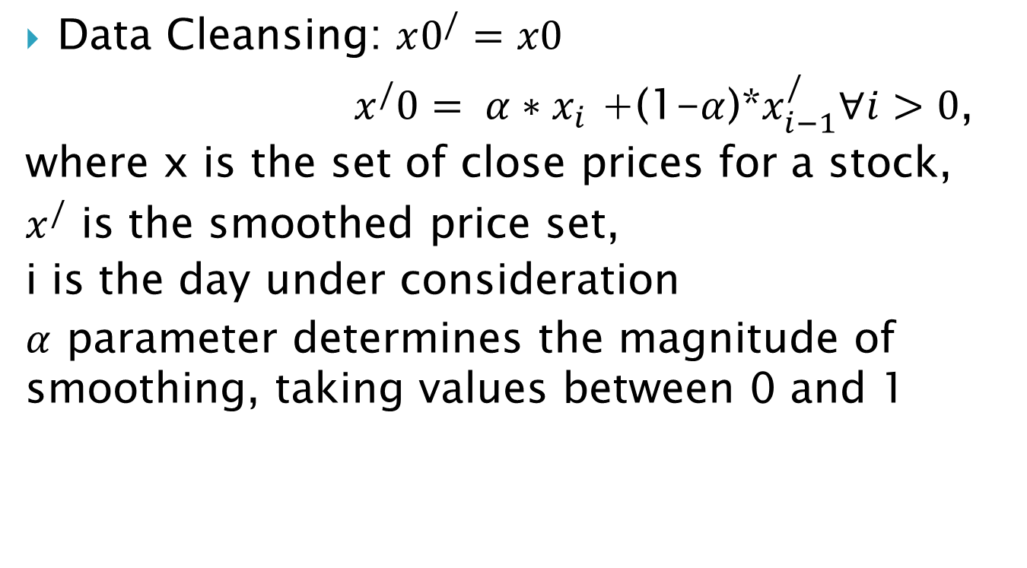
Data Pre-Processing
Data Cleansing: $x0^{/}=x0$
$x_{}^{/}0= α∗x_{i}$ +(1-$α$)*$x_{i−1}^{/}∀i>0$,
where x is the set of close prices for a stock,
$x^{/}$ is the smoothed price set,
i is the day under consideration
$α$ parameter determines the magnitude of smoothing, taking values between 0 and 1

Slide 17
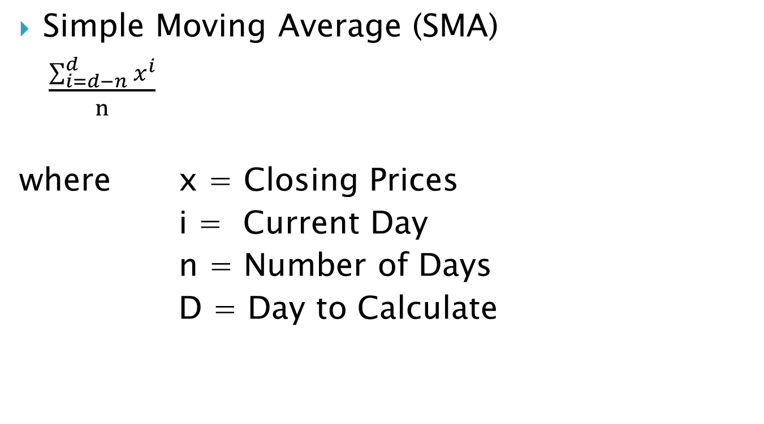
Technical Indicator Extraction
Simple Moving Average (SMA)
$\frac{\sum_{i=d−n}^{d}{x^{i}}}{n}$
where x = Closing Prices
i = Current Day
n = Number of Days
D = Day to Calculate

Slide 18
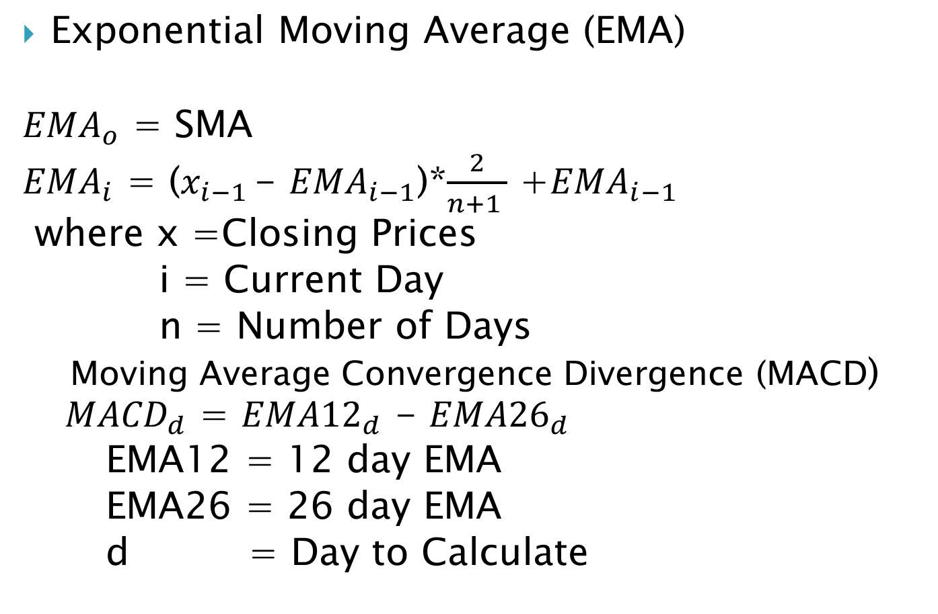
Exponential Moving Average (EMA)
${EMA}_{o}$ = SMA
${EMA}_{i}$ = ($x_{i−1 }$- ${EMA}_{i−1}$)*$\frac{2}{n+1 }$ +${EMA}_{i−1}$
where x =Closing Prices
i = Current Day
n = Number of Days
Moving Average Convergence Divergence (MACD) ${ MACD}_{d}$ = ${EMA12}_{d}$ - ${EMA26}_{d}$
EMA12 = 12 day EMA
EMA26 = 26 day EMA
d = Day to Calculate

Slide 19

Relative Strength Index (RSI)
RSI = 100 - $\frac{100}{1+RS}$
RS = $\frac{Avg (Gains i−14…i)}{\begin{aligned}Avg(Losses i −14…i) \\ \end{aligned}}$
Gains = Price increase sum over last 14 days
Losses = Price decrease sum over last 14 days

Slide 20
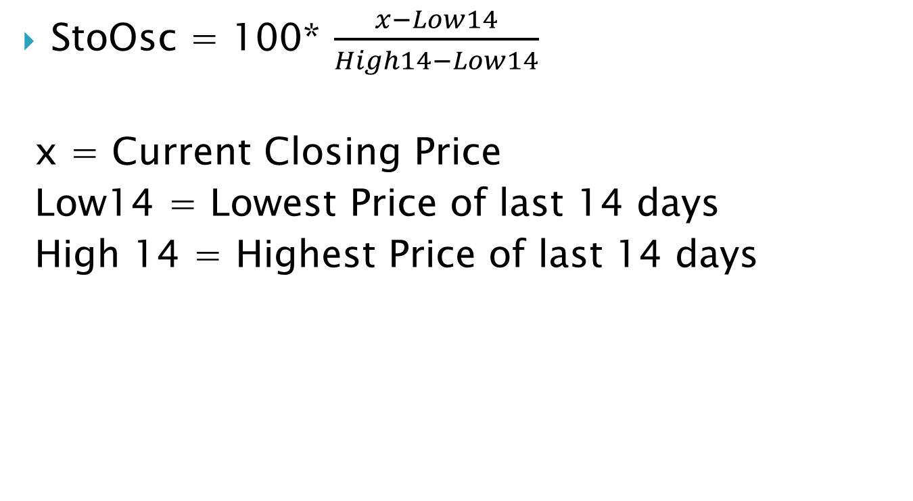
Stochastic Oscillator(StoOsc)
StoOsc = 100* $\frac{x−Low14}{High14−Low14}$
x = Current Closing Price
Low14 = Lowest Price of last 14 days
High 14 = Highest Price of last 14 days

Slide 21
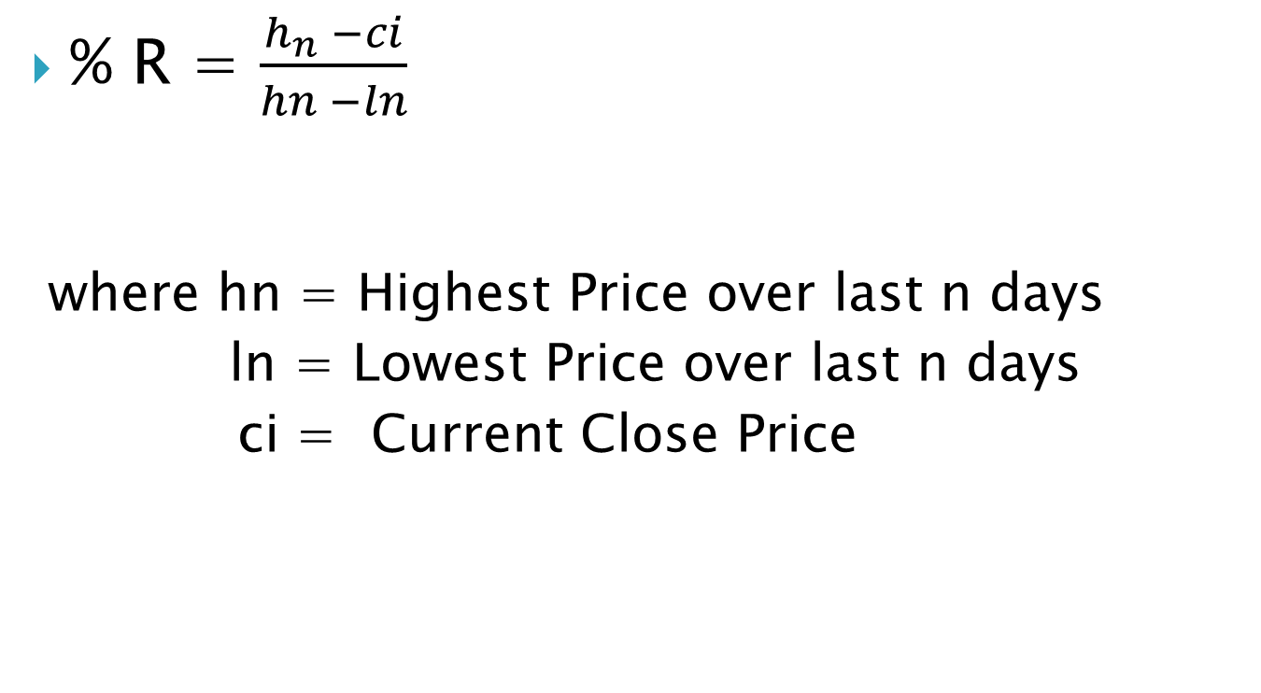
Williams % R
% R = $\frac{h_{n} −ci}{hn −ln}$
where hn = Highest Price over last n days
ln = Lowest Price over last n days
ci = Current Close Price

Slide 22
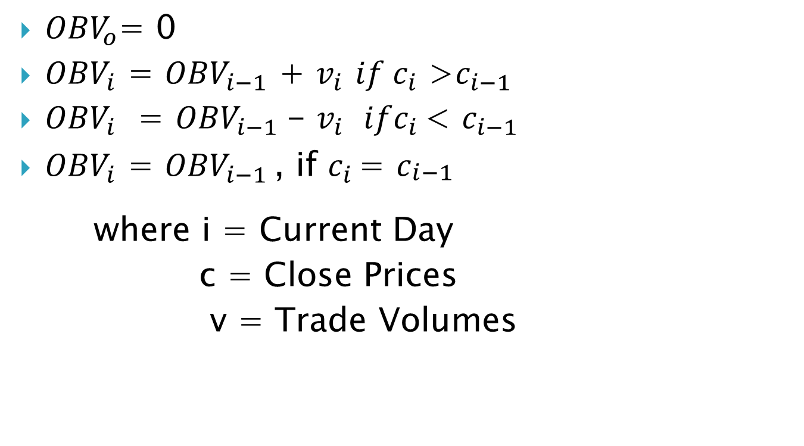
On- Balance Volume
${OBV}_{o}$= 0
${OBV}_{i}$ = ${OBV}_{i−1}$ + $v_{i}$ ${if c}_{i}$ >$c_{i−1}$
${OBV}_{i}$ = ${OBV}_{i−1}$- $v_{i } ifc_{i }$< $c_{i−1}$
${OBV}_{i}$ = ${OBV}_{i−1 }$, if $c_{i }$= $c_{\begin{aligned}i−1 \\ \end{aligned}}$
where i = Current Day
c = Close Prices
v = Trade Volumes

Slide 23
Stages
Stage1: Default Models and Price Data
Stage 2: Price Data & Technical Indicators
Stage 3 : Price Data, Technical Indicators & News Article Sentiment
Stage 4 : Machine Learning Model Selection i.e. Random Forests

Slide 24
Trading Automata
The Automated Trader will use a simple decision system, based on thee output of the prediction model.
Given a set of time periods to predict price changes for, the Automated Trader will count how many of the predictions suggest a price rise and use this to divide the total remaining allocation between the corresponding days.
This then will be used to invest in stocks, whereby the time period to hold the stocks is kept in the database until the time period has elapsed.
Once the period has passed, the corresponding stock will be predicted again for the same time period. If the prediction results in rise, the stocks will be kept in the portfolio and the elapsed time is reset, if fall, the stock will be sold.

Slide 25
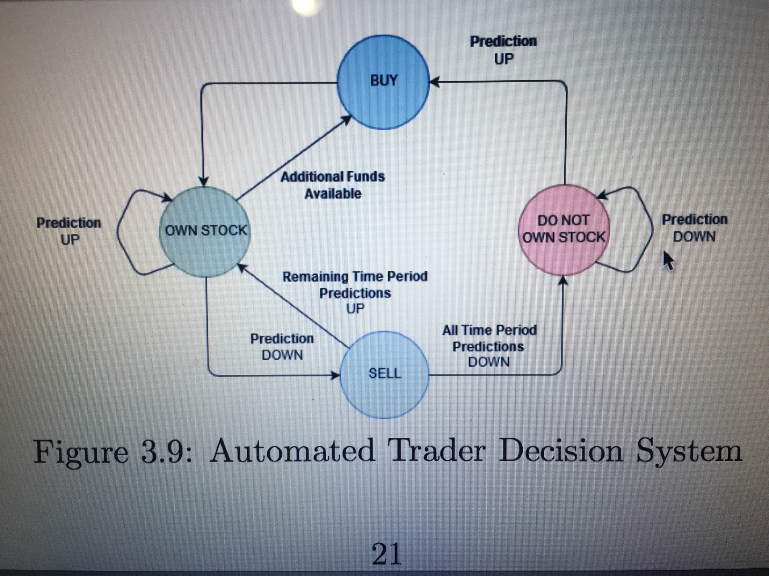

Slide 26
Trading Bot Return
Trading Method | Final Balance | Return Value
Automated Trader(Portfolio Optimisation) | 7259.18 | 25.529 %
Automated Trader (Initial Portfolio Allocation) | 6140.23 | 6.18%
Random Trader(Trade On Instincts) | 6134.81 | 6.09 %

Slide 27
THANK YOU

