Slide 1
Self-Taught Convolutional Neural Networks for Short Text Clustering
Jiaming Xua, Bo Xua, Peng Wanga, Suncong Zhenga,
Guanhua Tiana, Jun Zhao, Bo Xua*
Presented by Alexander Donets
NSU 2019

Slide 2
The Context
In Machine Learning (ML) field approaches to clustering problem are studied. This problem appears in many different fields such as biology, archeology, sociology, information technology and others.
Researchers in their paper suggested their new ML model to solve such a problem in some case related to Natural Language Processing (NLP).

Slide 3
Motivation
Short text clustering is a challenging problem due to its sparseness of text representation. It means that most of the words only occur once in each short text.
As a result, the Term Frequency - Inverse Document Frequency (TF-IDF) measure cannot work well in short text setting (it is the measure of word importance in context of given document, based on statistical information regardless of word order and some other features).

Slide 4
Motivation
There have been several studies that attempted to overcome the sparseness of short text representation and two major approaches took shape:
To expand and enrich the context of data;
To map the original features into lower-dimensional space.
But first approach requires solid NLP knowledge and typically works with high-dimensional data representations, which latter leads to increase in computational complexity and memory use.
In second approach it is problematically to design an eﬀective model, and most of these methods directly trained based on Bag-of-Words data model (BoW) are shallow structures which cannot preserve the accurate semantic similarities.

Slide 5
Motivation
Recently, with the help of word embedding, neural networks demonstrate their great performance in terms of constructing text representation, such as Recursive Neural Network (RecNN) and Recurrent Neural Network (RNN).
Still, RecNN exhibits high time complexity to construct the textual tree, and RNN, using the hidden layer computed at the last word to represent the text, is a biased model where later words are more dominant than earlier words.
More recently, Convolution Neural Networks (CNN), as the most popular non-biased model and applying convolutional ﬁlters to capture local features, has achieved a better performance in many NLP applications.

Slide 6
Research Objectives
To explore the power of CNN on one unsupervised learning NLP task, short text clustering, while most of the previous works focus CNN on solving supervised learning tasks.
To enhance the results of previous approaches to problem of short text clustering

Slide 7
Methods of Research
The architecture of ML system assumes that we use some unsupervised clustering technique to embed raw text features in lower-dimensional binary code representation.
Thus, it was decided to test the system by employing different clustering methods, let us describe them briefly.

Slide 8
Methods of Research
Average Embedding (AE): This method directly averages the word embeddings which are respectively weighted with TF and TF-IDF.
Latent Semantic Analysis (LSA): LSA is the most popular global matrix factorization method, which applies a dimension reducing linear projection, Singular Value Decomposition (SVD), of the corresponding term/document matrix.
Laplacian Eigenmaps (LE): method uses spectral techniques to perform dimensionality reduction. This technique relies on the basic assumption that the data lies in a low-dimensional manifold in a high-dimensional space.

Slide 9
Methods of Research
Locality Preserving Indexing (LPI) This baseline, projecting the texts into a lower dimensional semantic space, can discover both the geometric and discriminating structures of the original feature space.

Slide 10
Methods of Research
In paper chosen Bidirectional RNN (bi-RNN) as it can be seen in Figure 1, Particularly, LSTM (Long-Shot Term Memory) and GRU (Gate Recurrent Unit) units are used in the experiments.
In order to generate the ﬁxed-length document representation from the variable-length vector sequences, for both bi-LSTM and bi-GRU based clustering methods, we further utilize three pooling methods: last pooling (using the last hidden state), mean pooling and element-wise max pooling. These pooling methods are respectively used in the previous works (links present in paper).
For regularization, the training gradients of all parameters with an l2 norm larger than 40 are clipped to 40.

Slide 11
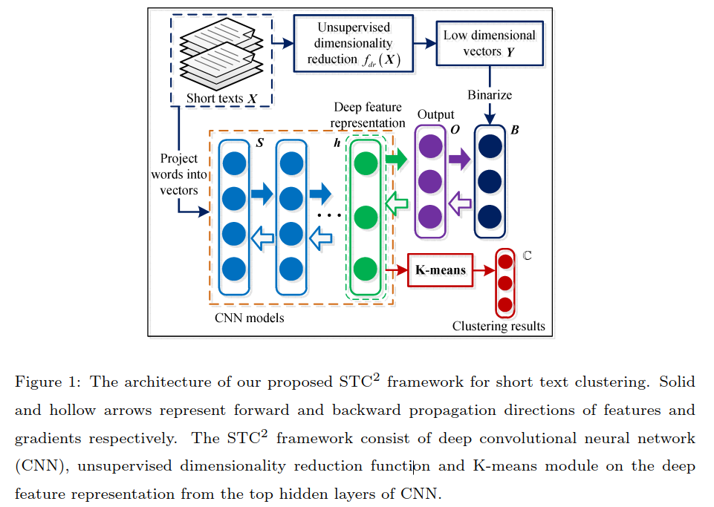
Model Architecture

Slide 12
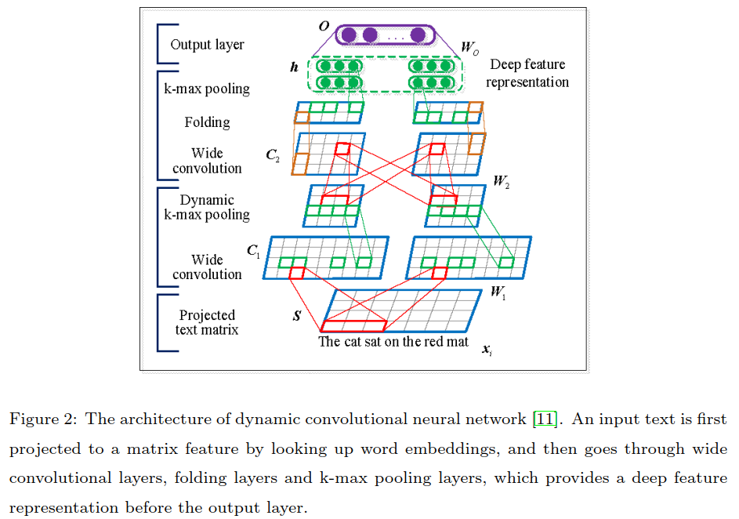
Model Architecture

Slide 13
Model Assessment
In current research were used three datasets:
SearchSnippets. This dataset was selected from the results of web search transaction using predeﬁned phrases of 8 diﬀerent domains.
StackOverﬂow. The challenge data published at Kaggle.com. The raw dataset consists 3,370,528 samples through July 31st, 2012 to August 14, 2012. 20,000 question titles were randomly selected with 20 different tags as in.
Biomedical. We use the challenge data published in BioASQ’s official website. 20, 000 paper titles were randomly selected from 20 different MeSH5 major topics. The max length of selected paper titles is 536.

Slide 14
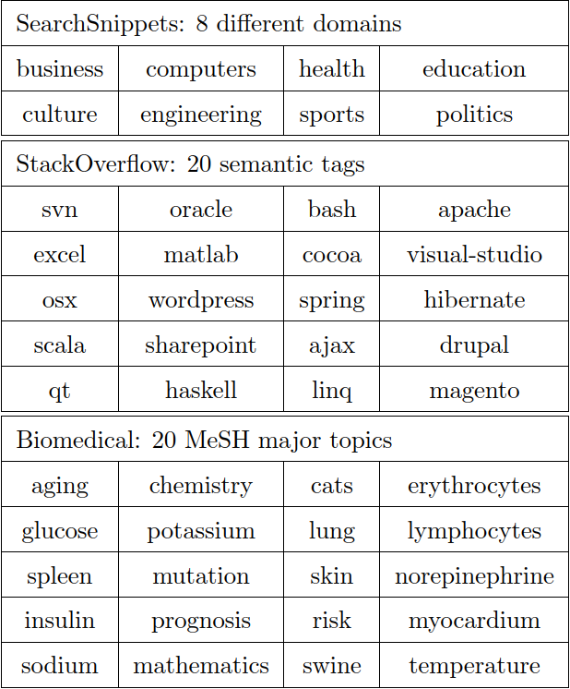
Model Assessment: datasets

Slide 15
Model Assessment: evaluation metrics
The clustering performance is evaluated by comparing the clustering results of texts with the tags/labels provided by the text corpus. Two metrics are used to measure the clustering performance:
Accuracy (ACC)
Normalized mutual information metric (NMI)

Slide 16
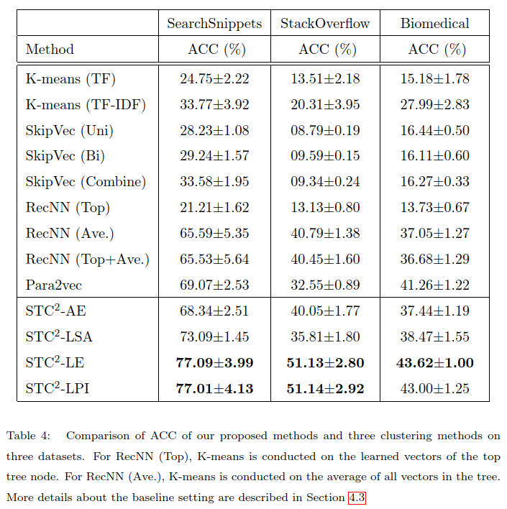
Model Assessment: results (ACC, 1)

Slide 17
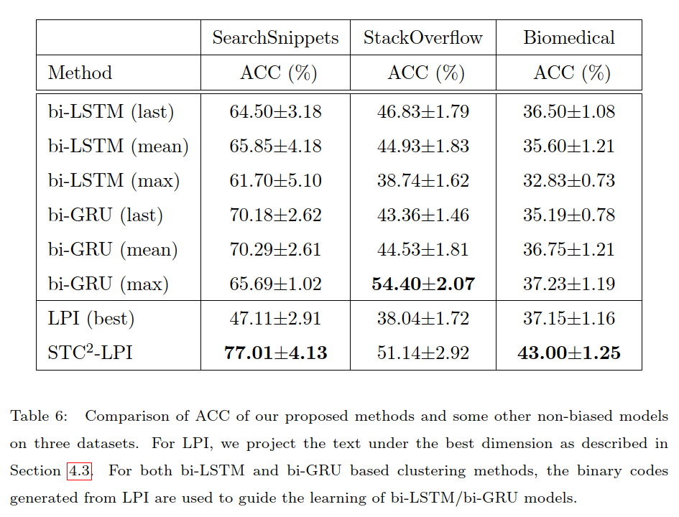
Model Assessment: results (ACC, 2)

Slide 18
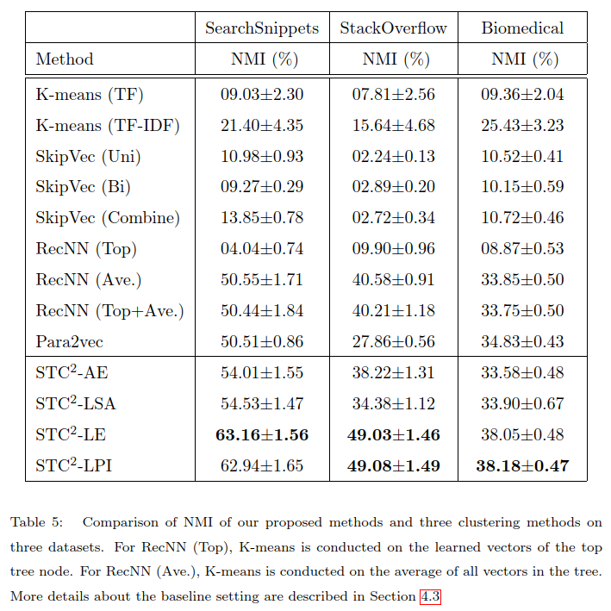
Model Assessment: results (NMI, 1)

Slide 19
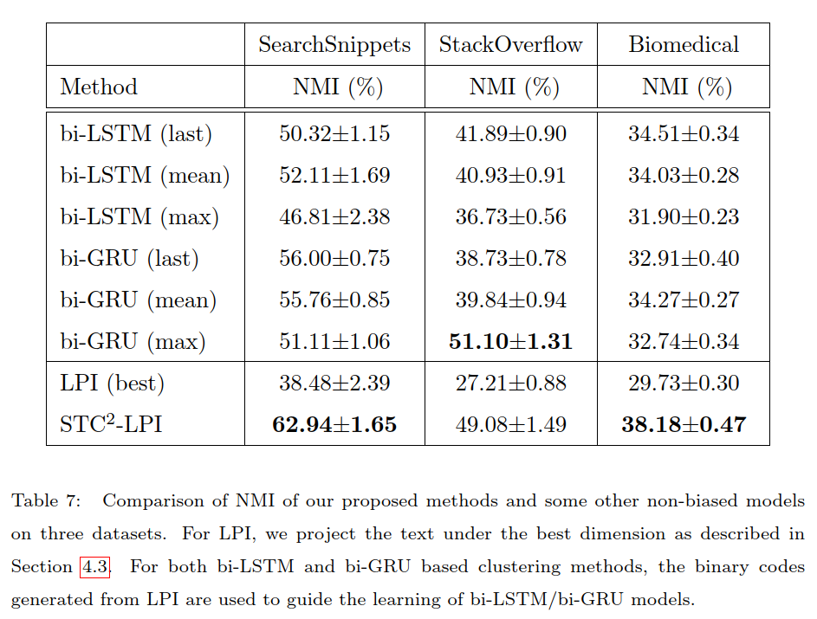
Model Assessment: results (NMI, 2)

