Slide 1
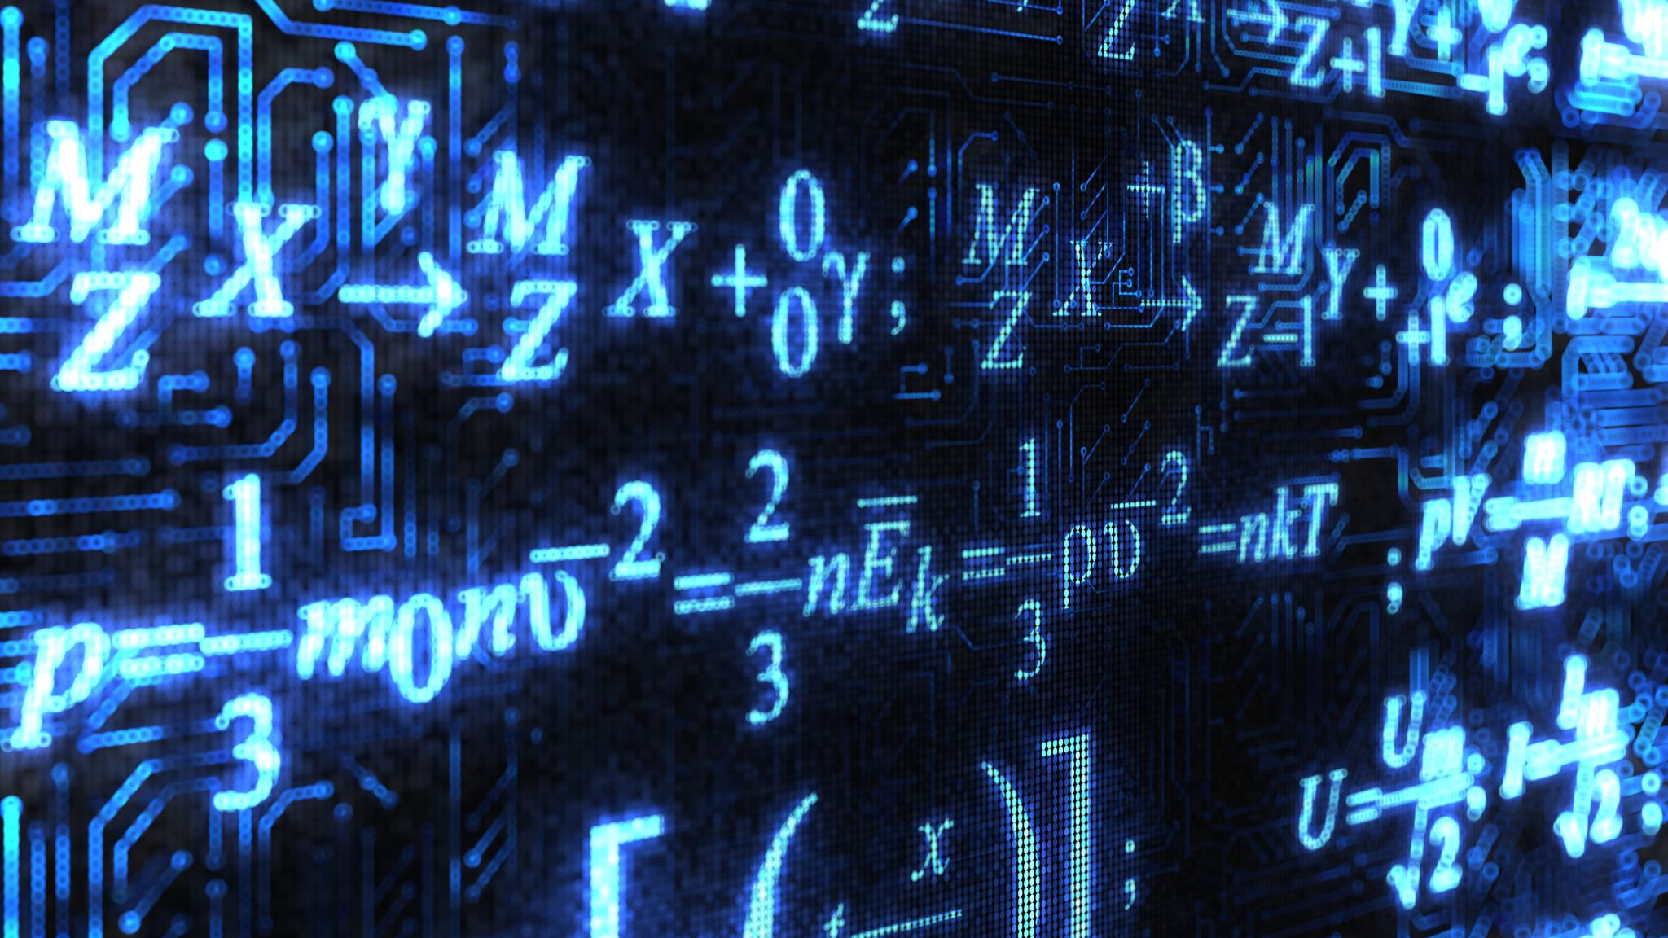
Solution of the Many-Electron Schrödinger Equation with DNN: Fermi-net
David Pfau, James S. Spencer, Alexander G. de G. Matthews, W. M. C. Foulkes

Slide 2
Quantum mechanics ?
DESCRIBING NATURE FOR SMALLEST SCALES
Atomic, subatomic

Slide 3
Quantum physics postulates
Quantum mechanics
Useful information
Schrodinger equation
Ansatz
DNN
Architecture
Features
Results
Conclusion
Classical or Newtonian mechanics => deterministic
Quantum mechanics => non deterministic
Impossibility to determine exactly the trajectory of the particles.
Function to describe the probability of finding a system at a point given space : the wavefunction Ψ
Wave-particle duality
Based on the article Les postulats de la physique quantique, Chapitre III , http://theo.ism.u-bordeaux.fr

Slide 4
Elementary particles
Quantum mechanics
Useful information
Schrodinger equation
Ansatz
DNN
Architecture
Features
Results
Conclusion
From the article Elementary Particle, Overview, https://en.wikipedia.org/

Slide 5
Spin
Quantum mechanics
Useful information
Schrodinger equation
Ansatz
DNN
Architecture
Features
Results
Conclusion
Spin : internal quantum property of a particle
Others quantum properties like mass or electrical charge have equivalents in classical mechanics
Spin no, but seems like the angular momentum but more complicated and weird
Examples : For the electron we return to the starting state after two laps !!
The spin values can only be integers or half integers of h-, the Planck reduced constant.
S = 0, ½, 1…. With h- the unity
Number of directions : $2S+1$
A lap
Angular momentum
Based on the articles Qu’est-donc le spin, https://www.pourlascience.fr and Qu’est-ce que le spin d’une particule ou d’un atome ? http://www.matierevolution.fr/

Slide 6
Schrödinger equation(1/2)
Quantum mechanics
Useful information
Schrodinger equation
Ansatz
DNN
Architecture
Features
Results
Conclusion
Time-independent Schrödinger Equation:
$x_{i}=(r_{i},σ_{i})$: Characteristics of electron i
$r_{i}$ : spherical coordinates of electron i
$σ_{i}$ : the spin $\{↑,↓\}$
H : Hamiltonian
E : Energy
Ψ : Ground state wavefunction of many-electrons systems

Slide 7
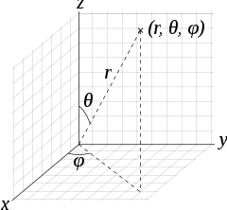
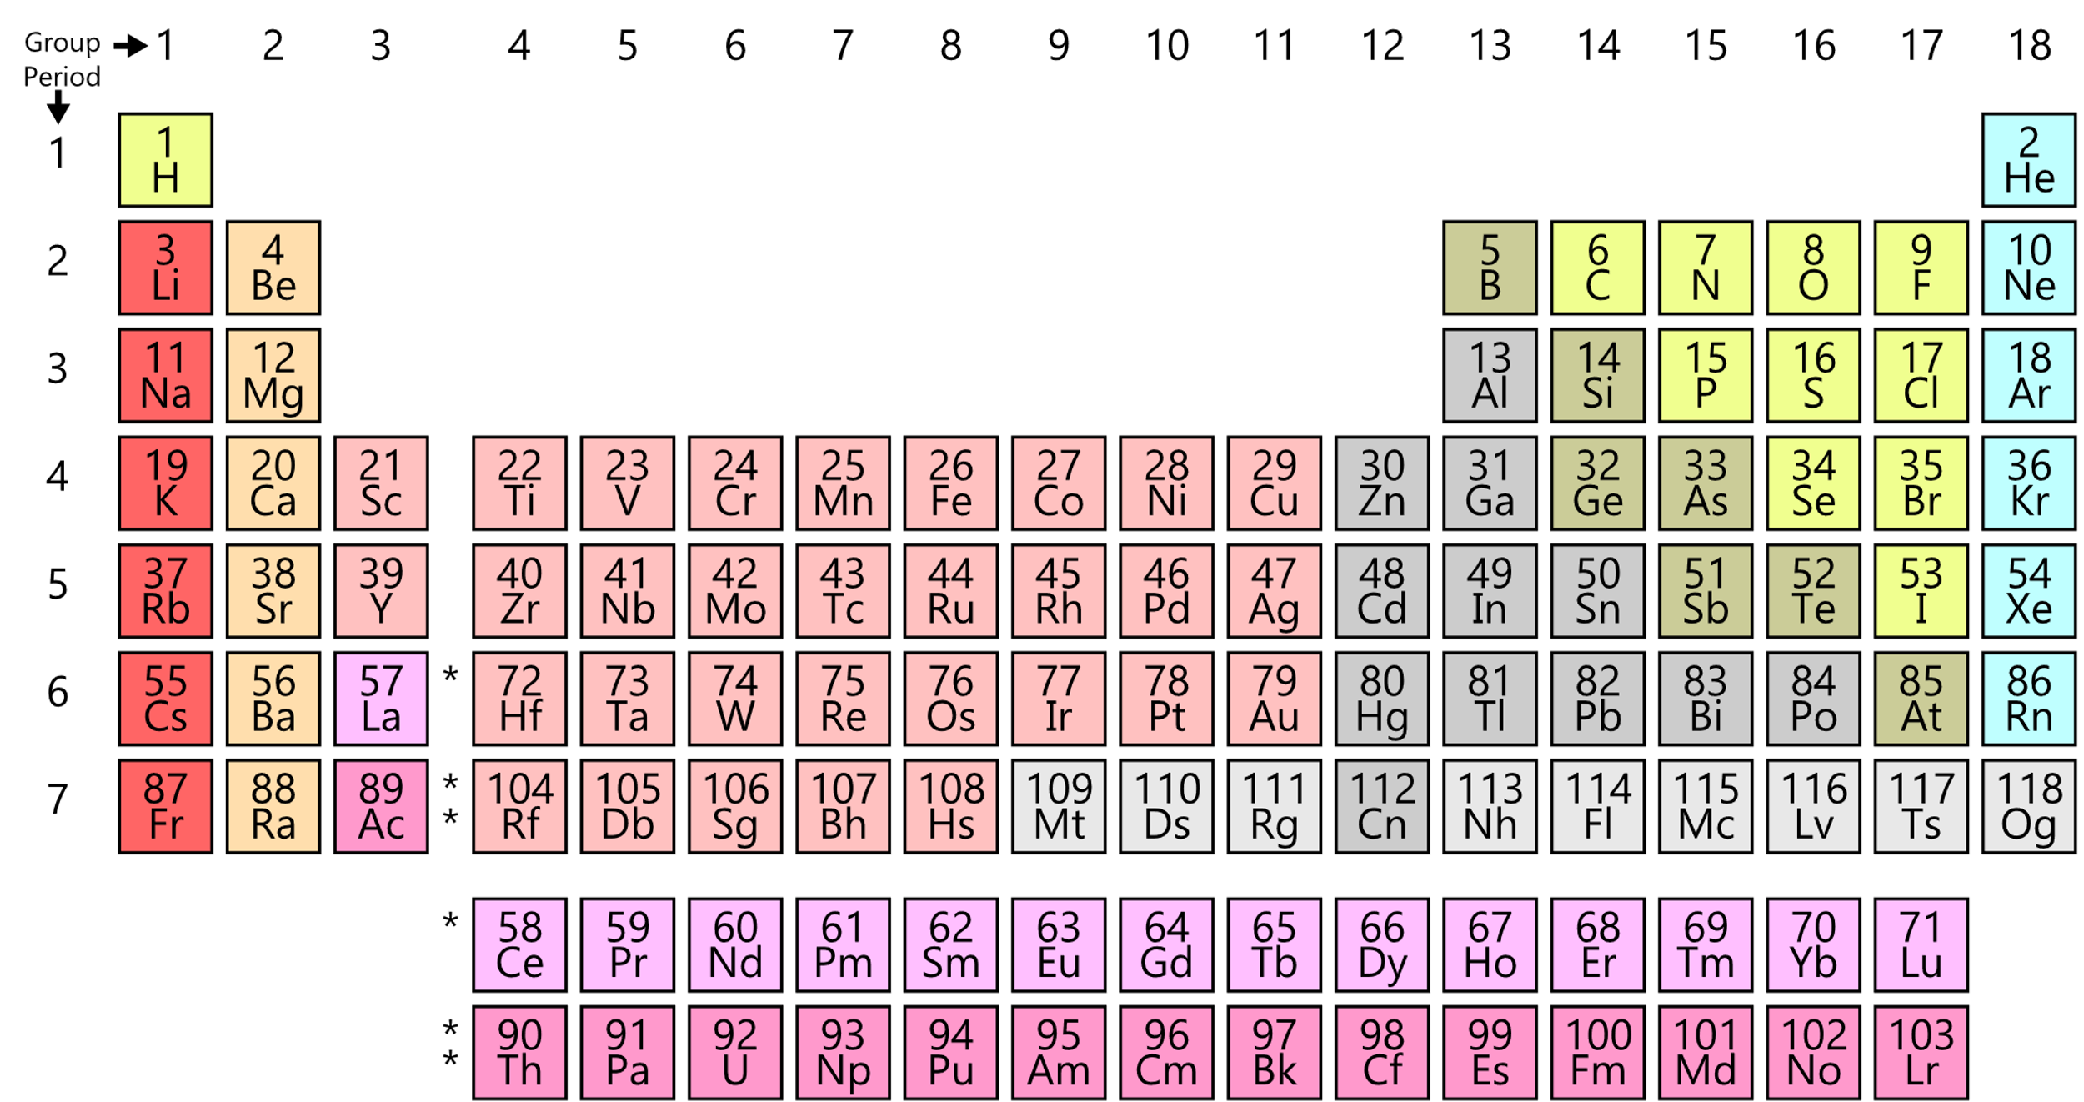
Schrödinger equation(2/2)
Quantum mechanics
Useful information
Schrodinger equation
Ansatz
DNN
Architecture
Features
Results
Conclusion
Spherical coordinates, (r, θ, φ)
H, Hamiltonian
$∇_{i}^{2}$: Laplacian
$r_{i}$ : spherical coordinates (r, θ, φ) of electron i
$R_{I}$ : position of nucleus I
$Z_{I}$ : Atomic number of nucleus I
Periodic Table (МЕНДЕЛЕЕВ)
Pictures from en.wikipedia.org

Slide 8
Exact method Ψ (FCI) :
Quantum mechanics
Useful information
Schrodinger equation
Ansatz
DNN
Architecture
Features
Results
Conclusion
n-Subset of one-electron orbitals from the N-set orbitals
Slater Determinant
Linear combination of products
Wave function of many- electrons system
FCI limited for bigger systems !
One-electron orbital: wave function for 1 electron

Slide 9
ansatz
Quantum mechanics
Useful information
Schrodinger equation
Ansatz
DNN
Architecture
Features
Results
Conclusion
Ansatz : “idea of how to solve a problem” => Approximated wavefunction
Common one : Slater-Jastrow Ansatz
Different categories : Quantum Monte Carlo methods to many-body problems, a lot of particles
Variational Monte Carlo ( VMC)
Projector Methods:
Diffusion quantum Monte Carlo(DMC)
Auxiliary Field Quantum Monte-Carlo (AFQMC)
Coupled Cluster methods (CCSD(T)) => Often gold standards

Slide 10
Deep neural networks
Inspired from real neural networks
More than 2 layers

Slide 11
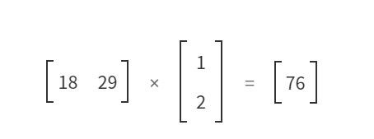
Simple DNN
Quantum mechanics
Useful information
Schrodinger equation
Ansatz
DNN
Architecture
Features
Results
Conclusion
Hidden layer
Of 2 Neurons
Input 1
Weights/
Parameters
Neuron 1
Activations functions
First step
Output
Input 2
Neuron 2
Simple network
Second step
From the article The basics of Deep Neural Networks, https://towardsdatascience.com/

Slide 12
Fermi-net
Quantum mechanics
Useful information
Schrodinger equation
Ansatz
DNN
Architecture
Features
Results
Conclusion
Variational quantum Monte-Carlo (VMC)
Avoid the use of finite basis set
Before: DNN used for others architectures, or bosons but limited for fermions
For previous works on fermions, small number of electrons of small accuracy

Slide 13
Fermi-net Architecture(1/2)
Quantum mechanics
Useful information
Schrodinger equation
Ansatz
DNN
Architecture
Features
Results
Conclusion
Inputs
4 Layers + the final linear layer
Output
Features of single or
pairs of electrons
wavefunction at that position
The Fermionic Neural Network (Fermi Net), Global architecture

Slide 14
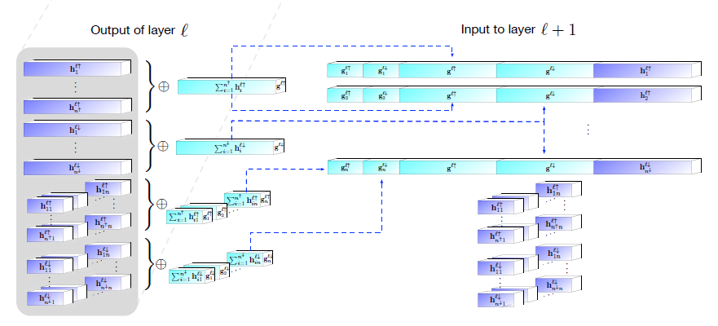
Fermi-net Architecture(2/2)
Quantum mechanics
Useful information
Schrodinger equation
Ansatz
DNN
Architecture
Features
Results
Conclusion
The averages of features of electrons with the same spin
Concatenation of these features to
construct an equivariant function of electron position at each layer.
Detail of a single layer

Slide 15
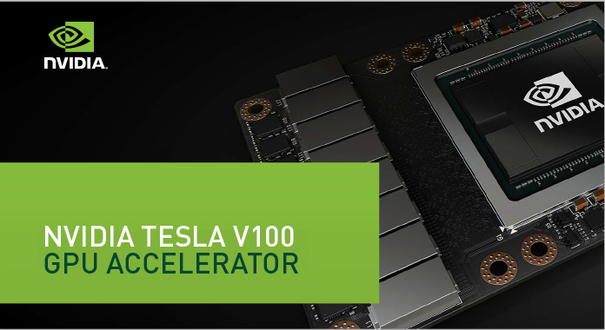
features
Quantum mechanics
Useful information
Schrodinger equation
Ansatz
DNN
Architecture
Features
Results
Conclusion
9000 $ each !
Ethene =8 x
+
=> 2 days
1 GPU => 2 weeks

Slide 16
Results 1/2
Quantum mechanics
Useful information
Schrodinger equation
Ansatz
DNN
Architecture
Features
Results
Conclusion
Reference : CCSD(T)
Energy(Milli-Hartrees) for some atoms with a single determinant.
Carbon monoxide and nitrogen energies with increasing numbers of determinants
Plot comparison of the error energy for the Fermi Net against the classic Slater-Jastrow Ansatz (VMC) and classic VMC Net

Slide 17
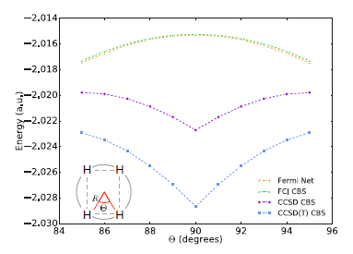
Results 2/2
Quantum mechanics
Useful information
Schrodinger equation
Ansatz
DNN
Architecture
Features
Results
Conclusion
References
Correlation with references
Ground state energy for small molecules
Others states or others geometries: The H4 rectangle: Comparison between CCSD(T)
and Fermi-Net

Slide 18
To conclude
High accuracy calculations of challenging systems.
VMC method competitive and sometimes better than the best methods
Need only one set of training parameters
Not have to choose a finite basis set => common source of errors.
Limits and Improvements :
Larger systems.
Computation time
Wavefunction for projector QMC methods.
“This has the potential to bring to quantum chemistry the same rapid progress that deep
learning has enabled in numerous fields of artificial intelligence.”

Slide 19
To go further…
The Einstein Enigma, José Rodrigues Dos Santos
Novel that popularizes the main concepts of quantum physics

