Slide 1
SphereFace: Deep Hypersphere Embedding for Face Recognition
Georgia Institute of Technology
Carnegie Mellon University
3. Sun Yat-Sen University
Created By:
Yandong Wen, Zhiding Yu
Ming Li, Bhiksha Raj,
Le Song and Weiyang Li
By: Mukul Vishwas

Slide 2
Content
Introduction.
Open set and closed set FR.
Different Loss.
Proposed solution.
Hyper-Sphere representation
Result

Slide 3
Introduction
This paper addresses deep face recognition (FR) problem under open-set protocol.
In this paper proposed the angular softmax (A-Softmax) loss that enables CNNs to learn angularly discriminative features.
Ideal face features are expected to have smaller maximal intra-class distance than minimal inter-class distance.
A- Softmax loss can be viewed as imposing discriminative constraints on a hyper sphere manifold.
the size of angular margin can be quantitatively adjusted by a parameter m.

Slide 4
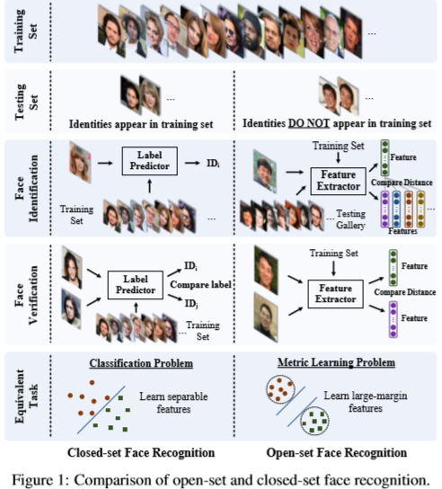
Open and closed set FR.

Slide 5
In open set FR the former classiﬁes a face to a speciﬁc identity, while the latter determines whether a pair of faces belongs to the same identity.
In closed set FR we need to map faces to a discriminative feature space, face identiﬁcation can be viewed as performing face veriﬁcation between the probe face and every identity in the gallery.
Open-set FR is essentially a metric learning problem, where the key is to learn discriminative large-margin features.

Slide 6
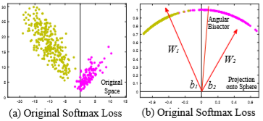
Different Loss
1. Softmax Loss
learn face features via the softmax loss, but softmax loss only learns separable features that are not discriminative enough.

Slide 7
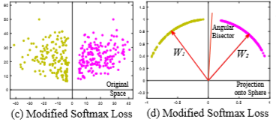
2. Modified Softmax Loss
Euclidean margin based losses are incompatible with softmax loss.
When adopts triplet loss to supervise the embedding learning it lead to state-of-the-art face recognition results.
Both contrastive loss and triplet loss can not constrain on each individual sample, and require carefully designed pair/triplet mining procedure, which is both time-consuming and performance-sensitive.

Slide 8
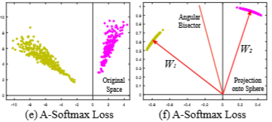
3. A- Softmax Loss
A-Softmax loss has clear geometric interpretation.
The decision regions become more separated.
With the learned features we can construct a discriminative angular distance metric that is equivalent to geodesic distance on a hyper-sphere manifold.
“The close connection between A-Softmax loss and hyper-sphere manifolds makes the learned features more effective for face recognition. For this reason, researchers term the learned features as SphereFace”

Slide 9
Proposed Solution
In this paper, writer propose to incorporate angular margin.
The decision boundary in softmax loss is : (W1−W2)x+b1−b2 = 0
Where: Wi - weight
bi – bias
“If we deﬁne x as a feature vector and constrain |W1|=|W2|=1 and b1=b2=0”
the decision boundary becomes ||x||(cos(θ1)− cos(θ2))=0, where θi is the angle between Wi and x.
“Now the new decision boundary only depends on θ1 and θ2”
Here softmax loss is able to directly optimize angles, enabling CNNs to learn angularly distributed features.

Slide 10
Now generalize the modiﬁed softmax loss to angular softmax (A-Softmax) loss.
Introduce an integer ‘m’(m>=1) to quantitatively control the decision boundary.
“In binary class case, the decision boundaries for class 1 and class 2 become |x|(cos(mθ1)−cos(θ2))=0 and |x|(cos(θ1)− cos(mθ2))=0, respectively.”
‘m’ quantitatively controls the size of angular margin.
Accuracy(%) comparison of different m and original softmax loss on LFW and YTF dataset.

Slide 11
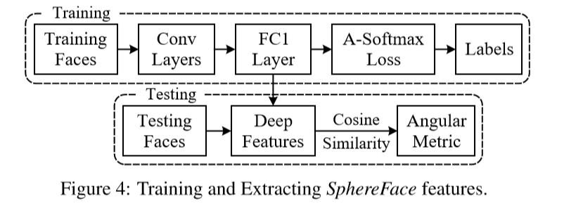
Training of Network
Models are trained with batch size of 128 on four GPUs.
The learning rate begins with 0.1 and is divided by 10 at the 16K, 24K iterations. The training is ﬁnished at 28K iterations.
extract the deep features (SphereFace) from the output of the FC1 layer.
The score (metric) is computed by the cosine distance of two features
The nearest neighbor classiﬁer and thresholding are used for face identiﬁcation and veriﬁcation, respectively.

Slide 12
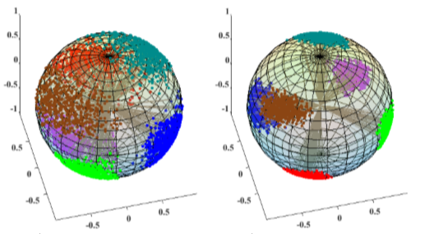
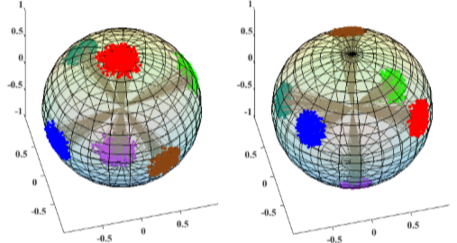
Hyper-Sphere representation

Slide 13
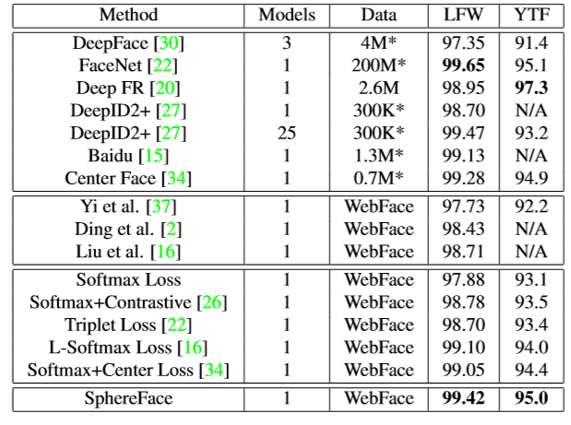
Result

Slide 14
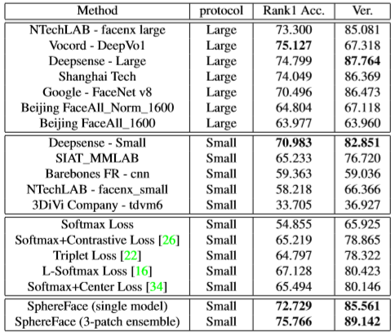

Slide 15
Thank you for your attention.

