Slide 1
Human-level control through deep reinforcement learning
Volodymyr Mnih , Koray Kavukcuoglu , David Silver, Andrei A. Rusu1 , Joel Veness, Marc G. Bellemare1, Alex Graves, Martin Riedmiller, Andreas K. Fidjeland, Georg Ostrovski, Stig Petersen, Charles Beattie, Amir Sadik, Ioannis Antonoglou, Helen King, Dharshan Kumaran, Daan Wierstra, Shane Legg & Demis Hassabis
Presented by: Kalmutskiy Kirill

Slide 2
What is Reinforcement Learning?

Slide 3
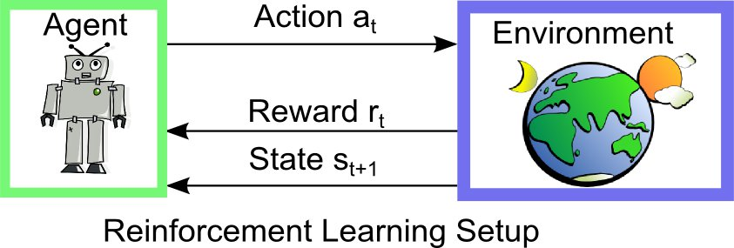
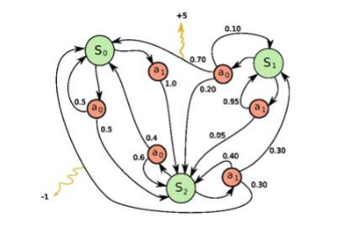
Who is agent?

Slide 4
Why reward system is so important?

Slide 5
State Representation
Think about the Breakout game. How to define a state?
• Location of the paddle
• Location/direction of the ball
• Presence/absence of each individual brick
Screen pixels!

Slide 6
How to make it work?

Slide 7
Q-Learning

Slide 9
Q-network

Slide 11
How to solve problems using a Q-network?
Preprocessing;
Objective function;
Exploration (𝜖-greedy policy);
Experience Replay;
Replacement idea;
Architecture / hyperparameters;
Training algorithm;

Slide 12
Preprocessing
RGB image -> grayscale image;
210 x 160 image -> rescale to 84 x 84 image;
Each state is represented as 4 most recent pictures;

Slide 14
Objective function

Slide 15
Exploration or Exploitation?
During training, how do we choose an action at time 𝑡?
• Exploration: random guessing;
• Exploitation: choose the best one according to the Q-value;
Let’s solve this dilemma using 𝜖-greedy policy:
• Exploration: With probability 𝜖 select a random action;
• Exploitation: With probability 1- 𝜖 select

Slide 16
Experience Replay
1. Take action 𝑎𝑡 according to 𝝐-greedy policy
2. During gameplay, store transition < 𝑠𝑡 , 𝑎𝑡 , 𝑟𝑡+1, 𝑠𝑡+1 > in replay memory 𝐷
3. Sample random mini-batch of transitions < 𝑠, 𝑎, 𝑟, 𝑠 ′ > from 𝐷
4. Optimize MSE between Q-network and Q-learning targets

Slide 17
Experience Replay

Slide 18
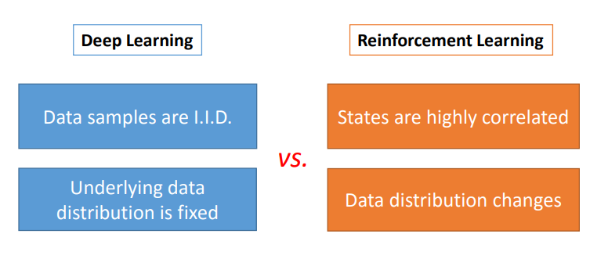
Replacement idea
Every C updates we clone the network Q to obtain a target network S and use S for generating the Q-learning targets for the following C updates to Q.
This modification makes the algorithm more stable compared to standard online Q-learning.

Slide 19
Model architecture

Slide 20
Also important
The agent sees and selects actions on every k-th frame instead of every frame, and its last action is repeated on skipped frames.
This technique allows the agent to play roughly k times more games without significantly increasing the runtime.
We also found it helpful to clip the error term to be between -1 and 1.

Slide 21
Learning algorithm
𝜖-greedy policy
Get reward
Replay buffer
Train Q-network
(objective function)
Replace with temp network

Slide 22
Results

Slide 23
Technique Impact

Slide 24
Bonus

Slide 25
Bonus x2

