Slide 1
Universal sentence encoder
Daniel Cera , Yinfei Yanga , Sheng-yi Konga , Nan Huaa , Nicole Limtiacob , Rhomni St. Johna , Noah Constanta , Mario Guajardo-Cespedes ´ a , Steve Yuanc , Chris Tara , Yun-Hsuan Sunga , Brian Stropea , Ray Kurzweila
Presented by Alexey Korolev

Slide 2
outline
Introduction
DAN
Transformed
Transfer task
How to use

Slide 3
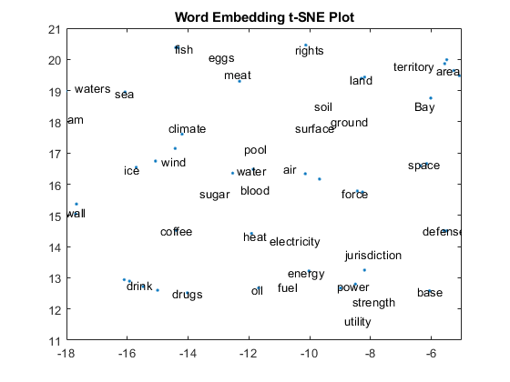
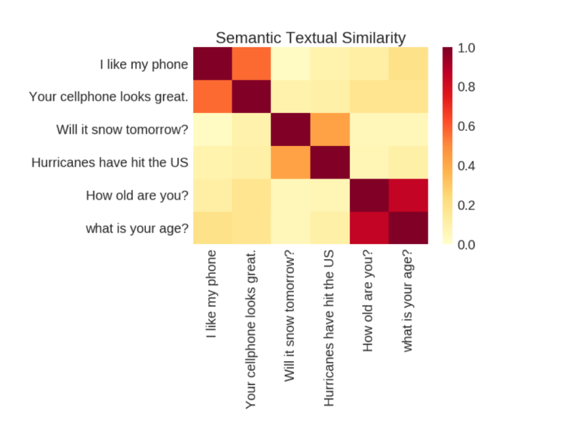
Introduction
For NLP task is necessary to encode text data into numeric data(embedding ).
Criteria of correctly is transfer task performance.
Similar text data – similar emending of this data.
Word embedding.
Text embedding.

Slide 4
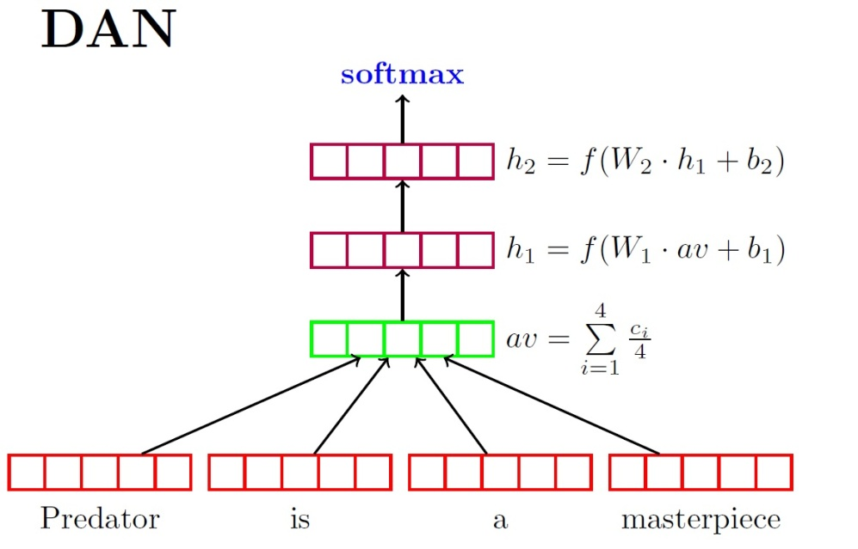
DAN
DAN - Deep Averaging Network.
Input: embedding word, output: embedding word .
Time : O(n), Memory : O(n).
Weakness: all word is equivalent.
F- activation function,
W – matrix of weight,
b – bias,
c – word embedding ,
Example of DAN .
Mohit Iyyer, Varun Manjunatha, Jordan Boyd-Graber, and Hal Daume III. 2015. Deep unordered composition rivals syntactic methods for text classification. In Proceedings of ACL/IJCNLP.

Slide 5
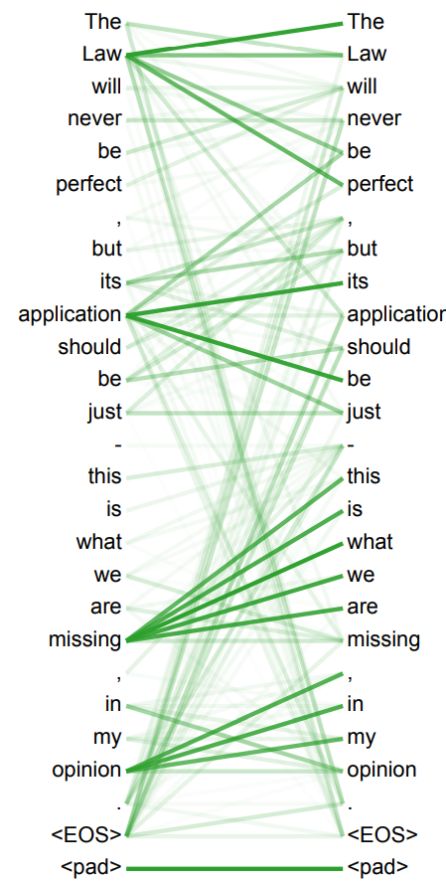
Transformed
Build sub-graph with attention, which consider place word in sentence and other word.
Compute new word embedding.
Sentence embedding = element wise sum of word.
Time = O(n^2), Memory = O(n)
Example sub-graph.
Ashish Vaswani, Noam Shazeer, Niki Parmar, Jakob Uszkoreit, Llion Jones, Aidan N Gomez, Ł ukasz Kaiser, and Illia Polosukhin. 2017. Attention is all you need.

Slide 6
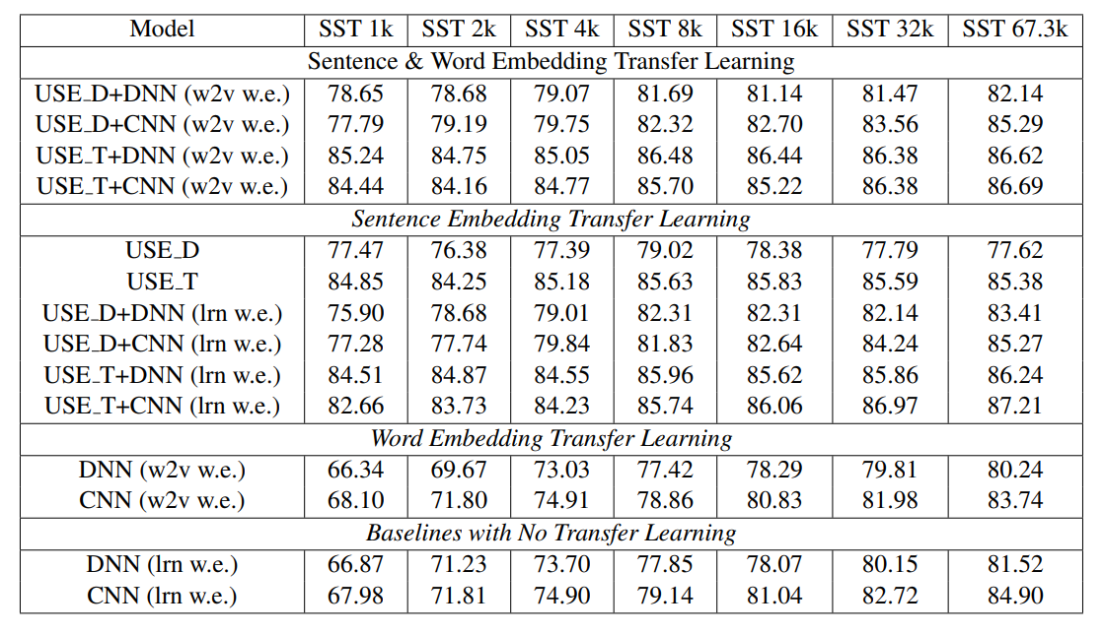
Transfer task
Idea of transfer knowledge from big amount of real data to particular task.
Transfer learning – best way, when train set small.
USE – training on Wikipedia, web news, web question-answer pages and discussion forums. Stanford Natural Language Inference (SNLI) corpus.
Task performance on SST for varying amounts of training data.
USE_D – universal sentence encoding with DAN approach. USE_T – same , but with transformed approach. W2v – word to vector, lrn – random word embedding.

Slide 7
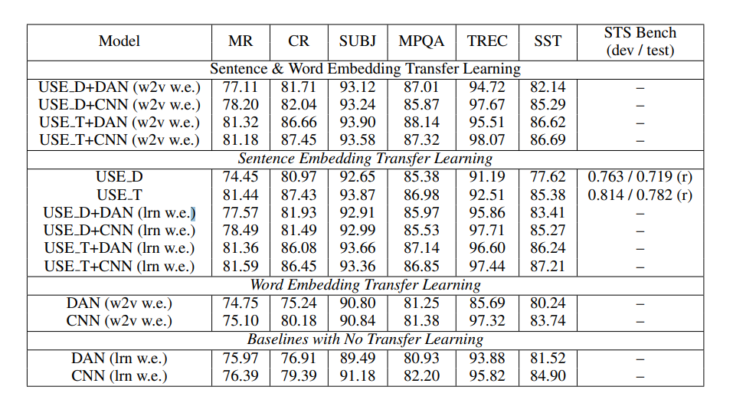
Transfer task
Idea – concatenate sentence and word embedding get best score.
Transformed approach gives better result than DAN.
Model performance on transfer tasks. USE_D – universal sentence encoding with DAN approach. USE_T – same , but with transformed approach. W2v – word to vector, lrn – random word embedding.

Slide 8
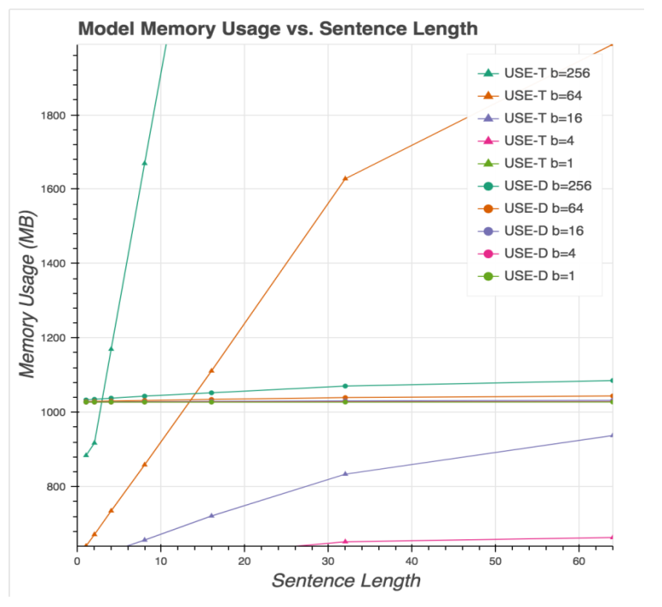
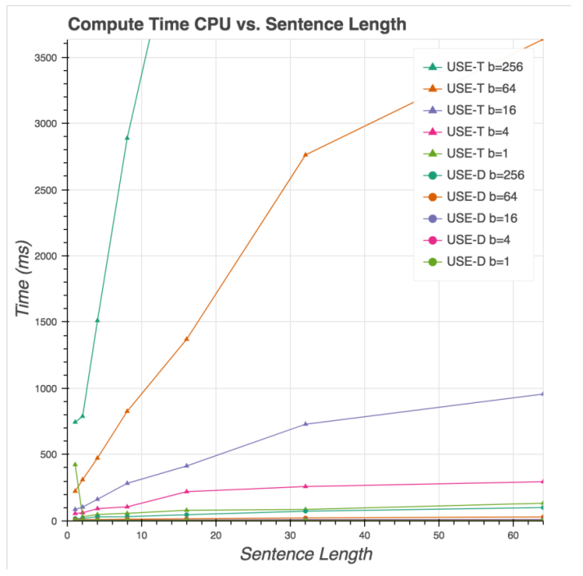
Memory & time cost
DAN almost constant time and memory cost in practice.
Therefore then sentence length isn’t large than better use transformed model.
Model Resource Usage for both USE D and USE T at different batch sizes (b) and sentence lengths.

Slide 9
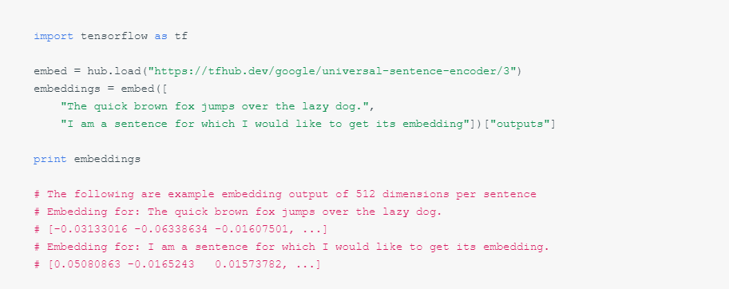
How to use
Library - TensorFlow.
Input – string any size (but it can take a lot of time if sentence is long).
Output – 512 size embedding.
Opportunity to use Multilanguage model.
Detail and example notebook you can find on https://tfhub.dev/google/universal-sentence-encoder/3

Slide 10
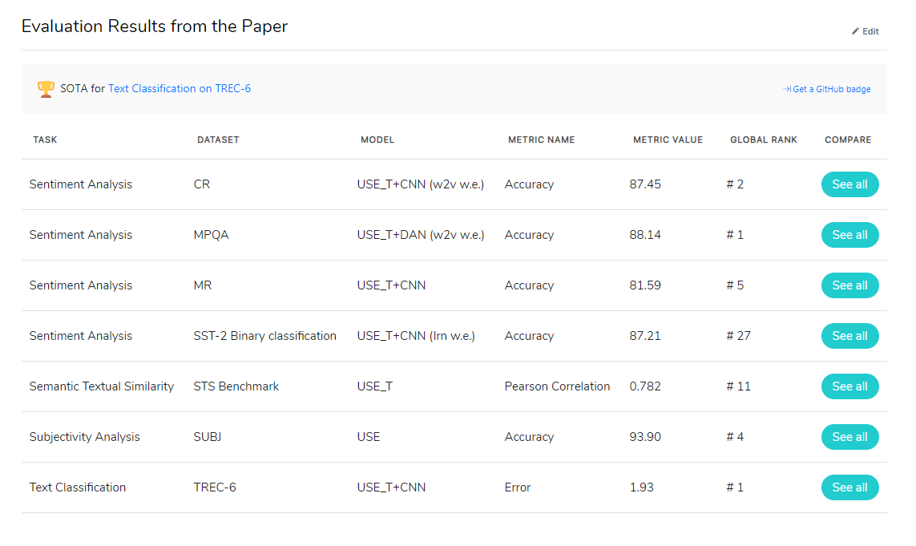
SOTA
USE – effective technique in NLP task.
Here some SOTA result this model in NLP task from paperwithcode.

Slide 11
Thanks for attention!

