Slide 1
A Neural Algorithm of Artistic Style
Voskoboy Elena

Slide 2
Steps of project
Convolutional Neural Network (CNN). A given input image is represented as a set of filtered images at each processing stage in the CNN.
Content Reconstructions. We can visualise the information at different processing stages in the CNN by reconstructing the input image from only knowing the network’s responses in a particular layer.
Style Reconstructions. On top of the original CNN representations we built a new feature space that captures the style of an input image. The style representation computes correlations between the different features in different layers of the CNN.

Slide 3
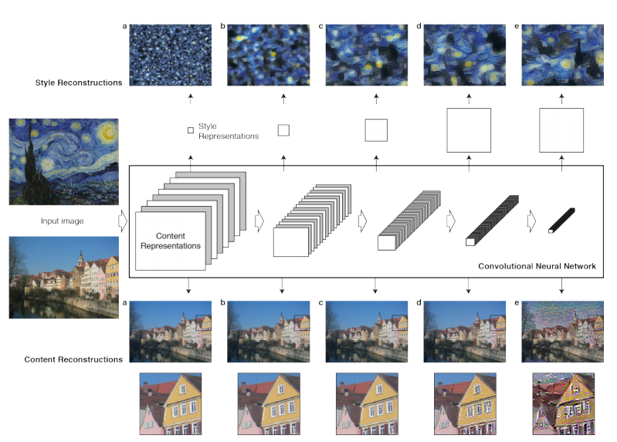

Slide 4
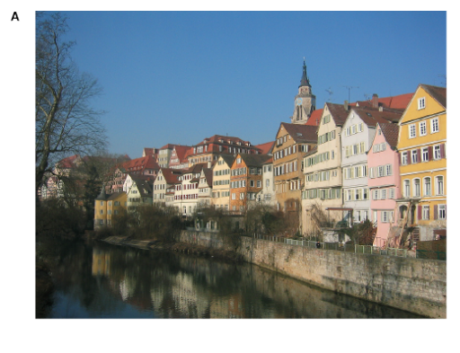
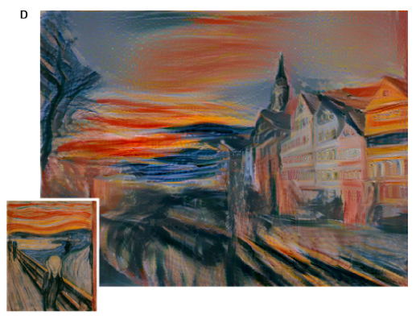
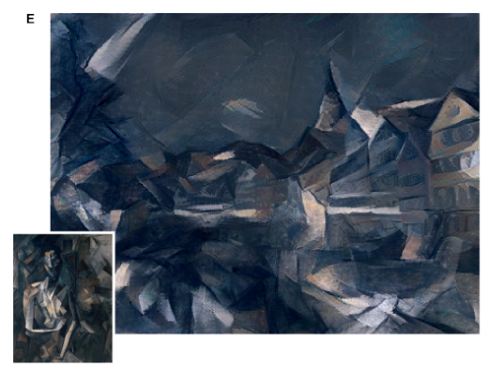
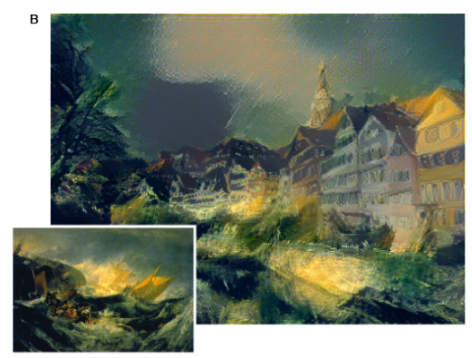
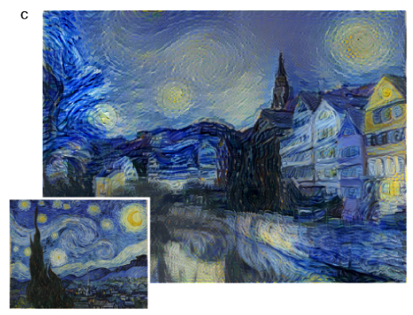
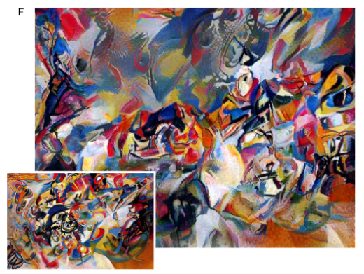

Slide 5
Methods and data
VGG-Network - Visual Geometry Group which achieved very good performance on the image dataset.
16 convolutional and 5 pooling layers of the 19 layer VGGNetwork

Slide 6
Methods
- a given input image
- an image that is generated
and
- their respective feature representation in layer l.
- amount of distinct filters
- size of feature map
The squared-error loss between the two feature representations
The derivative of this loss with respect to the activations in layer

Slide 7
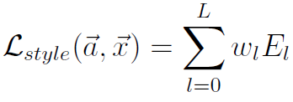
Methods
The inner product between the vectorised feature map i and j in layer l
and
the original image and the image that is generated and
and
their respective style representations in layer l
The contribution of that layer to the total loss is
and the total loss is
are weighting factors of the contribution of each layer to the total loss

Slide 8
Methods
The derivative of
analytically:
with respect to the activations in layer l can be computed
The loss function we minimise is
are the weighting factors for content and style reconstruction respectively

Slide 9
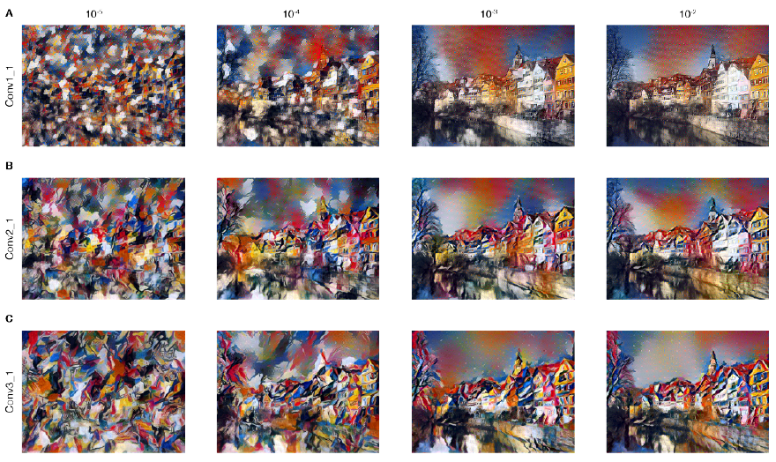
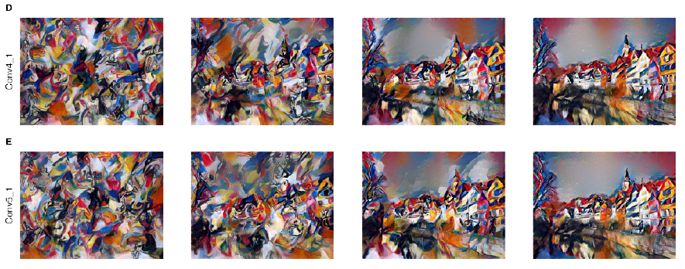

Slide 10
Thank you for attention

