Slide 1

Understanding Consumer Behavior with Recurrent Neural Networks
Paper by: Tobias Lang, Matthias Rettenmeier
Presented by: Abhishek Saxena

Slide 2
Research Focus
Consumer behavior in e-commerce can be described by sequences of interactions with a webshop. It is shown that
recurrent neural networks (RNNs) are a natural fit for modeling and predicting consumer behavior.
In multiple aspects, RNNs offer advantages over existing methods that are relevant for real-world production systems. Applying
RNNs directly to sequences of consumer actions yields the same or higher prediction accuracy than vector-based methods like logistic regression. Unlike the latter, the application of RNNs comes without the need for extensive feature engineering.
In addition, it is shown that RNNs help to link individual actions directly to predictions in an intuitive way. This allows us to understand the implications consumer actions have on predicted probabilities over the course of the consumer’s history.
We demonstrate the advantages of RNNs on the empirical data of a large European online
fashion platform “Zalando”

Slide 3
Why Understanding Consumer Behavior?
Predicting future consumer behavior is fundamental to
many use-cases in e-commerce.
Recommendor Systems
Recommender systems over fraud detection to real-time
bidding for online ad-inventory.
Product Sales and Inventory Management
It helps in knowing the need of the consumers and likeability also. To maintain the right inventory according to the latest sales and trend.
Previous Consumer Behavior
Data Assessment
Predictions are based on indicators found in previous consumer behavior. e.g. the time since a
consumer last visited the webshop, the products that were looked at or the amount of products added to the cart. Behavior is captured in consumer histories, which are, in their raw form, sequences of interactions with the webshop
Interactions are of a particular type, they have a timestamp and additional information such as product details. The type is derived from the associated action, such as a product-view or a cart-addition, the timestamp is simply the time of the action, etc.

Slide 4
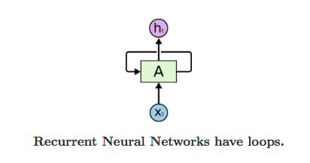
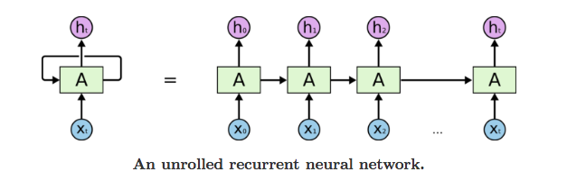
What is Recurrent Neural Network?
Chunk of neural network, A,
looks at some input xt
and outputs a value ht.
A recurrent neural network can be thought of as multiple
copies of the same network, each passing a message to a successor.
Above shown is what happens if we unroll the loop.

Slide 5
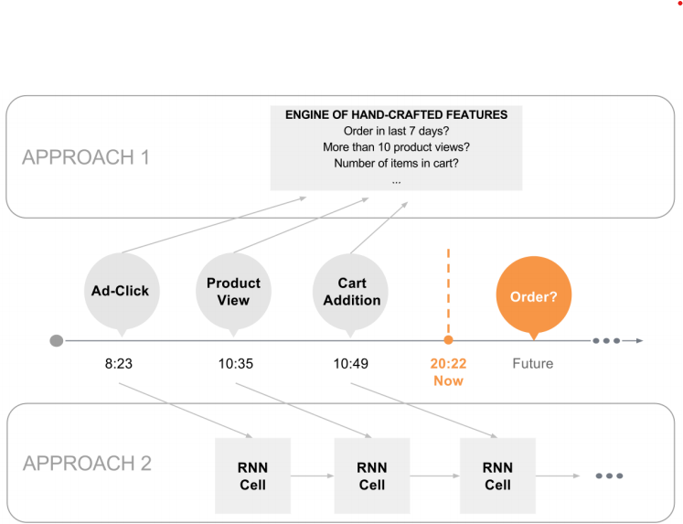
Vector Approach v/s RNN Approach
Approach 1
Approach 2
Vector-based methods use hand-crafted non-sequential features to encapsulate the signals in
the consumer history.
RNNs model the sequential consumer history directly.
Two approaches to model consumer histories

Slide 6
Detailed Background
Vector v/s RNN
Initialisation
Initialisation
RNNs take sequences X = (x1, . . . , xT) of varying length T as inputs. The computational cells at step t takes input xt and maintains a hidden state ht ∈ Rd, is computed from input xt and the cell state at the previous time-step htt1 as
ht = σ(Wx.xt + Wh.htt1 + b)
where Wx and Wh are learned weight matrices, b is a
learned bias vector and σ is the sigmoid function.
Consumer histories of arbitrary length requires feature engineering: a fixed set of identifiers fi has to be designed to capture the essence of an individual consumer history, i.e. Vectors f = (f1, . . . , fn) of fixed length n as inputs. Only signals that are encoded in the feature vector can be picked up by the prediction model.
Processing Consumer Behavior
A hidden state ht captures information from the input
sequence (x1, . . . , xt) up to the current time-step t.
Information from early inputs can thereby be preserved
over time.
Additional feature processing are often necessary to improve model performance. Preprocessing may be required if input features consist of numerical, ordinal, and categorical features at the same time; if features have different value ranges; or to ensure model
robustness with model regularization. A common pre-processing approach is to create binary input vectors from the original input features
Processing Consumer Behavior
During training, parameters W and b of computational cells are adapted to detect signals in the input sequences that increase prediction accuracy. Input sequences X are compressed by this process into
suitable feature vectors ht.
Results
While preprocessing is an important to improve model performance, it artificially increases the dimensionality of the input-vector. Also, the resulting binary features can be strongly correlated. Both outcomes make it difficult to tell which action patterns in the underlying consumer histories have a strong impact on the
prediction outcome.
Results
Compression process is viewed as feature learning from raw inputs, hence work-intensive human feature engineering is not required before applying RNNs. Also, it undertakes more valuable features which were usually get neglected in Vector based approach.

Slide 7
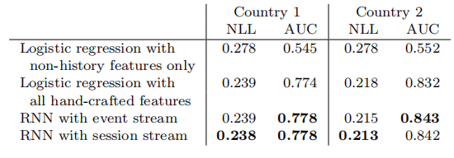
RNN Results
Vector Model Results
NLL, negative log-likelihood is reduced and AUC area under the ROC curve (for true positive results) increased. It truly shows that RNN model can easily catch all the features of the consumer behaviour here e.g. using Event and Session stream as base without handling feature engineering.
It can be argued that Vector based Logitic Regression can be modelled at every single step of the consumer behavior for better results.
The drawback is redundant calculations. Another thing is for multiple feature engineering the process would become infintely complex and tidious to handle.
Experiments performed on the real data on Zalando in two European countries.

Slide 8
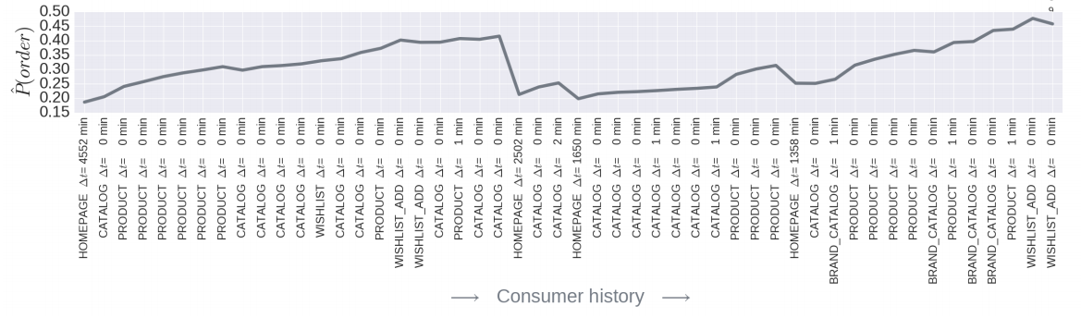
Typical Experiment Results for Consumer Behavior in Product Purchasing

Slide 9
RNN Better Usability
Consumer behavior is inherently sequential which makes RNNs a perfect fit
Reduced feature engineering; improved empirical performance
Better prediction explanations and Sophisticated product recommendations
RNN architectures will be
promising future research in other Domains.

Slide 10
Usability of this Paper in my Thesis
Canada
70%
Russia
60%
USA
80%
Australia
50%
Brazil
65%

Slide 11
NAMASTE
Any Questions?

