Slide 1
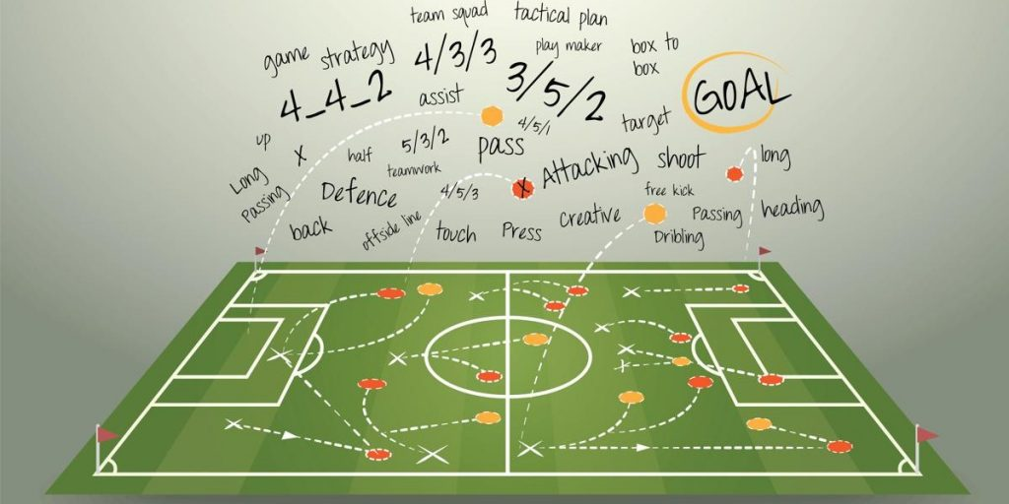
A Machine Learning Framework For Sport Result Prediction
Made By:
Rishabh Tiwari
Master in Big Data And AI
Novosibirsk State University
Novosibirsk,Russia

Slide 2
1.Introduction
Machine Learning tasks involves predicting a target variable in previously unseen data is classification.
The aim of classification is to predict a target variable class by building a classification model based on a training dataset and then utilising that model to predict the value of class of test data.
This type of data processing is called Supervised learning.

Slide 3
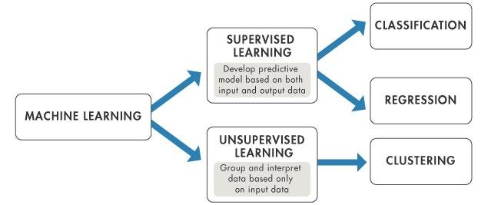
Supervised versus unsupervised Learning

Slide 4
Sports prediction is usually treated as a classification problem, with one class(win , lose, or draw) is predicted.
Some analysts also look for winning margin by looking numeric prediction problem.
In sports prediction large numbers of features can be collected including the historical performance of the teams ,results of matches and data on players.

Slide 5
2.Scope
To help different stakeholders understand the odds of winning or losing forthcoming matches.
To decide which team is likely to win because of the financial assets involved in the betting process(for approximate the odds of game in advance).
Once the predicted result for match is obtained, an additional problem is to then decide whether to bet on the match or not.
Sports managers also use this for assessing the potential opponent in match.
The increasing amount of data related to sports is available has meant there has been increasing interest in developing intelligent models and prediction systems to forecast the results of the matches.

Slide 6
3.Aims and Contribution
To provide a critical survey of the literature for sports result prediction focusing on the use of neural network for this problem.
To Discuss the challenge that arise when using these intelligent models on sports prediction.
To explain CRISP-DM type framework for sport result prediction is proposed(SRP-CRISP-DM) based on the six steps of CRISP-DM.
To serve researchers , sports fan , club managers ,book makers , and students who are interested in intelligent solutions based on NN for sports result predictions.

Slide 7
4.Literature Review and Critical Analysis
Artificial neural Networks are perhaps the most commonly applied approach among ML mechanisms to the sports prediction problem.
An ANN usually contains interconnected components (neurons) that transform a set of inputs into a desired output.
It is constructed after processing the training dataset that contains the features used to build an ANN model.
ANN model are quite flexible in terms of how the class variable is defined.

Slide 8
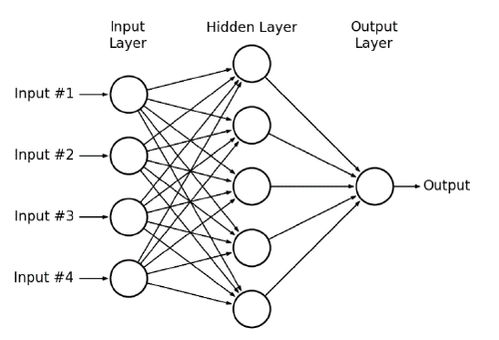
Artificial Neural network Structure

Slide 9
5.The proposed Sport Result Prediction Intelligent Framework
In this section an intelligent architecture for sports result prediction is presented.
Proposing steps of a possible framework and describing the characteristics of the data used for sports results prediction and how this fits in the framework.
This framework consists of six main steps based on the steps of the standard CRISP_DM.
This framework focuses on result prediction for team sports rather than individual sports.

Slide 10
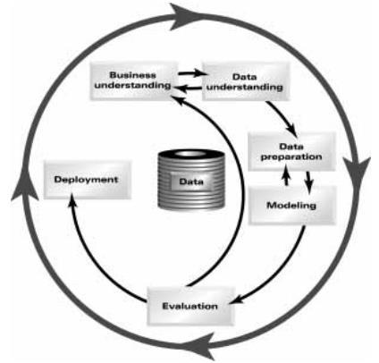
SIX Phases of Traditional CRISP-DM Model

Slide 11
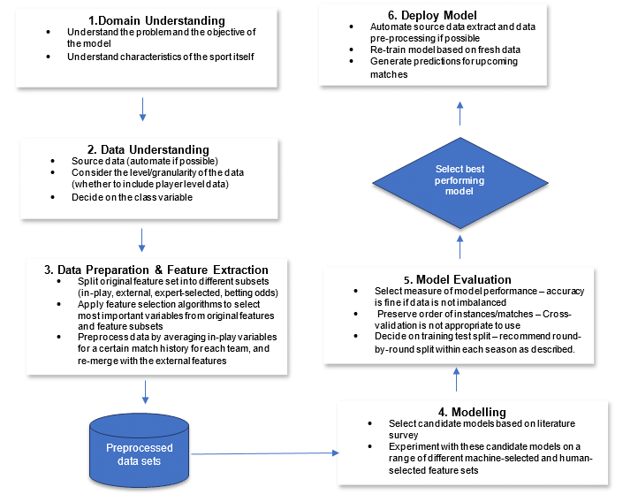
Steps of Proposed SRP-CRISP-Framework

Slide 12
5.1 Domain Understanding
It includes comprehending the problems, the goal of the modelling and the specific characteristic of the sport itself.
Some Understanding of how the sport is played and what factors are potentially involved in determining the outcome of matches.
It is obtained by personal knowledge , surveying existing literature or by consulting experts in the sports.
There also needs to be clarity regarding the objective of the model.
It could be to predict results to compare with experts predictions, online competitions or it could be to use result to bet on matches.
If the model is used for betting ,there needs to also be consideration of which matches will be bet on.
Example –There will be likely some betting odds threshold where although the model predict a victory for that team , the betting odds are so low that the return does not warrant betting on that match at all(for 100$ bet placed would only return $1)

Slide 13
5.2 Data Understanding
Data for sports prediction is obtained online.
Some prior studies have automated the data collection process , writing scripts that automatically extract the online data And then load it into some of database.
An end user interface where users can input data for an upcoming match and the prediction is then generated.

Slide 14
Granularity Level of Data
Previous study have generally had training data that is at the match /team level.
Now It is also possible to include player-level data which contain statistics on the player that have played in each of the matches.
Then player level data is contained is separate data set which is transposed and joined with match level data So that each match has player statistics as attributes in the data set.
Including this player level data have advantage that whether specific players actions or presence are important for performance of team whether they win or lose.

Slide 15
Class Variable
Most prior work has treated the sports prediction problem as a 2 or 3 class values classification problem(home win, Away win) or (home win, draw, away win).
Delen also considered the problem as a numeric prediction problem using regression techniques to predict the points margin(home points minus away points), then making win-loss prediction based on the predicted points margin.
Authors found that treating the problem as a classification resulted in superior results (not applicable in all sports or all datasets)

Slide 16
5.3Data Preparation & feature Extraction
5.3.1-Creating Feature Subsets
Features in sport result data can be divide into several different subsets.
Split the feature into match related and standings features
How a hybrid model of betting odds and public data features compared with a feature set of betting alone.
One can investigate which classifier and feature selection algorithm together produces the best classification accuracy
Another way to compare expert selected feature set to compare with machined learned feature.

Slide 17
5.3.2-Data Pre-processing : Match Features versus External Features
Match related features relate to actual events with in the sports match(For example in football these could be meters gained, passes made and so on)
External features do not relate to events with in the match , that is external to the match itself(example – recent form , travel, players available for match)
We know about the external features and but don’t know about match features until the match has been played.
Therefore match related feature should undergo a separate averaging process before being re-merged with external features .
For match related features we need to average past results.

Slide 18
6.Modelling
The first step in the modelling is to select candidate models will be used in the experimentation.
It involve a review of past literature and identification of commonly applied predictive models that have previously been successful.
Each model can be trailed on each feature subset and subsets that have been selected by feature selection algorithm.
Identify the best combination of classifier and feature selection technique.

Slide 19
7.Sports Prediction Model Evaluation
7.1Measuring Model performance
To evaluate model performance classify match results into home wins, away wins and draw(if the sports has draw).
Then look at the number of matches that the model has correctly identified ,using standard classification matrix.
Classification accuracy is a reasonable measure of evaluation.
In cases where the data is highly imbalanced, ROC curve evaluation may be more appropriate.

Slide 20
7.2.Training and Testing
It is important to preserve the order of the training data for the sport prediction problem, So that the upcoming matches are predicted based on past matches only.
Cross validation generally involves shuffling the order of the instances and therefore is not an appropriate means of splitting the data into training and testing.
A held out training test split is more appropriate with the order of the instances being preserved.
Machine Learning Software such as WEKA provide the option to preserve the order of instances.

Slide 21
An appropriate training split need to be decide on that depends on amount of data researcher have, whether they have only one season of data or multiple seasons.
Some sport competitions are organized in rounds, with teams playing matches over weekend.
In this case where one season of data is on hand ,the number of rounds that will be use for training and number of rounds for testing needs to be determined.
For Example – In a data set with 10 rounds of data, the first 7 round taken as training set and last three for testing the model.

Slide 22
For more realistic measure of model performance round 1 can be used a s training to test on round 2 , round 1 & 2 could be used as training set to test on round 3 ,round 1-3 could be used as training to test on round 4 so on.
So within season which contains a certain number of competition rounds, we use 1 to n-1 to train our model and use round n as the test data, For each round n in N where N is total no. of rounds.
Thus we obtain a classification accuracy for each of these training/test splits and take an average of the accuracies to give an overall measure of model performance.

Slide 23
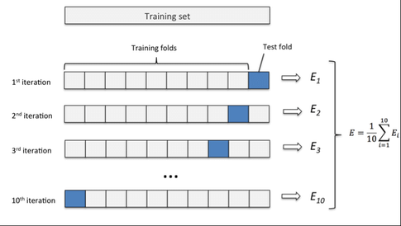
Diagrammatactic Representation of 10-Fold Cross Validation

Slide 24
8.Model Deployment
One can automate the process so that new round data is obtained from the web and added to match database(or manually by the end user)
The training data and test data are then adjusted, the model is retrained with the new training data and new matches are predicted.
Predictions are then returned to the end users.
The learning model in the proposed architecture could also be online and dynamically receiving input data prior to the match beginning(external feature) and while the match is played(match features).
It should be incremental in the way that the training set is continuously updated, and thus the classifier would keep changing to reflect those of the learning environment.

Slide 25
9.Conclusions
Sports require good predictive accuracy is match result prediction.
Traditionally the results of the matches are predicted using mathematical and statistical models that are then verified by a domain expert.
Due to specific nature of match related features to different sports, results across different studies in this application can generally not be compared directly.
Despite the increasing use of ML models for sports prediction , more accurate models are needed, this is due to high volumes of betting on sport, for sport managers .
Therefore ML seems an appropriate methodology for sport prediction Since it generates predictive models that can predict match results using predefined features in a historical dataset.

Slide 26
Rory Bunker and Fadi Thabath ,” A Machine Learning Framework for Sport Result Prediction” Applied Computing and Informatics Volume 15, Issue 1, January 2019, Pages 27-33
Reference

Slide 27
THANK YOU

