Slide 1
Universal Language Model Fine-tuning for Text Classification
Jeremy Howard, Sebastian Ruder

Slide 2
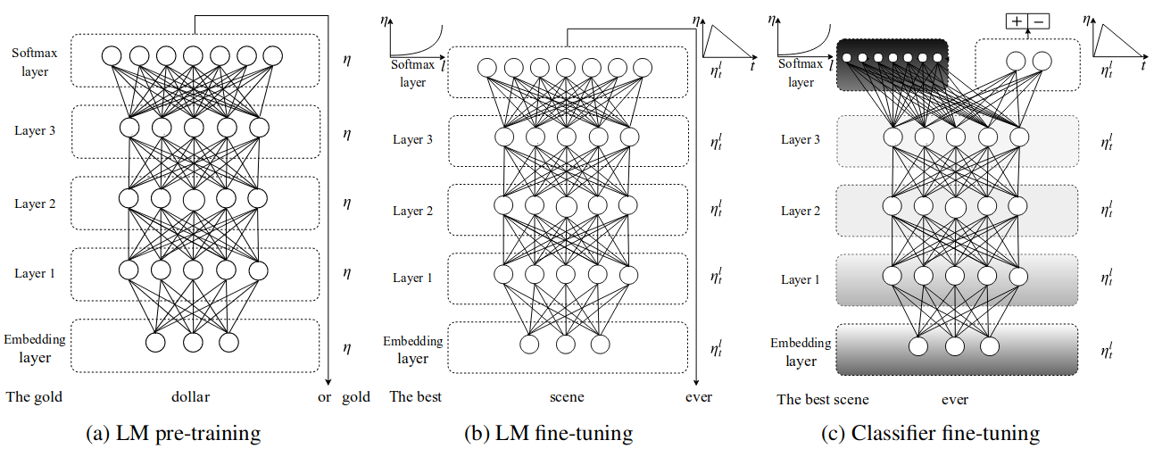
Architectural feature

Slide 3
LM is trained on a general-domain corpus

Slide 4
Slanted triangular learning rates (STLR)

Slide 6
Gradual unfreezing

Slide 7
Reducing error rate

Slide 8
Quick Start: Training an IMDb model with ULMFiT
Reading and viewing the IMDb data
Getting your data ready for modeling
Fine-tuning a language model
Building a classifier
Notes:
Let's start with a quick end-to-end example of training a model. We'll train a sentiment classifier on a sample of the popular IMDb data, showing 4 steps:

Slide 9
https://docs.fast.ai/text.html

