Slide 1
Zero-Shot Learning - A Comprehensive Evaluation of the Good, the Bad and the Ugly Yongqin Xian, Student Member, IEEE, Christoph H. Lampert, Bernt Schiele, Fellow, IEEE, and Zeynep Akata, Member, IEEE
Vladislav Panferov

Slide 2
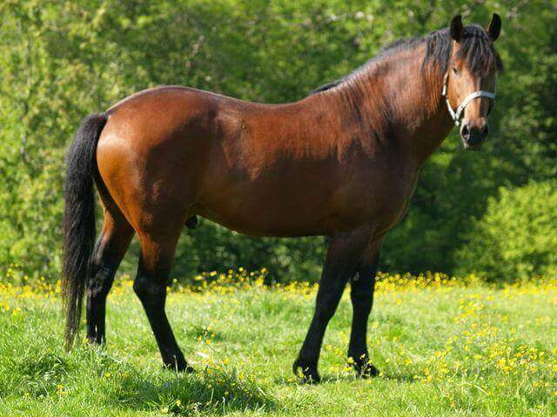
Horse
Black | Yes
White | No
Brown | Yes
Stripes | No
Water | NO
Eats Fish | No
Class Embedding (Vector)

Slide 3
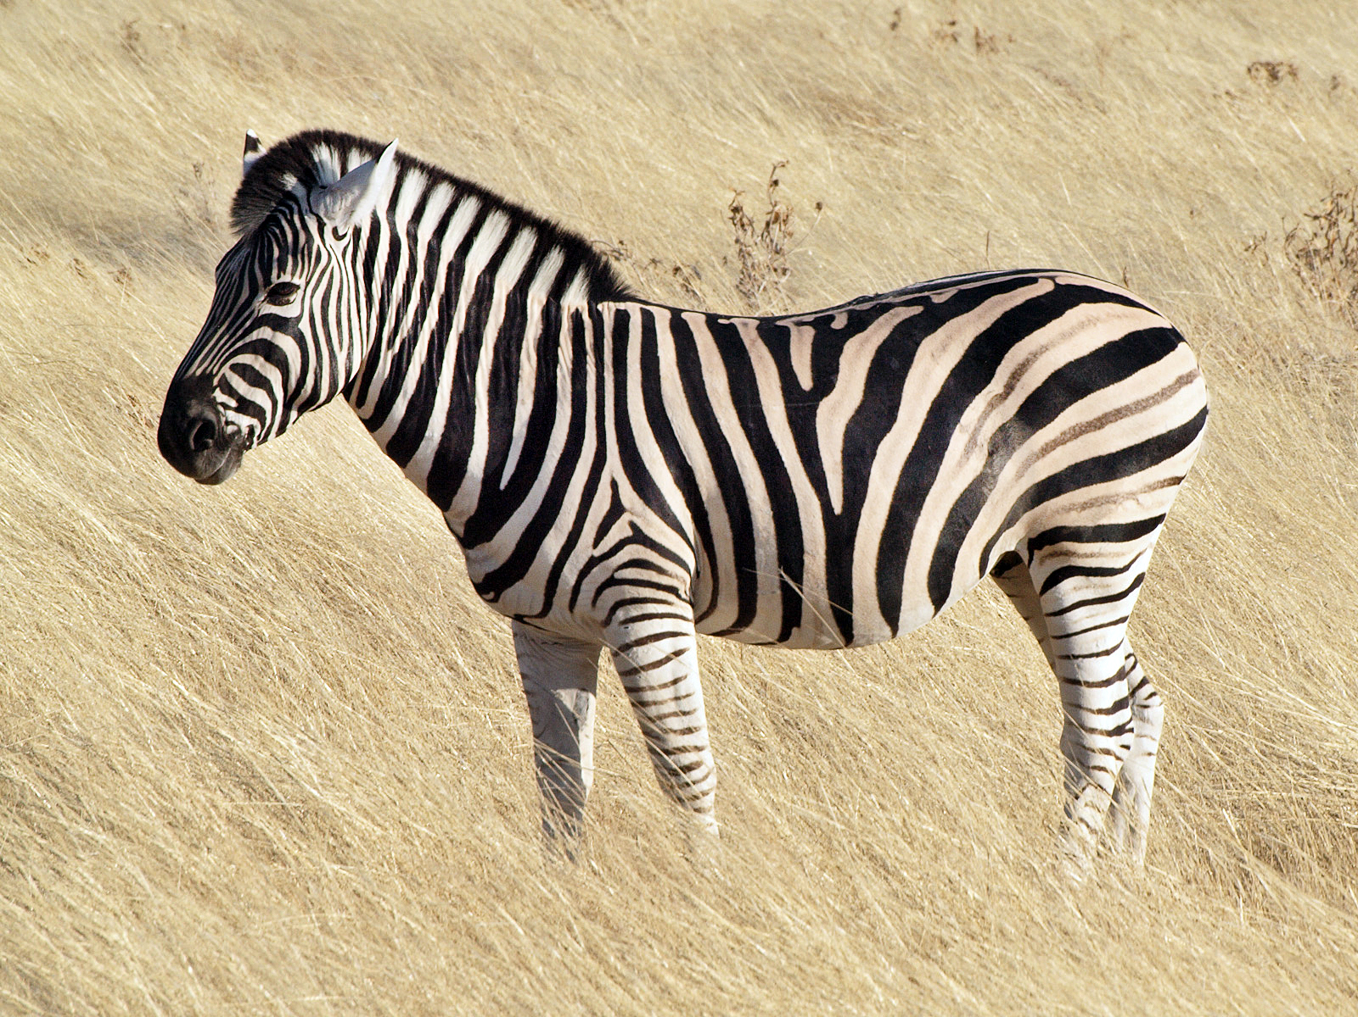
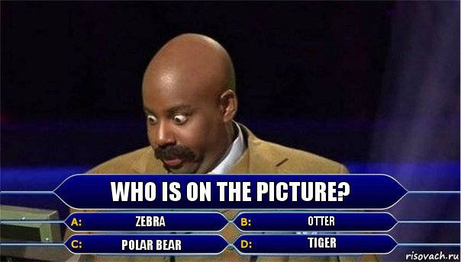
Zebra
Otter
Black | Yes
White | Yes
Brown | No
Stripes | Yes
Water | No
Eats Fish | No
Black | Yes
White | No
Brown | Yes
Stripes | No
Water | Yes
Eats Fish | Yes
Polar Bear
Tiger
Black | No
White | Yes
Brown | Yes
Stripes | No
Water | Yes
Eats Fish | Yes
Black | Yes
White | Yes
Brown | Yes
Stripes | Yes
Water | No
Eats Fish | No

Slide 4
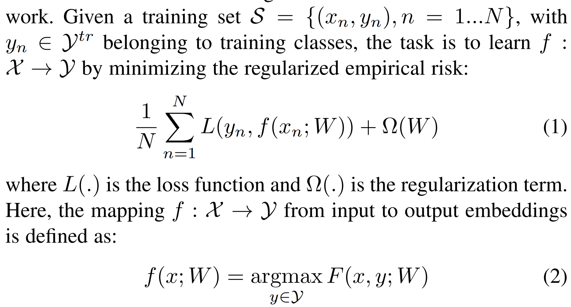
Zero-shot learning task (more formal)

Slide 5
Test time
Zero-shot learning
Generalized Zero-shot learning

Slide 6
HISTORY
2014…

Slide 7
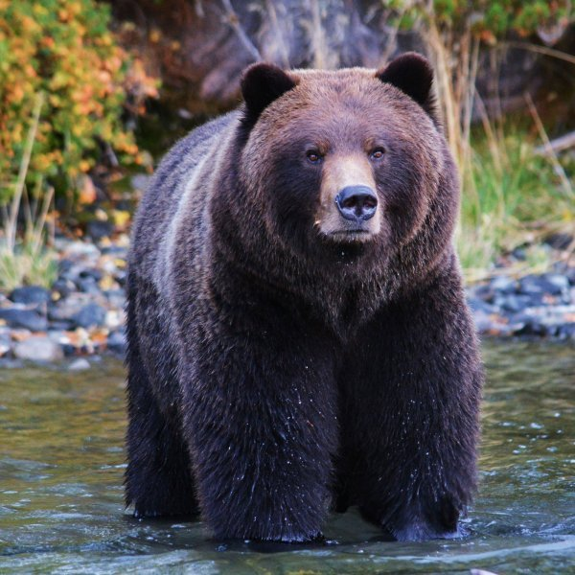
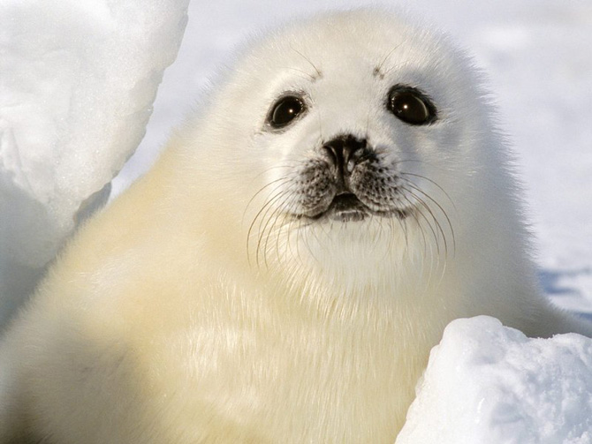
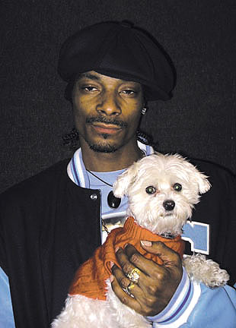
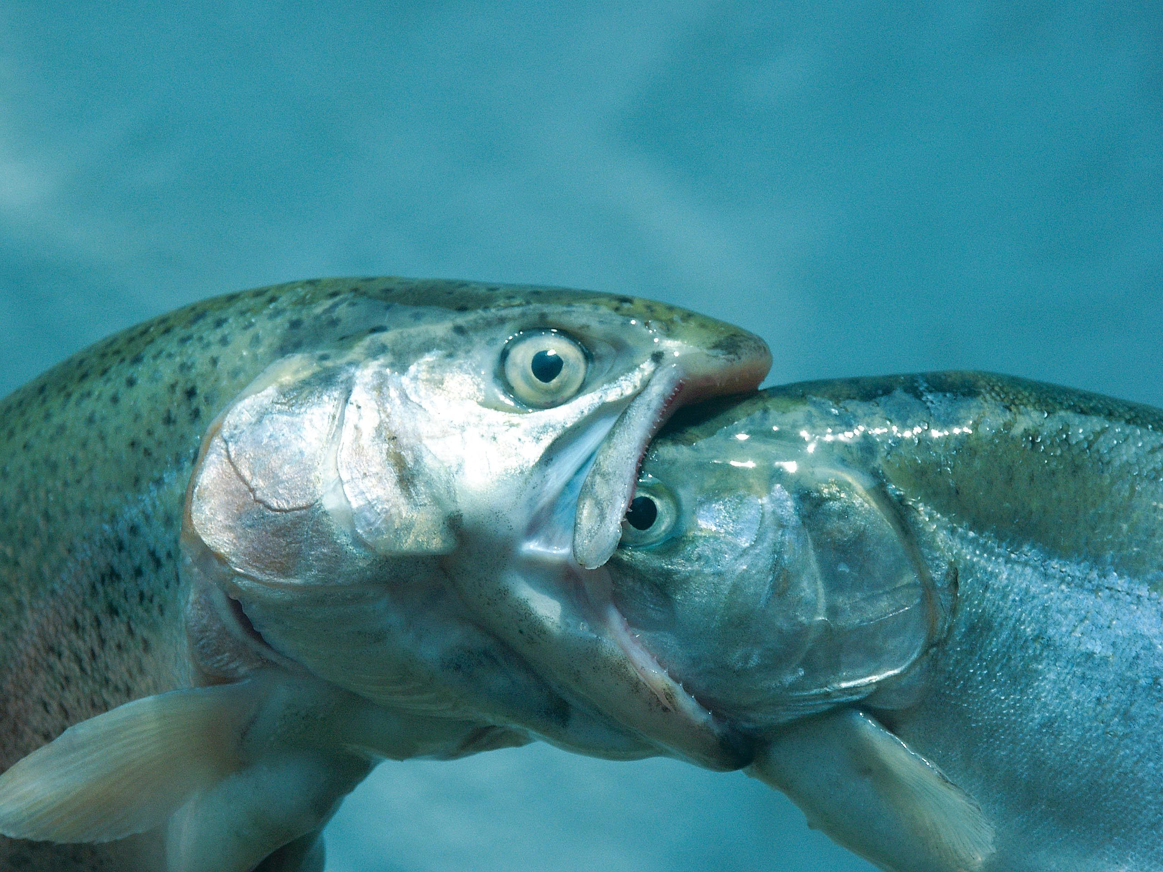
Zero Shot learning in 2 stages
1. Learn Attribute classifier to understand what “White”, “Stripes”, “Eats Fish” mean
2. Learn classifier to understand who the “Bear”, “Fish”, “Dog” are

Slide 8
HISTORY

Slide 9
Zero-Shot Learning - A Comprehensive Evaluation of the Good, the Bad and the Ugly

Slide 10
Purpose of the paper
Try several zero-shot learning implementation methods on several datasets.
Evaluated Methods (13):
Learning Linear Compatibility
Learning Nonlinear Compatibility
Learning Intermediate Attribute Classifiers
Hybrid Models
Transductive Zero-Shot Learning Setting
Datasets (6):
Coarse-grained – small-scale aPY, medium-scale AWA1 and AWA2 with attributes
Fine-grained:
Both medium-scale SUN, CUB with attributes
Large-scale ImageNet without attributes
* Medium scale – images (10,000 – 1,000,000)
and classes (100-1000)

Slide 11
Learning Linear Compatibility
Use bi-linear compatibility function to associate visual and auxiliary information
DEVISE (Deep Visual Semantic Embedding)
ALE (Attribute Label Embedding)
SJE (Structured Joint Embedding)
ESZSL (Embarrassingly simple zero- shot learning)
SAE (Semantic Autoencoder)

Slide 12
Learning Nonlinear Compatibility
LATEM (Latent Embeddings) uses nonlinear compatibility function
CMT (Cross modal transfer) first maps images into a semantic space of words, i.e. class names, where a neural network with tanh nonlinearity learns the mapping

Slide 13
Learning Intermediate Attribute Classifiers
Both perform poorly, and were included to the evaluation only for being historically the most widely used methods in the literature
DAP (Direct Attribute Prediction)
Learns probabilistic attribute classifiers and makes a class prediction by combining scores of the learned attribute classifiers.
IAP (Indirect Attribute Prediction)
Indirectly estimates attributes probabilities of an image by first predicting the probabilities of each training class, then multiplying the class attribute matrix

Slide 14
Hybrid Models
Express images and semantic class embeddings as a mixture of seen class proportions.
SSE (Semantic Similarity Embedding)
Leverages similar class relationships both in image and semantic embedding space.
SSE (Semantic Similarity Embedding)
Leverages similar class relationships both in image and semantic embedding space.
GFZSL (Generative framework for zero-shot learning)
Proposes a generative framework for zero-shot learning by modeling each class-conditional distribution as a multivariate Gaussian with mean vector and diagonal covariance matrix
SYNC (Synthesized Classifiers)
Learns a mapping between the semantic class embedding space and a model space.

Slide 15
Transductive Zero-Shot Learning Setting
In zero-shot learning, transductive setting implies that unlabeled images from unseen classes are available during training. Using unlabeled images are expected to improve performance as they possibly contain useful latent information of unseen classes
GFZSL-tran (Generative framework for zero-shot learning – transductive)
Leverages similar class relationships both in image and semantic embedding space.
Train time
DSRL (Discriminative semantic representation learning)
Proposes to simultaneously learn image features with non-negative matrix factorization and align them with their corresponding class attributes.

Slide 16
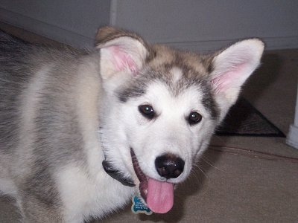
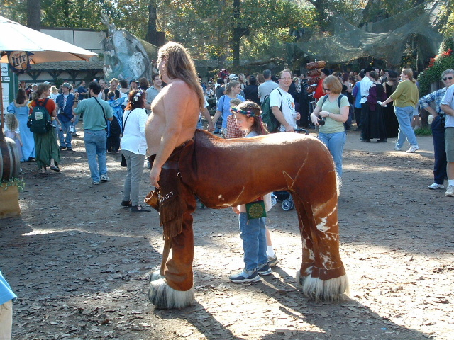
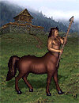
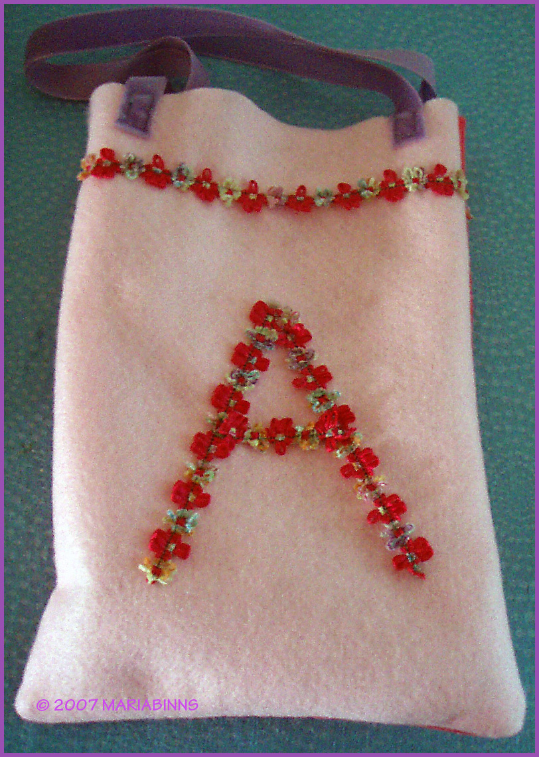
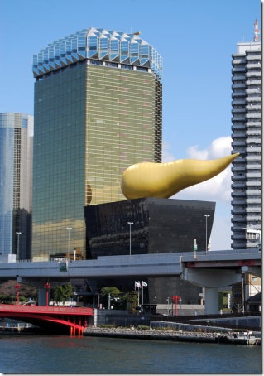
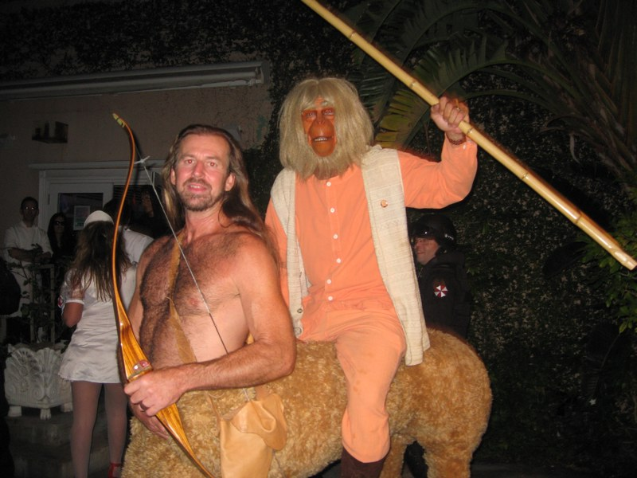
DATASETS - aPY
Coarse-grained
64 Attributes
32 classes (20 – Train, 12 – Test)

Slide 17
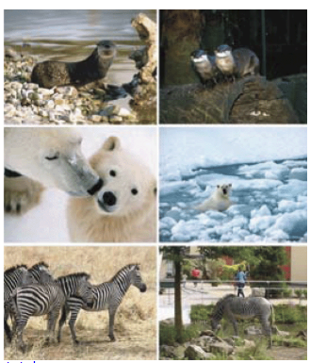
DATASETS – AWA1 Animals with Attributes
Coarse-grained
85 Attributes
30,475 images
50 classes (40 –train, 10 – test)
Commercial

Slide 18
DATASETS – AWA2 Animals with Attributes
Coarse-grained
85 Attributes
30,475 images
50 classes (40 –train, 10 – test)

Slide 19
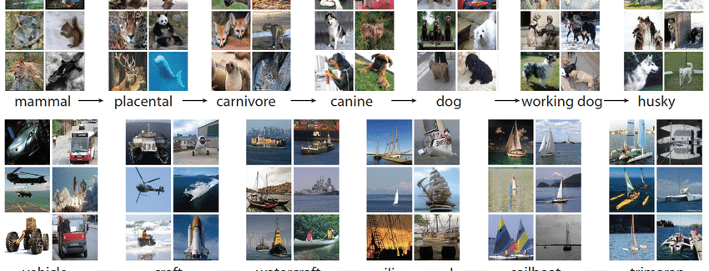
DATASETS – ImageNet1K
Fine-Grained
No Attributes – Word2Vec was used (binary)
1000 classes (800 – Train, 200 – Test)

Slide 20
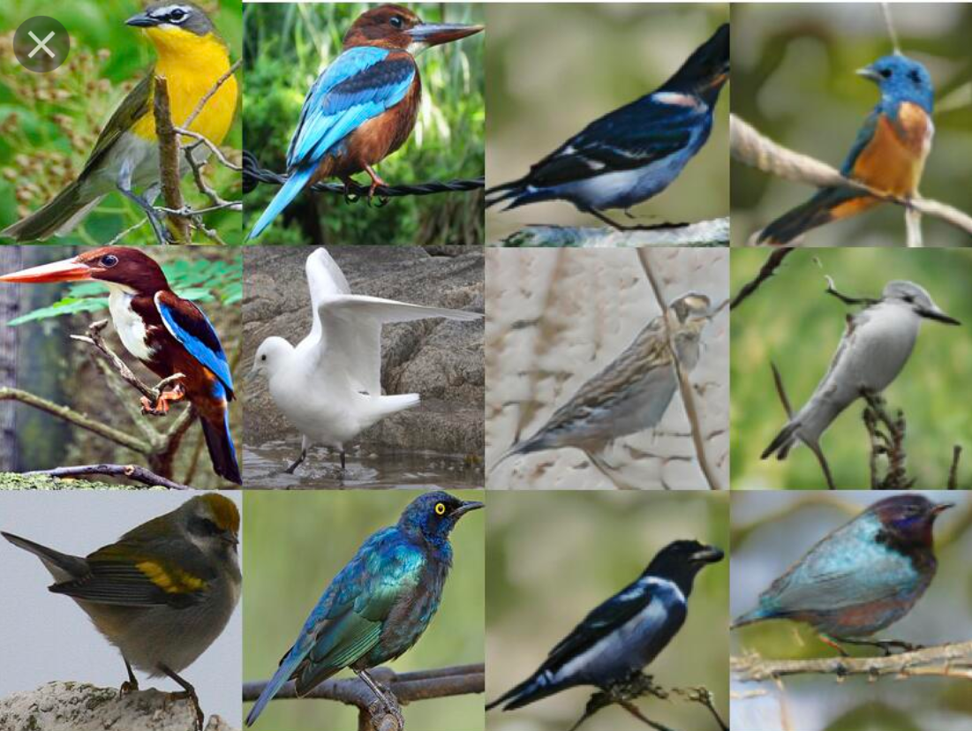
DATASETS – CUB (Caltech-UCSD Birds 200)
Fine-grained
312 Attributes
11,788 images
200 different Birds (150 - Train 50 – Test)

Slide 21
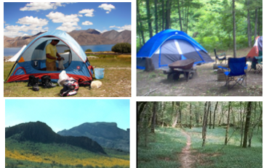
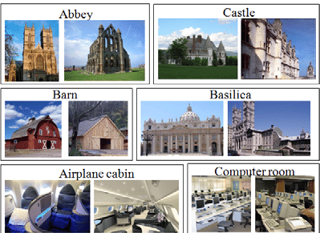
DATASETS – SUN
Fine-grained
102 Attributes
14,340 images
717 types of scenes (645 – Train, 72 – Test)

Slide 22
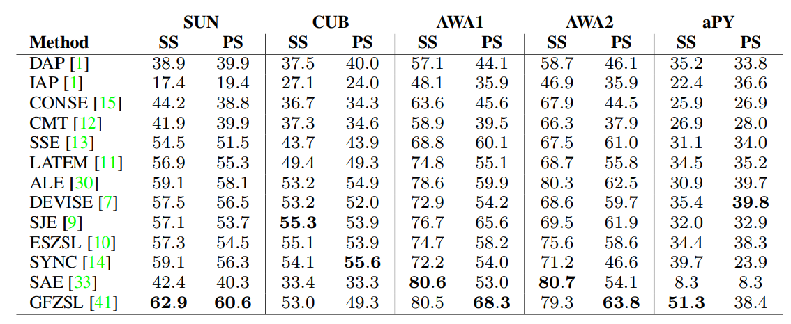
Results - ZSL

Slide 23
Results - GZSL

Slide 24
Conclusion

Slide 25
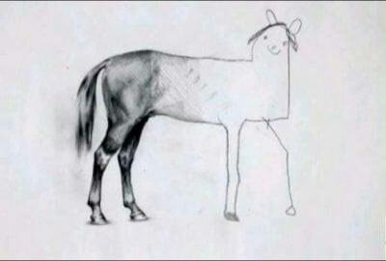
Thank you
Vladislav Panferov

