Slide 1
Towards Self-driving Car Using Convolutional Neural Network and Road Lane Detector
Brilian Tafjira Nugraha1, Shun-Feng Su2 , Fahmizal
Presented by Mohamed Nasser

Slide 2
self-driving car
A self-driving car, also known as an autonomous vehicle (AV(is a car that is capable of sensing its environment and moving safely with little or without human input.
self-driving cars (SDC), the goal is to be able to operate a car like a human driver. The only catch is that there’s no driver behind the seat
Self-driving cars combine a variety of sensors to perceive their surroundings, such as radar, lidar, sonar, GPS

Slide 3
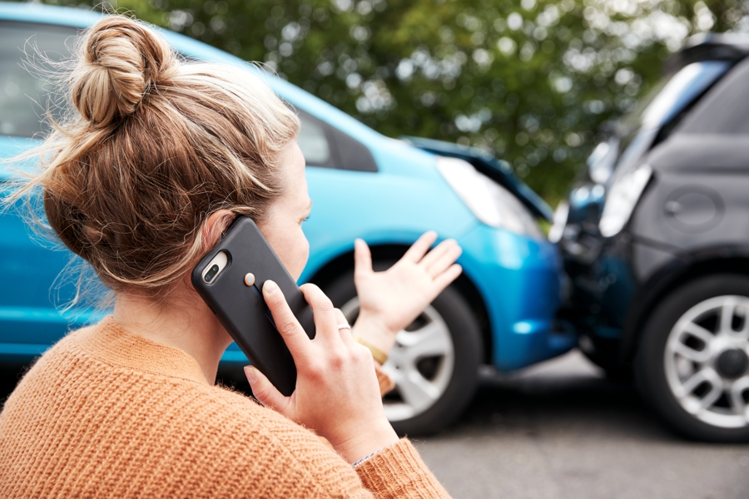
Why
Every year, there are around 1.25 million deaths caused by road accidents. That’s equivalent to 3,287 deaths on a daily basis! As a teenager just
This got me thinking … is there another way we can replicate the driving of humans, but we need better?

Slide 4
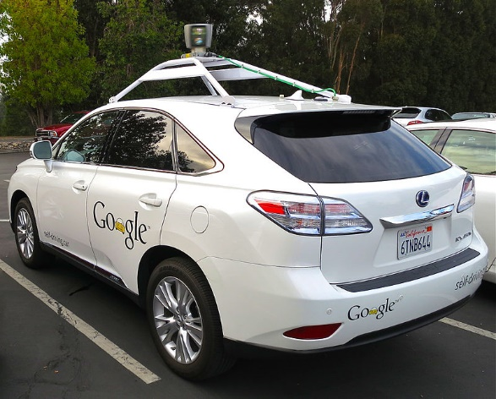
components we need make up an SDC:
Computer vision
Sensor fusion
Localization
Path planning
Control

Slide 5
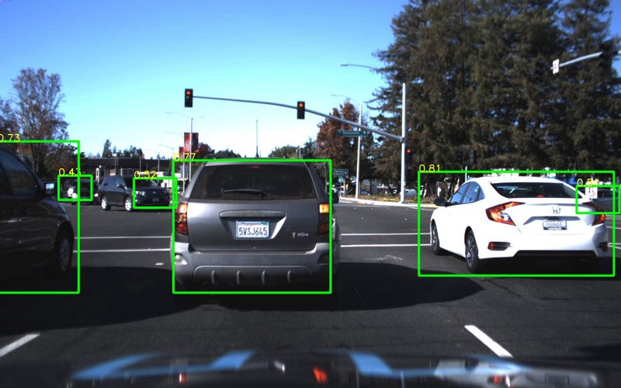
Computer vision
Like a human driver, we need to be able to see the environment around us, whether that’s looking ahead for traffic or reading road signs, detecting any object, vision is the Key .
Similarly, computer vision is how a car sees its environment.
In computer vision for SDC, the goal is to be able to identify objects near the car. We do that by using an image classification network called Convolution Neural Network

Slide 6
Computer vision helps in
Creating 3D Maps to capture visual data in real time to understand their surroundings better.
Classifying and Detecting different types of surrounding objects.
Gathering Data for Training Algorithms These details can be further used in training deep learning models For instance, a thousand images of traffic signals.
Computer Vision helps in Low-Light Mode

Slide 7
Classifying and Detecting : Road Lane Detector
To provide additional information that can be helpful for the decision-making process of the self-driving car.
Identifying lanes of the road is very common task that human driver performs. This is important to keep the vehicle in the constraints of the lane. This is also very critical task for an autonomous vehicle to perform.

Slide 8
CNN
CNN method has been mainly used for object detection and automation based on the images/videos.
are examples of the succession of the CNN : GoogLeNet, Faster R-CNN, Single Shot MultiBox Detector (SSD), and You Only Look Once(YOLO)

Slide 9
edge detection
There are many approaches that can be used for the edge detection to help the road lane detection: Sobel, Laplacian, and Canny detectors.
Sobel: gradient magnitude with the greatest rate’s change in the light intensity using two 3x3 kernels in x and y directions.
Laplacian :uses only one kernel. The main downside of this detection method is the extreme sensitivity of noises
Canny detectors: applying the Gaussian filter and the Non-Maximum Suppression (NMS) and thresholds the range of the gradient intensities

Slide 10
edge detection
adds more computation to the model that we built. On the other hand, the computation will be much faster if we can put the edge detection and the lane construction to run in parallel.

Slide 11
proposed method
self-driving car, in this paper we need three main parts: object detection, lane detection and controller. In this paper, we have combined these parts to help the driver with more info about the object in their driving environment and the road lane guidance.
The proposed method combines YOLO for the object detection, polynomial regression with thresholding as the road lane guidance, and a controller that manages the information between those two systems.
used for object detection, object position detection (left, front, or right),steering suggestion, and road lane’s guidance.

Slide 12
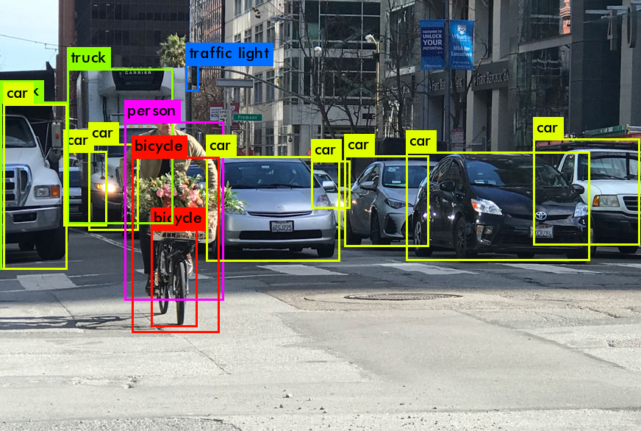
YOLO (You Only Look Once)
real-time object detection system implements a deep CNN architecture for its object detection approach. It consists of 24 convolutional layers along with 2 fully connected layers, inspired by the GoogLeNet model

Slide 13
proposed method
The proposed methods use a smaller version of the original YOLO (i.e. YOLO-small) for the object detection’s task. It has the same architecture with fewer computation demands. To use YOLO resize the image input into 448x448 pixels, so that it will be able to process the object detection as in their architecture.

Slide 14
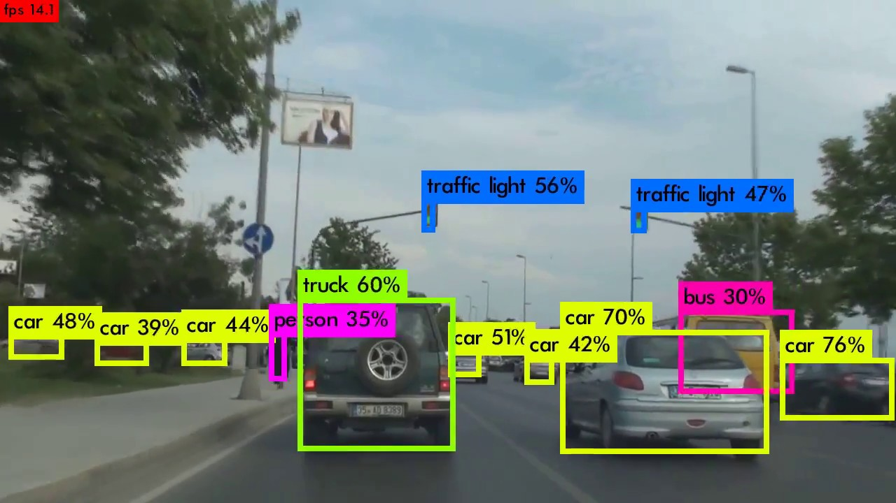
yolo
The outputs of the detection object’s name, x mid-point coordinate of the object, y mid-point coordinate of the object, the width of the object, the height of the object, and the accuracy of the predicted object.
object detection is pre-trained on the ImageNet dataset with 1000 classes .They also use dropout and data augmentation to avoid the overfitting issue.
It predicts 98 bounding boxes for each image and class probabilities for each box and presents a fast computation because of its single feed-forward evaluation network (yolo)

Slide 15
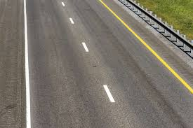
Road Lane Detector Process:
four main parts:
warping
filtering
detecting the road lane
de-warping

Slide 16
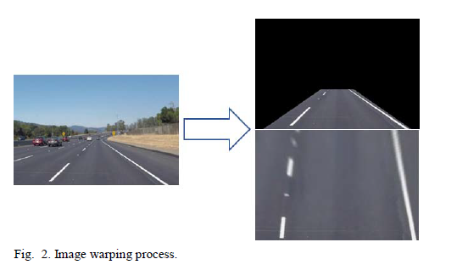
warping
warping part, we set The Region of Interest (RoI) of the road lane and change its perspective into new images. it will be much easier for us to visualize and to analyze road lane

Slide 17

warping
it tries to approximate (M) the new images’ points (dst) based on the previous RoI images (x, y) using (1)(2).

Slide 18
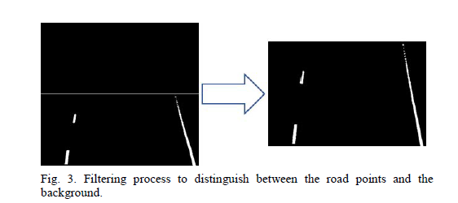
filtering
we do the filtering to separate the lane color with the others. In the filtering process, we pick the range of white and yellow color from the images using LUV and LaB image formats to get yellow and white colors from the road lane as shown

Slide 19
detect the road
After the filtering, we detect the road lane points by getting the nonzero values from the previous process.
we crop the images into 10 sub-images and divide them into left and right. The purpose of this is to get the peak of nonzero values of each lane (left and right)

Slide 20
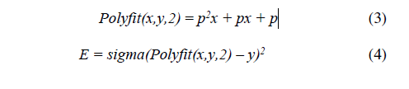
Polynomial regression
enables us to approximate the lane/curve (3) by fitting lane points (y) that have been collected with coefficient points (p) into the best approximated lane points (Polyfit) by minimizing the error (E) from the fitted lanes (4)

Slide 21
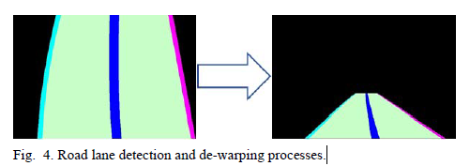
by getting right and left points, we could make functions to approximate the lane structures by feeding them into the regression method to find the best fit of the road lane detection.
Finally, we compute the original perspective by de-warping the new images to the input images

Slide 22
Controller
Take the information flows from YOLO and road lane detector. It also computes the object positions from the road lane and updates the road lane and the performance of the system in the real time.

Slide 23
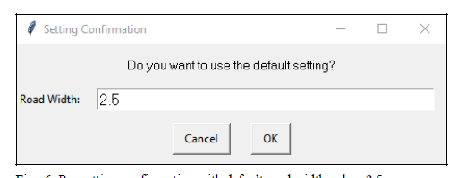
Pre-Setting for CONTROLLER
we need to get the information about the general road lane width in the pre-setting configurations to adjust the road width and the offset length
the controller loads the camera/video frames and feeds them into YOLO and Road Lane Detector.
After combining both results, it draws the road lane

Slide 24
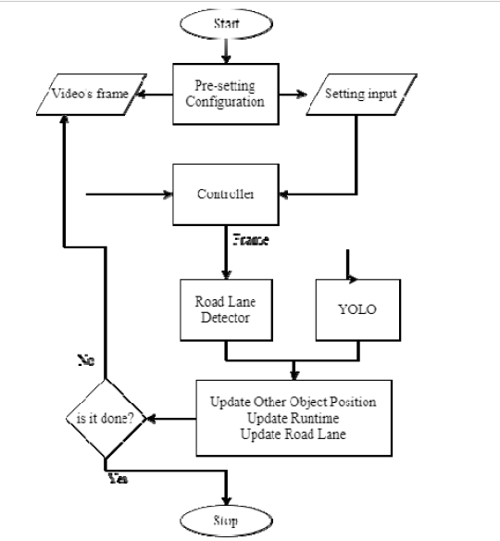
Controller Flow Process.

Slide 25
Has 6 functions :
YOLO object detection function: return the object points (x, y, width, and height) of the detected objects
Road lane detector function
Draw the detected lane: draw both left and right lanes that have been de-warped to the image frames
Object Position: draw the bounding box of the objects and its positions from the road lane points
Update the runtime: compute the running time of the proposed method to know its performance in the realtime.
Show the detection results

Slide 26
Implementations
The proposed method’s implementations and observations are computed using Python programming language and CUDA.

Slide 27
Result
The results of the implementation are shown in Fig. 8 and Fig. 9 with some screenshots of different videos and the steering direction’s suggestions. For the detection suggestion results in the highway areas, it gives pretty accurate results. For the urban area, it seems to be confused between the white line and the sands in the edge of the road.
The road lane detector also uses the crop of left and right to find the lane points in both lanes. While the approach is pretty good for straight and non-sharp-turned roads. However, it brings out a limitation, where the sharp-turned roads could lead to inaccurate detection

Slide 28
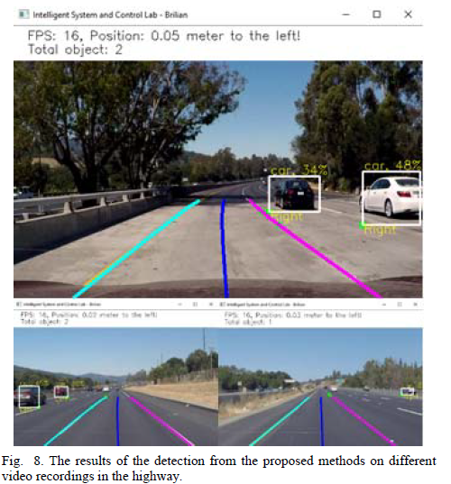
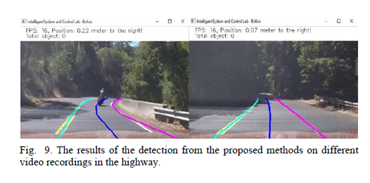

Slide 29
CONCLUSIONS
have demonstrated a detail and step-by-step approach for the road lane guidance. The proposed method use pre-trained YOLO, road lane detector, and a controller to integrate them into a smart system. Based on the observations, he proposed methods can adjust the road lane, detect the objects (e.g. cars), and provide the steering suggestion to the driver to help the automation of the driving process.

Slide 30
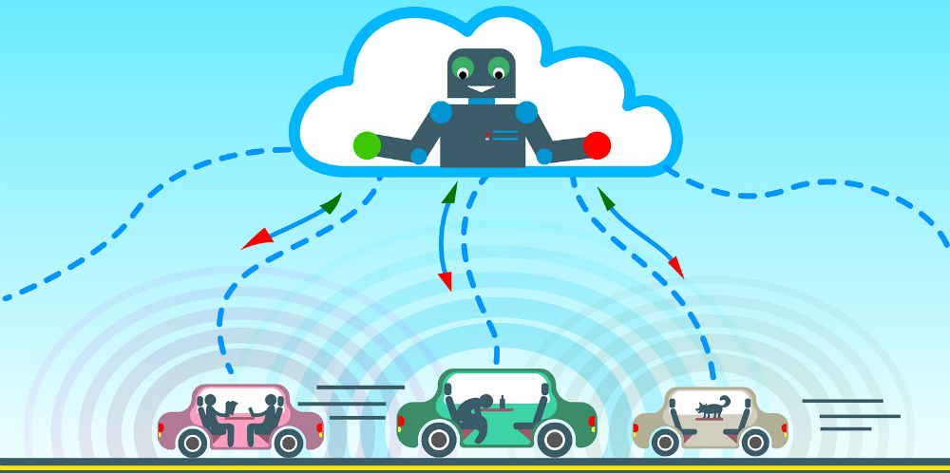
FUTUREWORKS
This paper is suitable for highway conditions, when it mostly fails to detect the road lane in the urban roads. With those limitations in mind, we will try to make better and robust system that can handle over lighting, sharp-turned roads, and collision warning, and different road environments by using end-to-end learning using CNN to increase the capability of our system to be applied in the real environment of self-driving cars.

Slide 31

Thanks

