Slide 1
Flow diagnostics and active flow control projects for students in LFET laboratory of ITP SB RAS
Dr. Mikhail Tokarev
Kutateladze Institute of Thermophysics, SB RAS, Novosibirsk, Russia
mtokarev@itp.nsc.ru

Slide 2
Outline
Short info about the institute and the lab
Recent development of analysis techniques in the lab
One minute video
Project #1
Project #2
Project #3

Slide 3
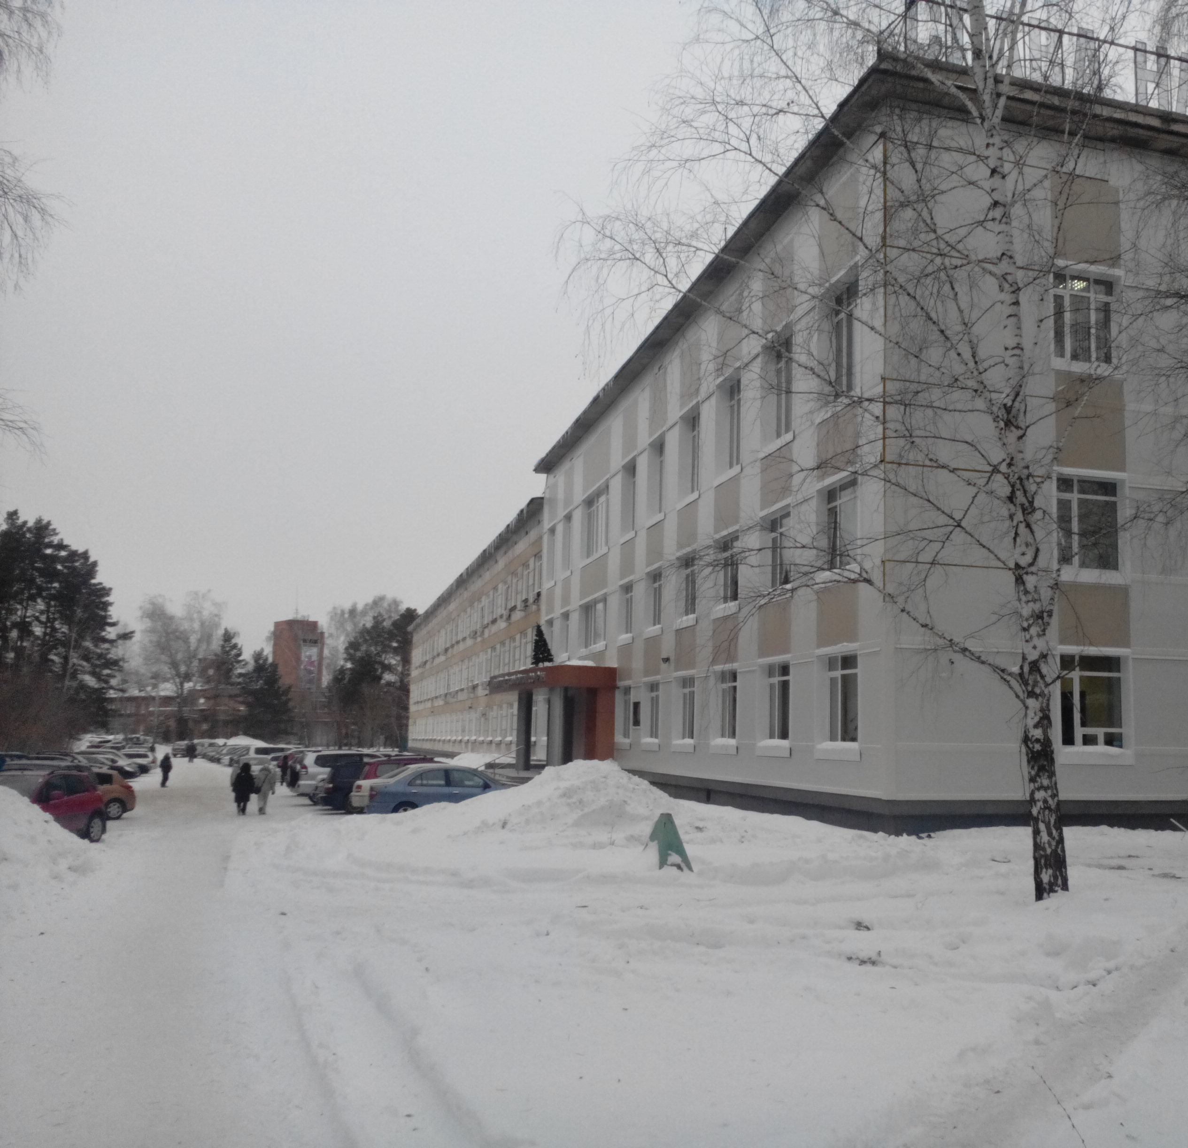
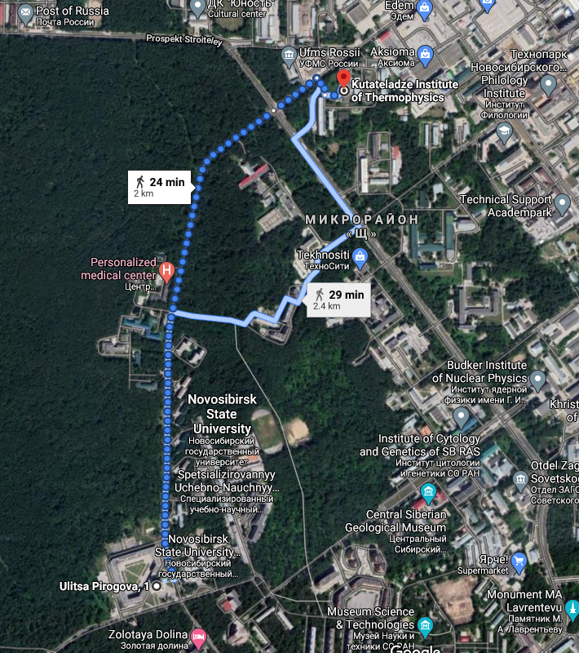
Institute of Thermophysics SB RAS
Year of foundation
1957
Named after S.S. Kutateladze
STAFF
500 Employees, 200 Researchers including : Members of RAS 7 Prof./Dr. Sci. 55 PhDs 100
Students PhD students 30 B. and M. Students 40
Head Prof. Dmitry M. Markovich
Notes:
Heat and mass transfer phenomena (properties of substances and materials, transport in multi-phase flows, liquid films)
Fundamentals of developing new technologies for power generation and energy saving (Efficient coal/gas combustion, Hydro- and nuclear energy, Hydrogen and solar energy)
Non-intrusive techniques for diagnostics of heat and mass transfer
Numerical simulations of unsteady heat and mass transfer in complex geometries

Slide 4
Laboratory for Fundamentals of Energy Technologies
Since 1992 (https://sites.google.com/view/lfet)
Basic and applied research in the field of fluid mechanics and heat transfer in energetic applications and environment. The research focus is at multi-scale transport phenomena and development of efficient methods for flow dynamics prediction and control. The research tools are advanced non-intrusive optical measurements and numerical simulations. Model reduction and machine learning methods are used for data analysis and patterns recognition. The research scope is the improvement of efficiency and safety of power-engineering facilities and reduction of environmental pollution.
Laboratory head: Vladimir Dulin, Ph.D., D.Sci. (Habil.)
Scientific interests:
Jet flows (swirl jets, impinging jet)
Two phase flows (liquid films, sprays, bubbly flows, flows with cavitation)
Microfluidics (mixing, control)
Flow control (forcing of large-scale vortices formation, swirl, dispersed phase)
Development of optical flow diagnostics techniques (2D-3D PIV, Planar LIF, …)

Slide 5
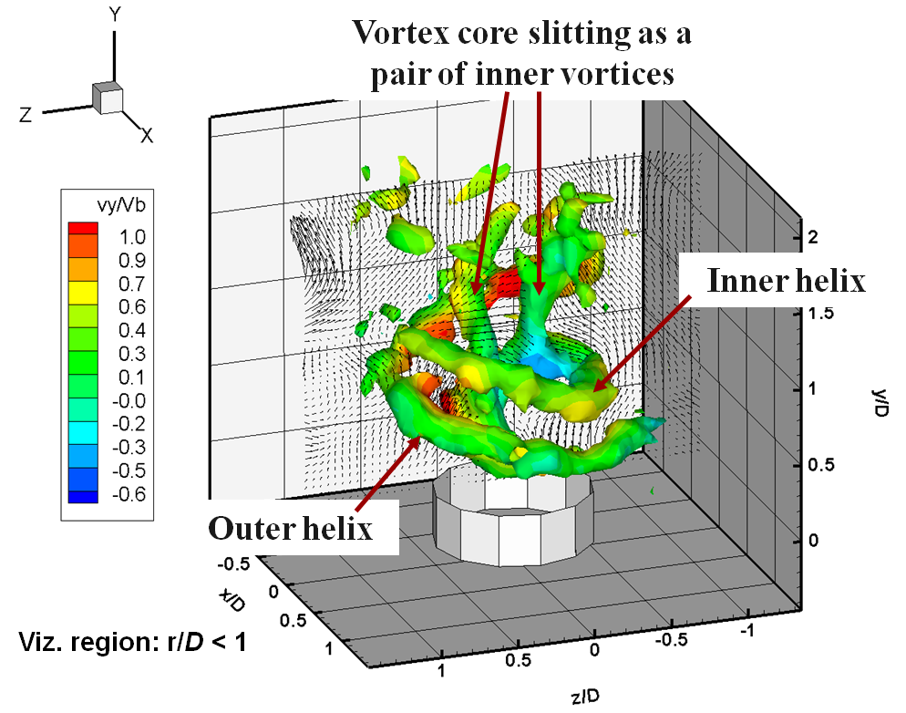
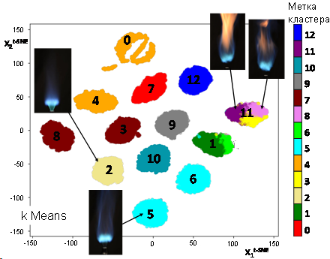
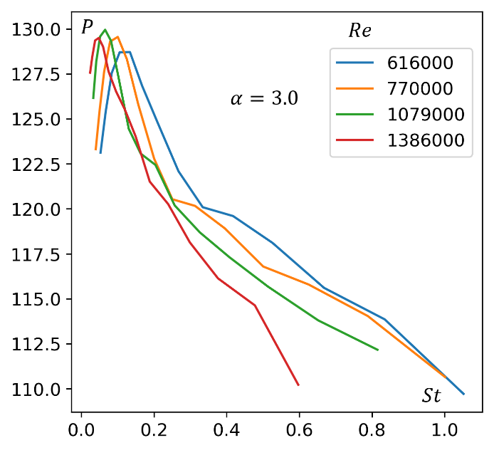
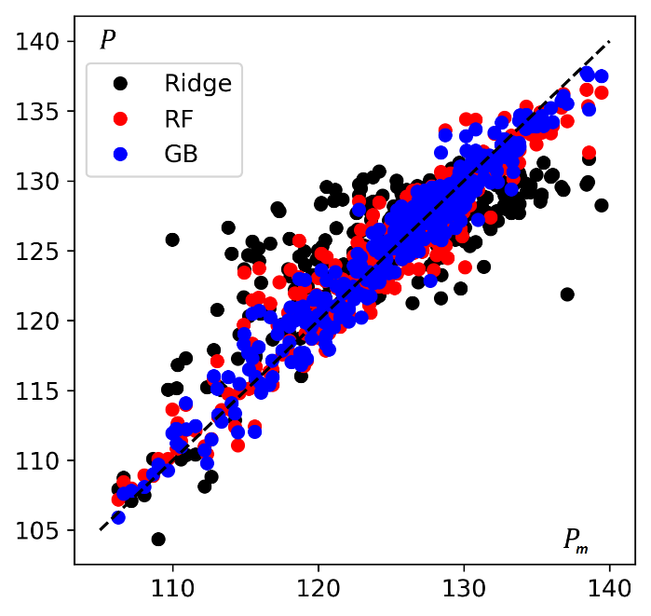
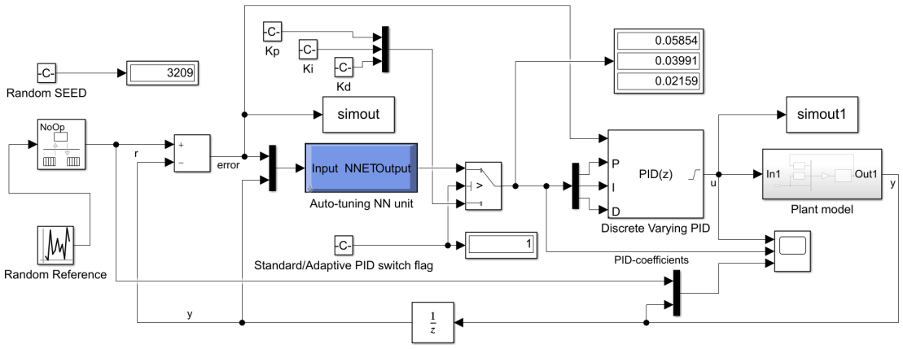
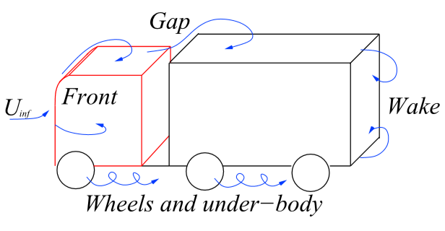
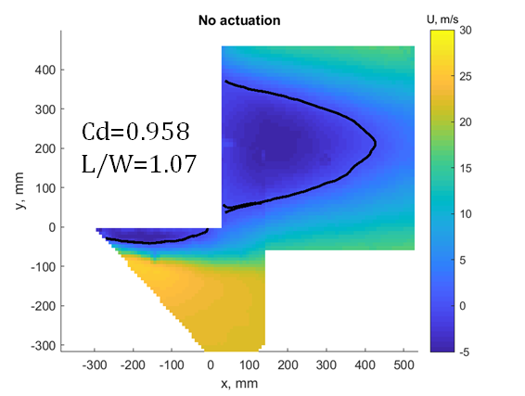
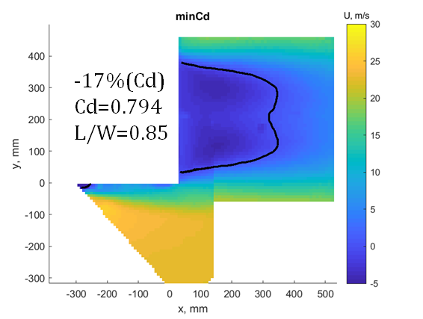
Recent development of analysis techniques in the lab
Alekseenko et al. 2014
2010-2014 (jets including reacting flows)
Few projections optical tomography for 3D velocity measurements
Iterative algebraic reconstruction for an ill-posed inverse problem
2016-2017 (two-phase jets)
Bubbles identification in gas saturated turbulent jets
Supervised learning with a deep CNN for classification and detection
2017-2018 (combustion, hydrofoils)
Detection of flame modes in combustors and furnaces by visual images
Unsupervised learning: linear and nonlinear clustering, supervised – CNN for classification
Prediction of noise in hydrofoils
Supervised/unsupervised learning
2018-2019 (intelligent control)
Adaptive PID controller with auto-tuning by NN unit for a nonlinear control of a laboratory gas-coal furnace
NN training through simulation of an air-supply control system
Aerodynamic drag reduction of a generic truck model by ML optimized bi-frequency control (in cooperation with Chalmers, Sweden)
Evolutionary genetic algorithm for optimization of the control lows
Poletaev et al. 2020
Tokarev et al. 2018
Abdurakipov et al. 2019
Chertovskikh et al. 2019
Tokarev et al. 2019

Slide 6
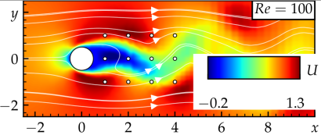
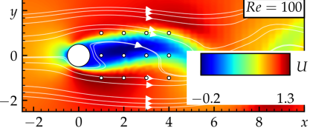
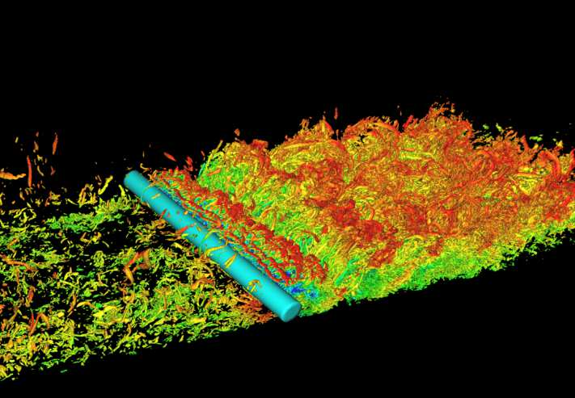
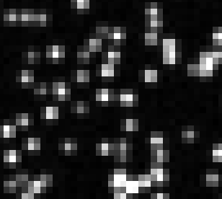
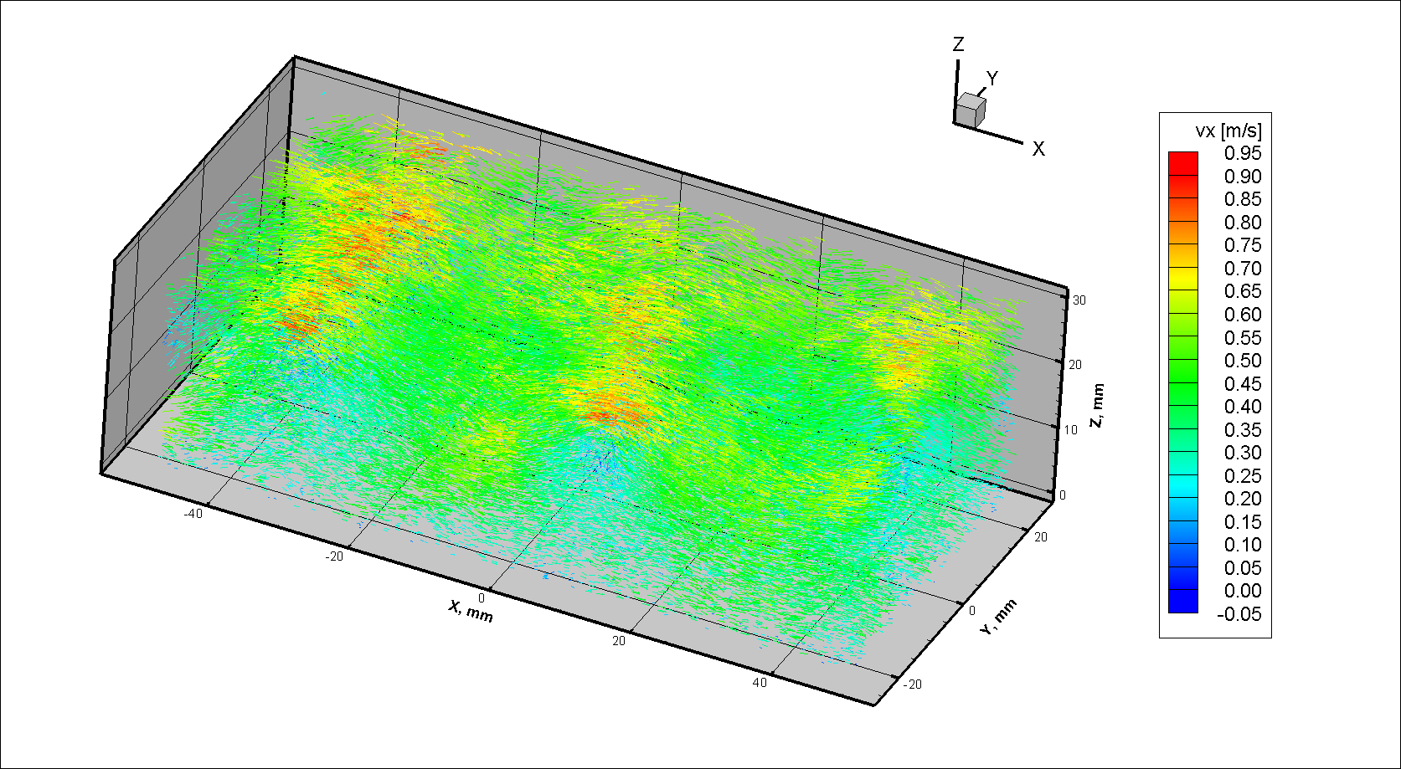
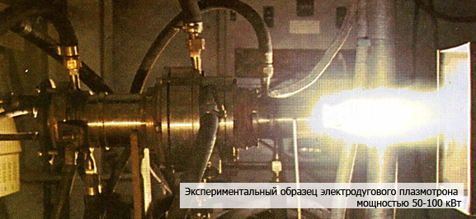
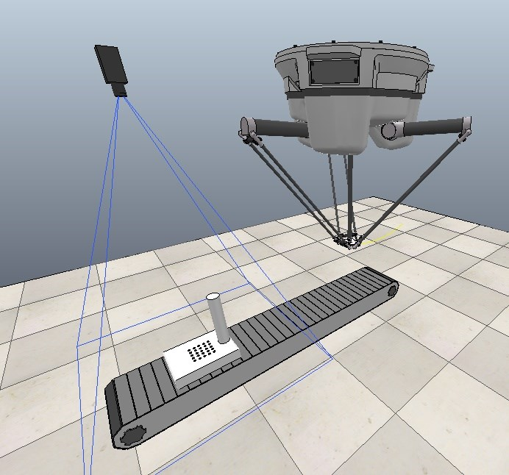
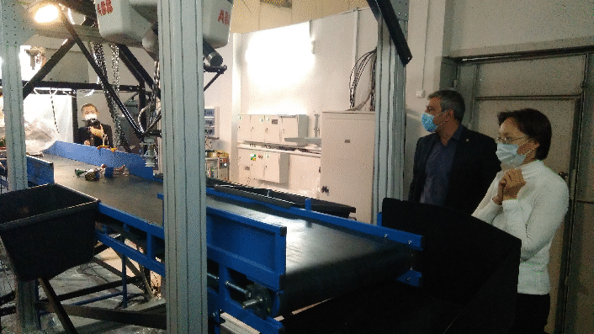
Recent development of analysis techniques in the lab
2020-present (active flow control, LPT, robotic waste sorting)
Deep reinforcement learning control of cylinder flow using rotary oscillations at low Reynolds number (with a feedback loop from pressure sensors)
Lagrangian Particle Tracking (Challenge on 3D LPT and Data Assimilation)
International Challenge 09.03-31.07.2020
Prototype of a waste sorting robotic system (Visible spectrum + rCNN + parallel robot, UV spectrum for plastic material recognition)
No control
After RL control enable
-14% for aerodynamic drag
LES Re=4500
Input
Output
Shake-The-Box (STB)
LPT Tracking algorithm
~70 000 particle tracks
Exp or synth 2D proj images in time
Connected 3D particle tracks
ITP previous systems
A link for a r-sorting video
Notes:
hazardous waste

Slide 7
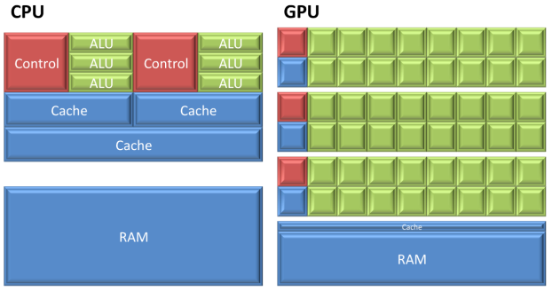
Project #1
2D online GPU correlation analysis of streamed images of particles
Two-dimensional online (~40Hz) velocity sensor for active flow control applications with a feedback loop
Sensor resolution up to 20x15 vectors
Tasks:
Development (existing code migration) of the correlation analysis in CUDA architecture
Integration of the algorithm with a streaming GigE CCD cam (API)
Processing hardware (available):
GPUs: nVidia GTX 1080, GTX Titan
Streamimg double frame CCD cam (available):
Imperx GEV-B0620M 648х488px, 259Hz
Skills
C++
Data analysis
Notes:
Can be embedded into a control loop

Slide 8
Project #1 (PIV animation)

Slide 9
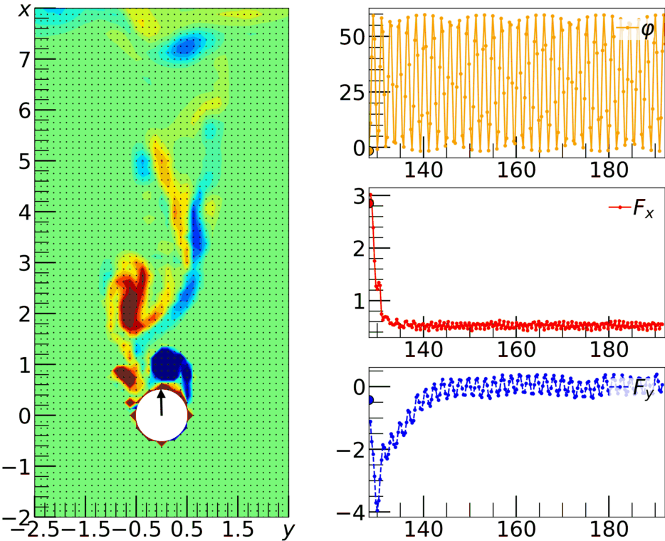
Project #2
Evolutionary optimization for control of cylinder flow using rotary oscillations at low and high Reynolds numbers
Coupling existing tree based and linear Genetic Programming algorithms with CFD codes used in the lab for comparison of the stability, convergence speed and computational complexity with the RL optimization
Tasks:
Coupling of a tree based GP with T-Flows CFD, turning optimization parameters
Running low Re opt for the cylinder flow
Comparison of the results with RL data
Running high Re distributed opt
Skills:
Python or Matlab
Linux
Basic knowledge of opt algorithms
vorticity field evolution for Re=140 000
and periodic control (Ω=2, f=2.5f₀)

Slide 10
Project #2 (RL control animation)
Vorticity field evolution for Re = 100 after turning on the neural network control from the state of a stationary cylinder (the black arrow shows the angle of rotation of the cylinder)

Slide 11
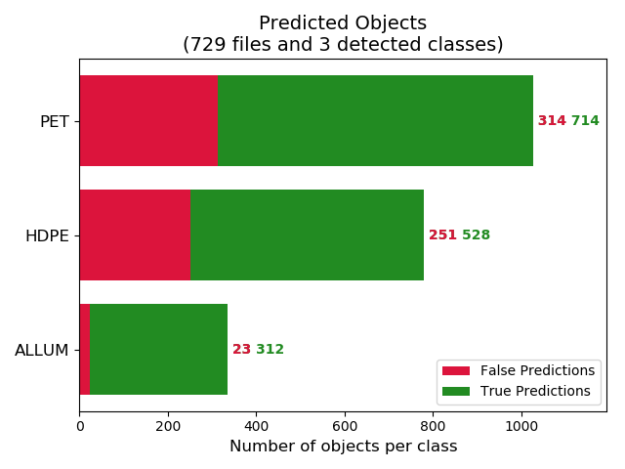
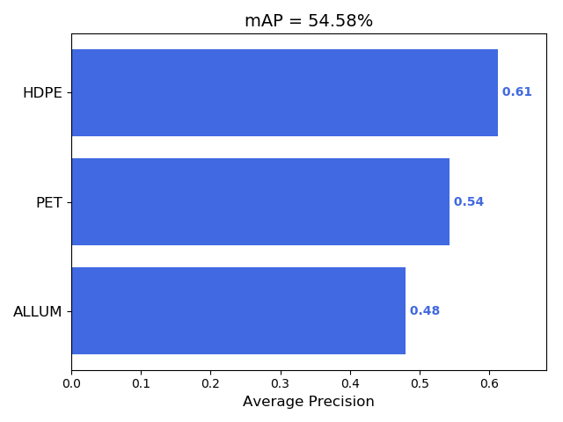
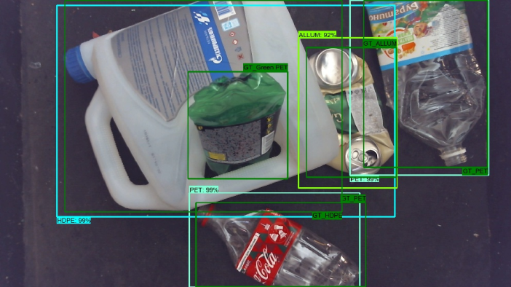
Project #3
Improvement of the sorting quality of the prototype of the industrial robotic sorting system
Tasks:
Training of the faster_rcnn_resnet101_coco or mask_rcnn_resnet101_atrous_coco (TOD API) on a larger dataset of objects
Adding new classes: split PET -> color PET (transparent, blue, green, brown)
Development precise landing system into objects by an elevation sensor (passive or active) for a more secure grip
Skills:
Python
TensorFlow Object Detection API
Seredkin et al. 2019

Slide 12
Project #3 (video)

Slide 13
Thank you for attention!
Questions?

