Slide 1
Trends and directions of development of geoinformatics and cartography
Kolesnikov Alexey Alexandrovich
Associate Professor of the Department of Cartography and Geoinformatics
alexeykw@yandex.ru
facebook.com/alexey.kolesnikov.77/
2020

Slide 2
About Me
Education
An engineer by specialization Information Systems
PhD in cartography on the topic "Multimedia technologies in the creation of maps"
Work Experience
About three years as a cartographer
About two years as a surveyor
About three years as a GIS developer
and now i'm
Associate professor in Siberian State University of Geosystems and Technologies ("Geoinformation mapping", "Spatial databases", "Web-cartography“ …)
2

Slide 3
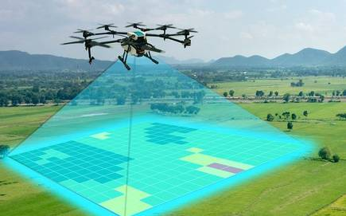
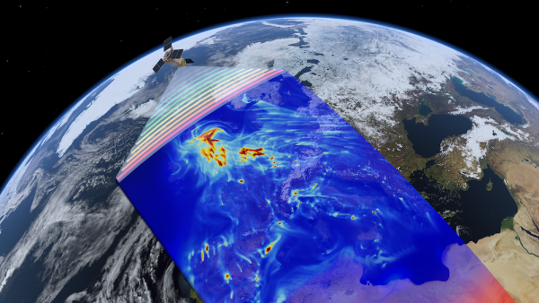
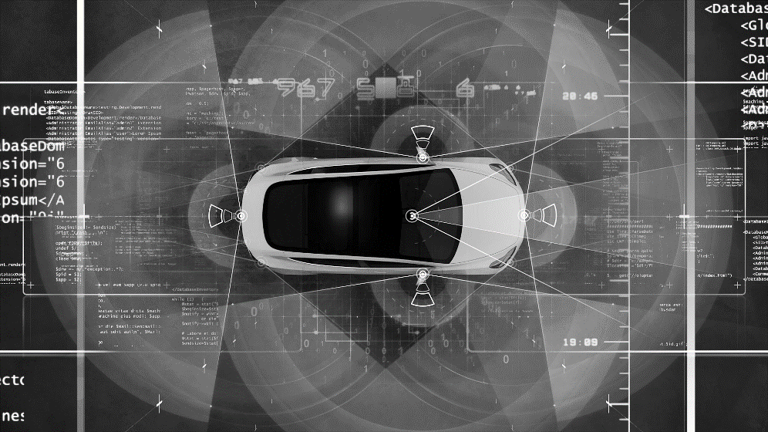
3
Significant growth in available data
Satellites
UAV
Self-Driving Cars
LiDAR
Smartphones
…

Slide 4
4
Current tasks of geoinformatics and cartography
Navigation systems
Web cartography
3D cartography
Multimedia cartography
Spatial analysis and modeling
Tactile mapping and assistive technology GIS
Perception of cartographic works
GIS of operational monitoring
Spatial question-answer systems
…
Calculations and forecasts based on tabular data
Image classification and segmentation
Natural language processing
and all this together

Slide 5
5
Specifics of processing of spatial information
Continually add data on a large scale - Distributed processing and storage, high-performance computing
Format heterogeneity - Integration systems and web services
Data description methods:
An object as a pair of coordinates and / or a set of coordinates and / or pixels of a space image and / or a point cloud and / or a set of semantic characteristics and / or a distance to influence points and / or ...
Satellite image as a raster image set or multidimensional array or one dimensional array or t-SNE or ...
Data engineering based on open and closed sources
Combination (ensemble) of processing algorithms
Systematization of methods for processing spatial data

Slide 6
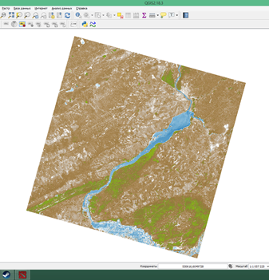
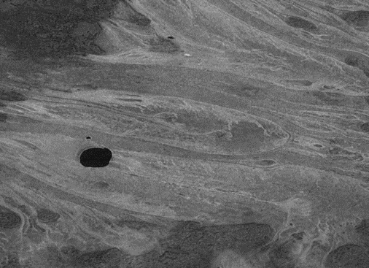
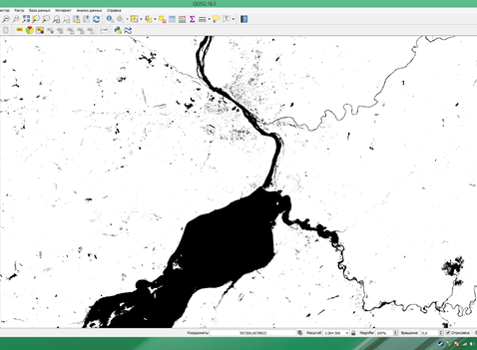
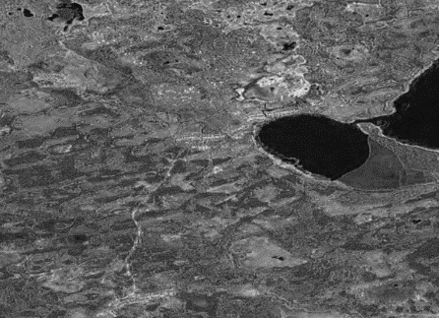
Semantic Segmentation of Satellite Images
Research cases
In collaboration with
6

Slide 7
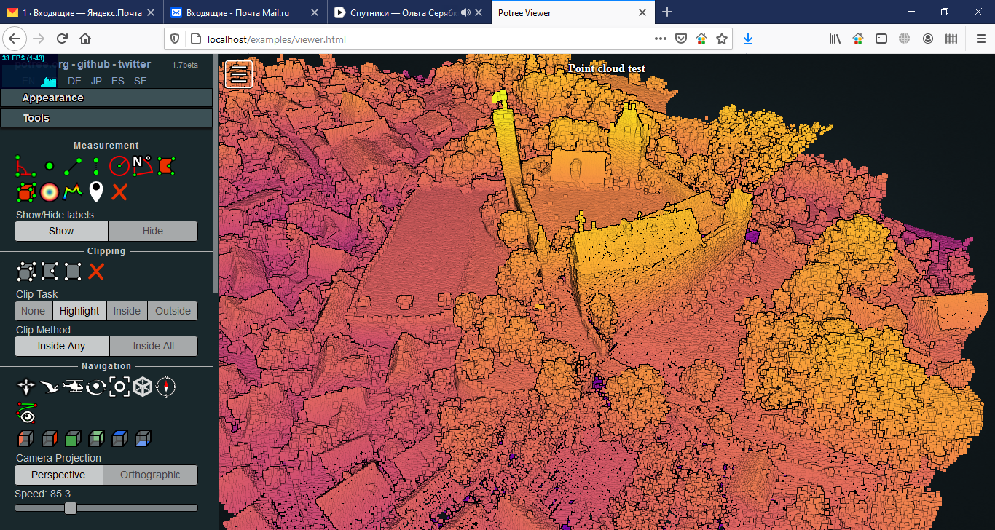
Research cases
Semantic Segmentation of Point Clouds
7

Slide 8
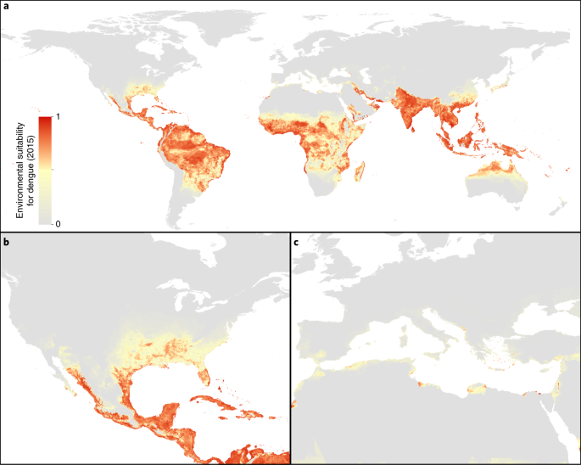
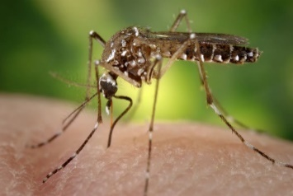
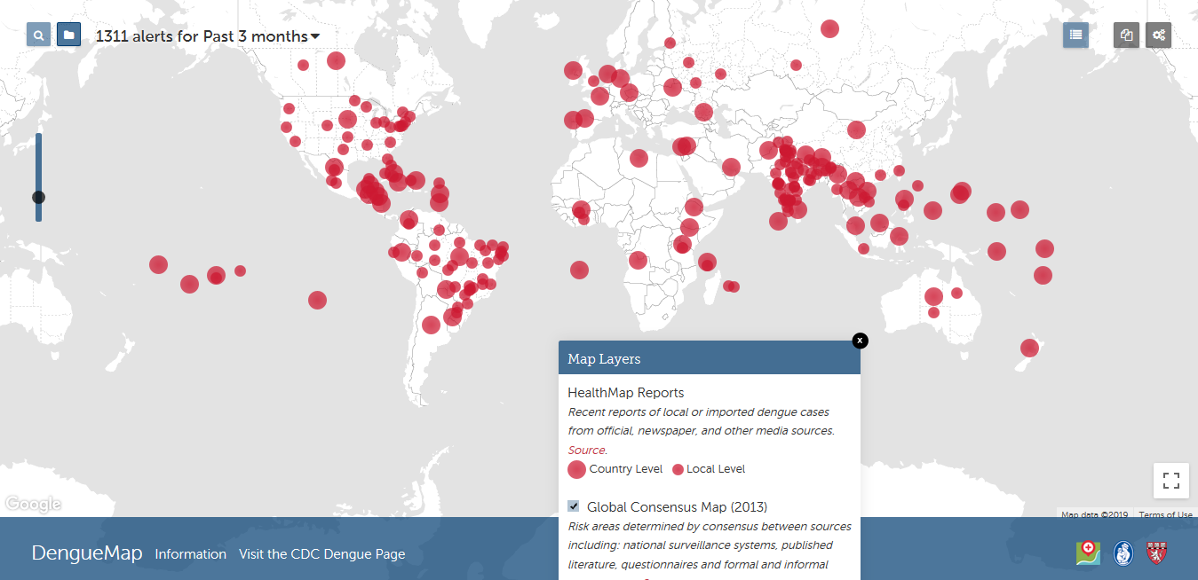
8
Research cases
Modeling the Spread of Tropical Diseases

Slide 9
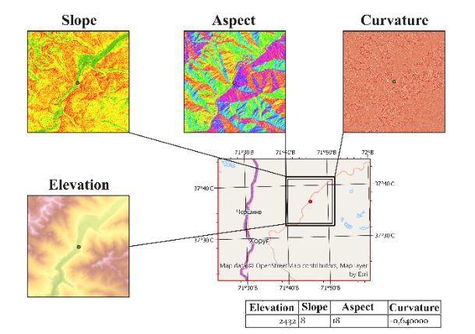
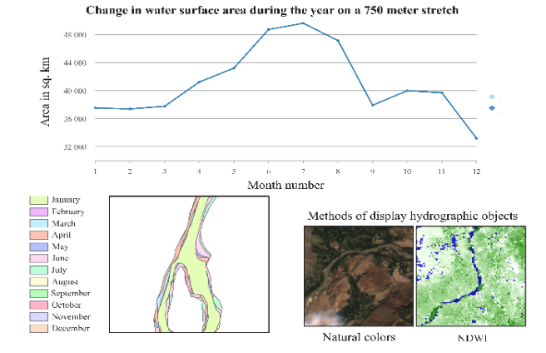
Research cases
Integration of GIS technologies into the simulation model of a HPP cascade
In collaboration with
9

Slide 10
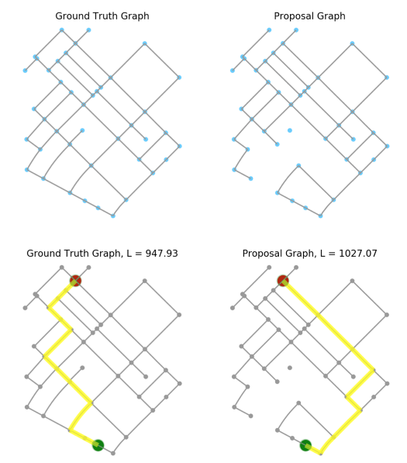
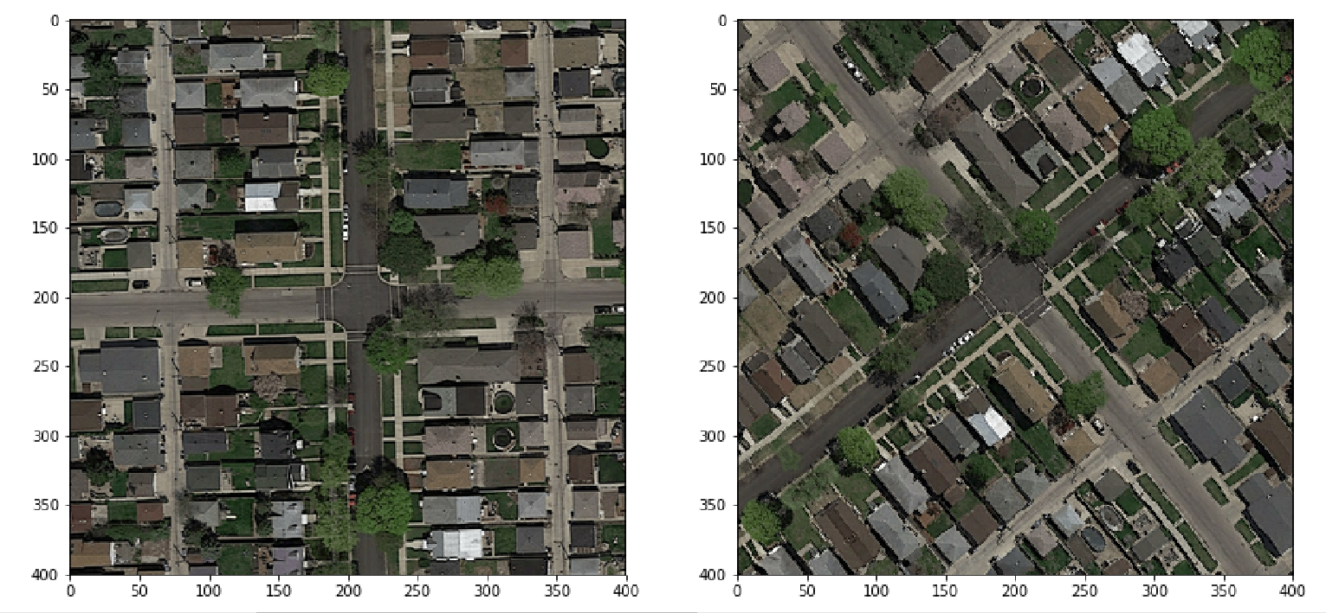
Research cases
Algorithms for determining the state of the road network as an integral part of the rapid mapping concept
In collaboration with
10

Slide 11
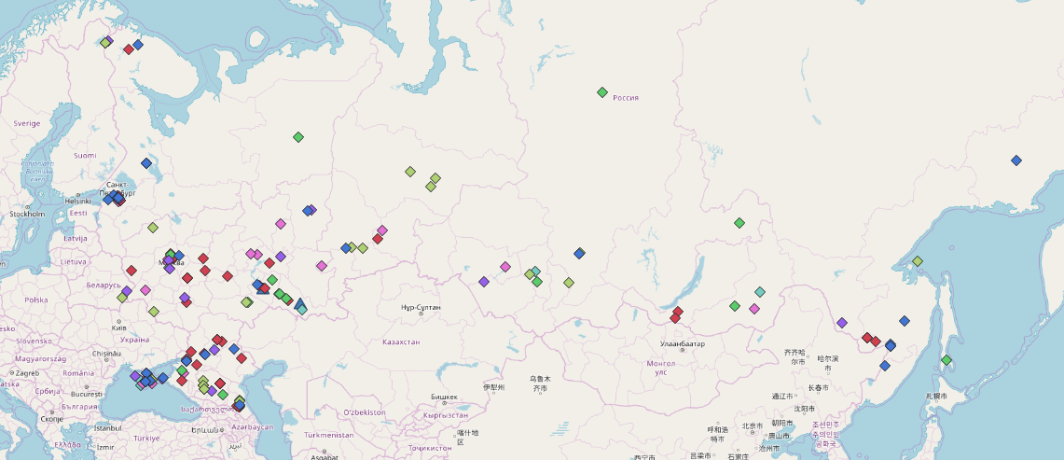
Research cases
Geocoding of Unstructured Blocks of Text
11

Slide 12
Thank you for attention!
Trends and directions of development of geoinformatics and cartography
Kolesnikov Alexey Alexandrovich
Associate Professor of the Department of Cartography and Geoinformatics
alexeykw@yandex.ru
facebook.com/alexey.kolesnikov.77/
2020

