Slide 1
Data Mining with Big Data
Xindong Wu1,2, Xingquan Zhu3, Gong-Qing Wu2, Wei Ding4
1 School of Computer Science and Information Engineering, Hefei University of Technology, China
2 Department of Computer Science, University of Vermont, USA
3 QCIS Center, Faculty of Engineering & Information Technology, University of Technology, Sydney, Australia
4 Department of Computer Science, University of Massachusetts Boston, USA
Academic Seminar – Paper Presentation
Presenter: Lunev Kirill

Slide 2
HACE theorem
H - Huge Data with Heterogeneous and Diverse Dimensionality
One of the fundamental characteristics of the Big Data is the huge volume of data represented by heterogeneous and diverse dimensionalities.
A - Autonomous Sources with Distributed and Decentralized Control
Autonomous data sources with distributed and decentralized controls are a main characteristic of Big Data applications.
C - Complexity
While the volume of the Big Data increases, so do the complexity and the relationships underneath the data.
E - Evolving Relationships

Slide 3
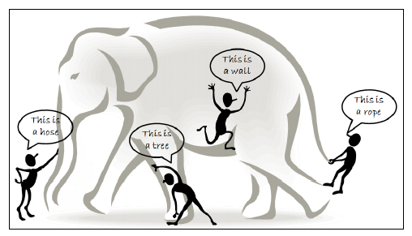
HACE Problem

Slide 4
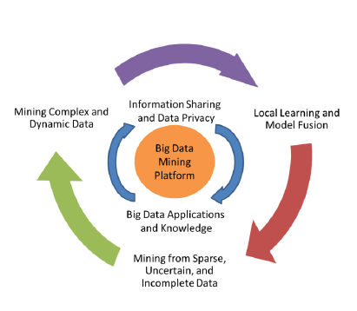
Data Mining Challenges
Tiers representation

Slide 5
Tier I: Big Data Mining Platform
In typical data mining systems, the mining procedures require computational intensive computing units for data analysis and comparisons. A computing platform is therefore needed to have efficient access to, at least, two types of resources: data and computing processors.

Slide 6
Tier II: Big Data Semantics and Application Knowledge
Information Sharing and Data Privacy
Information sharing is an ultimate goal for all systems involving multiple parties
Domain and Application Knowledge
Domain and application knowledge provides essential information for designing Big Data mining algorithms and systems

Slide 7
Tier III: Big Data Mining Algorithms
Local Learning and Model Fusion for Multiple Information Sources
As Big Data applications are featured with autonomous sources and decentralized controls, aggregating distributed data sources to a centralized site for mining is systematically prohibitive due to the potential transmission cost and privacy concerns
Mining from Sparse, Uncertain, and Incomplete Data
Spare, uncertain, and incomplete data are defining features for Big Data applications. Being sparse, the number of data points is too few for drawing reliable conclusions
Mining Complex and Dynamic Data
The rise of Big Data is driven by the rapid increasing of complex data and their changes in volumes and in nature.

Slide 8
Research Initiatives and Projects
Integrating and Mining Bio-Data from Multiple Sources in Biological Networks, sponsored by the U.S. National Science Foundation (NSF), Medium Grant No. CCF-0905337, October 1, 2009 - September 30, 2013.
Big Data Fast Response: Real-time Classification of Big Data Stream, sponsored by the Australian Research Council (ARC), Grant No. DP130102748, January 1, 2013 – Dec. 31 2015.
Pattern Matching and Mining with Wildcards and Length Constraints, sponsored by the National Natural Science Foundation of China (NSFC), Grant Nos. 60828005 (Phase 1, January 1, 2009 - December 31, 2010) and 61229301 (Phase 2, January 1, 2013 - December 31, 2016).

Slide 9
Conclusions
Big Data have shown to be a challenging yet very compelling task. While the term Big Data literally concerns about data volumes, HACE theorem suggests that the key characteristics of the Big Data are huge with heterogeneous and diverse data sources, autonomous with distributed and decentralized control, and complex and evolving in data and knowledge associations. Such combined characteristics suggest that Big Data requires a “big mind” to consolidate data for maximum values.

Slide 10
Thank you for attention!

