Slide 1
Deep Learning Applications in Medical Image Analysis
JUSTIN KER, LIPO WANG , JAI RAO
AND
TCHOYOSON LIM
Presenter
ENES KUZUCU

Slide 2
1.INTRODUCTION
2.MACHINE LEARNING ARCHITECTURES
Supervised Learning Models
Unsupervised Learning Models
3. APPLICATIONS IN MEDICAL IMAGE ANALYSIS
Classification
Localization
Detection
Segmentation
Registration
4.CONCLUSION
Research obstacles
Emerging trends
Possible future directions
Notes:
Give a brief overview of the presentation. Describe the major focus of the presentation and why it is important.
Introduce each of the major topics.
To provide a road map for the audience, you can repeat this Overview slide throughout the presentation, highlighting the particular topic you will discuss next.

Slide 3
Why ML Community is interested in Medical Image Analysis?

Slide 4
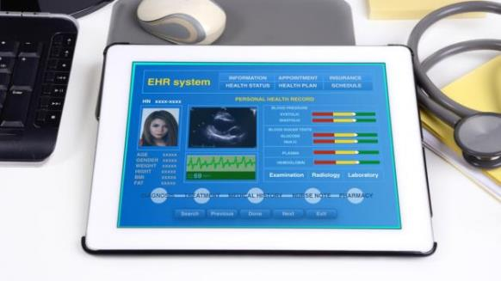
Why ML Community is interested in Medical Image Analysis:
Data is relatively structured and labeled and digitalization process of records are increasing every year vastly.
“The use of electronic health records (EHR) quadrupled from 11.8% to 39.6% amongst office-based physicians in the US from 2007 to 2012 “

Slide 5
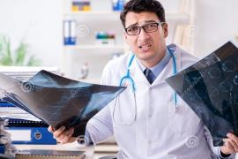
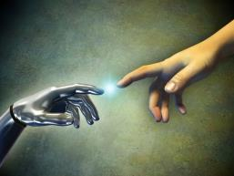
Why ML Community is interested in Medical Image Analysis
Medical images are an integral part of a patient’s EHR and are currently analyzed by human radiologists, who are limited by speed, fatigue, and experience.
A delayed or erroneous diagnosis causes harm to the patient. It takes years and great financial cost to train a qualified radiologist
It is likely that this will be the area where patients first interact with functioning, practical artificial intelligence systems
So there is need for better solutions in terms of efficiency and cost

Slide 6
We have different kind of medical visualization methods and each with has their benefits at certain situations Such like:
Ultrasound (US)
X-ray
Computed tomography (CT) scans
Magnetic- resonance imaging (MRI) scans
Positron emission tomography (PET) scans
Retinal photography
Histology

Slide 7
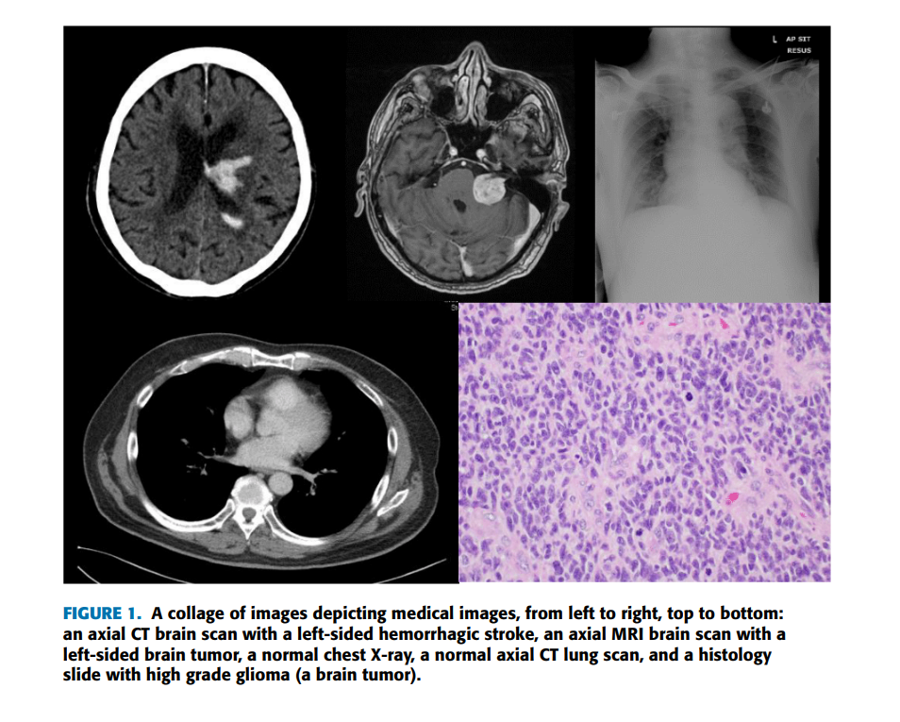

Slide 8
II. MACHINE LEARNING ARCHITECTURES
SUPERVISED LEARNING MODELS
CONVOLUTIONAL NEURAL NETWORKS
TRANSFER LEARNING WITH CNNs
RECURRENT NEURAL NETWORKS
UNSUPERVISED LEARNING MODELS
AUTOENCODERS
RESTRICTED BOLTZMANN MACHINES
DEEP BELIEF NET-WORKS
GENERATIVE ADVERSARIAL NETWORKS

Slide 9
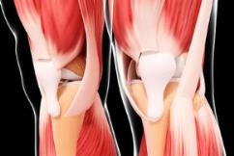
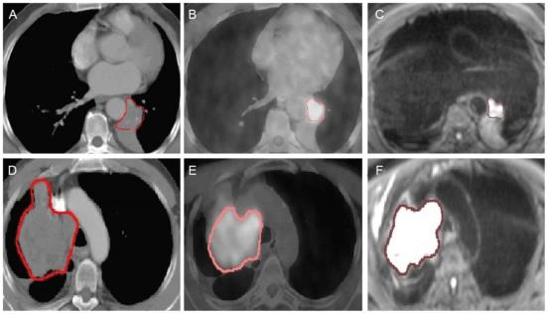
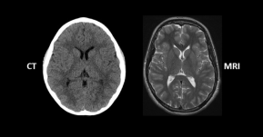
1.CONVOLUTIONAL NEURAL NETWORKS Currently, CNNs are the most researched machine learning algorithms in medical image analysis. The reason for this is that CNNs preserve spatial relationships when filtering input images.
(A-C) Images of central lung cancer [(A) CT , (B) PET/CT , (C) DW-MRI ]
(D-F) Images of central lung cancer (small cell tumor) [ (D) CT, (E) PE/CT, (F) DW-MRI]
Notes:
Figure 1. - Delineation of CT, PET/CT and DW-MRI images. (A-C) Images of central lung cancer (squamous cell carcinoma) in a 74-year-old male patient. (D-F) Images of central lung cancer (small cell tumor) in a 61-year-old male patient. (A) The lower left lung tumor was accompanied with atelectasis, which results in blurry tumor edges. The GTVCT is outlined in red. (B) PET/CT image of the concentrated radioactive tracers in the left lower lung. The GTVPET is outlined in pink. (C) DW-MRI of the lung tumor with clear edges. The signal from the atelectasis is relatively low, which can be easily differentiated from the real tumor tissues. The GTVMRI is outlined in brown. (D) CT image of the lung tumor. The GTVCT is outlined in red. (E) PE/CT image of the concentrated radioactive tracers in the lung tumor. The GTVPET is outlined in pink. (F) DW-MRI of the lung tumor. The GTVMRI is outlined in brown. CT, computed tomography; PET, positron emission tomography; DW-MRI, diffusion-weighted magnetic resonance imaging; GTV, gross target volume.

Slide 10
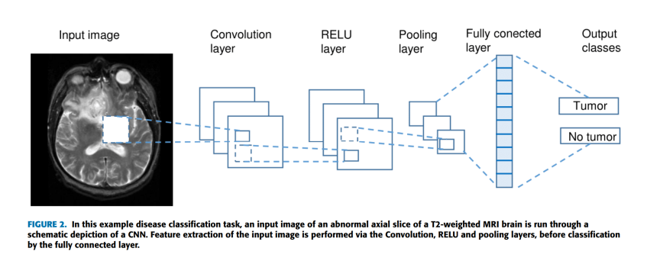
How CNN works?
As shown in Fig. 2., a CNN takes an input image of raw pixels, and transforms it via Convolutional Layers, Rectified Linear Unit (RELU) Layers and Pooling Layers. This feeds into a final Fully Connected Layer which assigns class scores or probabilities, thus classifying the input into the class with the highest probability.

Slide 11
Convolution exploits three ideas intrinsic to perform computationally efficient machine learning:
Sparse connections
Parameter sharing (or weights sharing) and
Invariant representation
RECTIFIED LINEAR UNIT (RELU) LAYER:
The RELU layer is an activation function that sets negative input values to zero. This simplifies and accelerates calculations and training, and helps to avoid the vanishing gradient problem. Mathematically it is defined as: f (x) = max(0, x). One way ReLUs improve neural networks is by speeding up training. The gradient computation is very simple (either 0 or 1 depending on the sign of xx). Also, the computational step of a ReLU is easy: any negative elements are set to 0.0 -- no exponentials, no multiplication or division operations.
POOLING LAYER:
The Pooling layer is inserted between the Convolution and RELU layers to reduce the number of parameters to be calculated, as well as the size of the image (width and height, but not depth). Max-pooling is most commonly used; other pooling layers include Average pooling and L2-normalization pooling. Max-pooling simply takes the largest input value within a filter and discards the other values; effectively it summarizes the strongest activations over a neighborhood.
FULLY CONNECTED LAYER:
This layer takes the output from the preceding layer (Convolutional, RELU or Pooling) as its input, and computes a probability score for classification into the different available classes

Slide 12
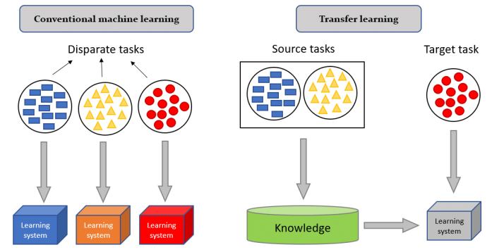
2) TRANSFER LEARNING WITH CNNs
Unlike general natural image recognition tasks, medical image analysis lacks large labeled training datasets. As a comparison,
Kaggle 2017 Data Science Bowl dataset of CT lung scans : 2000 patient scans
ImageNet ILSVRC 2017 :1.000.000 images with 1000 object classes

Slide 13
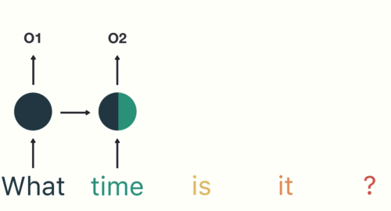
3.RECURRENT NEURAL NETWORKS (RNNs)
In common practice, a 3D biomedical image is often represented as a sequence of 2D slices (called a z-stack). Recurrent neural networks, especially LSTM [8], are an effective model to process sequential data
RNNs have traditionally been used in analyzing sequential data, such as the words in a sentence. Due to their ability to generate text [27], RNNs have been employed in:
Text analysis tasks
Speech recognition
Language modeling
Text prediction and
Image caption generation

Slide 14
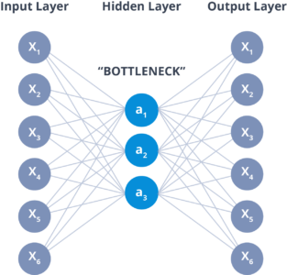
UNSUPERVISED LEARNING MODELS 1) AUTOENCODERS
Autoencoders learn feature representations of input data (called codings) in an unsupervised manner without labelled data. It is a model that takes input data, gleans codings from this, and then uses these codings to reconstruct output data (called reconstructions).
Autoencoders have several useful features.
Firstly, they are employed as feature detectors that can learn codings in an unsupervised manner, without training labels.
Secondly, they reduce the model dimensionality and complexity as codings often exist in a lower dimension.
Thirdly, by having to reconstruct outputs, autoencoders generate new data that is similar to the input training data.

Slide 15
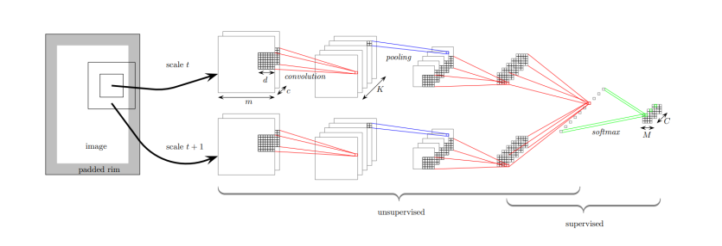
Kallenberg et al. [1] combined unsupervised convolution layers trained as autoencoders, and supervised layers to classify mammograms into different densities and textures
The texture classification task was used to impute if a mammogram was normal or depicted breast cancer.
They used 2700 mammograms from the Dutch Breast Cancer Screening Program, the Dutch Breast Cancer Screening dataset, and the Mayo Mammography Health Study.
Interestingly, they used a sparse autoencoder to learn the parameters of the feature extracting convolution layers, before this input was fed into a softmax classifier. For the cancer classification task, this Convolution stacked autoencoder (CSAE) model obtained an AUC score of 0.57, which the authors reported as state of the art.”

Slide 16
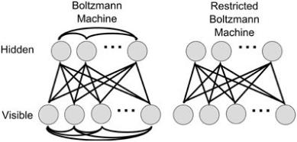
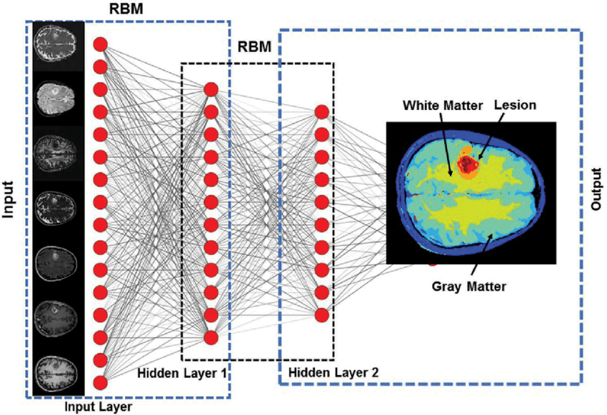
2) RESTRICTED BOLTZMANN MACHINES AND DEEP BELIEF NETWORKS
RBMs are generative, stochastic, probabilistic, bidirectional graphical models consisting of visible and hidden layers
DBNs could be trained in a greedy, layerby-layer fashion with lower layers learning low level features, and progressively higher layers learning high level features, mirroring real world data hierarchy

Slide 17
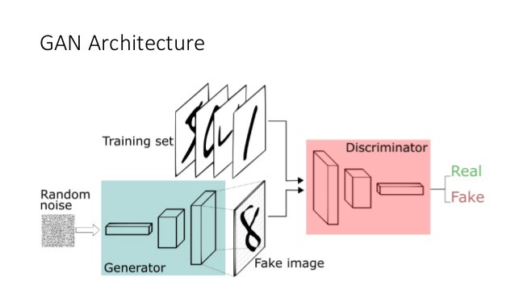
3 .GENERATIVE ADVERSARIAL NETWORKS
GANs comprise of two simultaneously-trained, competing models, which may be multilayer perceptrons such as CNNs. The models may be described as two players competing in a zero-sum game
One CNN is a generator that generates artificial training images. The other CNN is called a discriminator, which classifies if images are real training images or artificial ones from the generator. The desired end-point of this adversarial arrangement is one where the discriminator is unable to tell the difference between a real and a generated image i.e., the probability of assigning an image to either data distribution is 1/2.

Slide 18
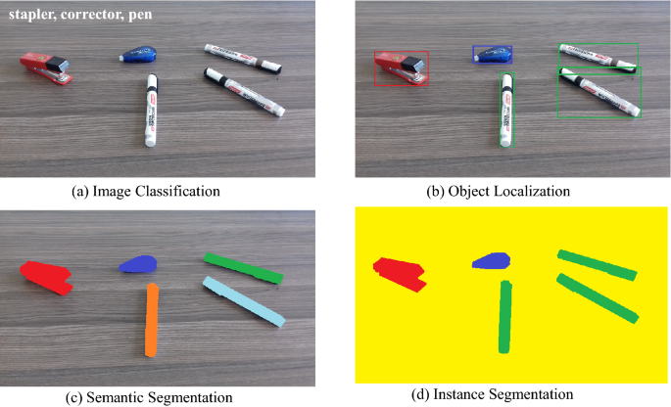
APPLICATIONS IN MEDICAL IMAGE ANALYSIS
A. CLASSIFICATION
B. LOCALIZATION
C. DETECTION
D. SEGMENTATION
E. REGISTRATION

Slide 19
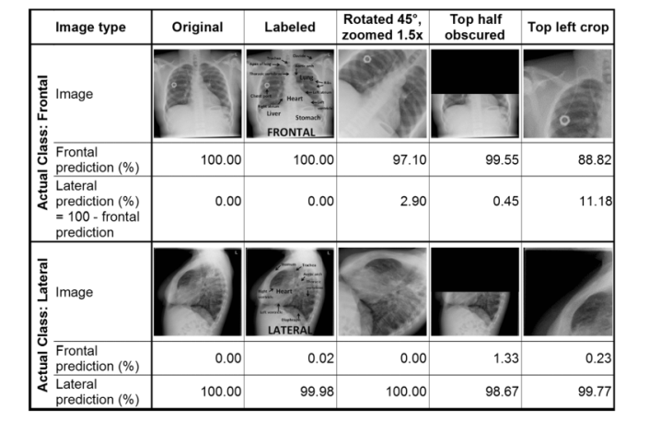
CLASSIFICATION
Rajkomar et al. [3] augmented 1850 chest x-ray images into 150,000 training samples.
Used a modified pretrained GoogLeNet CNN

Slide 20
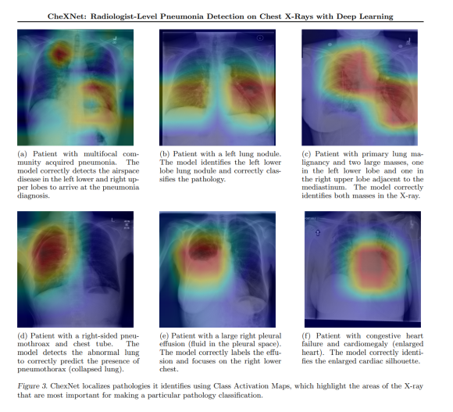
Rajpurkar et al. [4] used CheXNet which consists of121 convolutional layers to to classify 14 different diseases seen on the chest x-rays
Used 112,000 images from the ChestXray14 dataset.
CheXNet achieved state of the art performance in classifying the 14 diseases;
Pneumonia classification in particular achieved an Area Under Curve (AUC) score of 0.7632 with
Moreover, on a test set of 420 images, CheXNet matched or bettered the performance of 4 individual radiologists

Slide 21
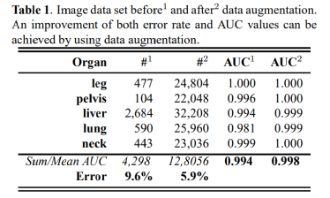
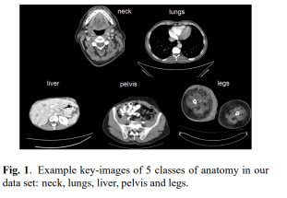
LOCALIZATION
Roth et al. [5] trained a CNN with 5 convolution layers to discriminate approximately 4000 transverse axial CT images into one of 5 categories: neck, lung, liver, pelvis, legs.
He was able to achieve a 5.9% classification error rate and an AUC score of 0.998,

Slide 22
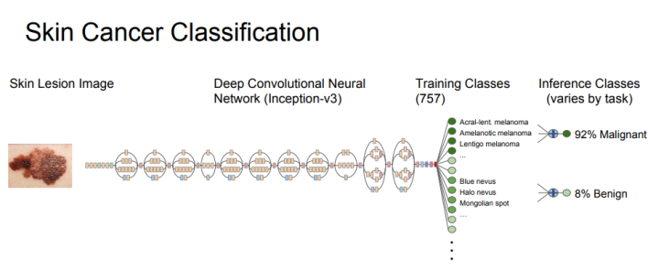
DETECTION
Detection, sometimes known as Computer-Aided Detection (CADe) is a keen area of study as missing a lesion on a scan can have drastic consequences for both the patient and the clinician
Esteva et al. [7] used 130,000 dermatological photographs and dermoscopic images to train a GoogLeNet Inception V3 CNN,
The CNN outperformed human dermatologists in classifying the images as benign, malignant or non-neoplastic lesions,
With the accuracy of 72% compared to the 65% and 66% accuracies obtained by 2 human dermatologists.
The CNN again bettered 21 human dermatologists at deciding treatment plans for two types of skins cancers: carcinoma and melanoma. This task involved 376 biopsy-proven images, and the CNN achieved AUC scores of between 0.91 to 0.96.

Slide 23
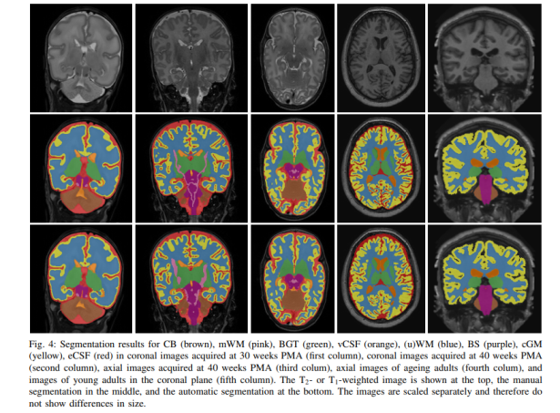
SEGMENTATION
Tumor segmentation especially important in surgical planning to determine the exact boundaries of the tumor in order to direct surgical resection.
Sacrificing too much of eloquent brain areas during surgery would cause neurological deficits such as limb weakness, numbness and cognitive impairment.
Moeskops et al. [6] used 3 CNNs, each with a different 2-dimensional input patch size, running in parallel to classify and segment MRI brain images of 22 pre-term infants and 35 adults into different tissue classes such as white matter, grey matter and cerebrospinal fluid. Overall, the algorithm achieved good accuracy, with Dice coefficients between 0.82 and 0.87.

Slide 24
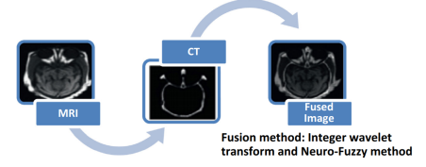
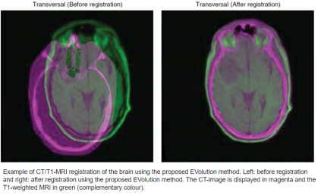
REGISTRATION
Image registration is employed in neurosurgery or spinal surgery, to localize a tumor or spinal bony landmark, in order to facilitate surgical tumor removal or spinal screw implant placement.
In registration A reference image is aligned to a second image, which can be 2 or 3-dimensional.
The reference image may be a pre-operative MRI brain scan and the sense image may be an intraoperative MRI brain scan done after a first-pass resection, to determine if there is remnant tumor and if further resection is required.

Slide 25
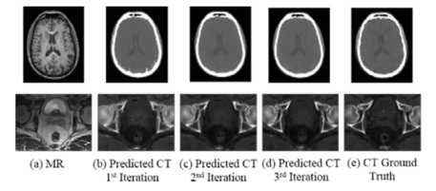
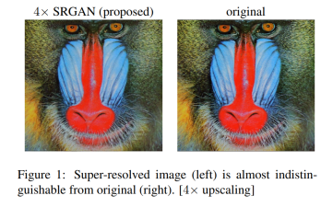
Future Promising Applications
An interesting application was reported by Nie et al. [6] in which GANs were used to generate CT brain images from MRI images. This is remarkable, as it means that patients can potentially avoid the ionizing radiation from a CT scanner altogether, lowering cost and improving patient safety
Nie also exploited the ability of GANs to generate improved, higher resolution images from native images [7] and reduced the blurriness in the CT images. High quality MRI images require high tesla (and correspondingly costlier) MRI scanners. Algorithmically generated high quality MRI images on a lower field-strength scanner would thus lower healthcare costs.A useful extension of resolution improvement techniques would be applying them to generate MRI images of higher quality.

Slide 26
IV. CONCLUSION A) Research Obstacles and Possible Solutions
Limited dataset problem
Data or class imbalance in the training set is also a significant issue in medical image analysis [94]. This refers to the number of images in the training data being skewed towards normal and non-pathological images
Rare diseases are an extreme example of this and can be missed without adequate training examples. This data imbalance effect can be ameliorated by using data augmentation to generate more training images of rare or abnormal data, though there is risk of overfitting.
Nonhuman actor problem
An important, non-technical challenge is the public reception towards their health results being studied by a nonhuman actor. This situation is not helped by the apocalyptic artificial intelligence scenarios painted by some.
Machine learning algorithms have surpassed human performance in image recognition tasks, and it is likely that they will perform better than humans in medical image analysis as well.
Yet the question regarding legal and moral culpability arises when a patient is misdiagnosed, or suffers morbidity as a result of AI or AI-assisted medical management.

Slide 27
[3] A. Rajkomar, S. Lingam, A. G. Taylor, M. Blum, and J. Mongan, ‘‘Highthroughput classification of radiographs using deep convolutional neural networks,’’ J. Digit. Imag., vol. 30, no. 1, pp. 95–101, 2017
[4] P. Rajpurkar et al. (Dec. 2017). ‘‘CheXNet: Radiologist-level pneumonia detection on chest X-rays with deep learning.’’ [Online]. Available: https://arxiv.org/abs/1711.05225
[5] H. R. Roth et al., ‘‘Anatomy-specific classification of medical images using deep convolutional nets,’’ in Proc. IEEE 12th Int. Symp. Biomed. Imag. (ISBI), Apr. 2015, pp. 101–104.
[6] D. Nie, X. Cao, Y. Gao, L. Wang, and D. Shen, ‘‘Estimating CT image from MRI data using 3D fully convolutional networks,’’ in Proc. Int. Workshop Large-Scale Annotation Biomed. Data Expert Label Synthesis, 2016, pp. 170–178.
[7] C. Ledig et al. (Sep. 2016). ‘‘Photo-realistic single image super resolution using a generative adversarial network.’’ [Online]. Available: https://arxiv.org/abs/1609.04802

Slide 28
Questions?

