Slide 1
Reinforcement Learning Applied to Forex Trading
João Carapuço, Rui Neves ∗, Nuno Horta Instituto de Telecomunicações, Instituto Superior Técnico, Torre Norte, Lisboa, Portugal

Slide 2
What is Reinforcement Learning(RL)?
Reinforcement learning (RL) is a sub-field of machine learning
in which a system learns to act within a certain environment in a
way that maximizes its accumulation of rewards, scalars received
as feedback for actions.

Slide 3
RL Success Stories (2013)
In 2013, a London-based artificial intelligence (AI) company called Deepmind, stunned the AI community with a system based on the RL paradigm that had taught itself to play 7 different Atari video-games, 3 of them at human-expert level, using simply pixel positions and game scores as input and without any changes of architecture or learning algorithm between games
Deepmind was bought by Google

Slide 4
RL Success Stories (2015)
the system was achieving performances comparable to professional human game testers in over 20 different Atari games

Slide 5
RL Success Stories (2016): Google DeepMind AlphaGo beating the best Go Player
Then, that same company achieved wide mainstream exposure when its Go-playing program AlphaGo, which uses a somewhat similar approach to the Atari playing system, beat the best Go player in the world in an event that reached peaks of 60 million viewers.
Combining Neural Networks using ReLu neuron and gradient descent algorithms wtih adaptive learning rate

Slide 6
The RL Learning Framework
Agent - learner/decision maker
Environment - agent interacts
Reward - One of the input signals of RL. Should relay to the system what is its objective bu providing feedback on its performance
State - One of the input signals of a RL system. Should include all relevant information about the environment for decision making.
a_{t} - action at step t
r_{t} - reward at step t
S_{t} - State at step t

Slide 7
Goal of RL
The goal is to find a policy πt that maximizes the sequence of rewards an agent will receive after step t:
Policy - A mapping from states of the environment to actions to be taken when in thost states

Slide 8
Forex Trading
MT4
https://www.fxblue.com/market-data/ticks/EURUSD
Tick Chart
Definition :The bars on a tick chart are created based on a particular number of transactions. While time-based charts draw a new bar after a set period of time, tick charts display a certain number of trades (ticks) before printing a new bar.

Slide 9
RL relies on Markov States
With a Markov state the environment’s response at t + 1 depends solely on the state and action on the previous time step t. Thus, the dynamics of a general, causal environment’s response at time t+1 to the action taken at time t that would otherwise need to account for everything that has happened earlier with a complete conditional probability.

Slide 10
RL Black Box
Feedforward backpropagation neural network acting as a Q-network
3 hidden layers of 20 ReLu neurons
3 output layer of linear neurons

Slide 11
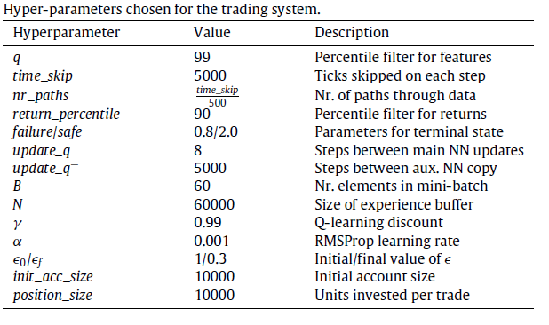
Combining RL and Neural Networks in FOREX Trading

Slide 12
Forex Trading using Tick Data
A tick in the context of forex tick charts is the change in price of a forex pair caused by a single trade. So instead of showing time-based charts like a 5 minute or 4 hour charts, tick charts will only print a new candle after a number of trades have happened

Slide 13
FLOW CHART

Slide 14
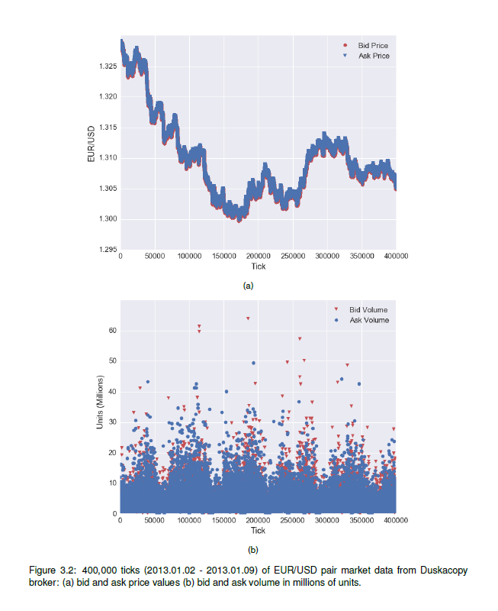
Preprocessing (mean difference between ticks is 1.11 to 2.43 sec)
Bid price
Ask price
Volume of bid price
Volume of ask price

