Slide 1
Application of Artificial Intelligence in Predicting Dengue Outbreak in the Philippines
Virgilio D. Espina
Big Data Analytics and Artificial Intelligence
Department of Mathematics and Mechanics
Novosibirsk State University
Alexey Kolesnikov, PhD
Department of Cartography and Geoinformatics
Siberian State University of Geosystem and Technologies

Slide 2
What is Dengue (WHO)
A mosquito-borne viral infection that is common in warm, tropical climates
Infection is caused by any one of four closely related dengue viruses (called serotypes)
lead to wide spectrum of symptoms
extremely mild (unnoticable)
may require medical intervention and hospitalization
can be fatal (severe cases)
No treatment for the infection but symptoms can be managed
Top 10 diseases for 2019
Fastest spreading, epidemic-prone infectious disease

Slide 3
Signs and Symptoms: Dengue
Dengue
40 degrees with atleast 2 of the following
severe headache
pain behind the eyes
muscle and joint pains
nausea
vomiting
swollen glands
rash

Slide 4
Signs and Symptoms: Severe Dengue
Severe Dengue
fever dropping below 38 degrees celius after 3 to 7 days of illness
severe abdominal pain
persisten vomiting
rapid breathing
bleeding gums
fatigue
restlessness
blood in vomit

Slide 5
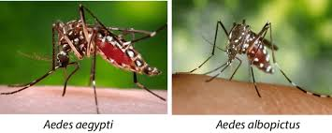
Who Spreads Dengue: Aedes aegypti/albopictus
Virus is spread through the bite of female mosquito
Becomes infected when it takes blood of an infected person with the virus
Typically lay eggs near standing water in containers that hold water
buckets
bowls
animal dishes
flower pots and vases
unused tires
Prefer to bite people
live both indoors/outdoors near people
Daytime feeder
Early morning
Evening before dusk
They also spread Zika and Chikununya virues

Slide 6
Dengue Status: Central Visayas
Increased in first two months of 2020 with 5,933 infection (Outbreak News Today, March 6, 2020)
8,724 cases with atleast 31 dengue deaths
case fatality rate 0.3% > 0.1 % National Dengue Program Goal (Cebu Daily News, July 8, 2020)
Department of Health: The Department of Health is the executive department of the Government of the Philippines responsible for ensuring access to basic public health services by all Filipinos through the provision of quality health care and the regulation of all health services and products.

Slide 7
Cebu Map
https://www.google.com/maps/@18.6032785,97.234004,2.93z
A Barangay captain (Filipino: punong barangay)
also known as a barangay chairman
is the highest elected official in a barangay
the smallest level of administrative divisions of the Philippines.
Sitios and puroks are sub-divisions of barangays, but their leadership is not elected.

Slide 8
Features/Predictors
Demographic and Environmental data
weekly reported dengue cases,
sea surface temperature,
precipitation,
air surface temperature,
humidity
population size (population risk and vulnerable population)
Aedes Mosquito monitoring
Number of tourists

Slide 9
Dengue Prediction: Machine Learning
Machine Learning Algorithm | RMSE | R-SQUARED | Residual Analysis
Machine Learning 1
Machine Learning 2
.
.
.
Machine Learning n

Slide 10
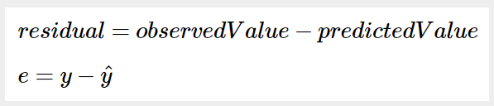
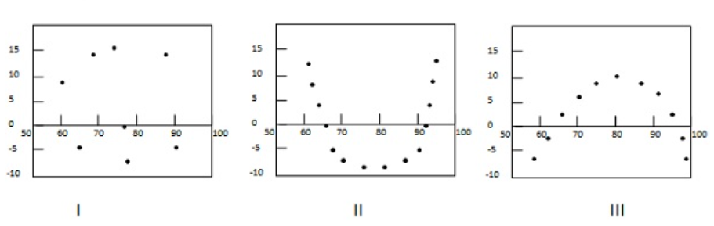
Residual Analysis: Model Validation

Slide 11
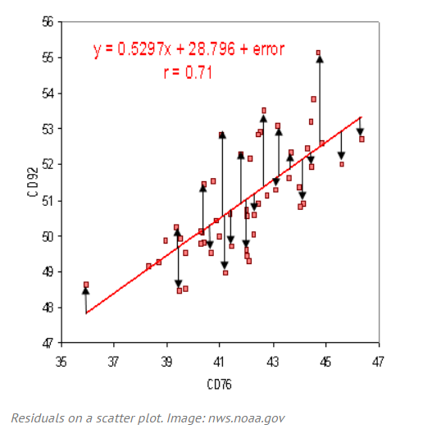
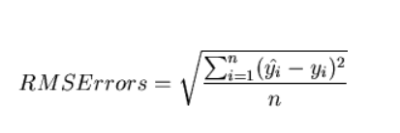
Root Mean Square Error (RMSE): Measure of Accuracy
Standard deviation of the residuals (prediction errors)
A measure of how spread out these these residuals are
It tells how concentrated the data is around the line of best fit

Slide 12
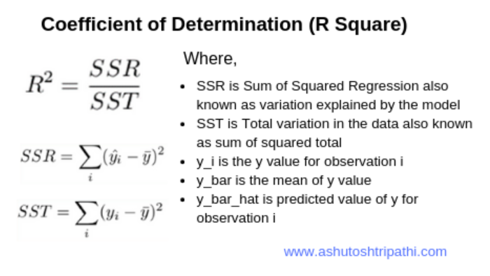
Coefficient of Determination (R-Squared): Goodness-of-Fit
Statistical measure that determines the proportion of variance in the independent variable that can be explained
Percentage variation in y-explained by x-variable

Slide 13
Spatial Analysis and Spatial Data Exploration
Model problems geographically
derive results by computer processing
explore and examine those results
Involves interacting with a collection of data and maps related to answering a specific question, which enables you to then visualiz and explore geographic information and analytical results that pertain to the question

Slide 14
Expected Output

Slide 15
Thank you for your attention

