Slide 1
Quantum Assisted Machine Learning
< QAML >

Slide 2
Points to discuss
Opportunities in QAML
Challenges
QAHM

Slide 3
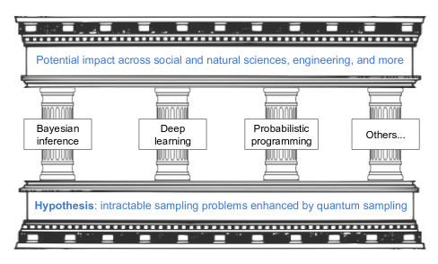
Opps: A- Quantum Devices for Sampling Applications

Slide 4
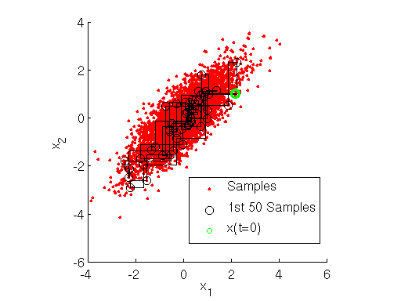
Opps: A- Quantum Devices for Sampling Applications
Quantum computers shows the capability to efficiently prepare and sample certain probability distributions.
One of the sampling algorithms that quantum computer shows efficiency in doing is gibbs sampling.
Notes:
More specifically, most earlier work in generative models in deep learning relied on the computationally costly step of MCMC, making it hard to scale to large datasets.

Slide 5
Opps: A- Quantum Devices for Sampling Applications
This approach to sampling holds promise for more efficient inference and training in quantum generative models.
< And >
A generative model is unsupervised approach that learns the joint probability of all variables involved in a problem.

Slide 6
Opps: A- Quantum Devices for Sampling Applications
< ALSO >
It’s expected that unsupervised learning will become far more important than purely supervised learning in the longer term. More specifically, most earlier work in generative models in deep learning relied on the computationally costly step of Markov chain Monte Carlo, making it hard to scale to large datasets.

Slide 7
Opps: A- Quantum Devices for Sampling Applications
< BAD NEWS >
The most used techniques in machine learning such as classification, regression, gaussian models, vector quantization, principal component analysis and other techniques wouldn’t be of practical use in near-term quantum computers.
Why ?
Authors stated that their scalability and algorithmic efficiency in tackling huge datasets make them less appealing to become top candidates as killer applications in QAML with devices in the range of 100-1000 qubits.

Slide 8
Opps: A- Quantum Devices for Sampling Applications
< BAD NEWS >
The small number of qubits and the limitations of currently available hardware may impair the sampling process and make it useless for real ML applications.
But authors argue that even noisy distributions could be used for generative modeling of real-life datasets.
They also argue that hybrid classical-quantum architectures are suitable for near-term applications where the classical part is used to bypass some of the limitations of the quantum-hardware hence called “Quantum-Assisted approach”.

Slide 9
Opps: A- Quantum Devices for Sampling Applications
< SUM UP >
< BECAUSE >
Inference is a way to learn from data and one of the tools of machine learning.
Hybrid Quantum-Classical Architecture
More Efficient Sampling Algorithms
More Efficient Inference & Training in Unsupervised ML
Helps
Helps
In
In

Slide 10
Opps: B- Not only computation time
Quantum computers improve other aspects of ML and AI.
Recent work shows that quantum mechanics can provide more light models of stochastic processes than classical models , as quantified by an entropic measure of complexity.
This suggests that quantum models hold the potential to substantially reduce the amount of other type of computational resources, e.g. mem-ory, required to model any given dataset.

Slide 11
Challenges
Issue of classical and quantum model compatibility in hybrid models approach.
Limited Connectivity.
Representation of complex ML datasets into near-term devices.

Slide 12
Challenges: A- Issue of classical and quantum model compatibility in hybrid models approach.
Essential to a hybrid approach is the need to have a flow of information between the classical preprocessing and the quantum experiments. The possibility of sharing information back and forth between the different architectures might pose a significant challenge, arising from the need to match samples from the classical and the quantum model.

Slide 13
Challenges: B- Limited Qubit Connectivity.
The basic principle behind this challenge is that physical interactions are local in nature. Although engineering advances can push the degree of qubit connectivity in quantum computers, required qubit-to-qubit interactions not available in the device will cost an overhead in the computational resources.

Slide 14
Challenges: C-Representation of complex ML datasets into near-term devices
For complex ML datasets such as for images. A naive binarization of the data will quickly consume the qubits of any device with 100-1000 qubits.
Many QAML algorithms rely on amplitude encoding instead, a technique where continuous data is stored in the amplitudes of a quantum state. This provides an exponentially efficient representation upon which one could perform linear algebra operations.
< BUT >
Unfortunately, it is not clear how one could prepare arbitrary states of this kind on near term quantum devices.

Slide 15
THE QUANTUM-ASSISTED HELMHOLTZ MACHINE
A framework for hybrid quantum-classical ML with the potential of coping with real-world datasets.

Slide 16
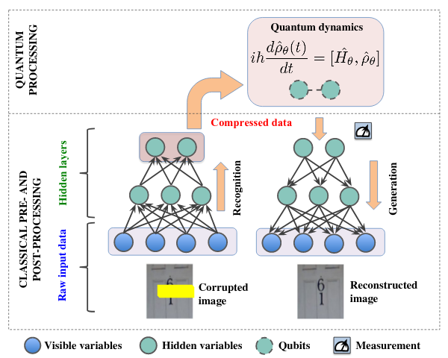
THE QUANTUM-ASSISTED HELMHOLTZ MACHINE

Slide 17
THE QUANTUM-ASSISTED HELMHOLTZ MACHINE
< HOW >
The framework employs a quantum computer to model the deepest hidden layers, containing the most abstract representation of the data.
This low-dimensional compact representation is where we believe the quantum device can capture non-trivial correlations and where quantum distributions might have a significant effect. The number of hidden variables in the deepest layers is much smaller than the number of visible variables, making it ideal for near-term implementation on early quantum technologies.
The model does not simply memorize the training set, but rather reproduce its statistics. In future work, the QAHM will be fine-tuned to provide sharper results.

