Slide 1
YOLO
Presenter: Zhang Xu

Slide 2
What is YOLO
YOLO is an object detecting model

Slide 3
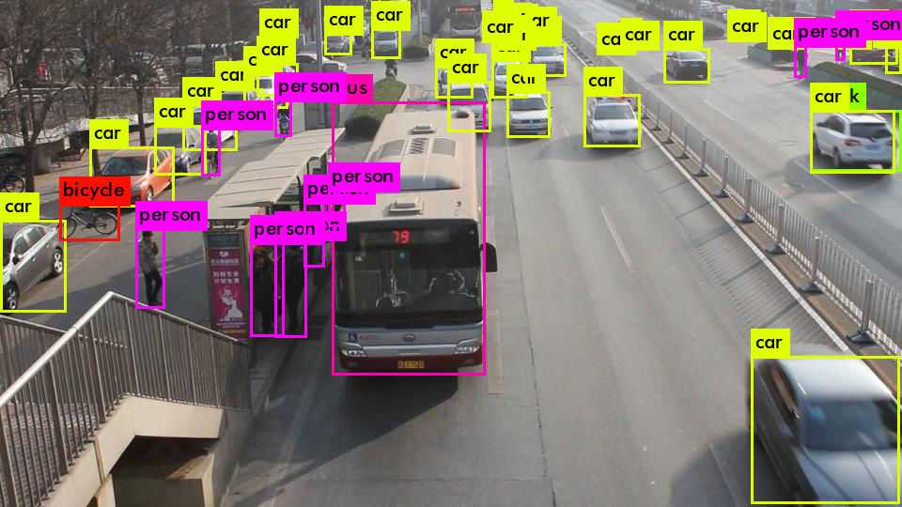

Slide 4
What is YOLO
YOLO is an object detecting model
A task in CV

Slide 5
CV tasks:
classification
detection
segmentation

Slide 6
CV tasks:

Slide 7
What we have before YOLO
Region - based detection
example: R - CNN (Rich feature hierarchies for accurate object detection and semantic segmentation)

Slide 8
Classifier

Slide 10
Moving window

Slide 11
What we have before YOLO
Moving Window

Slide 12
What we have before YOLO
Moving Window

Slide 13
What we have before YOLO
Region - based detection
example: R - CNN (Rich feature hierarchies for accurate object detection and semantic segmentation)
Region Proposal : seprate the picture into windows
but YOLO is faster

Slide 14
How YOLO works
Task:
find the object
label its class
label its position
5 information:
center position: (x,y)
hight
width
class

Slide 15
Cut the pic into s^2 grids
As long as the center of the object is in the grid
Every grid predicts B bounding boxes
box: center position (x,y), hight, width, confidence interval
it describes the rectangle that encloses an object
grid: B bounding boxes, class
Gound truth: s * s * (B * 5 + C)

Slide 16
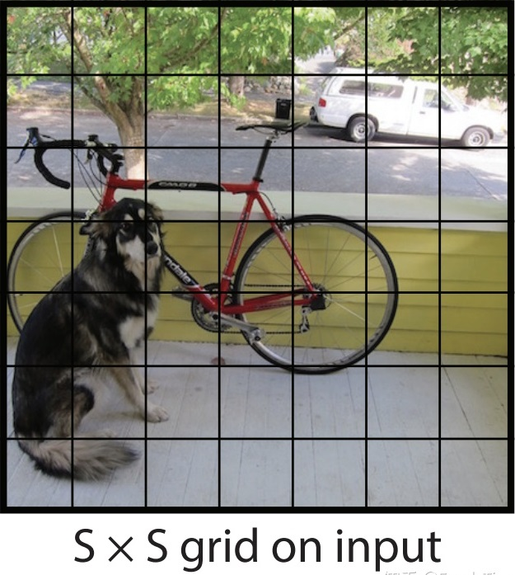

Slide 17
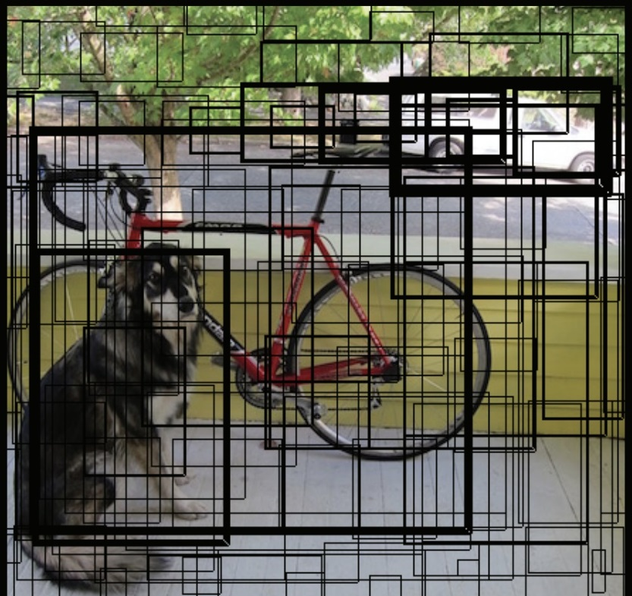

Slide 19
Pr(obj): 1 or 0
IoU reflect the similarity of the 2 boxes
the ratio of predicted bounding box and the real object

Slide 20
The confidence score does not say anything about what kind of object is in the box, just if the box is any good.
The higher the confidence score, the fatter the box is drawn
For each bounding box, the cell also predicts a class.
This works like a classifier: it gives a probability distribution over all the possible classes.
The confidence score for the bounding box and the class prediction are combined into one final score that tells us the probability that this bounding box contains a specific type of object.
There are a lot of bounding boxes, but most with really low score, it sets a threshold to keep the higher scores

Slide 22
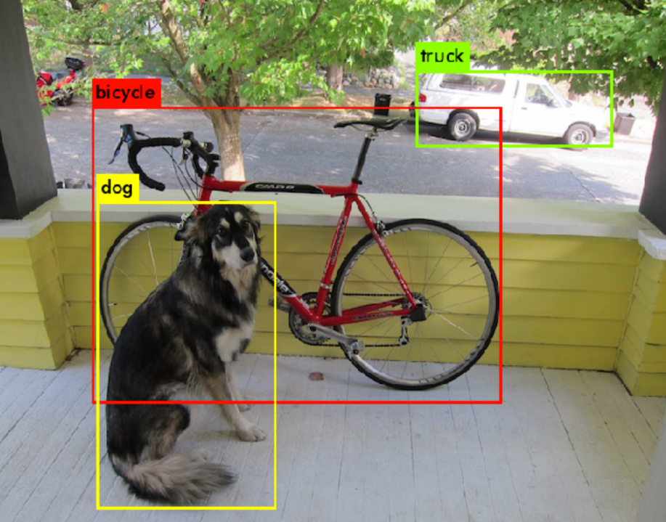

Slide 23
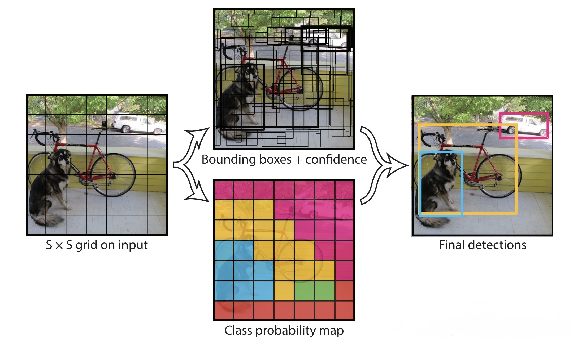

Slide 24
It makes 5 * s * s separate predictions, they were all made at the same time - the convolutional nerual network just ran once - powerful and fast

Slide 25
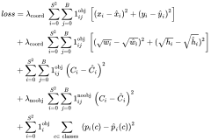
Loss Function
when we have the object, we have item 1,2,3,5; when we don't detect any object, we have item 4.

Slide 26
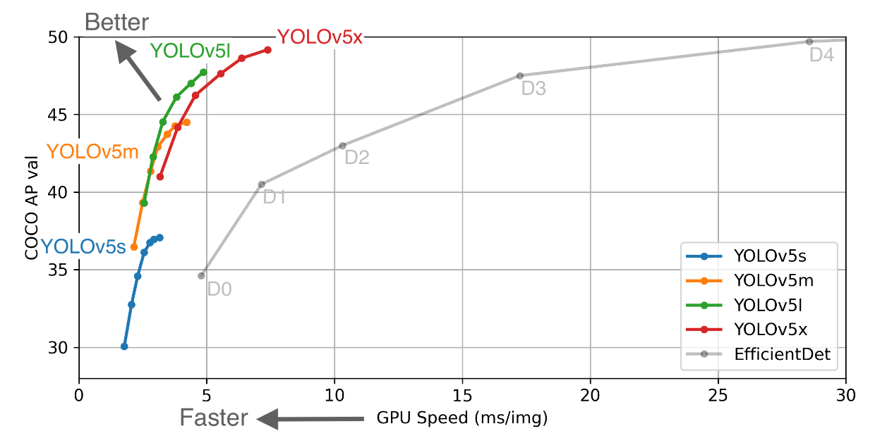

Slide 27
Thanks

