Slide 1
Thesis topic: Estimating average response time for Stop-signal paradigm from Electroencephalography (EEG) signals.
Presenter / Enes E. Kuzucu
Advisor / Prof. Alexander Savostyanov

Slide 2
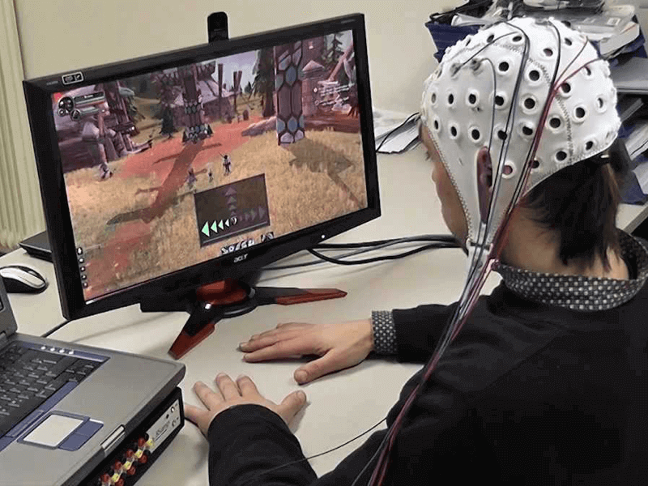
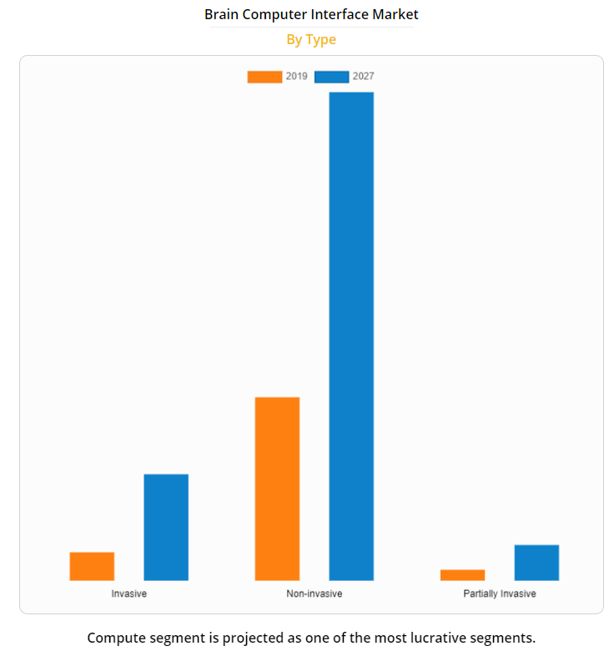
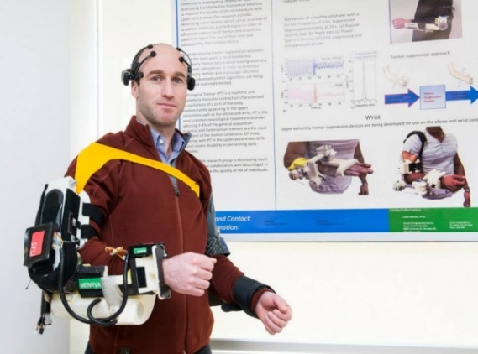
A brain–computer interface (BCI) is a computer-based system that acquires, analyzes, and translates brain signals into output commands in real time.
The performance of BCIs that use biological sensorimotor rhythms(improves with training).
Their usage is in large part a skill that is acquired through practice
The global brain computer interface market size was valued at $1.36 billion in 2019, and is projected to reach $3.85 billion by 2027, growing at a CAGR of 14.3% from 2020 to 2027.

Slide 3
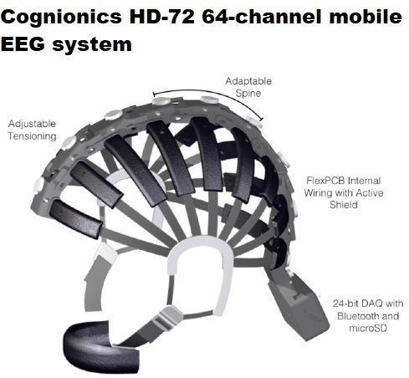
Brain-Computer Interface(BCI)
BCI operation entails the effective cooperation of two adaptive controllers: the user, who seeks to encode his/her intent in brain signals that the BCI can recognize; and the BCI, which adapts to recognize these signals and translate them into the intended output commands.
BCI high compatible, BCI compatible, BCI low compatible

Slide 4
What is EEG?
What is Stop-signal Paradigm?
What is research objective and what are the steps to follow?
Known handicaps and issues
Questions and Suggestions

Slide 5
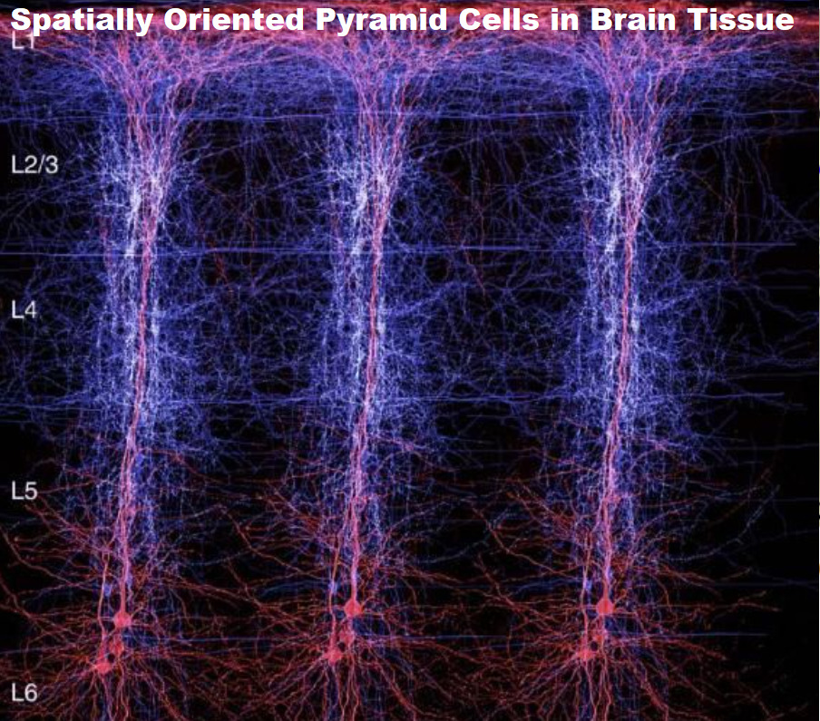
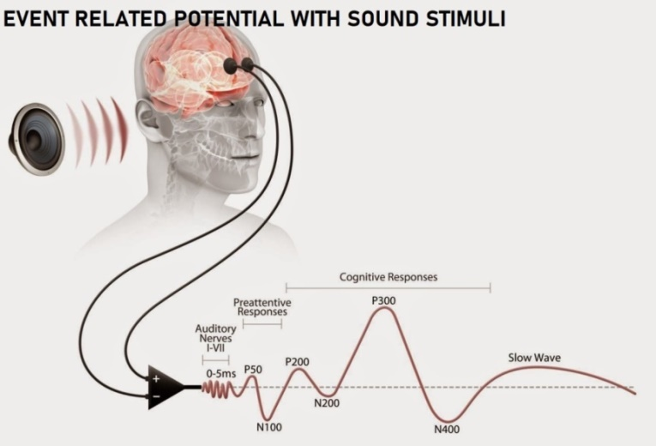
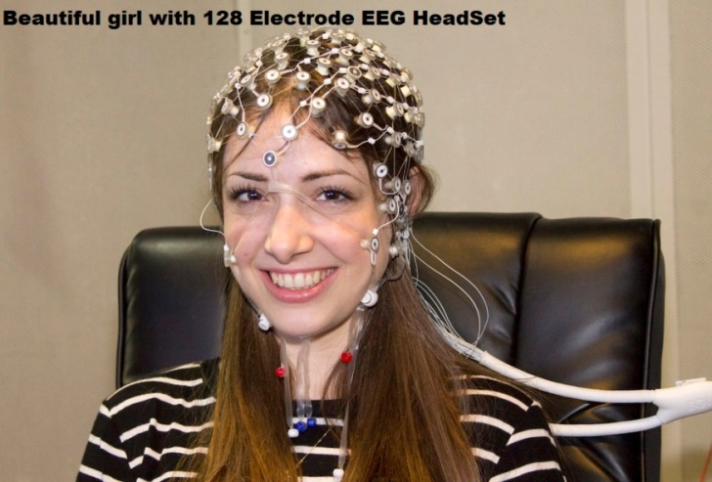
What is EEG Signal?
Electroencephalographic or EEG signals collected on the human scalp are sustained fluctuations of electrical potential that reflect corresponding variations in the upper layers of the brain cortex below the scalp surface.
An event-related potential (ERP) is the measured brain response that is the direct result of a specific sensory, cognitive, or motor event.

Slide 6
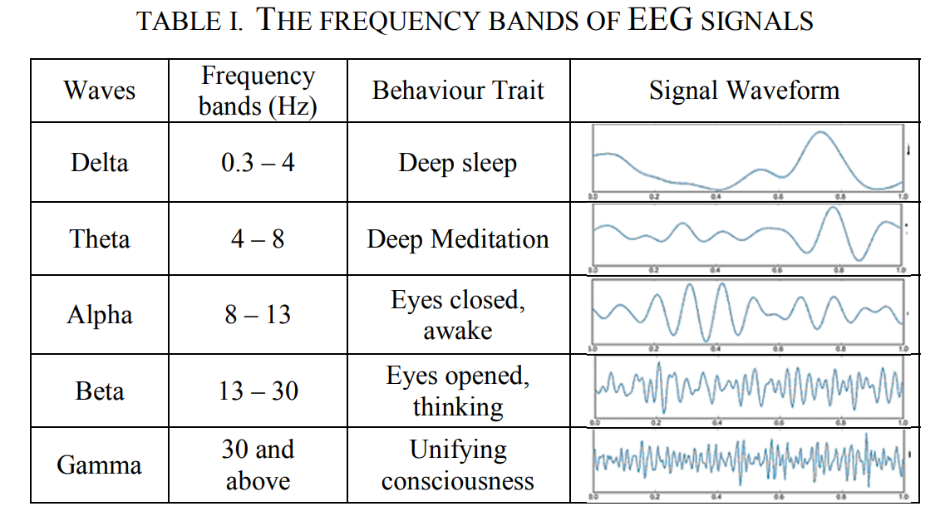
The frequency range of the EEG data is between 0.5-100 Hz and the amplitude is between 1 and 100µV.
Ambient noise, Motion artifacts and Extrinsic, Intrinsic, Intermediate, Deterministic Factors

Slide 7
What is Stop-signal Paradigm?
Human Cognitive System is The source of all mental processes and products, arising from complex neural activity in the brain.
Cognitive testing techniques to achieve “low, moderate, and heavy intensity effects on subjects physiology.
There are 4 main category of cognitive skills as : Perception, Attention, Memory, Logical reasoning.
There are various designed experimental tasks for understanding Cognitive System.

Slide 8
What is Inhibitory Control?
Inhibitory control is ability to inhibit or control impulsive (or automatic) responses, and create responses by using attention and reasoning.
Inhibitory control is the basis of the proper functioning of the rest of the executive functions.
Inhibition is what makes it possible for us to stay quiet when you want to say something, but know that you shouldn't,
it's what helps you stay quiet and seated when you're in class,
it's what helps you stay safe when someone merges into your lane without using their blinker,
it's what helps you study or work, even when you get bored or want to get up.
Inhibition allows you to react to unforeseen or risky situations safely and quickly.

Slide 9
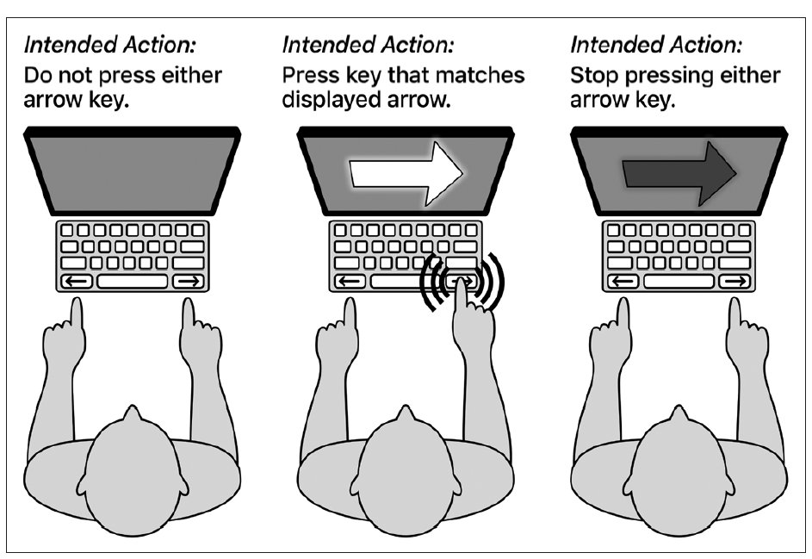
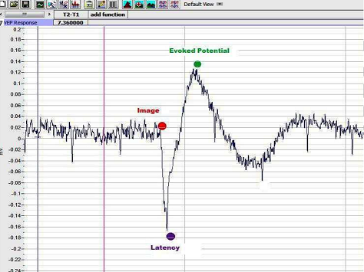
Stop-signal Paradigm
In the stop‐signal paradigm, participants perform a choice response time task that is occasionally interrupted by a stop signal.
In stop signal paradigm basically subjects make “go” responses while they prepare to stop at a suddenly given “stop” signal. And their reaction times area recorded and analyzed to estimate individuals cognitive ability in regards of inhibitory control .
We can see these responses as evoked potentials in EEG signals.
Stop Signal Paradigm Reaction Time( SSRT) = Task Complete Time- Stop Signal Delay(SSD)

Slide 10
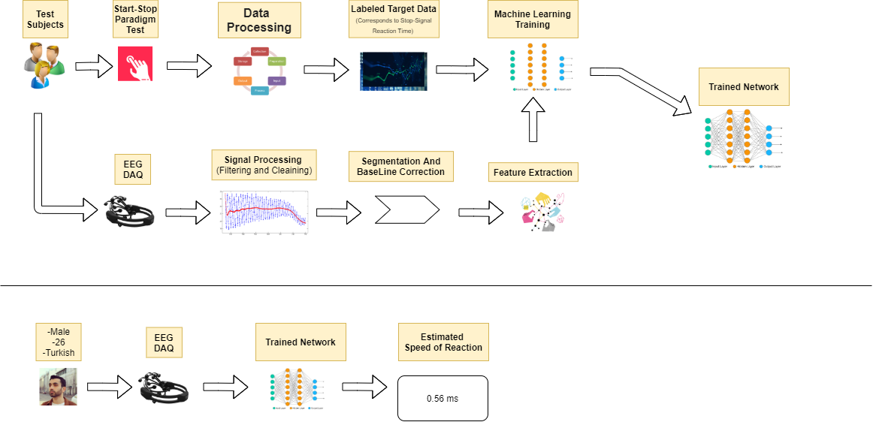

Slide 11
EEG Preprocessing& Signal Processing
Processing Steps
1. Cleaning/ Artifact removal
2. Filtering
3. Epoching /Segmenting
4. Averaging trials per subject
5. Averaging over subjects

Slide 12
Feature Extraction
Spectral information: This describes how the power of the EEG signal varies in some specific frequency bands
Temporal information: Describes how EEG signals vary over time.
Spatial information: Describes where (spatially) the relevant signal comes from

Slide 13
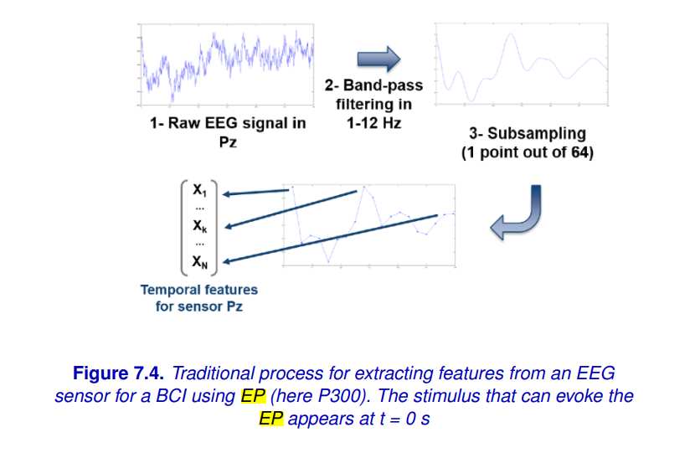
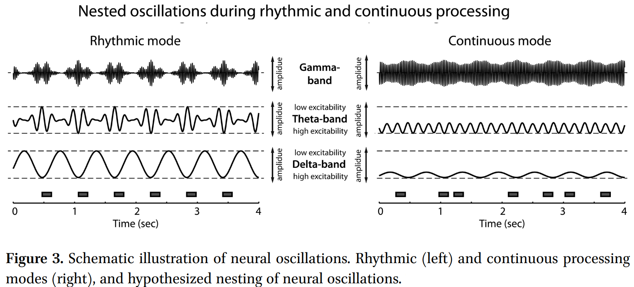
Feature Extraction
Frequency representations:
-Fourier transform
-Frequency filtering
Time–frequency representations:
-Short-term Fourier transform (STFT)
-Wavelet transform
-Time–frequency atom

Slide 14
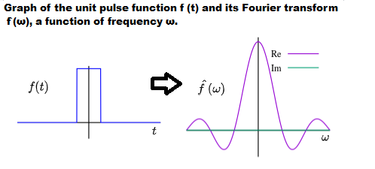
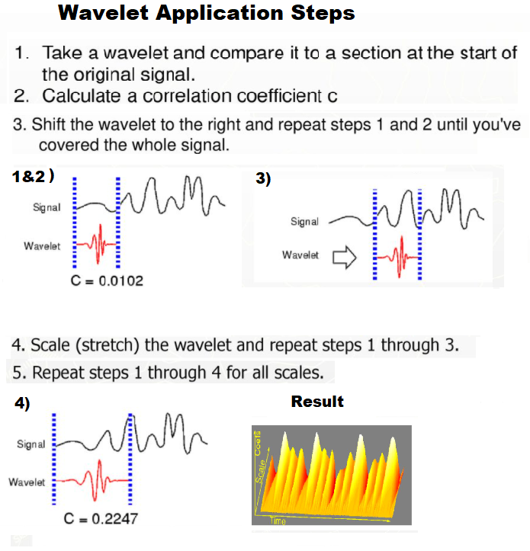
Feature Extraction
Fourier transform=
=Wavelet

