Slide 1
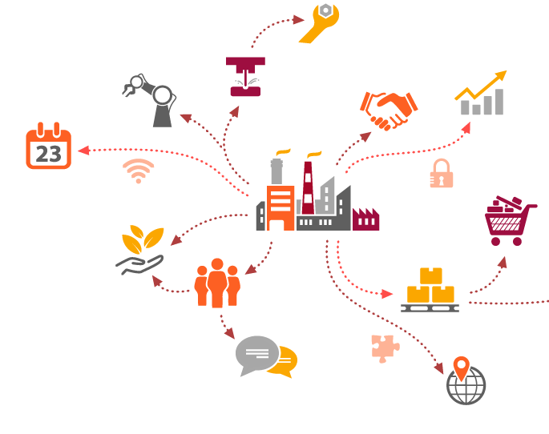
Predictive Big Data Analytics for Supply Chain Demand Forecasting methods, applications, and research opportunities
Survey Paper
Mahya Seyedan and Fereshteh Mafakheri
Concordia Institute
for Information Systems Engineering (CIISE),
Concordia University,
Montreal H3G 1M8, Canada
Presenter: Hami

Slide 2
Introduction
What is supply chain
Focus of the paper

Slide 3
Notes:
Focus of the paper is on the “demand forecasting”

Slide 4
Data in Supply Chain
Taxonomy
Data sources
Notes:
(1) increasing multiplicity of SC entities, (2) growing diversity of SC configurations depending on the homogeneity or heterogeneity of products, (3) interdependencies among these entities
(4) uncertainties in dynamical behavior of these components, (5) lack of information as relate to SC entities; [11],
(6) networked manufacturing/production entities due to their increasing coordination and cooperation to achieve a high-level customization and adaptaion to varying customers’ needs [22], and finally
(7) the increasing adoption of supply chain digitization practices (and use of Blockchain technologies) to track the activities across supply chains

Slide 5
Stores
Customers
Products
Sales
Orders
Shipping
Delivery
Department Code
Department Name
Location
Customer ID
Customer Name
Customer Address
Customer Email
Product Code
Product Category
Product Image
Product Name
Product Price
Value in Sales
Sales per Customer
Order Address
Order Customer ID
Order Date
Order Item
Order Quantity
Order Status
Date
Mode
Days for Shipping
Delivery Status
Late Delivery Risk
Product model
Product make

Slide 7
Demand Management in Supply Chain
Demand Forecasting
Existing real-life practice
Notes:
The term “demand management” emerged in practice in the late 1980s and early 1990s.
Traditionally, there are two approaches for demand management. A forward approach which looks at potential demand over the next several years and a backward approach that relies on past or ongoing capabilities in responding to demand.
Demand forecasting and planning refer to predicting the quantities and timings of customers’ requests. Such predictions aim at achieving customers’ satisfaction by meeting their needs in a timely manner [51].
Accurate demand forecasting could improve the efficiency and robustness of production processes (and the associated supply chains) as the resources will be aligned with requirements leading to reduction of inventories and wastes

Slide 8
Spreadsheet Models
Basic Statistical Methods (ie – Moving Average)
Benchmark-based Judgement

Slide 9
BDA in Demand Forecasting
Time Series Forecasting
Clustering Analysis
K-nearest neighbor (KNN)
Artificial Neural Network
Regression Analysis
Support Vector Machine (SVM)
Support Vector Regression (SVR)
Mixed Approaches

Slide 10
Time Series Forecasting
Notes:
Sample: ARIMA vs Prophet
ARIMA - Autoregressive integrated moving average
Prophet is by Facebook released on 2017
In case of ARIMA, the accuracy of predictions could diminish where there exists a
high level of uncertainty in future patterns of parameters [42, 74–76].

Slide 11
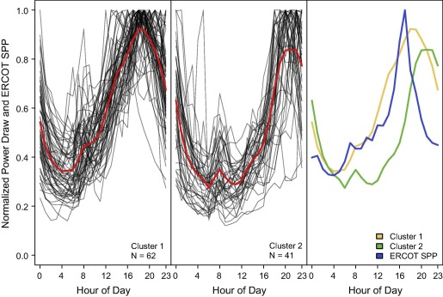
Clustering Analysis
Notes:
Clustering algorithms such as K-means, self-organizing maps (SOMs),
and fuzzy clustering have been used to segment similar customers with respect to their
behavior.
Clustering data of coat sells

Slide 12
K-Nearest Neighbor
Notes:
In the realm of demand forecasting in SC, Nikolopoulos et al. [80] applied KNN for forecasting sporadic demand in an automotive spare parts supply chain.

Slide 13
Artificial Neural Network

Slide 14
Regression Analysis
Notes:
Yang and Sutrisno [93] applied and compared regression analysis and neural network techniques to derive demand forecasts for perishable goods.

Slide 15
Support Vector Machine (SVM)
Notes:
Wu [95] applied an SVM, using a particle swarm optimization (PSO) to search for the best separating hyperplane, classifying the data related to car sales and forecasting the demand in each cluster

Slide 16
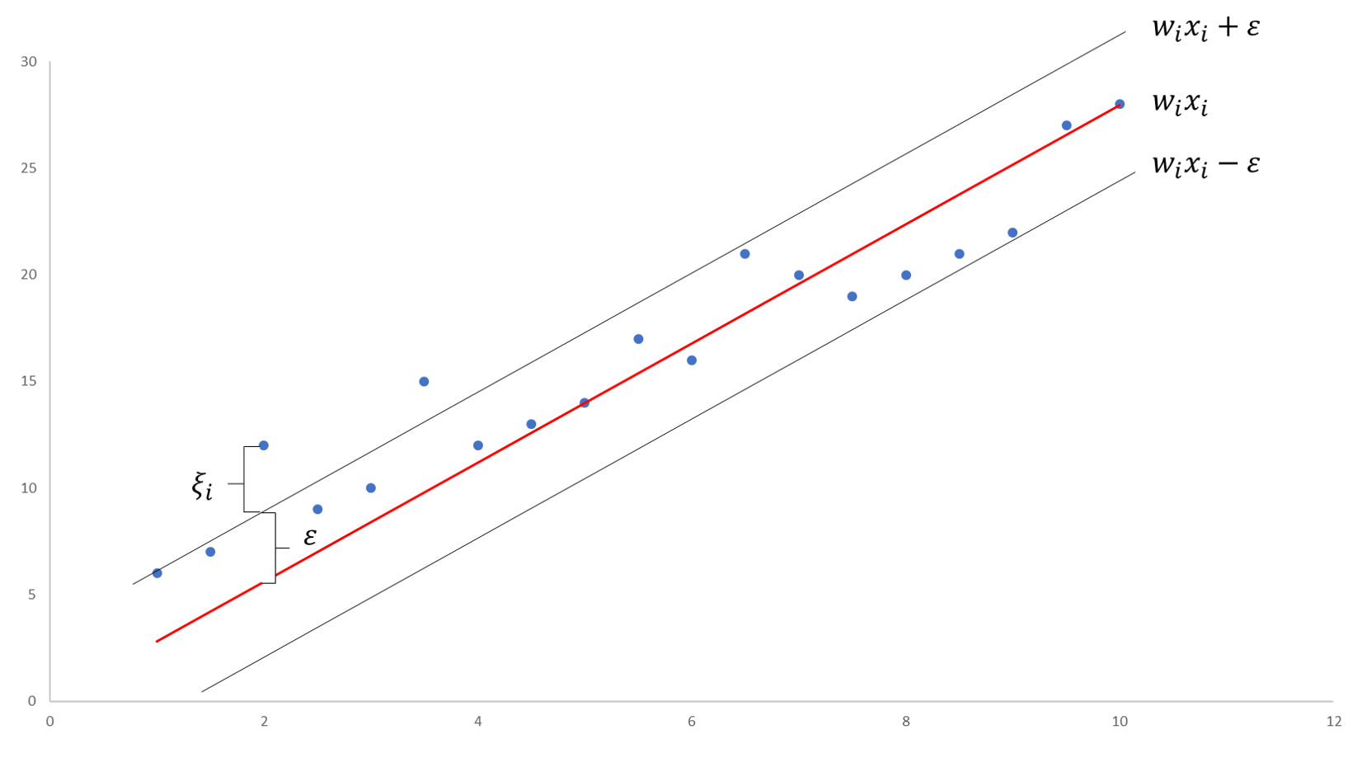
Support Vector Regression (SVR)
Notes:
Give flexibility to define how much error is acceptable in the model

Slide 17
Mixed Approaches

Slide 18
Statistics of Past Literatures

Slide 19
Discussions
Algorithms comparison
Applicability – external factors etc.
Closed-Loop-Supply-Chain (CLSC)
Notes:
Algorithms comparison: There are very few comparative studies available in the literature to provide a benchmark for understanding of the advantages and disadvantages of these methodologies
Applicability: external factors ie environments, organization reputation, political condition, etc

Slide 20
Notes:
A CLSC is a more complex system than a traditional SC because it consists of the forward and reverse SC simultaneously & lack of data for remanufacturing
IoT-based approaches can overcome the difficulties of collecting data in a CLSC

Slide 21
Conclusions
Neural networks and regression analysis are 2 most-used
Optimization could be done in the methods
Existing research are very limited in CLSC, which might be needed

