Slide 1
Deep Neural Networks for YouTube Recommendations
Authors: Paul Covington, Jay Adams, Emre Sargin
Presentation: Sergey Pnev

Slide 2
Introduction
YouTube is the world’s largest platform for creating, sharing and discovering video content.
Scale
Freshness
Noise
Framework: Tensorflow

Slide 3
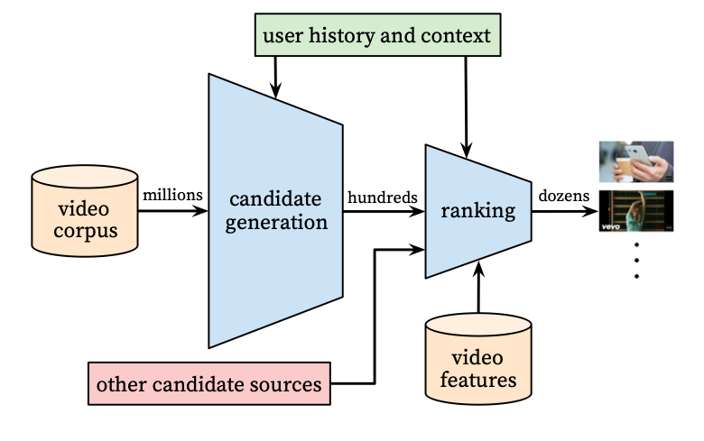
System Overview
2 NN: for Candidate Generation and Ranking
During development: precision, recall, ranking loss, etc.
Final determination: A/B testing via live experiments.

Slide 4
Candidate Generation
Purpose: to provide broad personalization and predict expected watch time
Predecessor: matrix factorization approach
Input: user’s activity history
Serving Output: top-N videos
Training Output:
Loss: CE

Slide 5
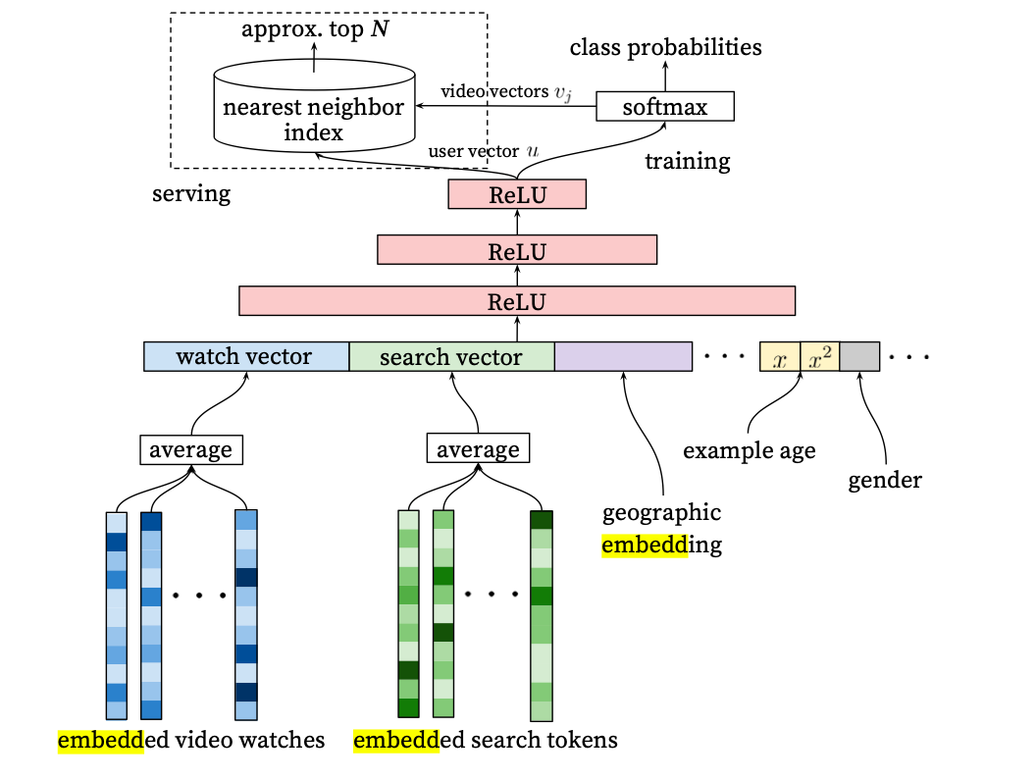
Efficient Extreme Multiclass
“Example Age” Feature
Label and Context Selection

Slide 6
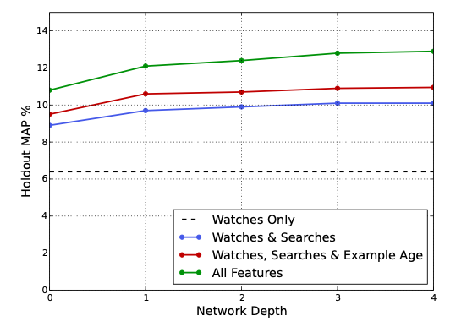
Results
Depth 0: A linear layer simply transforms the concatenation layer to match the softmax dimension of 256
Depth 1: 256 ReLU
Depth 2: 512 ReLU → 256 ReLU
Depth 3: 1024 ReLU → 512 ReLU → 256 ReLU
Depth 4: 2048 ReLU → 1024 ReLU → 512 ReLU → 256 ReLU

Slide 7
Ranking
Purpose: give the user a list of the most suitable videos
Predecessor: linear and tree-based methods for watch time prediction
Input: user’s activity history + more video features
Output: expected watch time of impression

Slide 8
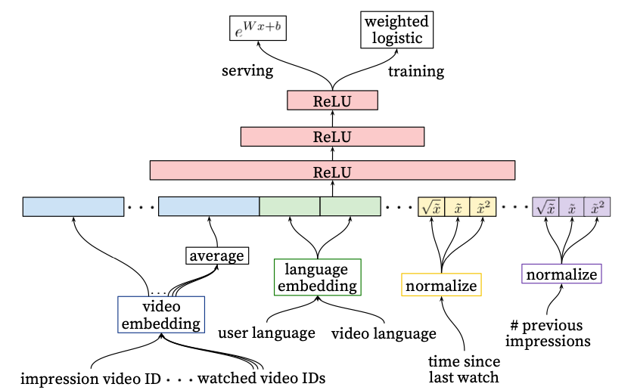
Feature Engineering
Embedding Categorical Features
Normalizing Continuous Features
Modeling Expected Watch Time

Slide 9
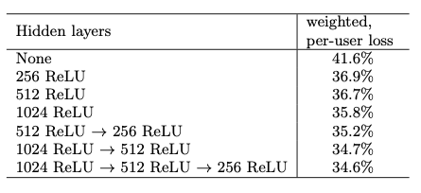
Experiments with the Hidden Layers

Slide 10
https://storage.googleapis.com/pub-tools-public-publication-data/pdf/45530.pdf
Thank you

