Slide 1
Clustering Communities
Social Network Analysis

Slide 2
What is social network and Why ?
The term social network refers to the articulation of a social relationship, ascribed or achieved, among individuals, families, households, villages, communities, regions, and so on. Each of them can play dual roles, acting both
as a unit or node of a social network as well as a social actor (cf. Laumann & Pappi, 1976).
Help us to understand how humanbeings are related to each other, the characteristics of the actions and how information is transmitting.

Slide 3
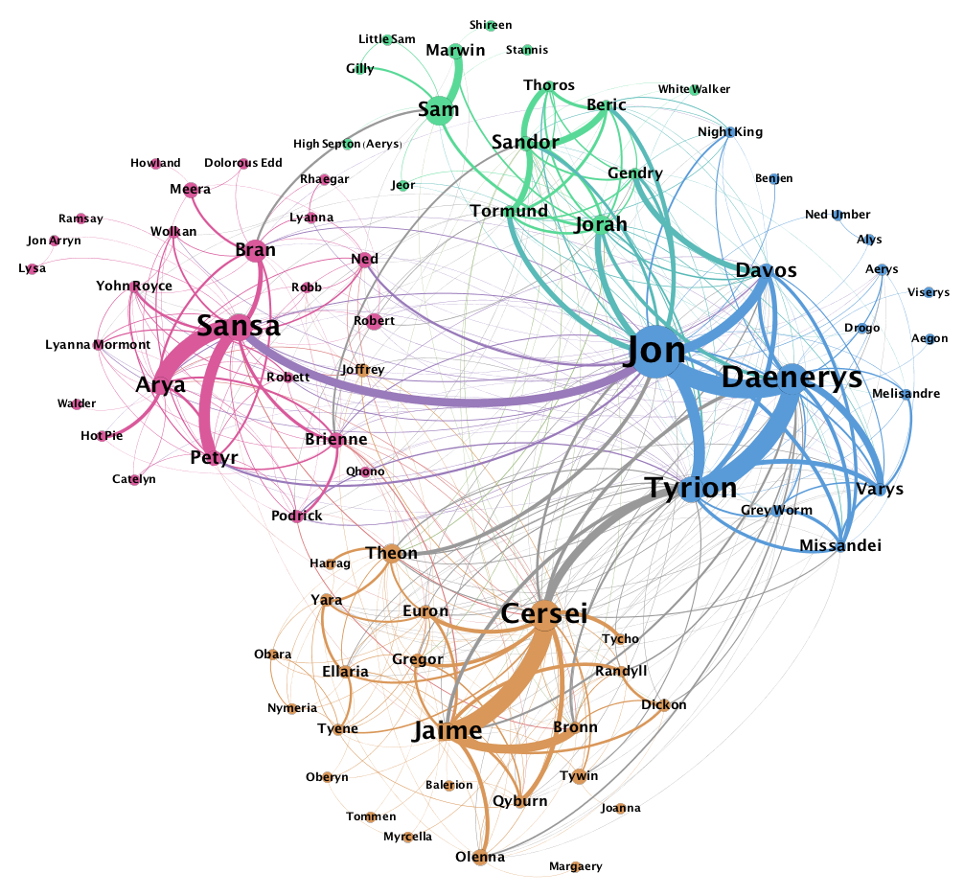
Network of Thrones

Slide 4
Cluster
A group of nodes more connected to each other than to other nodes

Slide 5
Cluster
A subset of a network
Independent / continuous
More edges inside / less edges outside

Slide 6
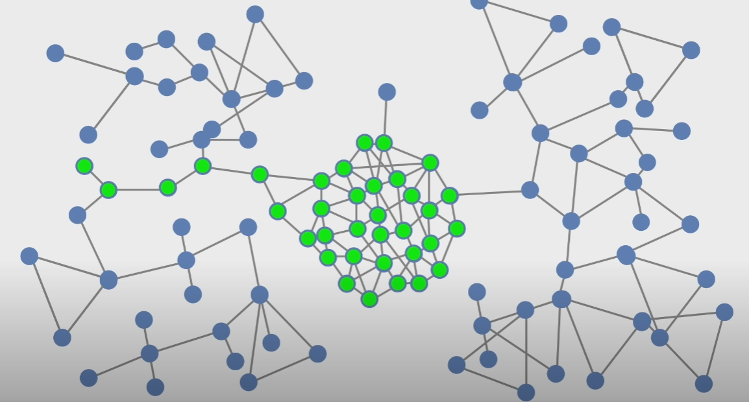
A cluster could be a bottleneck for information or in a diffusion process

Slide 7
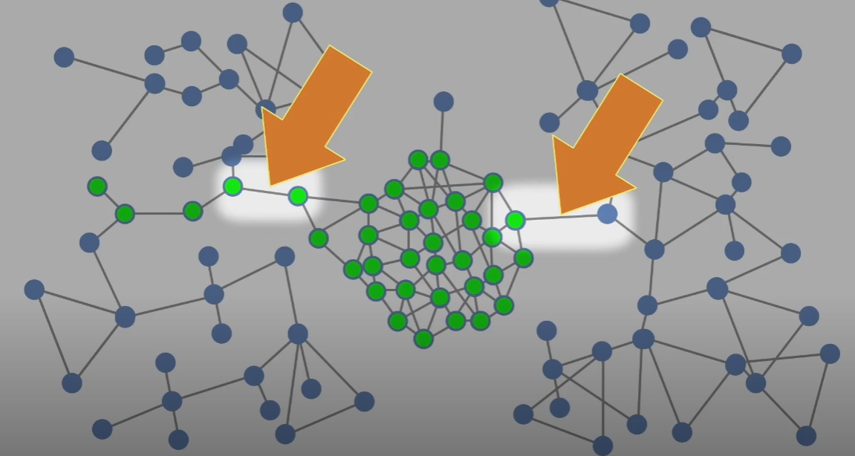
A cluster could be a bottleneck for information or in a diffusion process

Slide 8
A cluster can keep things in or keep things out

Slide 9
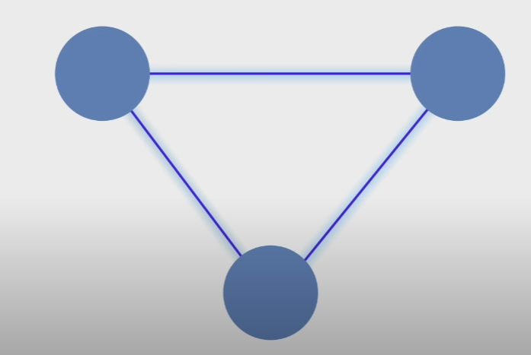

Slide 10
Knowledge / Plan

Slide 11
Prerequisite Knowledge
Graph Theory
ML
Social psychology

Slide 12
Where I am at?
Data colloction
API
Crawlers
Commercial Data

Slide 13
Thanks for your attention

