Slide 1
Exploring sentiment dynamics in social media
Lunev kirill
big data & ai

Slide 2
the sentiment dynamics? analysis?
Sentiment analysis models focus on polarity but also on feelings and emotions, urgency and even intentions.
Depending on how you want to interpret customer feedback and queries, you can define and tailor your categories to meet your sentiment analysis needs.

Slide 3
But there’s still question…
The phrase Sentiment Dynamics probably comes from the work of Sentiment Dynamics in Social Media News Channels. Where under this word was meant the idea that not only a sentiment analysis of each news was carried out, but also how different news agencies try to attract the user's attention and how the user ultimately reacts to this news If you want to read this paper: https://arxiv.org/pdf/1908.08147.pdf

Slide 4
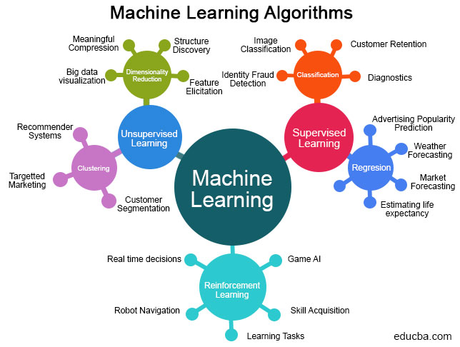
Basic idea
to create a bot for VK what will collect data from users and analyze it using a ML algorithm which will understand the sentiment of the user's posts and interpret it on how user’s environment (like friends or subscribers) reacts on these posts.

Slide 5
Main novelty

Slide 6
Work plan
1. Explore the subject domain, prepare the overview on available techniques/algorithms, write “Introduction/Overview” part of the thesis
2. Explore the possible sources of the data
Select the implementation technology
3. Decide where to store the Data
4. Evaluate existing algorithms on the following data sets, provide preliminary conclusion and defend the coursework
5. Extending the work, making sense of the results

Slide 7
What was done
1. “Introduction/Overview” part of the thesis still in progress
2. As the possible source of data I chose VK social network
As the implementation technology I chose Python and write code of my own from the scratch

Slide 8
What has to be done
1. Decide where to store the Data
2. Evaluate existing algorithms on the following data sets, provide preliminary conclusion and defend the coursework
3. Extending the work, making sense of the results

Slide 9
Best paperworks
Deep Learning for Hate Speech Detection in Tweets
https://arxiv.org/pdf/1706.00188v1.pdf
DepecheMood++: a Bilingual Emotion Lexicon
https://arxiv.org/pdf/1810.03660v1.pdf
Expressively Vulgar: The Socio-dynamics of Vulgarity
https://www.aclweb.org/anthology/C18-1248.pdf
Multilingual Twitter Sentiment Classification: The Role of Human Annotators
https://arxiv.org/pdf/1602.07563v2.pdf
MELD: A Multimodal Multi-Party Dataset for Emotion Recognition
https://arxiv.org/pdf/1810.02508v6.pdf

Slide 10
Thank you for your attention!

