Slide 1
DoubleU-Net: A Deep Convolutional Neural Network for Medical Image Segmentation
Review by Kochanov Maxim

Slide 2
Abstract
DoubleU-net - a combination of two U-Net architectures stacked on top of each other
Includes: VGG-19 as encoder (pre-trained on ImageNet), ASPP to capture contextual information within the network, squeeze-and excite block
Learned on four medical segmentation datasets, covering various imaging modalities such as colonoscopy, dermoscopy, and microscopy
Results of DoubleU-Net show the improvement over the existing U-Net model

Slide 3
U-net

Slide 4
VGG-19

Slide 5
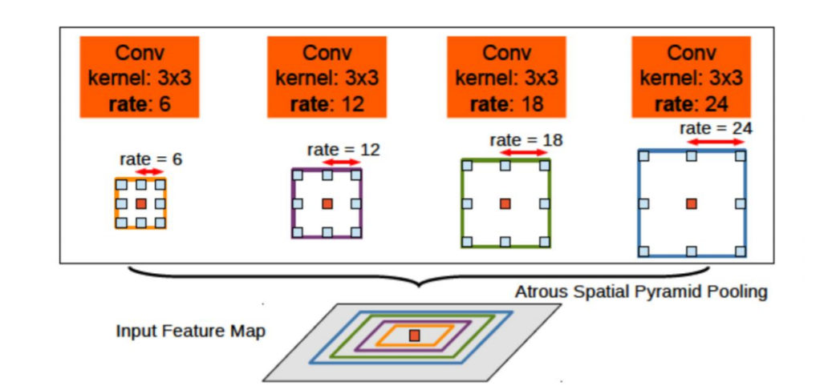
Atrous Spatial Pyramid Pooling – ASPP
For sustainable segmentation of objects at different scales apply extended spatial combining in pyramid. It converts the input signal with filters with different values upsampling, thus assimilating objects and context images of various scales.

Slide 6
DoubleU-Net architecture

Slide 7
DoubleU-Net architecture
In the NETWORK 1, the input image is fed to the modified U-Net, which generates a predicted mask (Output1). We then multiply the input image and the produced mask (Output1), which acts as an input for the second modified U-Net that produces another mask (Output2). Finally, we concatenate both the masks (Output1 and Output2) to see the qualitative difference between the intermediate mask (Output1) and final predicted mask (Output2).

Slide 8
Motivation of DoubleU-Net
Authors assume that the produced output feature map from NETWORK 1 can still be improved by fetching the input image and its corresponding mask again, and concatenating with Output2 will produce a better segmentation mask than the previous one. This is the main motivation behind using two U-Net architectures in the proposed architecture.

Slide 9
Encoder
Encoder1 uses pre-trained VGG-19
Each encoder block in the encoder2 performs two 3 × 3 convolution operation, each followed by a batch normalization. Then ReLu. Then squeeze-and-excitation block. Then max-pooling(2x2) with stride=2.

Slide 10
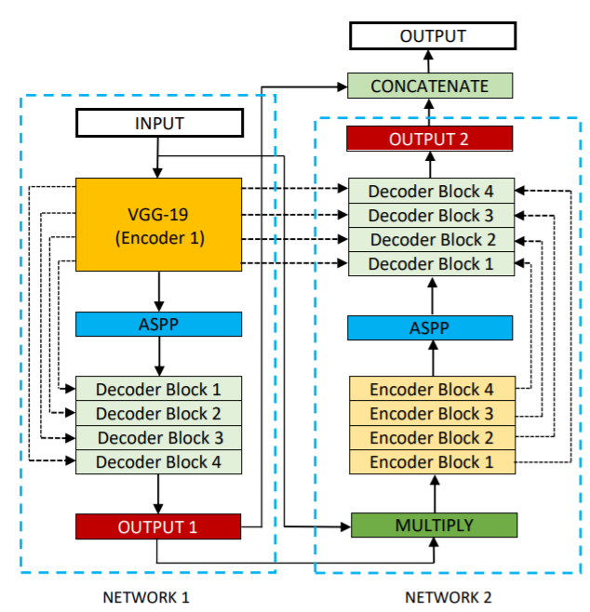
Decoder
Authors use two decoders in the entire network, with small modifications on the decoder as compared with that of the original U-Net (squeeze and excitation block and second decoder uses skip connections from both encoders)

Slide 11
Datasets

Slide 12
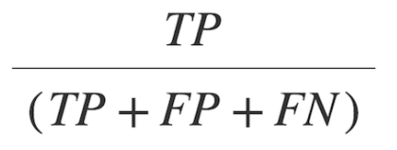
Evaluation metrics
Sørensendice coefficient (DSC)
mean Intersection over Union (mIoU)
Precision
Recall

Slide 13
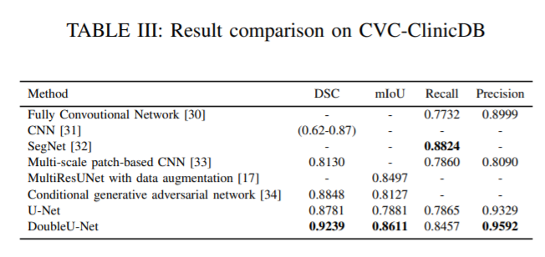
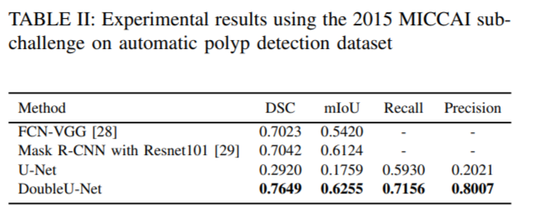
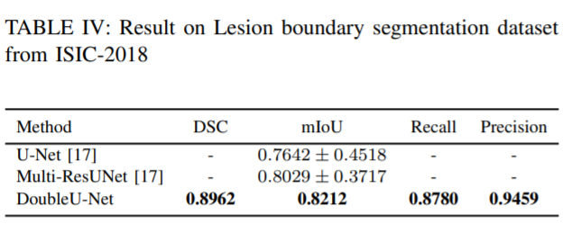
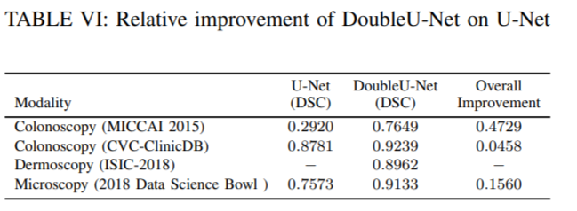
Results

Slide 14
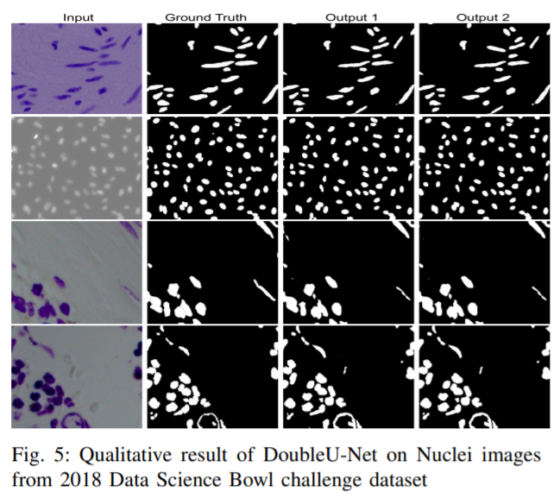

Slide 15
Conclusion
In this paper, authors have proposed a novel CNN architecture called DoubleU-Net. The DoubleU-Net has five main components, namely two U-Net networks, VGG-19, a squeeze-and excite block and ASPP. The performance of DoubleU-Net is significantly better when compared with the baselines and UNet on all four datasets.

Slide 16
Thanks for your attention!

